Slide 1
Value of Sports Marketing
Anil Dua
Sr. Vice President –Marketing & Sales
Hero Honda
Notes:
Good Afternoon ladies and gentlemen…….

Slide 2
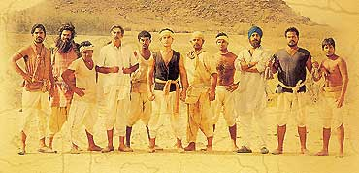
Notes:
As here we have all sports buffs… and people from the sports Industry… I would start by asking a simple question….
In his very first match, on the last day of the test… this Indian not only crossed a century but hit a six on the last ball to snatch victory from English team ?
He also captained the Indian side in this record match…..
Yes… it is Bhuvan…… Bhuvan from Lagaan….. The nation was on a high & the man & the ream went on to win several National and international awards…
2009
International Indian Film Academy Awards (IIFA)
Won: Movie of the decade [1]
Won: Music of the decade - A. R. Rahman [2]
http://www.thaindian.com/newsportal/entertainment/golden-decade-honours-to-be-given-at-iifa-2009_100196278.html Golden Decade Honours to be given at IIFA 2009]</ref>
[edit] 2002
Academy Awards
Nominated:Academy Award for Best Foreign Language Film
Bergen International Film Festival
Won: Jury Award - Ashutosh Gowarikar^{[1]}
European Film Awards
Nominated: Screen International Award for Best Non-European Film - Ashutosh Gowarikar^{[2]}
Filmfare Awards
Won: Filmfare Best Movie Award
Won: Filmfare Best Actor Award - Aamir Khan
Won: Filmfare Best Director Award - Ashutosh Gowarikar
Won: Filmfare Best Story Award - Ashutosh Gowariker
Won: Filmfare Best Music Director Award - A. R. Rahman
Won: Filmfare Best Lyricist Award - Javed Akhtar
Won: Filmfare Best Male Playback Award - Udit Narayan for the song "Mitwa"
Won: Filmfare Best Female Playback Award - Alka Yagnik For the song "O Re Chhori"
Won: Filmfare Best Lyricist Award - Javed Akhtar for "Radha Kaise Na Jale"^{[3]}
IIFA Awards
Won: IIFA Best Actor Award - Aamir Khan
Won: IIFA Best Actress Award - Gracy Singh
Won: IIFA Best Supporting Actor Award - Kulbhushan Kharbanda
Won: IIFA Best Comedian Award - Rajesh Vivek
Won: IIFA Best Villain Award - Paul Blackthorne
Won: IIFA Best Director Award - Ashutosh Gowariker
Won: IIFA Best Movie Award - Ashutosh Gowariker
Won: IIFA Best Male Playback Award - Udit Narayan for "Mitwa"
Won: IIFA Best Female Playback Award - Asha Bhosle For the song "Radha Kaise Na Jale".
Won: IIFA Best Music Director Award - A. R. Rahman ^{[4]}
Leeds International Film Festival
Won: Audience Award - Ashutosh Gowariker^{[5]}
Locarno International Film Festival
Won: Audience Award
National Film Awards
Won: National Film Award for Best Popular Film Providing Wholesome Entertainment, India
Won: National Film Award for Best Music Direction, India - A. R. Rahman
Won: National Film Award for Best Male Playback Singer, India - Udit Narayan For the song "Mitwa Re"
Won: National Film Award for Best Audiography, India - H. Sridhar, Nakul Kamte
Won: National Film Award for Best Lyrics, India - Javed Akhtar
Won: National Film Award for Best Costume Design, India - Bhanu Athaiya
Won: National Film Award for Best Art Direction, India - Nitin Chandrakant Desai ^{[6]}
NatFilm Festival
Won: Audience Award
Portland International Film Festival
Won: Audience Award for Best Film - Ashutosh Gowarikar,^{[7]}
Star Screen Awards
Won: Star Screen Award Most Promising Newcomer - Female - Gracy Singh
Won: Star Screen Award Best Director - Ashutosh Gowariker
Won: Star Screen Award Best Film - Ashutosh Gowariker
Won: Star Screen Award Best Male Playback - Udit Narayan for "Mitwa"
Won: Star Screen Award Best Female Playback - Asha Bhosle For the song "Radha Kaise Na Jale"
Won: Star Screen Award Best Actor - Aamir Khan
Won: Star Screen Award Best Villain - Paul Blackthorne
Won: Star Screen Award Best Music Director - A.R. Rahman
Won: Star Screen Award Best Background Music - A.R. Rahman
Zee Cine Awards
Won: Zee Cine Award Best Actor- Male - Aamir Khan
Won: Zee Cine Award Best Female Debut - Gracy Singh
Won: Zee Cine Award Best Actor in a Supporting Role- Female - Rachel Shelley
Won: Zee Cine Award Best Director - Ashutosh Gowariker
Won: Zee Cine Award Best Film - Ashutosh Gowariker
Won: Zee Cine Award for Best Lyricist - Javed Akhtar For the song "Radha Kaise Na Jale".
Won: Zee Cine Award Best Music Director - A.R. Rahman
Won: Zee Cine Award for Best Playback Singer - Male - Udit Narayan for "Mitwa"
Won: Zee Cine Award for Best Playback Singer - Female - Asha Bhosle For the song "Radha Kaise Na Jale".
Won: Zee Cine Award for Best Story - Ashutosh Gowarikar

Slide 3
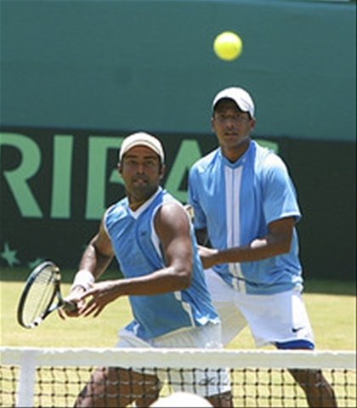
Competitive
Notes:
So sports can get us on a high like nothing else..
Not only in movies, but also in real.
Not only in cricket, but also other sports.

Slide 4
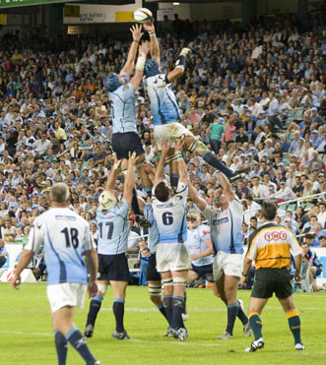
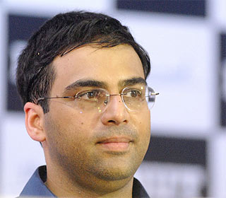
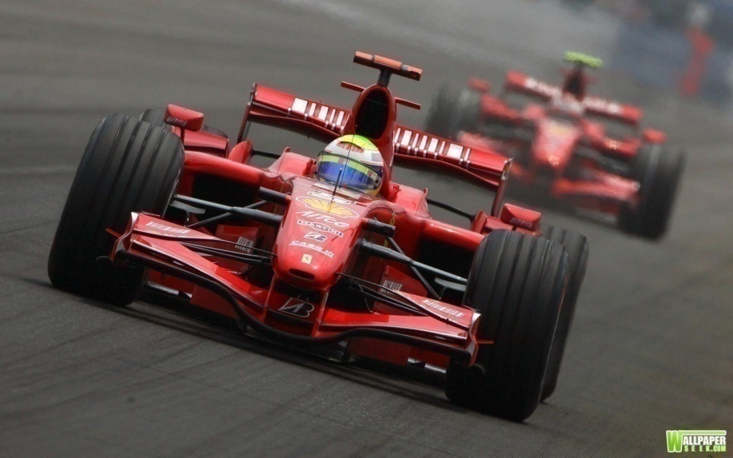
Physical /mental /equipment
Notes:
This may be a test of body or mind or equipment

Slide 5


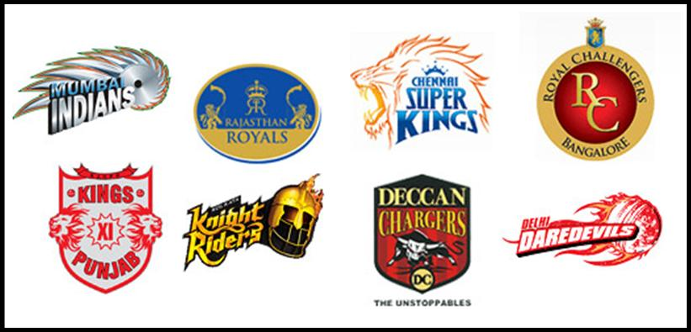
Formal
Notes:
It may be organised & formal

Slide 6
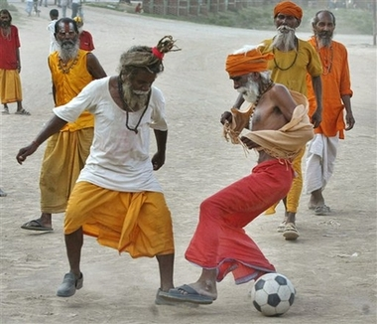
Informal
Notes:
Or it can be very informal as well….
To play all you need is spirited people…..

Slide 7
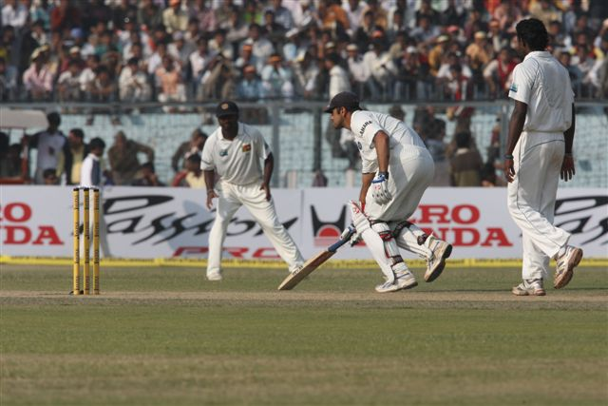
Notes:
And marketers love it…..
They leverage sports, of course to showcase themselves…

Slide 8

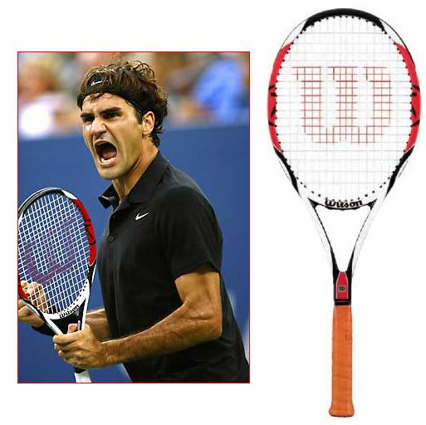
Products
Notes:
And a few go further and launch brands positioned around sports….

Slide 9
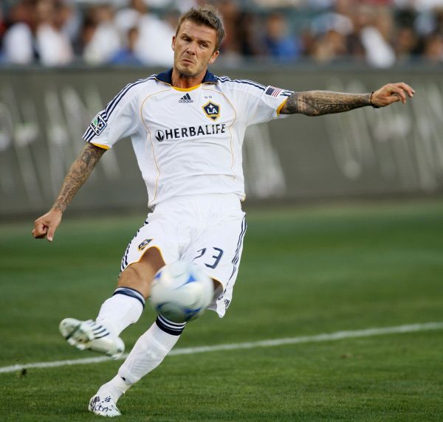
Passion
Notes:
Because they love the passion it arouses & hope that it will rub off on their brands

Slide 10
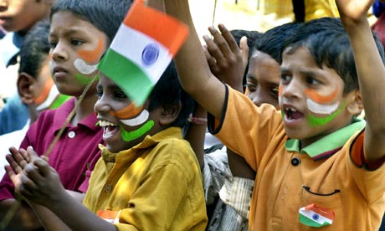
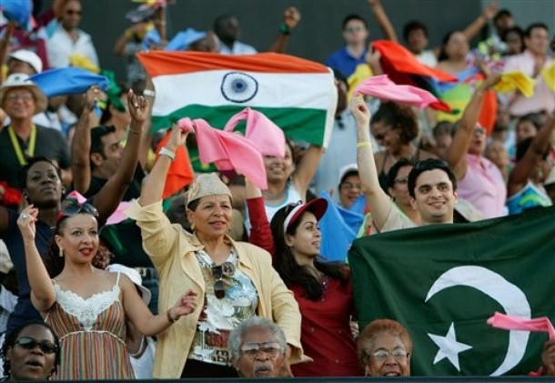
Mass appeal
Notes:
And they love its mass appeal, as it is said nothing unites the country more than a cricket match against Pakistan….
So they get both quality as well as quantum of delivery.

Slide 11
So, there is immense value…
But..the yardsticks are different…
Notes:
There is value in sports marketing. But it is different from other forms of marketing…

Slide 12
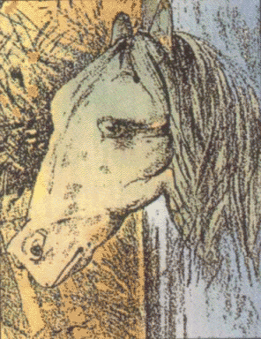
Subjective or Objective ?
Notes:
First, it is all about the way your orientation is.
On first look, there is a frog. But on second look, this may be a horse….
Sports marketing is a bit like that,
All depends on how you look at it.

Slide 13
Subjective or Objective ?

Slide 14
Subjective or Objective ?
Notes:
What do you make out of this… is it a horse or a frog ?
What a consumer could make out of this could be a frog or a horse →The sport product is invariably subjective -- what each consumer experiences is subjective-- it is subject to different interpretations and also to different degrees. This couples with the fact that when leaving a sporting event, the consumer leaves with a memory compounds the problem for sport marketers in trying to ensure customer satisfaction.

Slide 15
Subjective or Objective ?

Slide 16
Subjective or Objective ?

Slide 17
Subjective or Objective ?

Slide 18

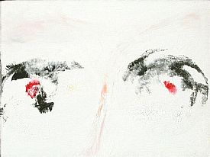
Tangible or intangible ?
Notes:
Also you are dealing with an intangible products
- Eventually an experience - .. Vicarious one…just like a reality show….

Slide 19
Predictable or unpredictable ?
Notes:
And be prepared for ups & downs.
ODI –World cup 2003 might have been great but World cup 2007 was a disaster
T-20 2007 was great (India won) but 2009 was a disaster…

Slide 20
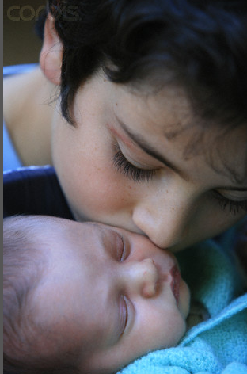
Control on quality ?
Notes:
The sport product (in an event form) is simultaneously produced and consumed --- There is no inventory

Slide 21
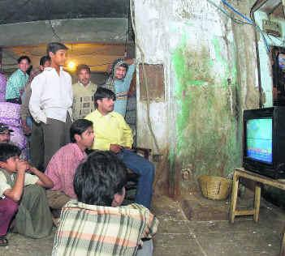
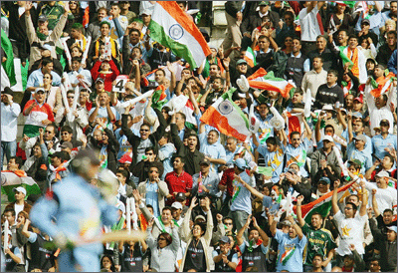
Group consumption or individual consumption ?
Notes:
Sport is generally consumed less as an individual – more as a group, whether at home or in the stadium..

Slide 22

How much is the value ?
INR spends in Crores on Sports marketing
Source : AdEx, Group M estimates
Notes:
There has been an increase of nearly 240 % in the total spends on sports marketing and it has been growing northwards, fuelled by India’s sports favoring demographics and growing affluence…….

Slide 23
Where is the value ?
% of spends on various components of sports marketing
Source : AdEx, Group M estimates
Notes:
And it is not only media.
There is lots more from ground to athletes to teams
Sports sponsorship – On-ground including cricket
Athlete management – Player cost of IPL + Companies brand ambassadors
Team sponsorship – teams / uniforms / clubs
Ideas & Innovation – Activations (Nokia – Consumer program, Xerox – golf)
Mass media spends – FCT + rest

Slide 24
Cricket dominates overall spends…
Sports sponsorships in 2008
Source : AdEx, Group M estimates
Notes:
But the skew has always been towards cricket…If we look at sports sponsorships….Cricket distantly is delivering maximum value and is also reaping the maximum value….

Slide 25
and also in team sponsorship….
Team sponsorships in 2008
Source : AdEx, Group M estimates
Notes:
In terms of team sponsorship as well..It is the cricket story…

Slide 26
and in deliveries…
Sports Genre
Sport | Event | Channel | Avg. TVRs
Cricket | IPL | SET Max | 4.50
* Soccer | EURO Cup | ESPN | 0.56
Tennis | US OPEN | Ten Sports | 0.10
Racing | F1 Grand Prix | STAR Sports | 0.07
Golf | European Tour - Sas Masters | Ten Sports | 0.04
Hockey | Sultan Azlan Shah Cup | Zee Sports | 0.02
Basketball | NBA | ESPN | 0.02
Badminton | Indonesian Open | ESPN | 0.02
Boxing | Sr National Boxing Championship | DD Sports | 0.01
*FIFA in 2007 had a rating 0f 1.01
GEC
Genre | Event | Channel | Avg. TVRs - Male TG | Avg. TVRs - Female TG
GEC | Kyunki Saas Bhi Kabhi | STAR Plus | 2.9 | 3.9
GEC | HH SRGMP Challenge | Zee TV | 2.8 | 3.7
GEC | Dulhan / Saat Phere | Zee TV | 2 | 3.4
Notes:
FIFA was 1.01…

Slide 27
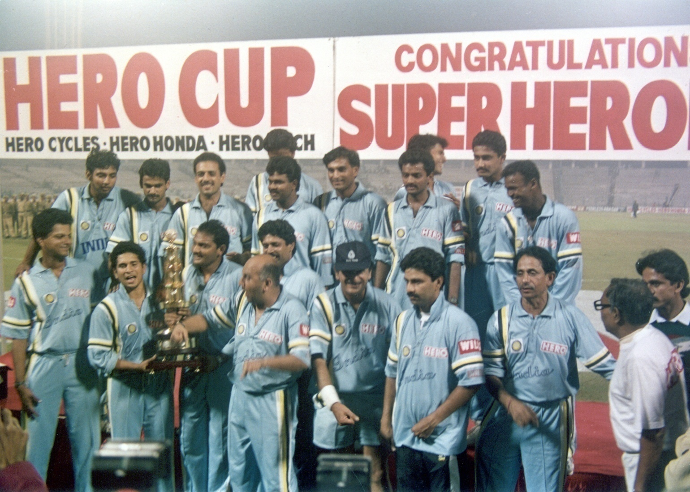
Hero Honda’s association with sports
Notes:
So, No wonder Hero Honda’s association started with cricket
Hero Cup started in 1993…

Slide 28
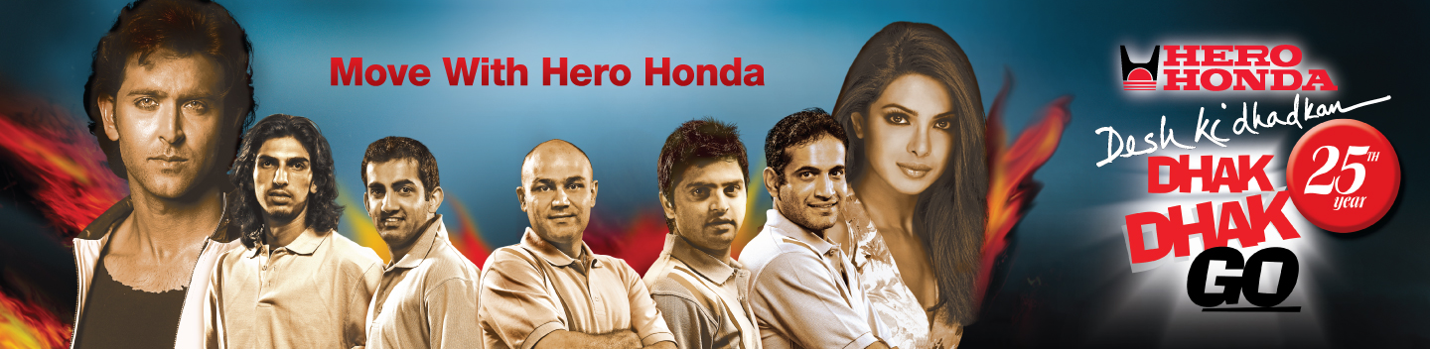
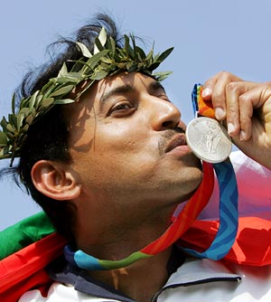
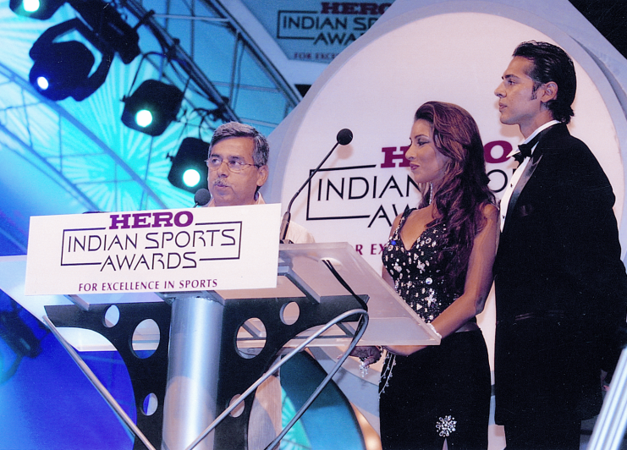

Hero Honda’s association with sports
Notes:
But over the years, we have added others –
Cricketers as brand ambassadors, Rathore as a brand ambassador, sponsors of the highest prize money Golf event & we have also dabbled with HISA – Hero India Sports Academy.

Slide 29





On ground
On air
Notes:
Currently we are GP of ICC , associate partner of IPL and principal sponsor of Delhi Dare Devil…
On air we have been present on air during FIFA, Euro Cup & Olympics….

Slide 30
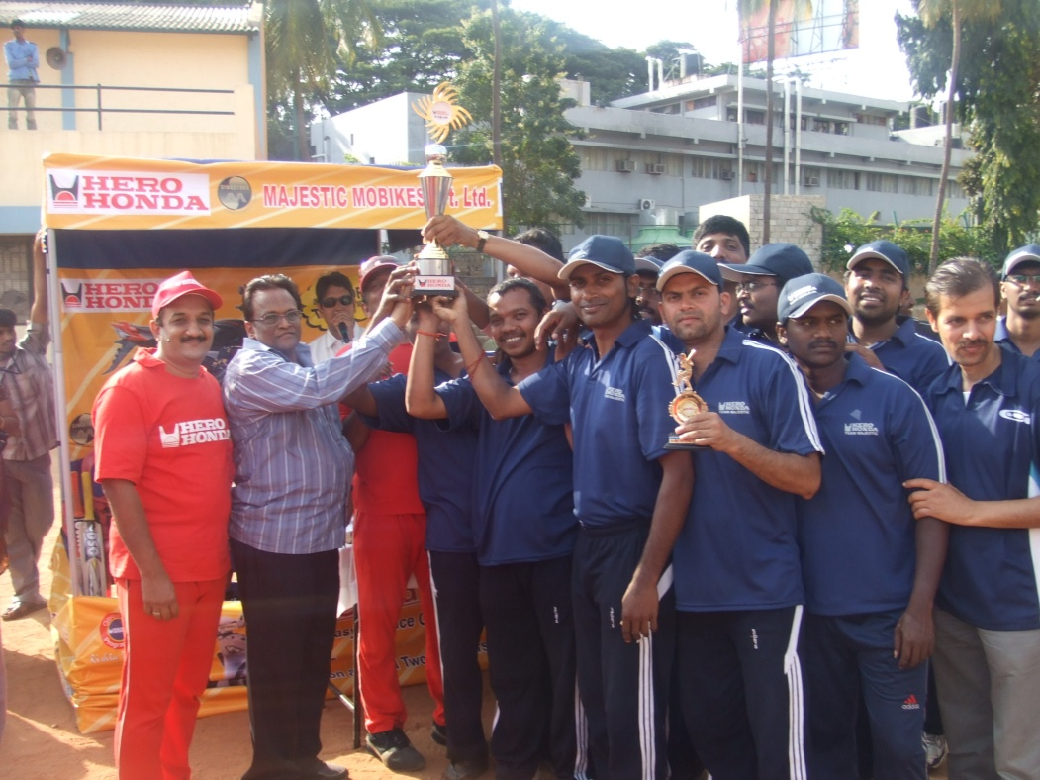
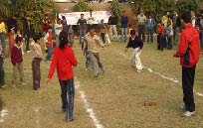
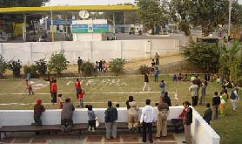
The real value is in taking it down the line
Notes:
Not only at national level but even in the deepest parts of countries… in villages we have been promoting different sports…. Body Building in Karnataka, Football in Pune…

Slide 31
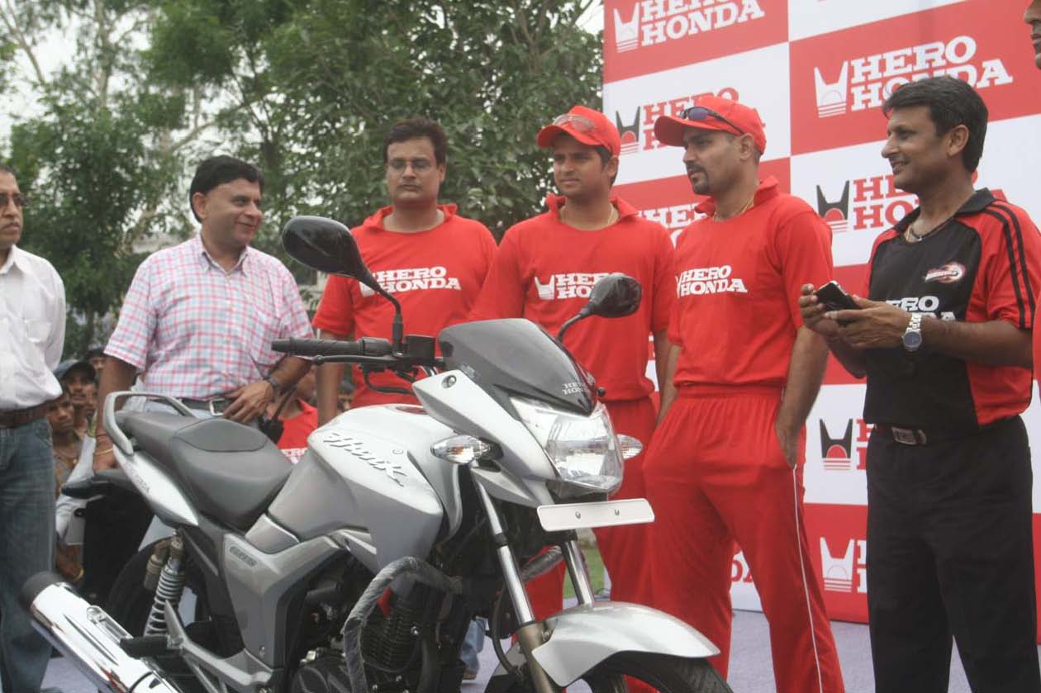
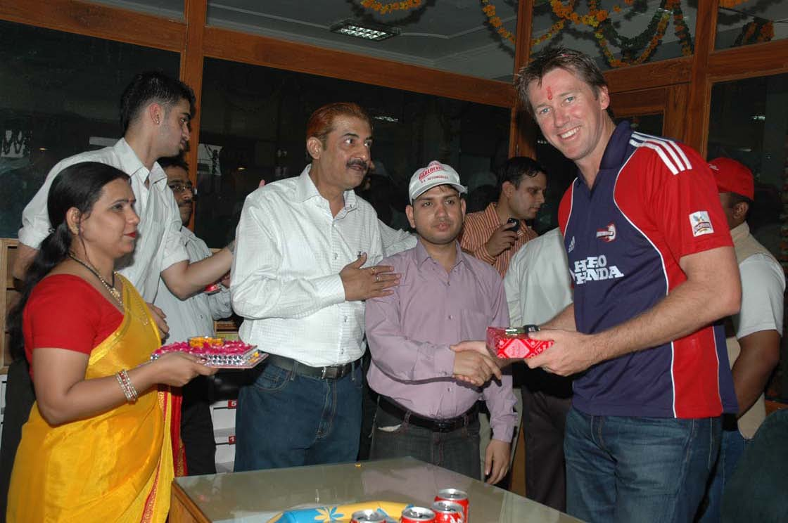
and in leveraging national events
Notes:
We have contests for dealers, test ride activities for customers and special matches for Goodlife members (our loyalty club members…)

Slide 32
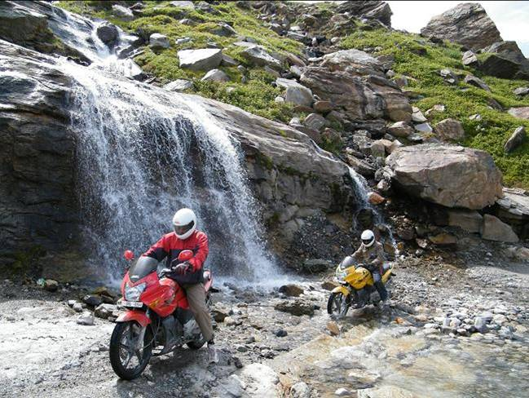
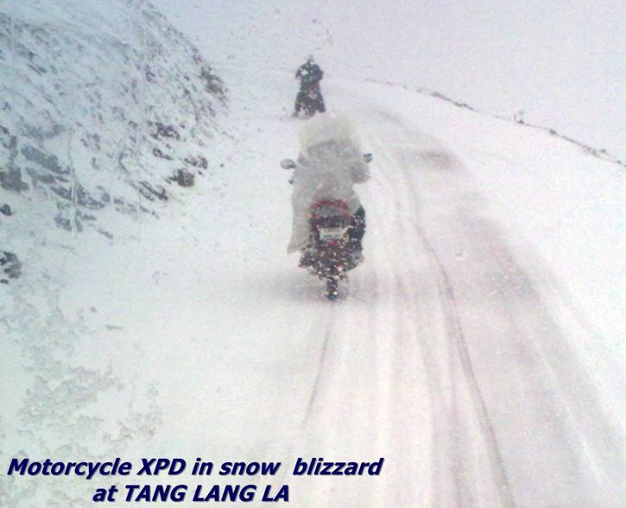
and also in getting into our core product area
Notes:
Biking is our core..and to match our core…we have been doing bike rallies and expeditions. We have been associated with defense forces in a big way….
So we are big on sports…..
Tang Lang La is in Ladakh
Why are we not in bike racing sports ?
Hero Honda has been very close to customer requirements. Today in India such kind of sports are very niche in nature and may make sense for high end cars…In our effort to be closest to the customer – we build on what is closest to the customer
1)Sports and in sports particularly cricket, now we are ofcourse getting in sports where see a lot of future potential
2)Entertainment – we are part of major reality shows Hero Honda Sa Re Ga Ma Pa & Roadies.
We would get there as soon as we spot growing interests in our customers for motor racing or any other sport.

Slide 33
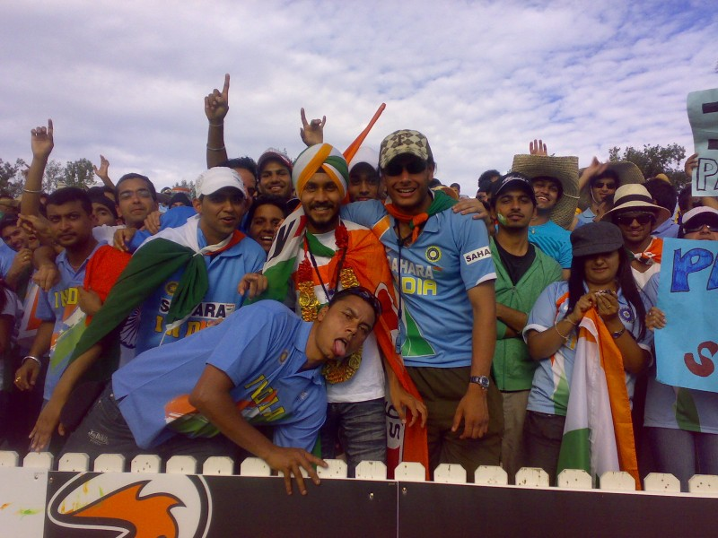
Share of Voice higher than Share of spend
TG – Male , 18 -40 yrs
Great ROI

Slide 34
Sponsoring sports – Inspiring people
Notes:
But for us sponsoring sports is more than the ROIs on our spends… It is about Inspiring people… You build brands by inspiring people….

Slide 35
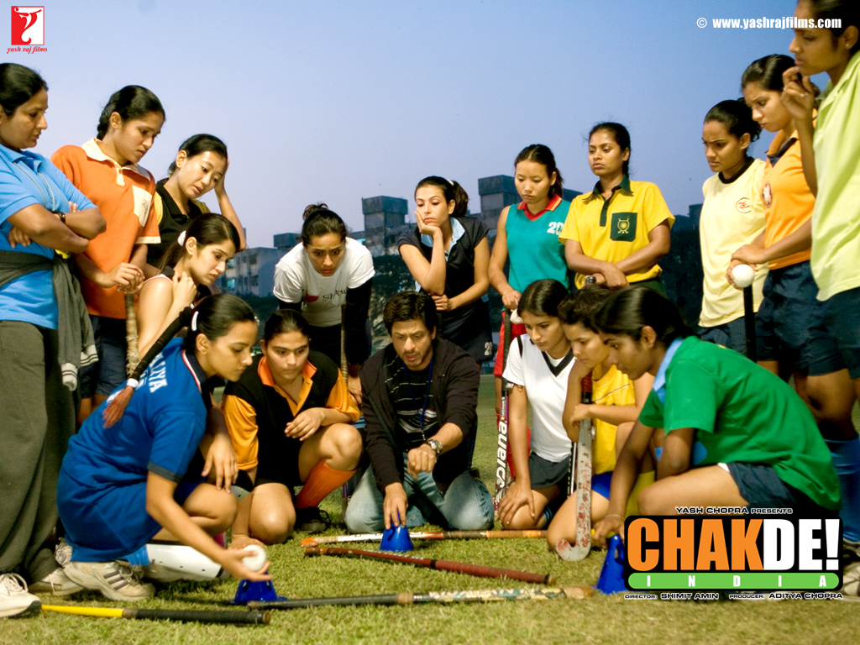
Notes:
Chak de had…..popularised hockey…during that period sale of hockey sticks went up….We know more about Komal Singh Chautala, Bindya Nayak ,Preeti Sabarwal, Sui Mui….& Gunjan Lakhani…..

Slide 36
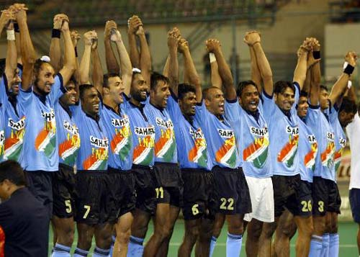
Notes:
Than our hockey team players –is there a lesson from Chak De….
The following players form the current squad of the Indian hockey team.
Indian Hockey Team
Prabodh Tirkey
Baljit Singh
Adrian D’Souza
V. R. Raghunath*
Gurbaz Singh
Sardara Singh
Ignace Tirkey
Rajpal Singh
Tushar Khandekar
Prabjodh Singh
Shivendra Singh
Dilip Tirkey
S. V. Sunil
Arjun Halappa

Slide 37
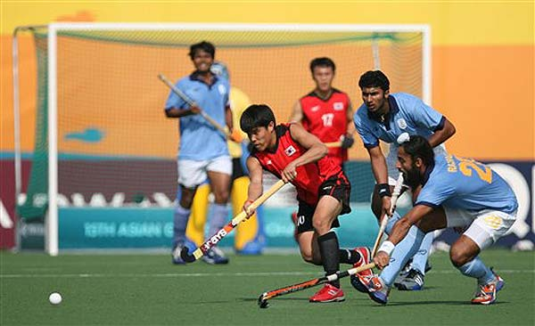
Notes:
Is it OK for our national sport to languish in current state….

Slide 38
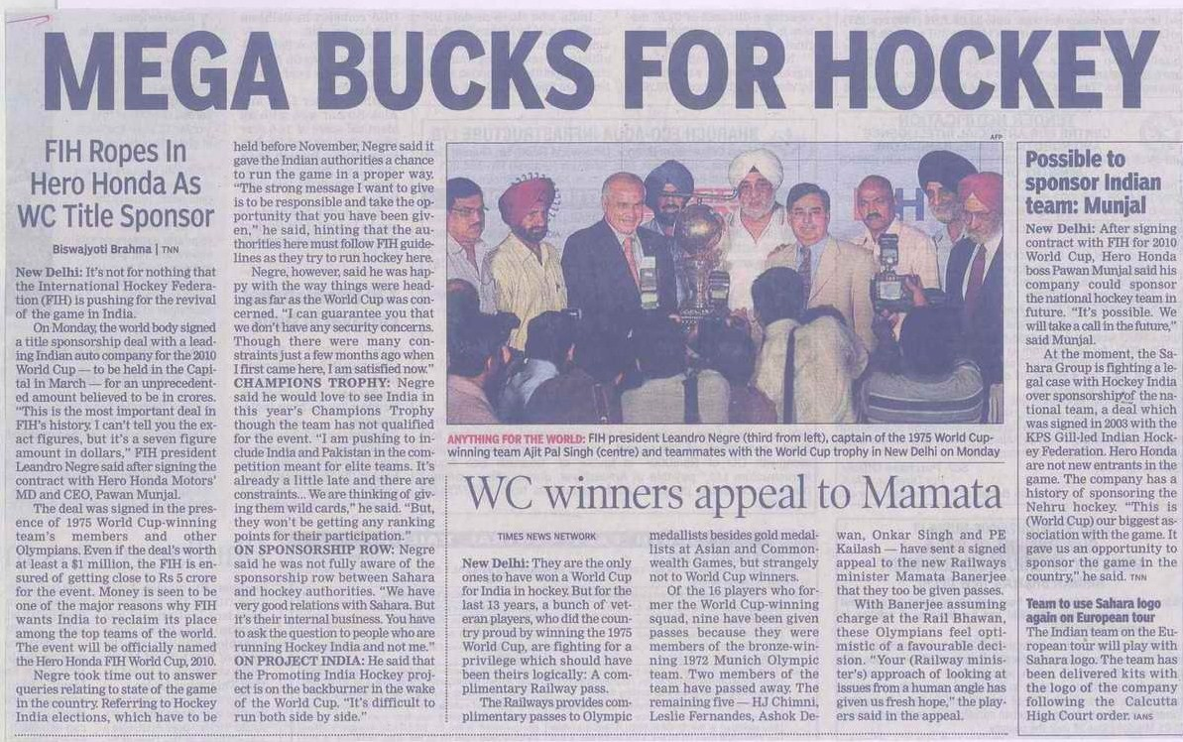
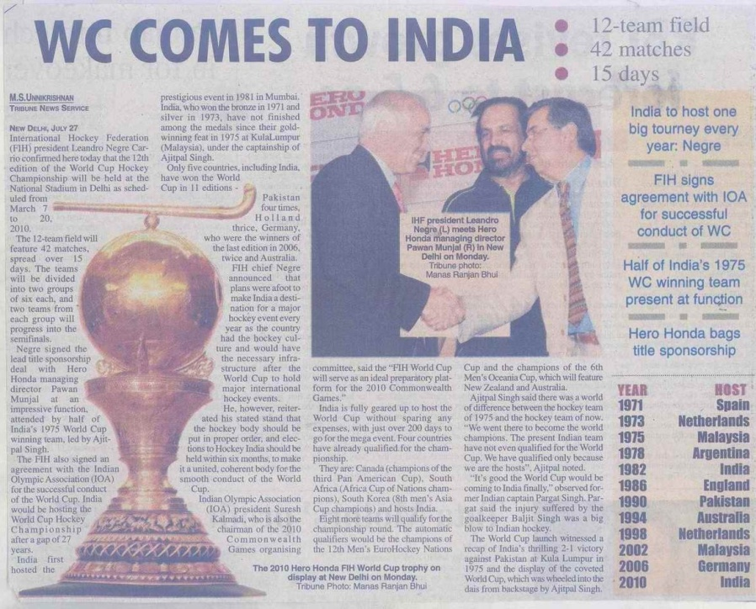
Notes:
Thus…….we thought of inspiring people by sponsoring hockey….hockey our national pride…..

Slide 39
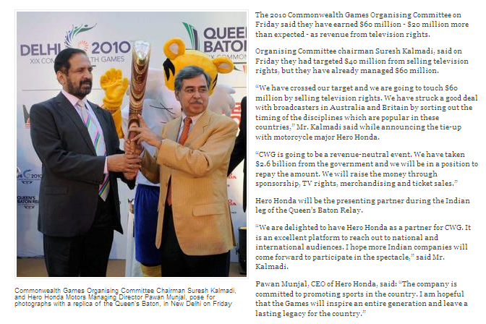
Notes:
And with the same spirit we have associated ourselves with Commonwealth games….We want to inspire a generation of youth that leaves a sports legacy for the country….

Slide 40
Is it enough?
Notes:
But we always ask ourselves if this is enough….?

Slide 41
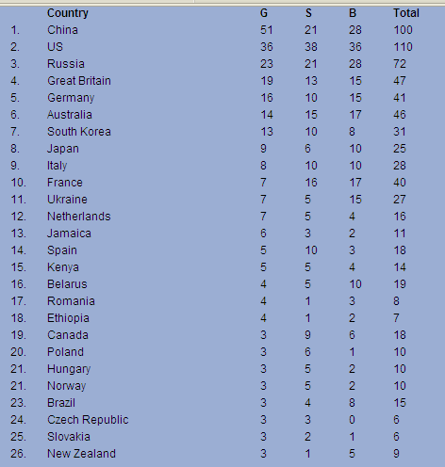
Olympics 2008 medals tally
Notes:
And we come across some stark realities.

Slide 42

Olympics 2008 medals tally
Notes:
India the second most populous country ranks 50 below 1/10 size countries like Turkey..

Slide 43
What ails Indian sports ?
Not enough playing population ?
Not enough interest ?
Not enough access ?
“The ability to participate depends on a variety of enabling social conditions” Amartya Sen
Notes:
Why does an Average Indian count so little…
Is it because of Genetic reasons…. India has a diverse gene pool so that can not be the case…
India’s large population automatically does not equal to effectively participating population…. On a continuum of 0 to 1 for effectively participating population…India would tend towards zero….
It is because of access… of sports… or disinterest of people….
Also as has been said by Nobel laureate Amartya Sen…”The ability to participate depends on a variety of enabling social conditions” . This would include education, access to health care and nutrition…
But if that were to be the only case, we would have never won the cricket world cup in 1983

Slide 44
What ails Indian sports ?
Infrastructure
Institutional & administrative reforms
  Talent tapping
  Talent nurturing
  Social security
Awareness & Interest
Notes:
Also we must very seriously look at institutional and administrative reforms for increasing efficiencies in talent tapping, nurturing and supporting them in addition to developing infrastructure and interest for sports amongst the youth….

Slide 45
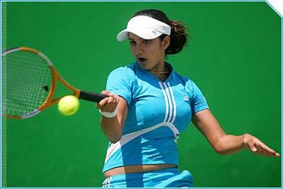
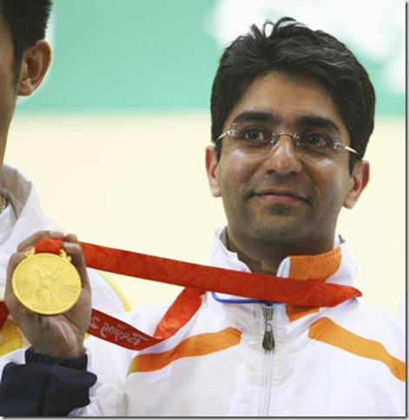
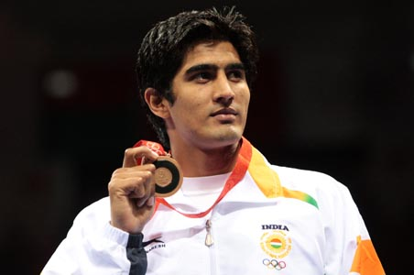
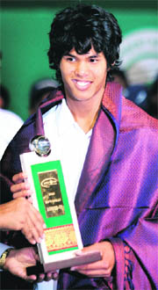
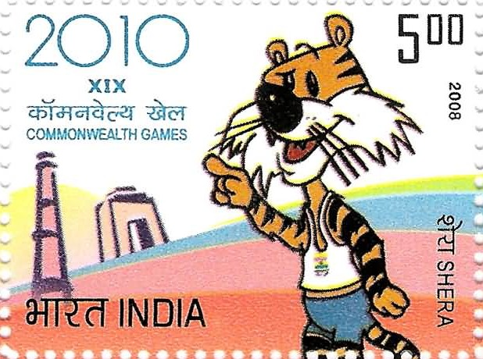
Opportunity – India Land of Sports…..but few Heroes…
Notes:
But still……Sports in India heralds huge opportunity…..an opportunity….that is still untapped but is on its way to become big…..We need to create Heros in all sports and they will inspire more & more people to do better…..

Slide 46
Making the cycle self perpetuating
More Icons
Higher participation
Bigger sponsors
Better Infrastructure
Greater talent
Notes:
How can we do that
Solution lies in making the sports cycle self perpetuating….. It is a loop that feeds into itself….. As we create more winners… more youth are inspired… they participate more…watch more… associate more…. This attracts more corporate… more money and thus better infrastructure can be created… more people find it glamorous and see it as a viable career option…..
This cycle is on for cricket…. We are trying to fuel this cycle for Hockey and also other games by common wealth….

Slide 47
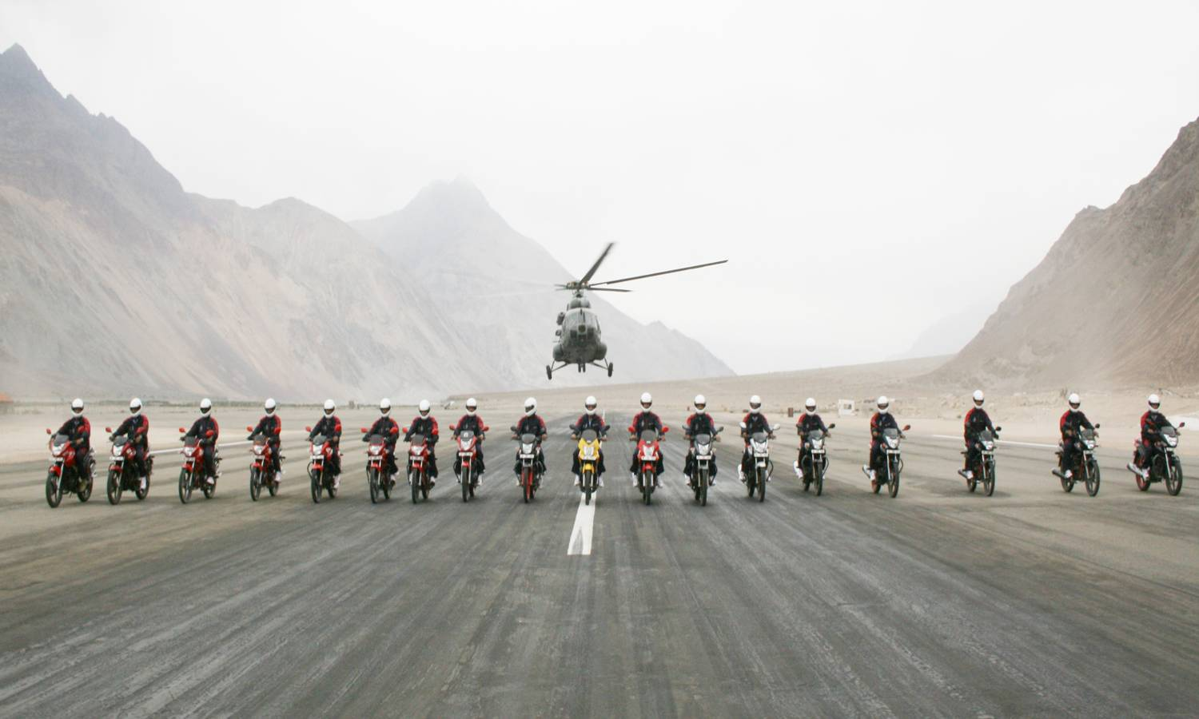
Lets give sports a chance…
Thanks….
Notes:
Lets give sports a chance…. This is an expedition that we did along with Airforce and army..

