Slide 1

Quality System in Supply Chain & After Sale
Making Science Work For You…

Slide 2
Best in Class : Supply Chain
Supply Chain
Supply Chain
Plan
Supplier processes
Customer processes
Supplier processes
Customer processes
Source
Make
Deliver
Return
Return
Achieve Timeliness , Agility & Speed in all supply chain processes
With collaboration across Plants & Corporate

Slide 3
SCOR METHODOLOGY
Plan
Plan
Plan
Deliver
Source
Make
Deliver
Source
Make
Deliver
Source
Make
Deliver
Source
Return
Return
Return
Return
Return
Return
Return
Return
Suppliers’
Supplier
Supplier
Internal or External
Jubilant Life Sciences
Customer
Internal or External
Customers’
Customer
  The SCOR (Supply Chain Operations Reference Model), is developed by Supply Chain Council. The model builds its strength around the linkage between process elements, metrics, best practices and features associated with supply chain execution in the areas of: Plan, Source, Make, Deliver, and Return

Slide 4
Supply Chain – Vision & Mission
Develop world class Integrated SC to accomplish the business goals
Align the Supply Chain Processes to support New Product Development
Consistent Processes in Forecasting ,Planning, Sourcing & Logistics
To standardize the “Operating Principles” and document the SOP’s for Supply Chain to be Process oriented & IT enabled
Define business wise measurement SCOR cards for both Internal & External deliverables & reengineer the supply chain
Sustain the improvements through review & lean strategies & align dynamically with the needs & changing market conditions
Notes:
4

Slide 5
Quality System in Supply Chain
In order to elevate the functional excellence in supply chain processes, we have decided the following key initiatives under evaluation :
E- procurement
(vend-x)
Bar Coding
Green Supply Chain
Supplier Quality Assurance

Slide 6
Quality System in Supply Chain
In order to elevate the functional excellence in supply chain processes, we have decided the following key initiatives under evaluation :
E- procurement
(vend-x)
Bar Coding
Green Supply Chain
Supplier Quality Assurance

Slide 7


eJ-Buy ......
Partners On-Line
Vendors ‘on-line’
Web-enabled Procurement Application
SCOR: Our expectations from you
Internet
ERP Based Indent
MRP based Planned Qty
Webpage
X
Administrative Time
Manual /
Paper

Slide 8
eJ-Buy Value – Proposition
To address partner’s expectations of fair opportunity, transparent decision making
Speedier response and clarity of communication,
Jubilant promised and launched eJ-Buy.
eJ-Buy is the
e-Procurement program of Jubilant Life Sciences
Powered by Vendx* Technology to Automate Procurement
Tool to Enable Superior Connection with Partners
Instant & electronic RFQ notification to Partners
Easy To Use, Standard Templates for RFQ Response /Quotes
Makes feasible Online retrieval and review of quotes
User-friendly platform for receiving and comparing quotes
Enabler for Online competition through Reverse Auctions
Vendx* - Software as a Service Model Proprietary product of M/s ebizChem

Slide 9

eJ-Buy – Future Road Map 2011-13
Mar-13
All Jubilant Spend on eJBuy
All Sites & corporate Spending
Dec-12
Savli & R&D
Oct-12
Aug’12
Gajraula , Nira & Roorkee
June’12
Projects
In direct
Material
Mar’12
Packing Material
Oct -11
Logistics on eJBuy

Slide 10

eJ-Buy – Transformation
  Manual Procurement
  Offline transactions
  Long Purchase Authorization Cycles
  Personalized Negotiation Styles
  Audit Trail on paper
  Diverse procurement practices and policies
  Automated Procurement
  Online transparent Transactions
  Short Purchase Authorization Cycles
  System based negotiations
  Paperless records
  Standard and Uniform Process
Traditional
eJBuy
A need to collaborate & accomplish the Vision is what we Expect !

Slide 11
Quality System in Supply Chain
In order to elevate the functional excellence in supply chain processes, we have decided the following key initiatives under evaluation :
E- procurement (vend-x)
Bar Coding
Green Supply Chain
Supplier Quality Assurance

Slide 12

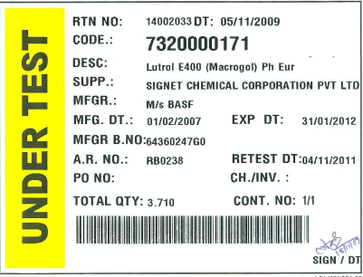

Bar- Coding
Material issue from stores after validation of item code,lot no, Manufacturing date & expiry date
Raw material received at factory gate
Bar coding completed for Ware House operations at all our locations
Integrated with our ERP
Extending to our Products for our downstream partners
Would like to extend to our upstream partners
Benefits :-
Easy accountability, FIFO enforcement ,accuracy, speed & fool proof system

Slide 13
Quality System in Supply Chain
In order to elevate the functional excellence in supply chain processes, we have decided the following key initiatives under evaluation :
E- procurement
(vend-x)
Bar Coding
Green Supply Chain
Supplier Quality Assurance

Slide 14


POLICY ADOPTED

Slide 15
Green Supply Chain
Initiatives Taken..
Awareness sessions conducted during Quality Audits. Partners were briefed on:
  Importance & significance of ISO 9001-2008, OHSAS and EHS system
  Encourage Supplier to implement ISO 9001-2008
  Awareness of 5 S Concept
  General Health and Hygiene
  Use of Safety Tools and Equipments
  Encourage Supplier for the recycle and reuse of the resource.
  Reduction of the waste and disposal of the waste as per prescribed rules.
  Compliance of the Safety and Environment regulations
  New Suppliers Selected based new questionnaire feed back

Slide 16
Quality System in Supply Chain
Supply Chain Management
Supplier Performance Management
Supply Chain Risk Management
Supplier Quality Management
Supply Chain Governance
Measure Supplier Performance Against contact &SLA through scorecard
Measure critical supplier quality through supplier corrective action & supplier audit.
Identify, manage and mitigate supplier risks.

Slide 17
Supplier Quality Assurance
Supplier Management
Supplier Audit
Supplier Performance Score cards
Supply Chain Risk Management
Supplier
Corrective Action

Slide 18
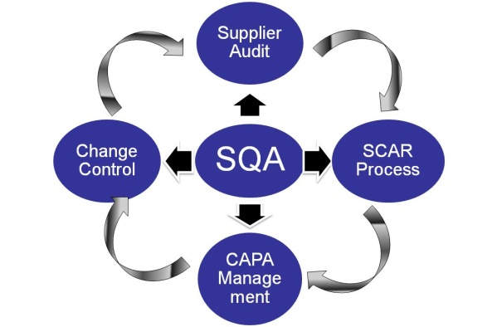
New Supplier Development-
Sent Supplier initial Assessment Questionnaire & Supplier Registration Form
Initial Supplier Evaluation based on Questionnaires
Request For Sample & Approval (QC & R&D)
Supplier Certification / Final Approval for Commercial Supply
Supplier Approval for Pilot Lot / Trial
Supplier Site Audit
Following controlled format are used for introduction of supplier:
Supplier Quality Evaluation Questionnaire- (FM/QA/057 )
Green Supply Chain Questionnaire -(F3 / SC/ SOP /001)
Supplier Registration Form - (F1 / SC / SOP / 001 )

Slide 19
Integrated Quality & Compliance Management
Enterprise
Procurement
Distribution
Manufacturing
Supplier
Customer
Quality Management
Supplier Quality
Supplier Audit
Containment & Failure Analysis
Internal Quality
Internal Audit
CAPA
Customer Quality
Customer Complaint Management
Supplier Corrective Actions
Charge Back / Cost Recovery
Supplier Scorecard
Containment & Failure Analysis
Change Control
Document Control
Quality Scorecard
CAPA
Change Control
Quality Scorecard
Document Control
Containment & Failure Analysis

Slide 20
GSCM QUESTIONNAIRE ANALYSIS RESULT
Area Of Improvement (Target 75% in 2012-13 including new suppliers)

Slide 21
GSCM QUESTIONNAIRE ANALYSIS RESULT
Area Of Improvement (Target 85% in 2012-13 Including new suppliers)

Slide 22
Quality System in Supply Chain
In order to elevate the functional excellence in supply chain processes, we have decided the following key initiatives under evaluation :
E- procurement
(vend-x)
Bar Coding
Green Supply Chain
Supplier Quality Assurance

Slide 23
Existing Supplier Evaluation:
Sent Supplier Quality Assurance Questionnaire
Initial Supplier Evaluation based on Questionnaires
Plan for Site Audit
Verify Effectiveness in follow up Audit
Request for CAPA
Send Audit Report to Supplier

Slide 24
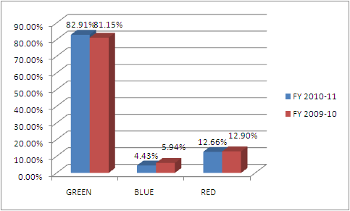

Supplier Performance Management
 | Company | GREEN | BLUE | RED | Grand Total
RM | AC - Gaj | 63 | 4 | 1 | 68
 | AC - Nira | 67 | 1 | 2 | 70
 | AI-Gaj | 82 | 6 | 3 | 91
 | FC-Gaj | 87 | 9 | 18 | 114
 | AI-Nira | 3 |  | 1 | 4
 | Form.-RK | 33 | 1 | 10 | 44
 | API-Njd. | 110 | 3 | 15 | 128
 | API-Njd. | 132 | 4 | 29 | 165
 | ANU-Sav. | 78 | 7 | 21 | 106
RM Total |  | 655 | 35 | 100 | 790
Improvement required for
Fine Chemicals, ANU ,API, & Formulation Business

Slide 25
PROCESS CONTROL CHART :
TOLLER NAME: VEER CHEMIE( Exhibit 1)
Product Name: NIACINAMIDE USP (ASSAY---> Not Less than 99 % w/w)

Slide 26
Highlight For Q1~Q3
PROCESS CONTROL CHART :
KOPALLE :SODAMIDE ( Exhibit2)
ASSAY---> Not Less than 99 % w/w

Slide 27
Our Resolve
Creating Opportunities for Collaborative working together & eJ-Buy implementation
Development and Up gradation of Best Practices in Supply Chain –SCOR
Exposure to Best Ethical & Transparent commercial dealings
Continuously help in Making the Supply Chain Green Clean with contribution together to the society

Slide 28
Thank you

