Slide 1

Sustainable Quality Systems
in
Supply Chain & After Sales
19 Jan’12
Girish Shah – Service Head
Videocon Industries Ltd

Slide 2
















CE Technology Progression
2011 | 2012
One chassis with D2H 3D LED TV range Real 2D-3D conversion IP TV , Health TV & Security TV. Education TV through D2H Digital Signage Crystal design with new design trends. 3D transmission through D2H | OLED introduction. Solar power LED TV 3G compatible LED with Datacom support. Multiple injection molding. Video streaming server. Auto stereoscopic 3D TV Gesture Recognition. Projection through Mobile

Slide 3
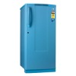



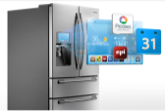











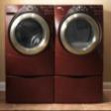
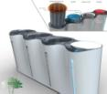
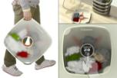
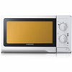









Home Appliances Technology Progression
2000-2005
2008
2009
2010-2011
2012
2013-2015
FF Ref
Electronic Temp Control
Side by Side & DC Inverter Technology
External Micom with Interactive LCD/ LED Panel with improved energy efficiency.
Smart Refs with Wi-Fi Connectivity, Remote Access, Interfacing with other Smart Appliances , Various Intelligent & Customised Applications etc.
Community Refs
DC Ref
FF Ref
Side by Side
with LCD Screen
FAWM – FL
with Heater
FAWM – FL
Direct Drive
FAWM – Tilt Drum
Direct Drive
Community Laundry
Portable/ Wall Mount WM
SAWM
FAWM - TL
FAWM - FL
Smart Washers with Intelligent Wash programs, Wi-Fi Connectivity, Remote Access, Interfacing with other Smart Appliances , Various Intelligent & Customised Applications etc.
Music/ Voice Activated Ovens/ USB Interface
(Stores upto 40 voices)
Oven with Separate
Bottom Grill
Multi Steamer
( with detachable Water tank)
Smart MWO with Smart Apps & Communication Capability, Interface with other smart appliances
MWO - Solo
MWO - Grill
MWO
Convection
Auto Cook Menus
MWO with
LCD Screen

Slide 4
INDUSTRIES SUPPLY CHAIN
PRODUCT DEVELOPMENT CYCLE
CUSTOMER SATISFACTION
VENDOR MANAGEMENT
AFTER SALES & SERVICE MANAGEMENT
PRODUCTION MANAGEMENT
LOGISTICS MANAGEMENT

Slide 5
MY PRODUCT MY PRIDE
WORLD CLASS PRODUCT
Product Innovation
New Model Quality Performance
Production Quality Assurance
System
Setup
My Model Ownership
Standardization
Product Innovation
3F .
Part Reliability
Product Performance.
System (PLM) / mySAP
Process Quality system set up (VMES)
Field Quality system set up (VQINS)
Mould System
Productivity Improve by
LOB and Standardization
Internal Process Quality Control
100% Defect free delivery

Slide 6
New Product Launch Process
New Product Launch Process
1 . IDEATION
- Market Study / Potential
- Understanding of Need & Gaps
- Driven through Quantitative
research
- FGD’s
- Workshops
- TG Mapping
4 . LAUNCH PROCESS
- PRODUCT LAUNCH
COMMUNICATION
- PRODUCT LAUNCH
CHANNEL & PLACEMENT
PRODUCT LAUNCH CYCLE
PRODUCT TESTING - POST LAUNCH
2. CONCEPTLIZATION
- Based on ideation concepts
taken ahead
- Need s & benefits / features
- Product design & style
- International concepts
3 . MANAGEMENT PLAN
- Feasibility study / Project
- Cost & market planning
- Production
-Pricing
-Channel selection & criteria
PRODUCT TESTING - PRE LAUNCH

Slide 7
VENDOR MANAGEMENT
Q
TOWARDS
100
PPM
APPROACH
THE BEST PRACTICES:
Self Q Certification by Vendors (DOL).
JIT Supplies. –MILK VAN CONCEPT
Strong 4M Management system.
Periodic Supplier Assessment
Initiative from Vendors for Cost & Q Innovation.
Setup Inhouse Reliability Test Facilities
Performance Evaluation & Monitoring thro’ SAP
version-6.0 or Equivalent.
Periodic Review system(Meetings)
WIN – WIN SITUATION

Slide 8
PRODUCTION MANAGEMENT :
PROCESS QUALITY CONTROL TOOLS
Daily Monitoring Thro’ 6-TOOLS
Monthly Auditing system thro’ MI 10 Tools(End-to-End)
Mind innovation School for Training all employees.
Improvement Projects thro’ SRT/SRP/QIT/PIT
Online Monitoring of Field Quality thro’ New VQNIS System

Slide 9
What are 6 Tools?
100 PPM QUALITY PROCESS
1
OS&D*(Over/Shortage/Defect)
2
Sequential Inspection
Perfect
Check
System
Cultivating
Team
Skill
3
Main Process Control
4
Time Check
5
Quality Audit
6
Review Meeting
Implement
6TOOL
*OS&D : Over, Shortage & Defect

Slide 10
PROJECTS THRO’ - SRT/ SRP/ QIT/ PIT
Types of SRT/SRP
Productivity
Quality
Inventory
R &D
Top Down
a) Increase UPH
b) Increase Sets/hr
a) Decrease FCR
b) Customer
Delight :3F
Inventory
Reduction
b)Supply Improve
RMC /VCI
New Model
Types of QIT/PIT
Bottom up
Productivity
Quality
Vendor
PE
a) Tact time Reduction
b) Improve process
Process
Defect Reduction
Quality
Improvement.
Reduce M/C
Loss

Slide 11
Mi-10/ The 10 Pillars for Manufacturing Innovation
Mi-10 items
Audit Area
Audit Factors
Keep Basics
1
Sorting
Systematic Arrangement
Sweeping
Systems
Self-discipline
Mixing in one box
Easy to find
Floor/conveyor
5S Map/Checklist
Always clean
5S
T5S
2
Productivity Mgt.
3
Maintenance
4
Material Flow
Right Location
Right Q’ty
Right Container
Location Marking
Standard Stock
Box, trolley
5
3R
Q A System
6
Vendor Development
7
Multi Skill
8
Communication System
Identification Boards
Production Control Boards
Slogan
Office/Supervisor/
Operator
Area/Location
Monthly,Daily,Hourly
Line/Shop Slogan
Visual
Management
Self Management
9
EESH
10

Slide 12


Quality Management System
All of India Factory
AUR
KAS
GAN
BAN
HYD
KOL
SHJ
Field Quality
Manufacturing Quality
Service
Master Data Server
Dealer
SAP
Call center
WEBCMS
Customer
R&D
FCR
M-Graph
S/W
IR Trend
VMES
PE/Prod
Worst Defect
VQINS
(Sep.2011~)
QA
Repeat Call
Impr. History
Manufacturing Data Monitoring System
Logistic
Field Quality Data Analysis System
Correlation Process vs Field
Provision
Under Development
Developed

Slide 13
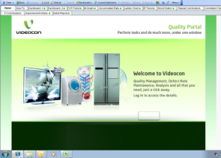
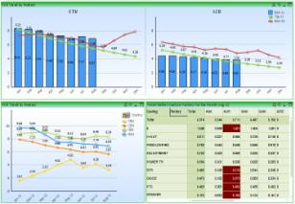
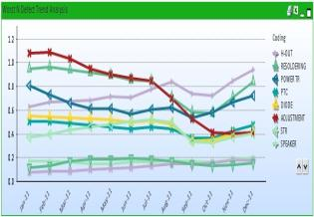
VQINS : Videocon Quality Information Network System
Benefits :
Field Defect Auto Analysis Reports on real time basis –
  FCR Trend, IR Trend, Accumulated Rate, Worst Defect, Monthwise Graph(M-Graph),
  Improvement History & Effectiveness Monitoring
  F-Cost Monitoring
  Correlation Analysis, Field vs Process
Detail Analysis -
Product wise, Factory wise, Category wise, Segment wise, Worst defect wise,
Branch wise, Brand wise
Easy to access from every factory through www.vqins.com , so no man dependency
Support to R&D for defect condition study and improvement plan

Slide 14
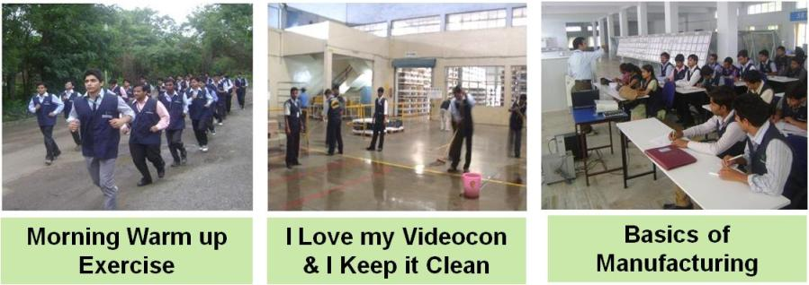
Innovation School
Mind Innovation | Basics of Manufacturing
What is culture Morale Training What is Mind innovation Attitude , Discipline & Passion Continuous & Continual Improvement Cost Innovation ( SRT,SRP,QIT,PIT & LET Projects) Self Analysis Smart Working for Quality Output Positive Attitude | Basics of IE (Industrial Eng.) Total 5S (5S,3R, & Visual Management) What is Work What is Quality 7 Types of Losses Fool Proofing OEE Training & Practical Exercises

Slide 15
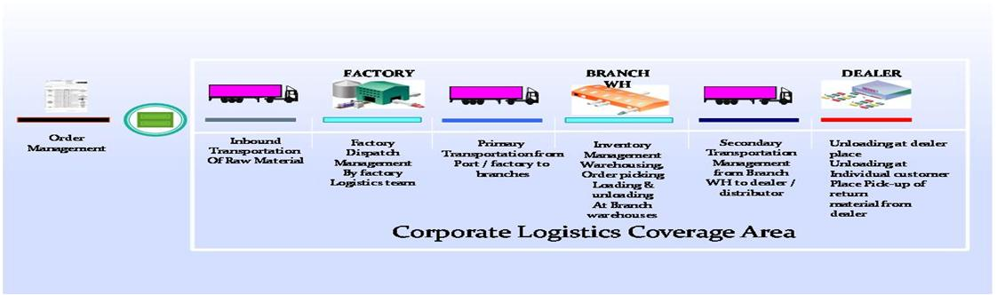
VG – Logistics in Domestic
Owned Fleet Infrastructure(More than 350 owned trucks).
Wide network based & Owned 3PL company
Last Mile reach distribution Network in the industry.
Flexible & easy Adaptability to the situation.
Tracking thro’ ERP SAP System

Slide 16
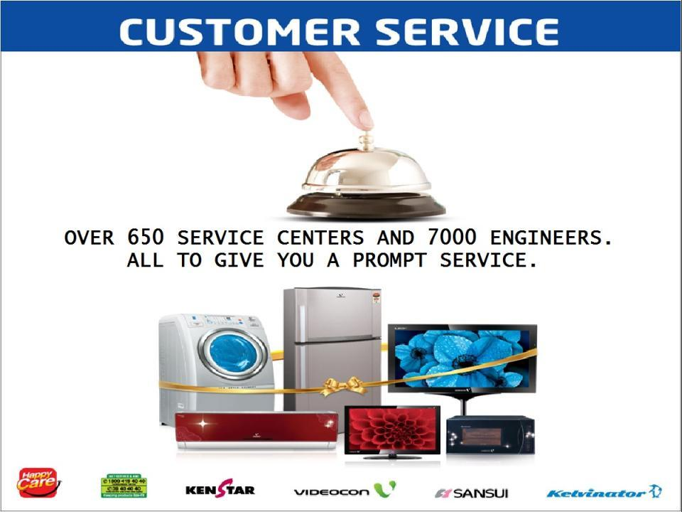

Slide 17
Service Strength : Differentiated Service Experience
Speed
Service Quality
Wide, Customized & optimized Network -
- 650 Service Centers across India
Speed of Service
- 24 Hrs Response > 80% at ASC Locations
Parts availability for immediate solution
- Regional Hub for immediate supply
- MSL at ASCs – 1 month
Call Registration
- Outbound Calls to Dealers
- 7 days Call Centre support ( 8:00 am to 10 pm)
7 Days Service
Quality Manpower
- Tie up with ITI
Evaluation at all levels
- Monthly evaluation for Branch/ASI/ASC
Trained Manpower
- Technical, Soft Skills 2 Mandays/Qtr.
Awards & Penalties
Exclusive Hi End Engineers
Review Mechanism
Strong CRM for Monitoring
Meetings , Interaction
Market Visit
Audits & Evaluation
Competitor Information
Service Marketing
Free Service Camps in off season
Glow Sign at ASCs
Uniform and I Card with Engineers
Other Initiatives
Acknowledgement of Call within 2 Hrs
Reassurance to Customer over SMS
Engg Evaluation thru Happy Calls/CRM
Service Infra improvement at ASCs

Slide 18
Service Network
Our Network
TAT – 75%
RT - 80%
650 Franchisee
35 Direct Service Center
400 Sales & Service Dealers
Service center at more than 350 location
7000 Service Engineers
Multilingual Call Center
Web based Strong CRM

Slide 19
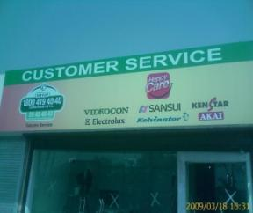
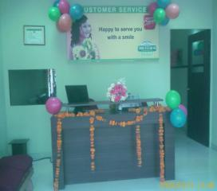
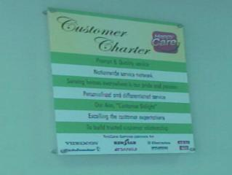
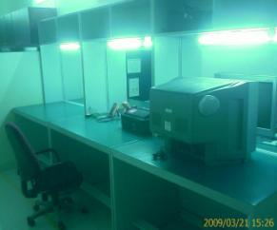
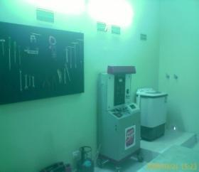
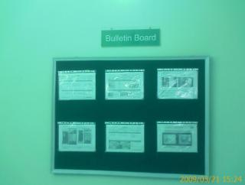
Service Centre
Front & Glow sign board
Reception
Customer Charter
CE Workshop
HA Workshop
Bulletin Board

Slide 20
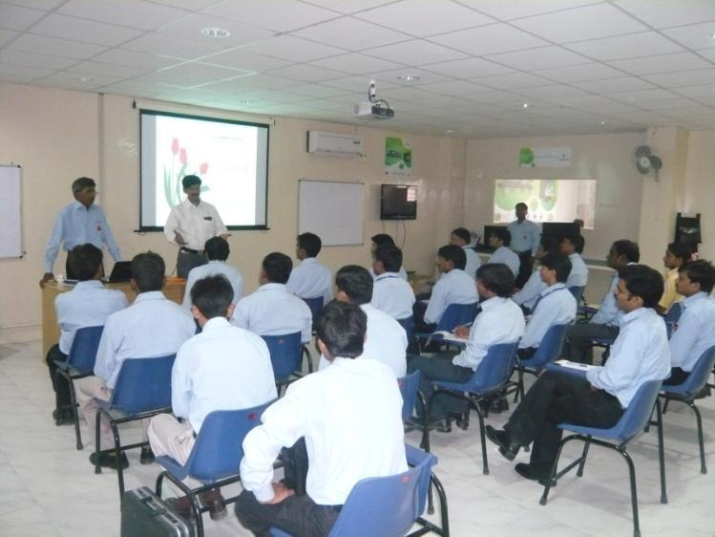
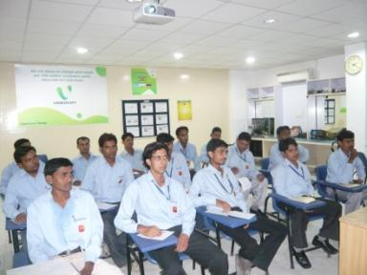
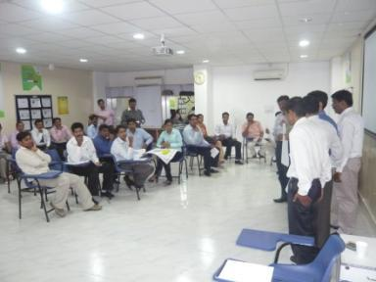
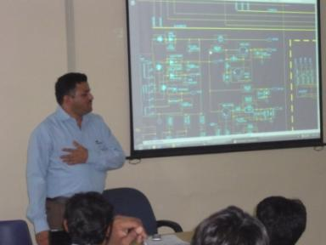
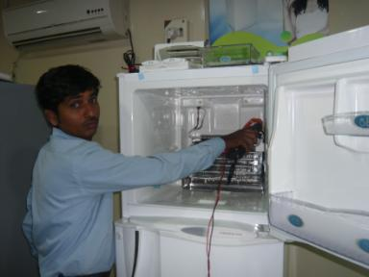
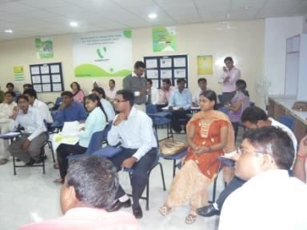
Training Academy Delhi
Training Centre's at Sahajanpur, Aurangabad, Bangalore & Kashipur

Slide 21
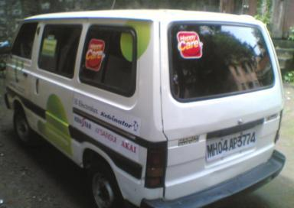

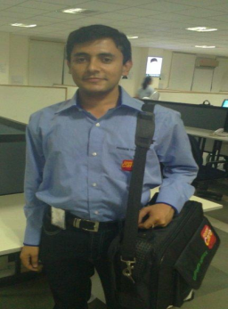
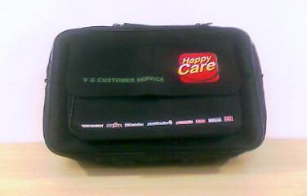
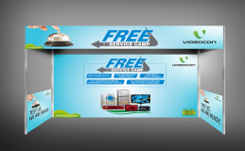
Service Marketing
Service Van
Free Service Camp ( Leaflet )
Engineer Uniform
Engineer Toolkit
Free Service Camp ( Canopy )

Slide 22

THANKS

