Slide 1
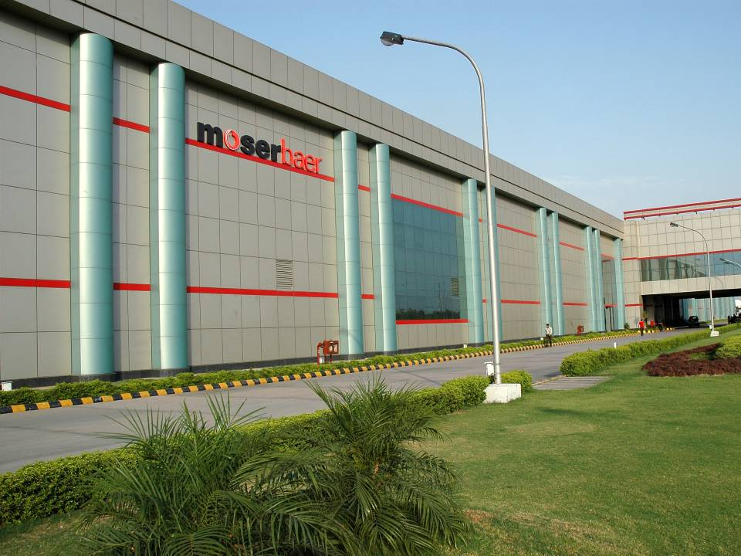
FICCI – Conference on ‘Sustainable Manufacturing Growth through Quality System’
Competency Building / Training for Quality Systems
Speaker : Sanjay Narula
Associate Vice President – Moser Baer Solar Limited
19th Jan ’ 2012

Slide 2
Moser Baer Group – Introduction
Moser Baer : A Well- Diversified Group
Blank Optical Media
World’s 2nd Largest Optical Media producer with 20% global market share and 60% Indian market share
Leader in next Generation Blu Ray, HD DVD Technology
Business operations in 82 countries
Reduced cost from $1/disc to 7 cents/disc
Entertainment
No. 1 Home Video Company in India with over 10,000 titles (~1/3rd of Indian movies ever released)
22 DCs / 550 distributors in place
Disruptive pricing model (~75¢ DVD, ~63¢ VCD) to curb piracy
Solar Photovoltaic
180 MW Cells, 150MW Modules (Crystalline Silicon)
50MW Amorphous Thin Film Modules
Consumer Electronics & IT Peripherals
Products include DVD players, MP3/MP4 players, LCD TV’s, Solid State media storage products (USB’s/ Flash Cards), Gaming Console, Set-Top-Boxes etc.

Slide 3
Certifications and Recognitions
TUV 5 STAR
Green Leaf Certification
SA 8000
OHSAS 18001
ISO 14001
ISO 9001
Moser Baer Solar is the only 5-Star Rated PV company globally.

Slide 4
INDEX
Management & Total Quality Management
Quality Management Principles
Quality System : Definition and Need
QMS Competence Building Process
Competence Building & Trainings at Moser Baer

Slide 5
INDEX
Management & Total Quality Management
Quality Management Principles
Quality System : Definition and Need
QMS Competence Building Process
Competence Building & Trainings at Moser Baer

Slide 6
Management & Total Quality Management
Q.
What is Management ?
Management is carrying-out all the necessary activities for achieving an objective; efficiently and economically.
ACT
PLAN
CHECK
DO
MANAGEMENT CYCLE

Slide 7
Management & Total Quality Management
Q.
What is TQM ?
TQM is a set of systematic activities carried out by the entire organization to effectively and efficiently provide products and services with a level of quality that satisfies customers at the appropriate time and price so as to achieve company objectives. (JUSE)
Source: JUSE, Deming Guide
A Management approach of an organization, centered on quality, based on the participation of all its members and aiming at long term success through customer satisfaction, and benefits to the members of the organization and to society. (ISO 8402-93)
Q.
What is “Total” in TQM ?
a) Objectives:
Not only QEHS but also other parameters including productivity, cost, delivery etc.
b) Every Department:
Not only a manufacturing department but also other departments including Supply-Chain, R&D,
marketing, HR Administration etc.
c) Every Level:
Not only engineers but also top managers, middle managers, supervisors and technicians.

Slide 8
Management & Total Quality Management
Q.
TQM : Whose Responsibility ?
Quality Management is the responsibility of all levels of Management but must be led by The Top Management.
Its implementation involves all members of the organization.

Slide 9
INDEX
Management & Total Quality Management
Quality Management Principles
Quality System : Definition and Need
QMS Competence Building Process
Competence Building & Trainings at Moser Baer

Slide 10
Quality Management Principles
Principle-1
Customer Focus

Slide 11
Quality Management Principles
Principle-1
Customer Focus
Principle-2
Leadership

Slide 12
Quality Management Principles
Principle-1
Customer Focus
Principle-2
Leadership
Principle-3
Involvement of People

Slide 13
Quality Management Principles
Principle-1
Customer Focus
Principle-2
Leadership
Principle-3
Involvement of People
Principle-4
Process Approach

Slide 14
Quality Management Principles
Principle-1
Customer Focus
Principle-2
Leadership
Principle-3
Involvement of People
Principle-4
Process Approach
Principle-5
System approach to Management

Slide 15
Quality Management Principles
Principle-1
Customer Focus
Principle-2
Leadership
Principle-3
Involvement of People
Principle-4
Process Approach
Principle-5
System approach to Management
Principle-6
Continual Improvement

Slide 16
Quality Management Principles
Principle-1
Customer Focus
Principle-2
Leadership
Principle-3
Involvement of People
Principle-4
Process Approach
Principle-5
System approach to Management
Principle-6
Continual Improvement
Principle-7
Factual Approach to Decision Making

Slide 17
Quality Management Principles
Principle-1
Customer Focus
Principle-2
Leadership
Principle-3
Involvement of People
Principle-4
Process Approach
Principle-5
System approach to Management
Principle-6
Continual Improvement
Principle-7
Factual Approach to Decision Making
Principle-8
Mutually beneficial Supplier Relationships

Slide 18
INDEX
Management & Total Quality Management
Quality Management Principles
Quality System : Definition and Need
QMS Competence Building Process
Competence Building & Trainings at Moser Baer Group

Slide 19
Quality System : Definition and Need
Quality system is an organizational structure, procedures, processes and resources needed to implement Total Quality Management.
National Manufacturing Policy by Govt. Of India
NMC aims at enhancing the Manufacturing share in GDP to 25% within a decade
Aims at creating 100 Million New Jobs
Sustainable Development is Integral to the Manufacturing Policy
In manufacturing, quality is an important component of all the functions
Implementation of Good Quality Systems is must to sustain Development and Growth
ISO 9001:2008 (6.2.1) :
Personnel performing work affecting conformity to product requirements shall be competent on the basis of appropriate education, training, skills and experience.

Slide 20
INDEX
Management & Total Quality Management
Quality Management Principles
Quality System : Definition and Need
QMS Competence Building Process
Competence Building & Trainings at Moser Baer

Slide 21
QMS Competence Building Process
In order for a Quality Management System to be successful, a majority of those involved in the Quality System must be competent.
APTITUDE : A person's innate ability to perform a task.
Competence
Is the ability to perform required tasks at a “Role Model” level of behavior.
SKILLS : A person's learned ability to perform a task.
KNOWLEDGE : The conscious understanding of the theoretical
principles, data and its interpretation, and
integrating themes for a particular subject.
BEHAVIOR : The actions that a person takes.

Slide 22
QMS Competence Building Process
Critical Success Factors
Commitment of Top Management
Establish a culture of Learning Organization
Respect People’s competence & support its improvement
Appreciate Creativity
Accepting heterogeneity & tolerating failures
Recognize and Reward positive outcomes
Build an atmosphere of mutual confidence
Provide opportunities for exchange internally and externally
Effective use of IT, Information, Knowledge and Wisdom of internal / external origin.

Slide 23
QMS Competence Building Process
Competence Assessment & Identification
Competence Planning
Competence Execution
Competence Evaluation

Slide 24
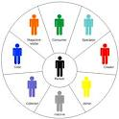
QMS Competence Building Process
Assessment & Identification
Defining and Enlisting of QMS Roles & JDs
Structuring Of Roles in a way that each role is unique and non-repetitive
Systematic Vertical and Horizontal Role Deployment
Establish Linkage to bring in competitive advantage
Document Job Descriptions & Desired Competence
QMS Competence Gap Identification
Desired Competence for Roles as defined in JDs
Define Competence Levels (Sample on Next slide)
Evaluate Existing Competence Levels
Gap Identification
QMS Competence Mapping
Mapping of competence in a visual manner
Utilization as Monitoring Tool
 |  |  |  |  |  |  |  |  |  |  |  |  |  |  |  |  |  |  |  |  |  |  |  |  |  |  |  |  |  |  |  |  |  |  |  |  |  |  |  |  |  |  |  |  |  |  |  |  |  |  |  |  |  |  |  |  |  |  |  |  |  | DOC NO. PV/CN/HRD/FM/021
 |  | SKILL MATRIX
 |  |  |  |  |  |  |  |  |  |  |  |  |  |  |  |  |  |  |  |  |  |  |  |  |  |  |  |  |  |  |  |  |  |  |  |  |  |  |  |  |  |  |  |  |  |  |  |  |  |  |  |  |  |  |  |  |  |  |  |  |  | REVISION NO. 02
 |  |  |  |  |  |  |  |  |  |  |  |  |  |  |  |  |  |  |  |  |  |  |  |  |  |  |  |  |  |  |  |  |  |  |  |  |  |  |  |  |  |  |  |  |  |  |  |  |  |  |  |  |  |  |  |  |  |  |  |  |  | REVISION DATE : 27/03/2009
 |  | DEPARTMENT
OPERATIONS |  | CRITERIA FOR SKILL EVALUATION
S.L NO. | EMPLOYEE NAME
1
 |  |  |  |  |  |  |  |  |  |  |  |  |  |  |  |  |  |  |  |  |  |  |  |  |  |  |  |  |  |  |  |  |  |  |  |  |  |  |  |  |  |  |  |  |  |  |  |  |  |  |  |  |  |  |  |  |  |  |  |  |  |  | Legend SL=SKILL LEVEL
2
 |  |  |  |  |  |  |  |  |  |  |  |  |  |  |  |  |  |  |  |  |  |  |  |  |  |  |  |  |  |  |  |  |  |  |  |  |  |  |  |  |  |  |  |  |  |  |  |  |  |  |  |  |  |  |  |  |  |  |  |  |  |  |  |  |  | Beginner
 |  |  |  |  |  |  |  |  |  |  |  |  |  |  |  |  |  |  |  |  |  |  |  |  |  |  |  |  |  |  |  |  |  |  |  |  |  |  |  |  |  |  |  |  |  |  |  |  |  |  |  |  |  |  |  |  |  |  |  |  |  |  |  |  | 0<SL<25%
3
 |  |  |  |  |  |  |  |  |  |  |  |  |  |  |  |  |  |  |  |  |  |  |  |  |  |  |  |  |  |  |  |  |  |  |  |  |  |  |  |  |  |  |  |  |  |  |  |  |  |  |  |  |  |  |  |  |  |  |  |  |  |  |  |  |  | Can perform under guidance
 |  |  |  |  |  |  |  |  |  |  |  |  |  |  |  |  |  |  |  |  |  |  |  |  |  |  |  |  |  |  |  |  |  |  |  |  |  |  |  |  |  |  |  |  |  |  |  |  |  |  |  |  |  |  |  |  |  |  |  |  |  |  |  |  | 25<SL<50%
4
 |  |  |  |  |  |  |  |  |  |  |  |  |  |  |  |  |  |  |  |  |  |  |  |  |  |  |  |  |  |  |  |  |  |  |  |  |  |  |  |  |  |  |  |  |  |  |  |  |  |  |  |  |  |  |  |  |  |  |  |  |  |  |  |  |  | Can perform Independently
 |  |  |  |  |  |  |  |  |  |  |  |  |  |  |  |  |  |  |  |  |  |  |  |  |  |  |  |  |  |  |  |  |  |  |  |  |  |  |  |  |  |  |  |  |  |  |  |  |  |  |  |  |  |  |  |  |  |  |  |  |  |  |  |  | 50<SL<75%
5
 |  |  |  |  |  |  |  |  |  |  |  |  |  |  |  |  |  |  |  |  |  |  |  |  |  |  |  |  |  |  |  |  |  |  |  |  |  |  |  |  |  |  |  |  |  |  |  |  |  |  |  |  |  |  |  |  |  |  |  |  |  |  |  |  |  | Can perform independently & can train others
 |  |  |  |  |  |  |  |  |  |  |  |  |  |  |  |  |  |  |  |  |  |  |  |  |  |  |  |  |  |  |  |  |  |  |  |  |  |  |  |  |  |  |  |  |  |  |  |  |  |  |  |  |  |  |  |  |  |  |  |  |  |  |  |  | 75<SL<=100%
6
 |  |  |  |  |  |  |  |  |  |  |  |  |  |  |  |  |  |  |  |  |  |  |  |  |  |  |  |  |  |  |  |  |  |  |  |  |  |  |  |  |  |  |  |  |  |  |  |  |  |  |  |  |  |  |  |  |  |  |  |  |  |  |  |  | SL = 100%
7
8

Slide 25
QMS Competence Building Process
Quality System Competencies
Competency model
Knowledge of Business Processes
Interpersonal Skills
Standards Knowledge (ISO 9K)
QMS Competence Model
Conceptual Skills
Planning & Organizing / Auditing Skills
Communication Skills

Slide 26
QMS Competence Building Process
QMS Competencies Scale
Continuous incremental scale from 1 to 4
1- Negative behavior, or no attitude/ knowledge of the required behaviors
2- Attitude/ understanding is present; however more skill needs to be developed
3- Comfortable exhibiting the behaviors; also attempts to align others in most cases
4- Seen as a guru/expert; initiates system wide changes to inculcate desired behaviors across levels
Competency | Rating 1: Needs Development (Does not meet requirements) | Rating 2: Learner (Meets partial requirements with stretch) | Rating 3: Strength (Meets requirements consistently) | Rating 4: Sets standards for excellence (Exceeds requirements )
Scale Definition | Shows negative behavior/ or encourages negative behaviors in others Is either not aware of what is required, or does not intend to implement/ exhibit those behaviors Has a closed mindset to learn about the competency requirements Needs development in knowledge, skill or attitude regarding respective behavior Only pretends to demonstrate the behavior due to organizational pressures Regular supervision or guidance needed. | Has the knowledge of what to do, however exhibits the behavior only in some cases (skill issue) Shows positive behavior when reminded, or in simple cases Needs to develop more consistent habit of showing the required behavior Wants to demonstrate (and/or knows the importance of the behavior) but needs more time/ exposure to be comfortable (especially under pressure situations) Supervision or guidance needed in complex cases Mostly exhibit self behavior for the respective competency | Besides possessing the required knowledge, demonstrates the behaviors on the job consistently (almost always) Reiterates the benefits of such behavior in cases of resistance/ work pressures (complex cases) Believe in the importance of the required behaviors; rewards No supervision or guidance necessary Demonstrates self behavior and attempts to align immediate team to the desired behaviors as well | Is accepted as a guru/ expert in this field Is spontaneous in exhibiting this behavior on a consistent note (always) Encourages and influences others to display the skill as well No supervision or guidance necessary Aligns organization systems to encourage desired behaviors across levels

Slide 27
QMS Competence Building Process
Planning & Organizing / Auditing Skills
Competency: | Rating 1: Needs Development (Does not meet requirements) | Rating 2: Learner (Meets partial requirements with stretch) | Rating 3: Strength (Meets requirements consistently) | Rating 4: Sets standards for excellence (Exceeds requirements )
Scale Definition | Ad hoc approach while planning for Auditing; prefers to take things as they come; does not prioritize even in simple scenarios. | Is able to plan and organize for routine/ simple matters; delegates in simple cases and looks for directions in more complex (and or new) cases; shows inclination to expedite only when pushed through organization requirements | Is able to create prioritizations; identifies resource requirements and evenly allocates resources for relatively known situations; anticipates problems and prepares for them proactively in most cases | Creates highly efficient and effective Audit; accurately define timelines; creates new possibilities of resources to meet plans; generates various scenarios, creates various planning options and chooses best
Illustrative behaviours observed | Is not able to identify the major activities Does not prioritize Gets on to the work without thinking Is not able to sequence activities; feels overwhelmed by information Unable to distribute load, as he cannot anticipate what might happen | Breaks Plan into known activities Identifies the major concern areas based on past experience only Finds it difficult to prioritize in case of new situations Audit Plans are sequential in nature Randomly reviews progress against audit plans Practices contingency approach in some cases only (or when told by superiors) | Breaks up Plan into activities (known and new) Prioritizes, plans workload Deploys resources and realistic time scales for conducting audit Plans include parallel processes as well (when required) Establishes checkpoints to monitor progress Is able to anticipate apparent patterns in simple cases Plans for review and update of contingency plans for abnormal situations | Never seems to fall short of resources - is able to juggle resources effectively In case of constraints, looks out to create new possibilities of resources Is very particular about details and achievement of Audit Objectives Does not accept even minor slippages Uses delegation effectively to manage people development as well

Slide 28
QMS Competence Building Process
Competence Building Planning
Develop Training Content
Course title and description
Course objectives
Description of the target audience
Duration of the course
Course prerequisites
Information about the faculty
Description of training material
Description of any items the participant should bring to the course
Create a consolidated Training Plan
List all the competencies
Identify Faculty for each competency (Internal / External)
Define Training Schedule vide each competency
Decide Timelines to achieve desired competencies
Identify and allocate resources
Training Details |  |  |  |  |  | Target AUDIENCE
Date | Day | Name of the Training program | Venue | Time | Faculty | Below DET | DET - Sr. Officer/ Sr. Engg | AM-Mgr
7-Jan-12 | Saturday | Measurement System Analysis | HR Training Room | 15.30 - 17.30 | Mayank Sangal
8-Jan-12 | Sunday
9-Jan-12 | Monday
10-Jan-12 | Tuesday | Projects Safety | HR Training Room | 11.00 - 14.00 | Zahid Ansari
11-Jan-12 | Wednesday | MS Excel | GURU Training Room | 15.00 - 18.00 | Vikas Bhat
12-Jan-12 | Thursday | Selective Emitter: Process | HR Training Room | 15.00 - 18.00 | Anupam Sharma
13-Jan-12 | Friday
14-Jan-12 | Saturday
15-Jan-12 | Sunday
16-Jan-12 | Monday | Effective Writing Skills | Satkar Training Room | 10.30 - 18.30 | Tilak Kapoor
17-Jan-12 | Tuesday
18-Jan-12 | Wednesday | Communicating in English | HR Training Room | 15.00 - 18.00 | Odile Soreng
19-Jan-12 | Thursday
20-Jan-12 | Friday | Motivation | HR Training Room | 11.00 - 14.00 | Jaipal Singh
21-Jan-12 | Saturday

Slide 29
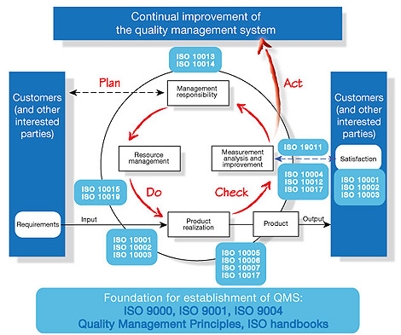
QMS Competence Building Process
QMS Training Features
Process Approach
Best Practices like 5S, TPM, Six Sigma, Lean Mnfg.
Critical / Special Processes
Customer Specific Requirements
Failure Mode Effect Analysis
Design of Experiment
Advanced Product Quality Planning
Statistical Process Control
Geometrical Dimensioning & Tolerencing
QC Tools

Slide 30
QMS Competence Building Process
Competence Building Execution and Evaluation
Comparison of Plan vs Actual vide Training Plan
Examination / Test / Feedbacks at defined Intervals
Plan vs Actual vide Competency Build-up
Stakeholder Feedback (Throughout Program)
Monitor Improvement in Matrices / Performance Measures

Slide 31
Competence Building & Trainings at Moser Baer
Training Procedure
Competence Building and Trainings at Moser Baer
Role description & Competence Identification
JD forms
Competency Mapping
Identification of Training needs
TNI forms
Business Needs
Consolidation of Training Requirements
Identification of Training resources
Internal
External
Execution of Training and its Monthly Monitoring
Training Feedback from participants
Tests
QA Sessions
Training Evaluation
Feedback from Managers
Training Effectiveness
Measurement Indicators
Trainings
Induction Trainings for new Entrants
Classroom Training for Employees
On Job Training for Associates
Classroom Trainings at Monthly Frequency
Emphasis on ISO Standard requirements and QMS Principles
Training methodology involves lot of Practical examples

Slide 32
Competence Building & Trainings at Moser Baer
Indicators
Role | Competence Requirements | Trainings | Perf. Indicators
Sr. Mgr and Above | Corporate Policies Awareness Ability to Lead Understanding about Business Scenario Interpersonal skills | Quality Policy Leadership Team Management Business Plan Contingency Plan | Achievement of Targets Employee Grievances Response During Exigencies Business Growth
AM – Sr. Mgr. | Ability to Lead Team Process Knowledge Awareness of QMS Customer Focused Legal & Statutory knowledge | Quality Policy Team Management Standard Requirements Customer Specific Req. Legal Requirements | Achievement of Targets Employee Grievances NCs During QMS Audits Customer Complaints NCs during Legal Audits
Engineers / Officers | RCA Ability Technical Know How Prevention of Failures Quality Planning NVA Removal | Quality Tools SPC FMEA APQP Lean Mnfg. SMED | CAPA Response Time In House Complaints Cycle Time Reduction in NVAs
Technicians | Work Station Knowledge Interpretation of WIs Safety Awareness | 5S Work Instructions Process MSDS Suggestion Scheme Quality Circles | Condition of Workstation Station Rejection Product Quality Emergency Response Imperative Suggestions

Slide 33
Competence Building & Trainings at Moser Baer
YB Certification
Competence Building and Trainings at Moser Baer : YB Certification
YB Certification
Well structured Yellow Belt training programs
100% Employee Coverage (Below Managers)
Emphasis on Basic Quality Tools
Special Focus on Practical Applications
Qualification Criteria Exam
Learning's Application
Advanced YB Certification
Emphasis on Advanced Quality Tools
Special Focus on Practical Applications
Two days’ Full Time Program
Effectiveness Measurement of Training

Slide 34
Competence Building & Trainings at Moser Baer
Green Belt
Green Belt
Six Sigma Approach
Project based Training
Dedicated Team of “Business Excellence”
Modules based Program including Transactional Projects
Savings Validated by Finance Team

Slide 35
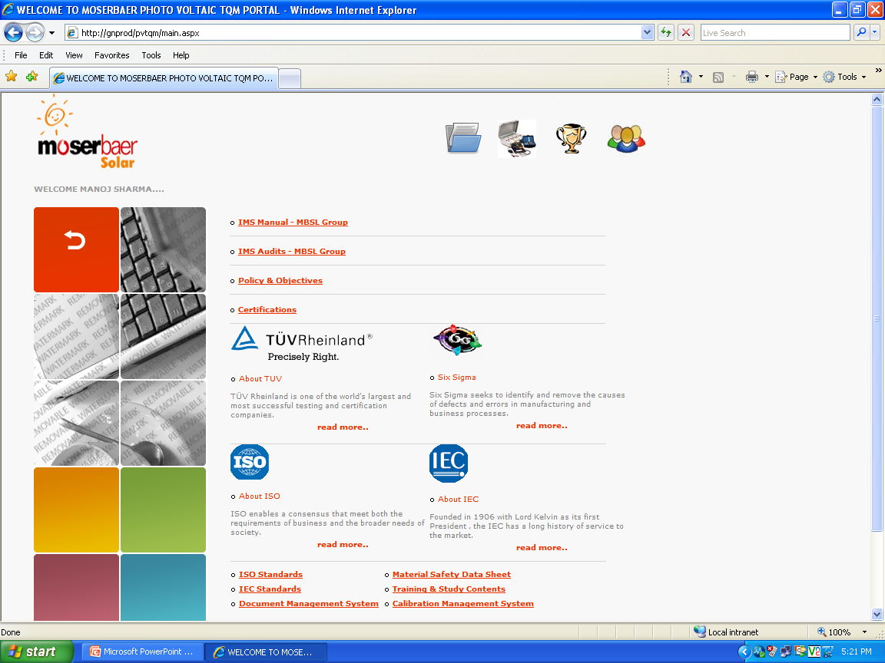
Competence Building & Trainings at Moser Baer
QMS Deployment
IT Services Deployment for QMS
Paperless Document Management System
Online Document Control through Intranet
Fully Secured Document accessibility for employees
Our Integrated Management Systems have been highly appreciated during External Due Diligence
Online Calibration Management System

Slide 36
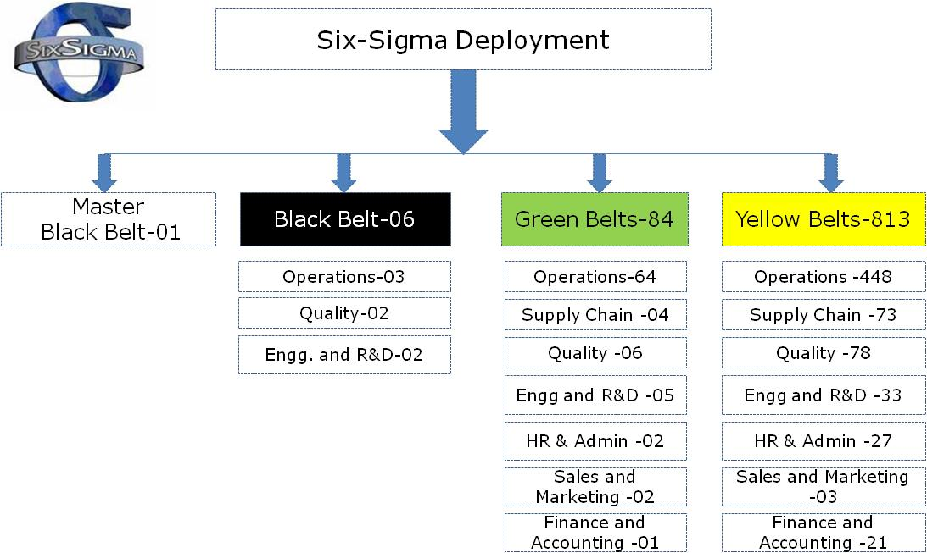
Six Sigma

Slide 37
Thank You

