Slide 1
RISK
Classification, Measurement & Mitigation
Archer Daniels Midland

Slide 2
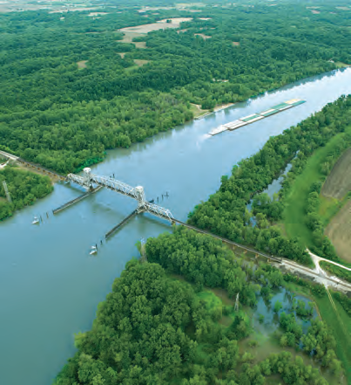
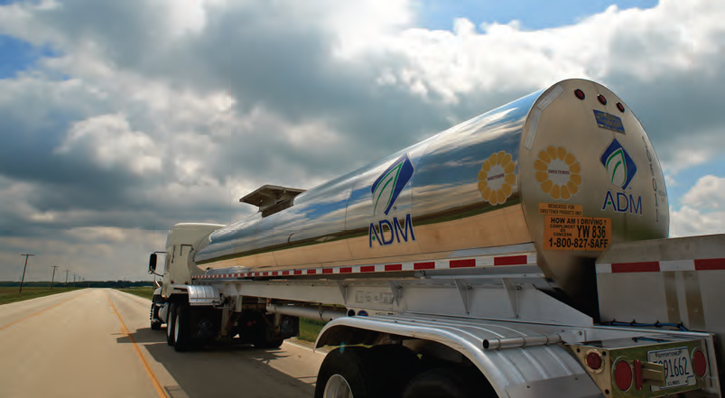
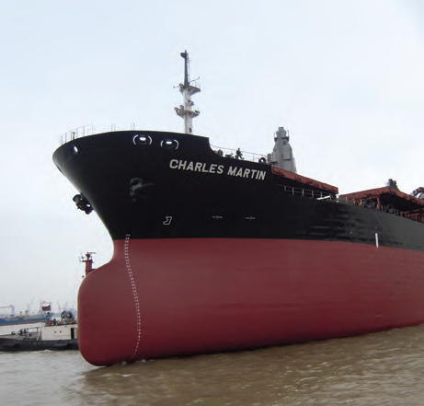
ADM Archer Daniels Midland Company
Founded in 1902
Headquartered in Decatur, Illinois, USA
ADM is one of the Largest Agricultural Processors in the world
World’s Largest Corn Processor
Each Day ADM Processes 66,000 MT of Corn
Fortune 28 Company (US)
Fortune 92 Company (Worldwide)
Fortune “Most Admired Food Production Company” (2009,2010, 2011)

Slide 3
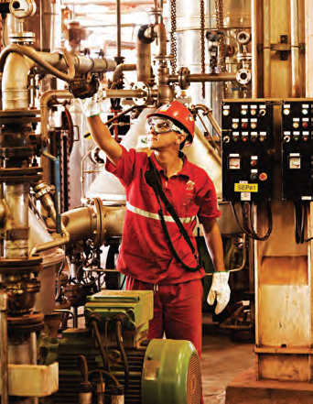
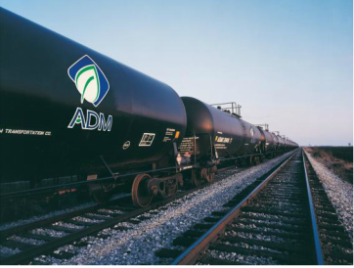
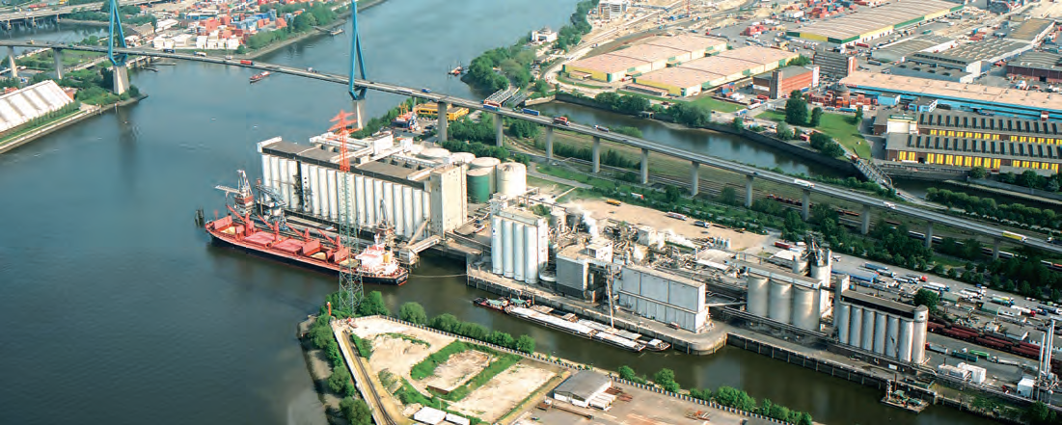
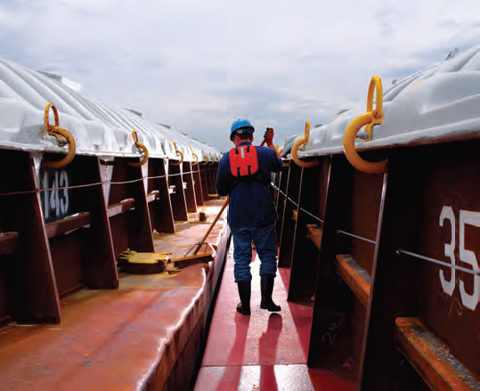
Premier Player in Global Agribusiness
Serving Vital needs throughout the world
Key Facts
FY’12 Segment Operating Profit
$2.9 Billion
FY 12 Net sales: | $89 Bn
Employees: | 30,000+
Facilities: | 685+
Net Fixed Assets | ~$10Bn
Market cap: (10/26/12) | ~$18 Bn
Corn Processing
Oilseeds Processing
Ag Services
Other

Slide 4
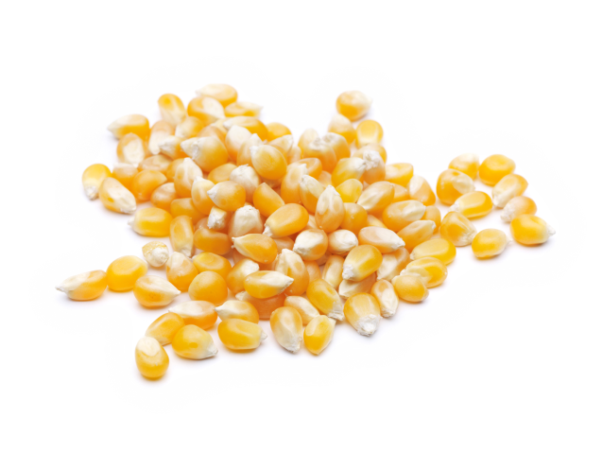
ADM Corn
Corn Syrup, High Fructose Corn Syrup
Dextrose (Liquid and Crystalline), Maltodextrin
Starch
Xanthan Gum, Citric Acid, Lactic Acid, Yeast
Sorbitol (Liquid and Crystalline)
Propylene Glycol, Ethylene Glycol
Isosorbide – Pilot Scale
Lysine, Threonine, Astaxanthin
Corn Oil
Fuel Alcohol
Gluten Feed
Food and Industrial Starches
Gluten Meal
Ethyl Lactate
Additional Products

Slide 5
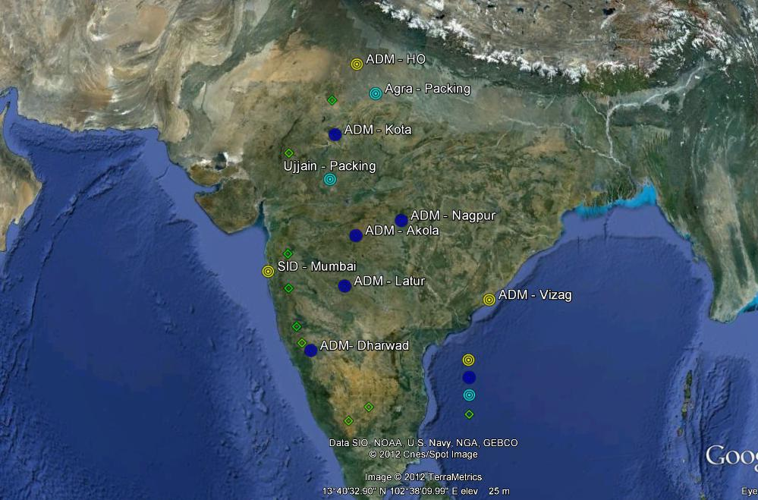
ADM India:
HQ & Offices/ Warehouse
Crush Plants
Mangalore - Packing
3rd Party Packaging - Branded
Branded Oil Depots & Sales Offices

Slide 6
RISKS - Classification
Price Position Risk
Currency Risk
Credit Risk
Counter Party Risk
Quality Risk
Production & Climate Risk
Regulatory Risk
Political & Country Risk
Fidelity Risk
Operational Risk
Financial Risk
Reputational Risk

Slide 7
RISKS - Measurement
Marked to Market
Value At Risk

Slide 8
Marked to Market
S. No | Commodity | Bought | Sold | Net Position | Avg Cost | CMP | Difference | M 2 M
 |  | A | B | (a-b) = C | x | y | (y-x)=z | (c ) x ( z )
1 | Corn
2 | Cocoa
3 | Coffee
4 | Cashew
5 | Rice
6 | Sesame
7 | Wheat
 | Total

Slide 9
Value At Risk
S No. | Risk | Current Exposure in $ | Percent Volatility | Value at Risk
1 | Price-Position-Sales
2 | Price-Position-Buying
3 | Currency Risk (Uncovered currency)
4 | Credit Risk
5 | Advance Risk to Seller
6 | Quality Risk (Sailed not Received)
7 | Crop Risk (Qualitative)
8 | Country Risk (Qualitative)
 | Total

Slide 10
RISKS - Mitigation
Price Position Risk – Position Limits & Sheet, Hedging
Currency Risk – Cover & Forward Cover
Credit Risk – Credit Assessment, Limits & Re-insurance
Counter Party Risk – PG Deposit, Payment Retention
Quality Risk – Staff Training, Storage, Transportation
Production & Climate Risk
Regulatory Risk – Dialogue & Anticipation
Political & Country Risk – Historical Assessment
Fidelity Risk – Re-insurance and Compliance Action
Operational Risk – Broad Def, Safety, Process Related
Financial Risk – Project, Interest Rate, Cost Comp etc.
Reputational Risk – Organizational, Response -> CEO.

Slide 11
RISKS – Global Consolidation
Crop -> Region -> Country
Country -> Region -> Crop -> ADM International
Risk Management Teams, Risk Officers, Risk Offices

Slide 12
Thank You

