Slide 1
Notes:
Another way of thinking about Cargill is as an international provider of food, agricultural and risk management products and services.
We are a very diverse company with more than 80 businesses. As the following slides will show, most of these are related to the agri-food system.
The customers we serve are in many different industries, including crop, livestock, food, health, pharmaceutical, industrial and financial.
And although we may not be a common household name, we help meet the needs of millions of people everyday — from food ingredients and prepared foods, to energy, financial services and agricultural inputs.
OPTION:
Speaker uses own example.
IMAGE DESCRIPTION:
Big sky and big farm country in Saskatchewan, Canada

Slide 2
Seasonality
Window of No new Arrivals
Supply

Slide 3
Qualitative Challenges in Sourcing
Weevil
Quality is not homogenous
In Bilty trade mixing of grains takes place
Bag Quality used is very poor
Fungus increases when stored at high/uneven moisture
Moisture losses and weevil infestation is common
Moisture
Low
Fungus
Main Quality threat, attracts maximum rejections- Due increased afla toxin levels
New Crop
Old Crop
Grain count attracts no premium in market, but higher grain count is less acceptable
Desired
Grain Count

Slide 4
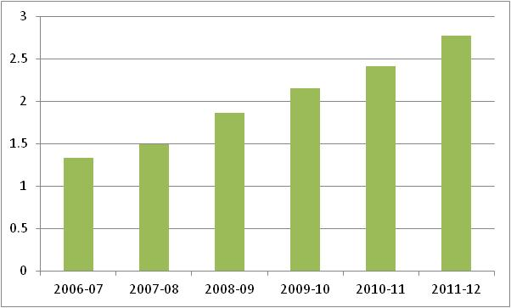
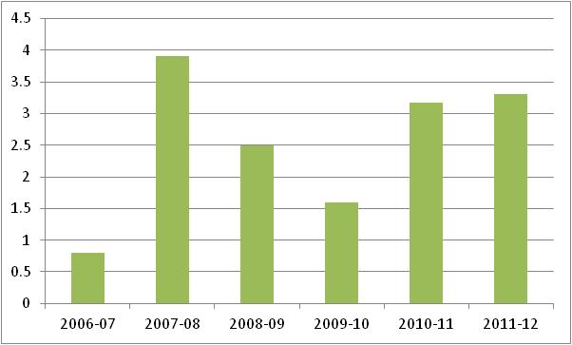
Industry Segments
Starch Industry
Layer egg production and per capita consumption
Exports

Slide 5
Challenges in Sourcing
Fragmented Supply Chain
Regional and Spatial Distortions
Increasing Commodity Prices due MSP
Quality Challenges- Small landholding and uneven storage
High interest rate regime
Differing quality requirement of different customers
Availability in various seasons make carry unattractive but any supply shock makes users vulnerable to price risk
Logistical challenges- Rail/Road
Easy substitutability-
Export linkage

