Slide 1


THE INDIA MAIZE SUMMIT
NEW DELHI
21ST MARCH 2013

Slide 2
FLOW OF PRESENTATION
MAIZE S&D – GLOBAL/INDIAN
RABI 2013 PRODUCTION ESTIMATES
INDIA MAIZE EXPORTS
DESTINATION MARKETS
MAIZE PX SERIES CHART
FUTURE CHALLENGES
ROLE OF INDIA IN INTERNATIONAL TRADE

Slide 3
MAIZE GLOBAL S&D
MARKET YEAR | 2009/10 | 2010/11 | 2011/12 | 2012/13
Production (MMT) | 820 | 830 | 877 | 883
Trade (MMT) | 86 | 93 | 97 | 99
Consumption (MMT) | 822 | 844 | 875 | 880
Carry over stocks (MMT) | 145 | 131 | 133 | 132
Source - IGC
CBOT prices which have tumbled in Nov and Dec have recovered some ground after Jan USDA report, which reported higher than expected feed usage
Better crop estimates for US and Argentina, global output revised upwards by 38 mmt, to 883 mmt.
Global end-season stocks expected to be down by 1m t y/y
World consumption is revised higher, but forecasts for overall declines in both feed and industrial use remain.

Slide 4
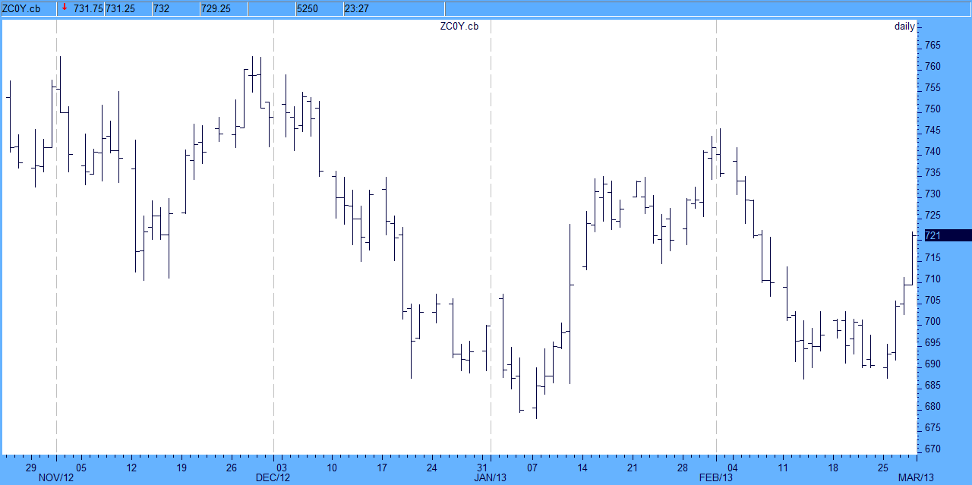
CBOT PRICE SERIES CHART
US Drought fears

Slide 5
MAIZE INDIA S&D
MARKET YEAR (OCT-SEPT.) | 2010 | 2011 | 2012
Beginning Stocks (MMT) | 0.453 | 0.576 | 0.756
Area Harvested (MHA) | 8.6 | 8.67 | 8.5
Production (MMT) | 21.73 | 21.57 | 20
Imports (MMT) | 0.019 | 0.01 | 0.01
Total Supply (MMT) | 22.202 | 22.156 | 20.766
Feed Domestic Consumption (MMT) | 9 | 9 | 9.5
FSI Consumption (MMT) | 9.1 | 8.6 | 8.5
Domestic Consumption (MMT) | 18.1 | 17.6 | 18
Exports (MMT) | 3.526 | 3.8 | 2.5
Total Demand (MMT) | 21.626 | 21.4 | 20.5
Ending Stocks (MMT) | 0.576 | 0.756 | 0.266

Slide 6
IMPACT OF MAIZE INDIA S&D
Drop in Kharif production from 16.2 to 14 .5 Mn YoY
Projected fall in exports due to Domestic S&D imbalance and relatively bearish to stable international markets.
Ending stocks precariously low unless Rabi goes beyond 6.2 Mn
Later part of the year can see upsurge in domestic prices.
Improved poultry demand within India will add on to the existing demand.
Alternate usages of corn increasing in starch/distillery/biofuel.

Slide 7
INDIA RABI PRODUCTION ESTIMATES FOR 2012-13
States | 2008-09 | 2009-10 | 2010-11 | 2011-12 | 2012-13E
Andhra Pradesh | 2.59 | 1.77 | 2.32 | 2.27 | 2.69
Bihar | 1.34 | 1.08 | 1.02 | 0.99 | 1.23
Gujarat | 0.14 | 0.14 | 0.13 | 0.23 | 0.20
Karnataka | 0.31 | 0.26 | 0.33 | 0.43 | 0.41
Maharashtra | 0.24 | 0.30 | 0.39 | 0.31 | 0.27
Tamil Nadu | 0.57 | 0.45 | 0.47 | 0.77 | 0.97
West Bengal | 0.09 | 0.13 | 0.08 | 0.28 | 0.16
All India | 5.61 | 4.43 | 5.09 | 5.35 | 5.93
Production (figures in '000 tons)
Major increase in production is expected in AP & Bihar …..

Slide 8
INDIAN MAIZE EXPORTS
On the export front, in the current marketing year (Oct12-Sep13), total maize exports reported around 1.87 million tons during the October- February month.
During Feb month, 0.552 million tons corn exports reported to Indonesia, UAE, Vietnam, Malaysia, Taiwan, China, Bahrain, Singapore, Philippines through JNPT Sea, Chennai Sea & Vizag Sea port.

Slide 9
DESTINATION MARKETS AND EXPORTS
COUNTRY | TY 2011/12 | OCT-12 TO FEB-13
Indonesia | 1.21 | 0.73
Vietnam | 1.30 | 0.28
Malaysia | 1.04 | 0.28
Taiwan | 0.34 | 0.15
Bangladesh | 0.29 | 0.04
Kenya | 0.02 | 0.02
Yemen | 0.06 | 0.02
Singapore | 0.05 | 0.01
Cameroon | 0.02 | 0.00
Others | 0.59 | 0.35
Grand Total | 4.91 | 1.87
Vietnam had Trogoderma issues coupled with afla problems .

Slide 10
MAJOR DESTINATION MARKETS

Slide 11
MAIZE PX SERIES CHART
1175
980
540
* PRICES FOLLOWING A LONG TERM BULLISH TREND SO DO THE MSP

Slide 12
FUTURE CHALLENGES
STAGNATING PRODUCTION
  GMO still not allowed
  Competing crops
  Global warming leading to inconsistent weather.
LACK OF QUALITY CONSISTENCY
  High on aflatoxin & mycotoxins
  Not deemed fit for human consumption in developed nations.
  Lack of mechanization for harvesting
LOGISTICAL ISSUES
  Higher wastages during transit
  Rail/road transport always a limiting factor for speedy movement
  Frequent Port Congestions
LACK OF QUALITY WAREHOUSING
  Inadequate and poor quality warehousing facilities.
  Long term storage always remains a concern.

Slide 13
THANK YOU

