Slide 1
Adaptation & Technology:
Key to Productivity Improvement
Pritiranjan Rath
DuPont Pioneer India
+91 8008566646
Notes:
http://www.ipcc.ch/publications_and_data/ar4/wg1/en/ch11s11-1-2.html
Self introduction
Topic of today – why is it important
Why should I talk to it

Slide 2
Breeders and agronomists have sustained crop production in the last century by developing improved crops and technologies
Notes:
Adapting to change is not new to farmers - or to those of us at Pioneer and in the ag industry who serve them.
Tell story on the chart
Early 1900’s farmers used open pollinated varieties.
Henry Wallace and others like him discovered that hybrids were heterotic – they performed better
Over time, new inventions came: different ways for hybrid production, mechanization, fertilizers, transgenic traits
In addition, the world was changing – population was growing, and the climate was changing.
At every step of the way, farmers had to adapt the way they did things to ensure maximum yields.

Slide 3
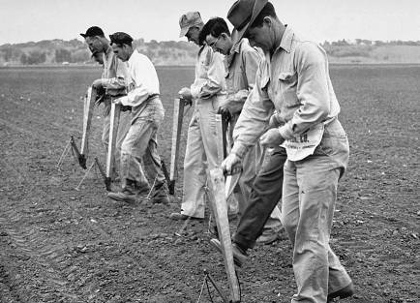

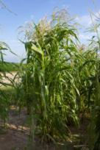
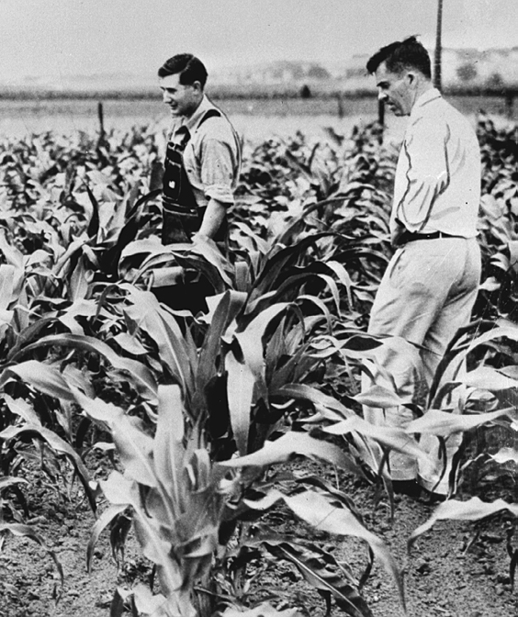

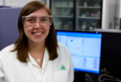
Integrated Approach
Farming System
Breeding Program
Germplasm
Notes:
But climate change results in more than just changes in temperature. Over time, we have seen that changing climate (top left photo) occurs at the same time as
Changes in the farming system: hand/animal planting to mechanization (picture from Plainview)
Breeding progress, technology markers changing
The advances are complicated and probably not necessarily anticipated, yet we, and farmers have adapted to them to continuously increase yields

Slide 4
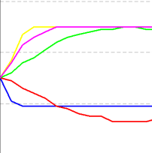
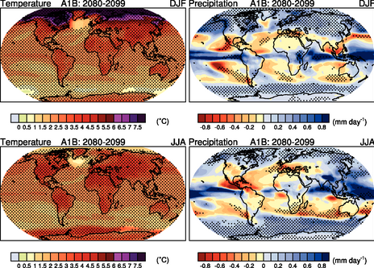
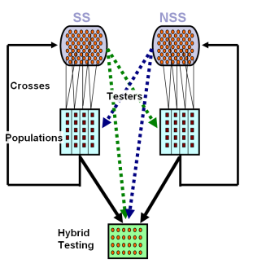
Improving adaptation to future climate change
Evolving landscape of breeding simulation
Breeding in 2050
+
Trait Value
Define
Climate Scenarios
Translate
Climate to Yield
Simulate
Breeding
+
Cycle of selection
New capabilities to deal with more complexity
Expect Genetics x Environment interaction may change in the future
Capability to learn and understand as we track
Assess
Changes in Adaptive Traits
And Performance
Notes:
I’d like to take a minute to talk about how at Pioneer we are looking at the future.
We have advanced modeling capabilities with our breeding simulation technology to to assess traits and germ for future climates.
These are built on evolution, theory and frameworks. Capability developed by Pioneer.
This slides shows some of the modeling concepts but what I really want to focus on is the unique capability and the fact that we combine information from a number of sources. We do have capability to predict plant performance to some extent.

Slide 5
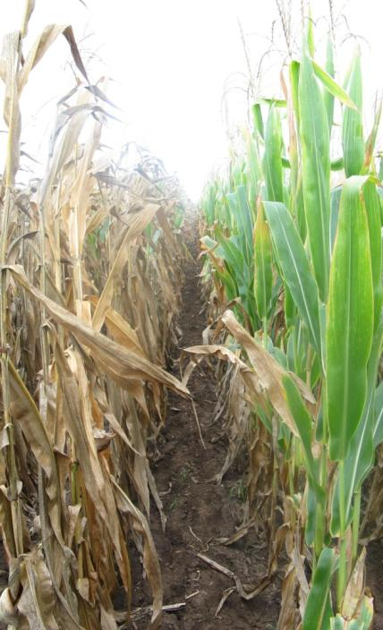

Integrated approach to drought tolerance
Pioneer is the leader in delivering performance in water-limited environments
Industry-leading
HYBRIDS
Superior germplasm
Breeding since 1950’s
35F44
Power of genetics
NATIVE TRAITS
Native tolerance + AYT™ system technology
Next generation TRANSGENIC TRAITS
Broad acreage applications
Integrated approach
Herculex® XTRA Insect Protection technology by Dow AgroSciences and Pioneer Hi-Bred. ® Herculex and the HX logo are registered trademarks of Dow AgroSciences LLC. Ignite®, LibertyLink ® and the Water Droplet Design are s trademarks of Bayer. ® Roundup Ready is a registered trademark used under license from Monsanto Company. Products will not be offered for sale or distribution until completion of field testing and approval by regulatory authorities. ©2011 PHII.
Notes:
Drought tolerance is one area where we have been using AYT with great success.
Pioneer is the leader in delivering performance advantages in water limited environments. We do this through an integrated approach. While we do this for all traits, I’ll just talk today about drought tolerance.
First, we have industry leading hybrids – developed through conventional breeding techniques. Our germplam collection was first established in the 1920’s by our founder Henry Wallace. In the 1950’s we opened the first drought breeding program in the industry in Nebraska.
This year, we launched AQUAmax hybrids in a limited area of the Western US, which is an arid region. These hybrids were developed through AYT and native traits.
In Europe, we are continually increasing our investment in the number of sites specifically targeting improvements in yield in water limited conditions, in 2011 we will have for example eight sites with controlled irrigation, and this represents a doubling of our efforts since 2009.
We are continuing work in both of these areas as well as in transgenic traits and have a number of transgenic leads in drought tolerance.
I’d also like to point out that we are combining our drought tolerance traits with advanced biotech traits to protect against a number of ag challenges. For example – we have hybrid 35F44, with improved drought tolerance, carrying insect resistance and herbicide tolerance. By improving these two factors, we can help improve performance in water stressed environments.
In this case it is clear to see that water, a very costly and finite resource and crop input would be considerably reduced by advances in breeding leading to greater drought tolerance of major crops such as maize.

Slide 6
Modeling for Climate Change
Modeling to determine optimum genotypes for future climate situations
Molecular markers allow for rapid shift of product line, Kernel Chipping, DH
Phenotyping - Precision Screening, IMPACT™ trials, EnClass® system

Slide 7
Thank you
Notes:
http://www.ipcc.ch/publications_and_data/ar4/wg1/en/ch11s11-1-2.html

