Slide 1
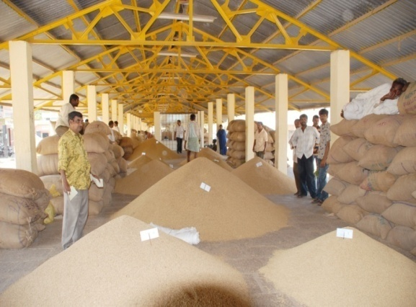
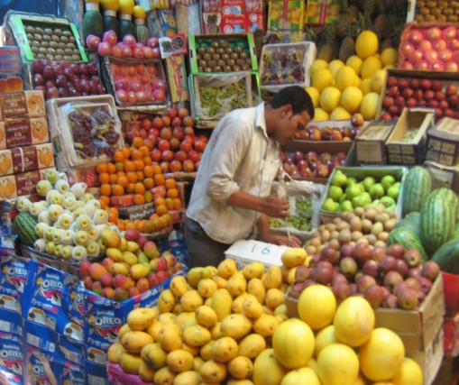
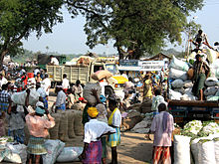
The India Maize Summit 2013
Agricultural Marketing Policy Roadmap
(22nd March, 2013)
Sanjay Sharan
Director (Marketing),DAC
Ministry of Agriculture
Government of India

Slide 2
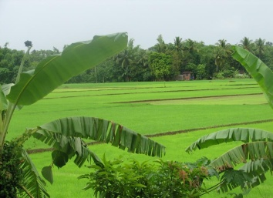
Indian Agriculture-An Overview
Agriculture is the backbone of Indian economy
  Contributes ~ 13.9% to the GDP (2011-12)
  Employs ~ 52% of the work force
  Contributes ~ 10.2% of exports (2008-09)
Annual production
  Foodgrains ~ 259.32 million tons (2011-12)
  Fruits ~ 75.30 million tons (2011-12)
  Vegetables ~ 150.60 million tons (2011-12)
Largest producer of milk, livestock, sugar, tea and cauliflower
Second largest producer of rice, wheat, fruit, vegetables and tobacco
Maize production,6th in global rank,2.4% of World production, used for food, feed and fuel.
Despite of immense potential in the sector, India’s share in international agribusiness is negligible due to:
  Inefficient/insufficient Agricultural Infrastructure
  Lack of value added quality products (Food Processing)
  Lack of integration of food value chain

Slide 3
Overall XII Plan Objectives for the Agriculture Sector
To ensure inclusive and sustainable growth rate in excess of 4% per annum

Slide 4
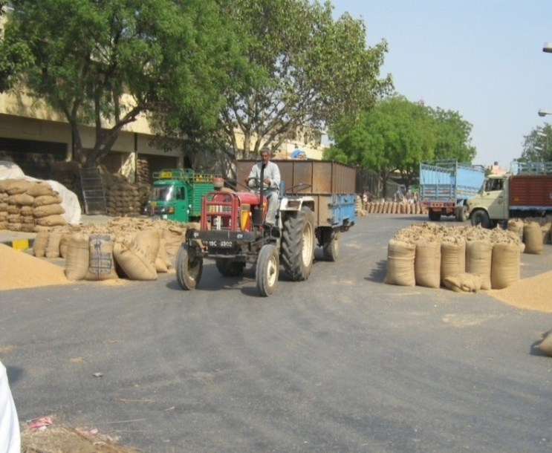
Agricultural Markets in India
No of Regulated Markets - 7190
No of Principal Market Yards:- 2456
No of Sub Market Yards :- 4734
No of Rural Primary Markets -- 22,505
No of Wholesale Markets : 6,489 -
Availability of Markets | Area Served
Average area Served by a Market | 115 sq. km
Av. Area Served by a Regulated market | 454 sq. km
Area served per Regulated Market | varies from 103 sq km in Punjab to 11,215 sq km in Meghalaya
Recommendations by National Farmers Commission - Availability of Markets within 5 km radius | (approx. 80 sq km) (2004)

Slide 5
Agricultural Marketing Scenario
Strength
Large Consumer Base
Rise in household income- enhanced demand for high value foods and FMCG products
Wide network of Regulated markets -7,190 and RPMs -22,505
No alternative and competitive choices to Farmers resulting into monopolistic approach by APMCs
Fragmented Supply Chains and High marketing Cost
Lack of adequate Scientific Storage facilities near to Farm
Low price realization by farmers
Multiple intermediaries- 5-6 numbers in supply chain
Density of markets vary (Punjab- 103 sq km , Meghalaya-11215 Sq km.)
High Post-harvest wastages and Transportation cost
Weakness
Diversified agriculture commodity base

Slide 6
STATE WISE INVESTMENT IN AGRICULTURAL MARKETING & PROCESSING
Modification of APMC act remains priority in XII Plan
Modernization of infrastructure-adequate provision for communications and transportation

Slide 7
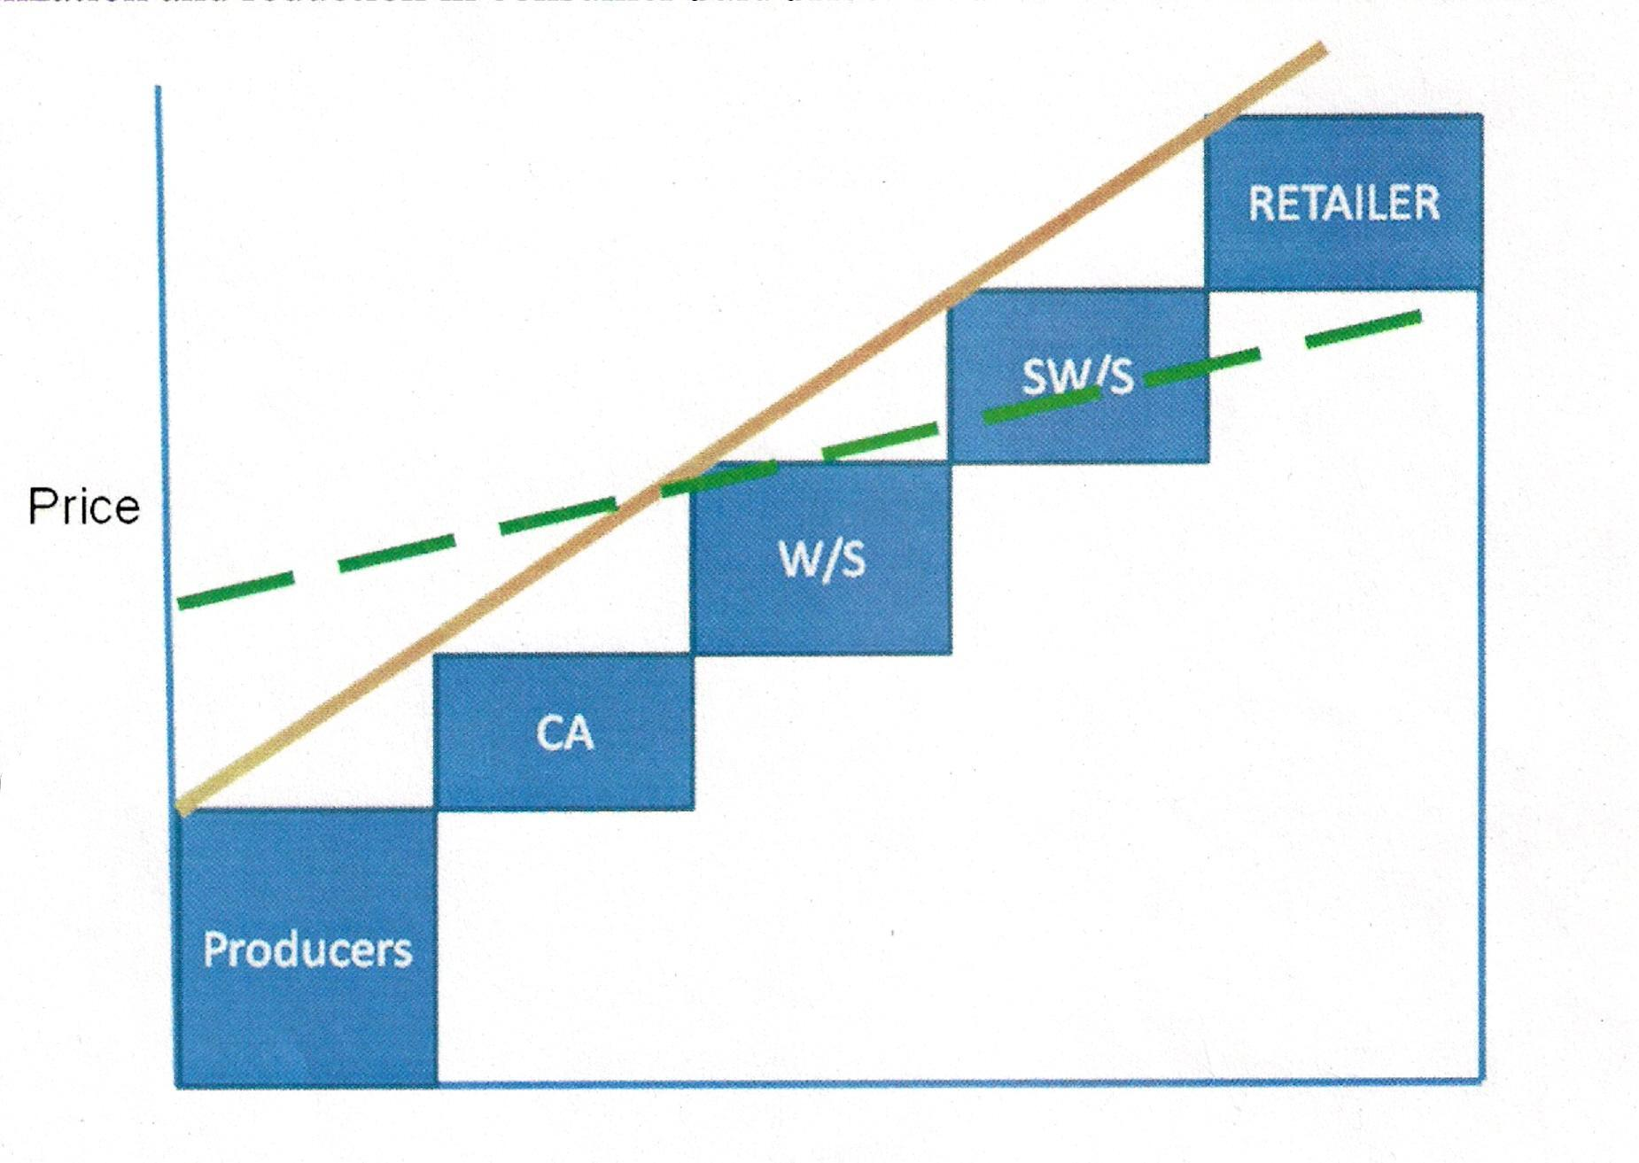
Improved Marketing Enhances Price Realization
Cost Built up for one Kg of average basket of Fruit
(Rs. Per Kg)
11.5
2.5
1.7
4.1
3.3
Source- Modernization of Market Infrastructure for Agri. Produce by Shri Karnail Singh

Slide 8
Market Infrastructure in Wholesale Markets
Source:- World Bank Report,2003

Slide 9
Modern Terminal Market (MTM)
Retail Consumer
The CONCEPT
“To create a professionally managed alternative market system to bridge the gaps existing in the supply chain of perishable produce”
Wholesalers & Institutional Buyers
Processor/ Exporters
Govt. Support
Operation by Private Player
Hub
Basic Features of Spoke
Strategic Location
Strong backward linkage
Presence of basic infrastructure and services
Spoke
Spoke
Spoke
Farmers/ Farmer Associations

Slide 10
Conflict of Interest in Agricultural Marketing
Farmers – Maximum Price and higher production.
Manufacturers – Low Purchase Price, High and specific Quality.
Traders and Retailers – Low Purchase price, High Margin.
Consumers – Good Quality with freshness.
Calls for - Efficient Market Information and sound Market-led Extension to enhance farm income and quality produce to consumers at reasonable price.

Slide 11
Need for reform in Agricultural Marketing
Necessary to :
Provide Multiple and competitive choices to the farmers.
Attract Large Scale investments for building Post-Harvest infrastructure.
Empower farmers with market information.

Slide 12
Vital Areas of Reforms as per Model APMC Act 2003
Establishment of private market yards / private markets managed by a person other than a Market Committee;
Establishment of private yards and direct purchase of agricultural produce from agriculturist by a person other than a Market Committee (Direct purchasing from producer).
Establishment of consumer / farmers market by a person other than Market Committee (Direct Sale by the producer to the consumers).
Provision of Contract Farming.
Single registration / license for trade transaction in more than one market.
To promote and encourage e-trading.
Single point levy of market fee.

Slide 13
Status of Reforms in Identified Major areas
Sl. No. | Vital areas of reforms | Name of Reformed States Providing the Provision in their APMC Act | Name of Reformed States not Providing the Provision in their APMC Act
1. | Establishment of private market yards / private markets managed by a person other than a Market Committee | Andhra Pradesh, Arunachal Pradesh, Assam, Goa, Gujarat, Himachal Pradesh, Jharkhand, Karnataka, Maharashtra, Mizoram, Nagaland, Orissa, Rajasthan, Sikkim, Tripura and Uttarakhand . | .-
2. | Establishment of private yards and direct purchase of agricultural produce from agriculturist by a person other than a Market Committee (Direct purchasing from producer). | Andhra Pradesh, Arunachal Pradesh, Assam, Goa, Gujarat, Himachal Pradesh, Jharkhand, Karnataka, Maharashtra, Mizoram, Nagaland, Rajasthan, Sikkim, Tripura and Uttarakhand . | Odisha
3. | Establishment of consumer / farmers market by a person other than Market Committee (Direct Sale by the producer to the consumers). | Andhra Pradesh, Arunachal Pradesh, Assam, Goa, Gujarat, Himachal Pradesh, Jharkhand, Karnataka, Maharashtra, Mizoram, Nagaland, Orissa, Rajasthan, Sikkim, Tripura and Uttarakhand | -
4 | Provision of Contract Farming | Andhra Pradesh, Arunachal Pradesh, Assam, Goa, Gujarat, Himachal Pradesh, Jharkhand, Karnataka, Maharashtra, Mizoram, Nagaland, Orissa, Rajasthan, Sikkim, Tripura and Uttarakhand .

Slide 14
Status of Major areas of Reforms
Sl. No. | Vital areas of reforms | Name of States providing the Provision in their APMC Act | Name of States not providing the Provision in their APMC Act
4. | Provision of Contract Farming | Andhra Pradesh, Arunachal Pradesh, Assam, Goa, Gujarat, Himachal Pradesh, Jharkhand, Karnataka, Maharashtra, Mizoram, Nagaland, Ordisha, Rajasthan, Sikkim, Tripura and Uttarakhand . | -
5. | Single registration / license for trade transaction in more than one market. | Assam, Goa, Himachal Pradesh, Jharkhand, Karnataka, Maharashtra, Mizoram, Nagaland, Rajasthan, Sikkim. | Arunachal Pradesh, Gujarat, Uttarakhand, Odisha, Karnataka and Tripura.
6. | To promote and encourage e-trading | Goa, Gujarat, Himachal Pradesh, Jharkhand, Karnataka, Maharashtra, Mizoram, Nagaland, Odisha, Rajasthan, Sikkim, Tripura and Uttarakhand | Andhra Pradesh, Assam and Arunachal Pradesh.
7. | Single point levy of market fee | Andhra Pradesh, Arunachal Pradesh Goa, Himachal Pradesh, Jharkhand, Karnataka, Mizoram, Nagaland, Rajasthan, Sikkim, Tripura and Uttarakhand | Assam, Maharashtra, Gujarat and Odisha.

Slide 15
Reform Initiatives by State Governments
License for Spot Exchange
  Gujarat, Maharashtra, Karnataka, Odisha, Rajasthan, M.P., U.P.
Common License for Direct procurement from farmers
  Gujarat, M.P, U.P., Maharashtra and Karnataka
License to Private Markets
  Maharashtra, Karnataka, Gujarat, Bihar, Odisha, Andhra Pradesh and Tamil Nadu
License for Direct marketing
  Andhra Pradesh, Gujarat, Haryana, Himachal Pradesh, Karnataka, Maharashtra, Madhya Pradesh, Odisha, Punjab, Rajasthan, Tamil Nadu, Uttar Pradesh.

Slide 16
Road Ahead
Expedite the process of amendment of APMC Act/Rules on the lines of Model Act/Rules
Bring independent regulator for market operation- demarcate the functions of Director of Marketing and M.D. of Mandi Board
De-link the compulsory requirement of shops for registration of market functionaries
Waive market fee on perishable horticultural produce to facilitate private investment in development of marketing infrastructure
Rationalize market fee and market charges
District level authority for registration of contract farming in place of APMC may be nominated
Ensure reporting of market data at AGMARKNET portal
Organize farmers in to Groups to aggregate surplus akin to FPO’s
Promoting self-help groups, FPOs, Cooperatives etc.
Facilitation of Inter-state trade and commerce of agriculture produce.

Slide 17
Committee of State Ministers In-charge Agricultural Marketing
Constituted on 2nd March, 2010 to :
persuade State/UT Governments to implement the Reform in agricultural Marketing through adoption of Model APMC Act/Rules;
suggest further reforms necessary to provide barrier free market;
suggest measures to effectively disseminate market information;
promote Grading, Standardization, packaging and quality certification of agricultural produce; and
policy advise, bringing consensus to encourage reforms.
First Report of the Committee submitted to Government on 8th September, 2011 and the final report is expected shortly.

Slide 18
Major Recommendations of the Committee
All states to expedite market reforms
In order to enhance private sector investment in market and marketing infrastructure, there is need to incentivize such investment
There should be single point levy of market fee
There should be independent regulator for regulation and operation of marketing
District level authority may be setup for dispute settlement under contract farming

Slide 19
Scheme of Development/Strengthening of Agricultural Marketing Infrastructure, Grading and Standardization
It is reform linked scheme implemented w.e.f. 20/10/2004 and implemented in those States/UTs which amend their APMC Acts, wherever required, to allow Direct Marketing, Contract Farming and permit setting up of Markets in private and cooperative sectors.
Assistance for State agency projects under the scheme is also linked with waiver of market fee on fruits and vegetables . However, States can levy user charges .
28 states and UTs are eligible to get assistance under the scheme to develop Market Infrastructure including the Value Chain project.
Agricultural Value chain projects are being considered for eligibility under the scheme.
Since Inception of the scheme up to 31-12-2012, a total number of 8087 marketing Infrastructure projects have been sanctioned and subsidy of Rs 782.14 crores has been released.

Slide 20
Illustrative List of Eligible Projects under AMIGS scheme
Market user common facilities like market yards, platforms for loading, assembling and auctioning of produce, weighing and mechanical handling equipments, etc.
Functional Infrastructure for assembling, grading, standardisation and quality certification, labeling, packaging, value addition facilities(without changing the product form).
Infrastructure for E-trading, market extension and market oriented production planning,
Mobile Infrastructure for post harvest operations viz grading, packaging, quality testing etc,(excluding transport equipments)
Reefer vans, or any other refrigerated vans used for transportation of agricultural produce, which are essential for maintaining cold supply chains.

Slide 21
Rural Godown Scheme(GBY)
The Scheme was launched w.e.f 01.04.2001 with the main objectives of creation of scientific storage structure for agriculture commodities in rural areas to meet various requirements of farmers for storing farm produce, processed farm produce, agricultural inputs, etc., so as also to prevent distress sale. Under the scheme subsidy @ 25% is being given to all categories of farmers, Agriculture Graduates, Co-operatives & CWCs/ SWCs. All other categories of individuals, companies and corporations are eligible for subsidy @ 15% of the project cost. Enhanced subsidy is 33.33% in case of NE States/hilly areas, SC/ST entrepreneurs & their Co-operatives and Women Farmers. The scheme has been recently revised by enhancing the maximum capacity to 30,000 MT with maximum ceiling on subsidy of Rs. 3 crores for areas other than North Eastern States and by enhancing the maximum capacity to 25,000 MT with maximum ceiling on subsidy of Rs. 3.333 crores in respect of North Eastern/Hilly States. The scheme is demand-driven, back-ended and not location specific.
As on February-2013, 30,929 Godown projects have been sanctioned with capacity of 39.11million tonnes under the scheme. An amount of Rs.1065.30crores of subsidy has been released to various banks and Cooperatives through NABARD and NCDC.

Slide 22
Investment on Infrastructure Proposed in XII Plan for creation of Market Infrastructure
Total Investment requirement = Rs. 64,312 Crores
Besides Food Processing Sector = Rs. 43,000 Crores
Rs. 12,000 Crores can flow from RIDF
Rs. 5,000 Crores from APMCs & SAMBs
Rs. 30,625* Crores from Private Sector
* Need for proactive Government Policy to attract Private Sector Investment

Slide 23
Value Chain Concept
The concept of “agricultural value chain” (Ag VC) covers the full range of activities and participants involved in moving agricultural products from farm gate to the consumer’s table (Farm to Fork).
VC is often defined as sequence of value adding activities, from production till consumption, through processing and commercialization.
The Value chain concept of developmental approach through private sector investment is gaining momentum across the world.
In Maharasthra and Bihar four value chain projects assisted by ADB is now in implementation stage.

Slide 24

THANKS

