Slide 1
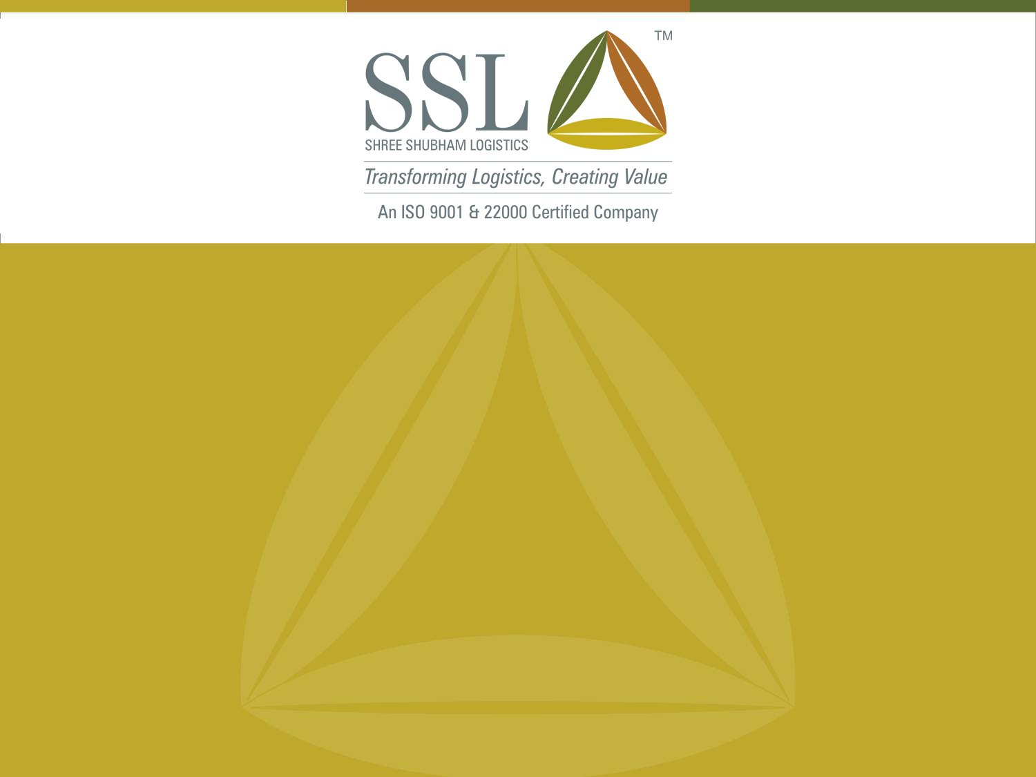
Post Harvest Management
The India Maize Summit 2013

Slide 2

Post Harvest Management
Post- Harvest Management (PHM) can be defined as methods and techniques applied to increase the life and retain produce. Post-harvest grain loss is the loss of grains (quality and/or quantity) between the moments of harvest and consumption.
Close to30% of the crop is lost due to inefficient post harvest management
Losses in Maize can be of two types:
Quantity Loss | Quality Loss
· Improper time of harvesting | · Change in colour, smell or taste
· Inconsistent Harvest technology (Thrashing & shelling) | · Contamination with toxins
· Improper drying methods | · Pathogen
· Spillage during storage | · Insect excreta
· Damage caused by pest organism (Aflatoxin) | · Reduction in nutritional value
· Poor handling
· Damage caused due to rodents
The losses above can be summarized by two main causes:
  Shelling and Drying Techniques (Moisture content)
  Storage and Handling

Slide 3
Post Harvest Management - Drying
Low moisture content and low storage temperatures reduce the opportunity for deterioration and microbial growth
At harvesting, the shelled kernels contain too much moisture for safe storage (18 – 24%), and must be dried to safe moisture levels of about 12 % to store maize effectively for a longer duration
Lack of access to technologies and use of indigenous / improper drying methods can however induce the formation of stress cracks, puffiness and discoloration or leave higher moisture content than desired
Drying also leads to weight reduction which can create conflict of interest for the seller (farmer / trader)
Lower the moisture content, less the damage

Slide 4
Post Harvest Management – Storage
The efficient conservation of maize depends basically on
  the ecological conditions of storage (relative humidity, temperature, etc.)
  the physical, chemical and biological characteristics of the grain
  the storage period
  the type and functional characteristics of the storage facility
A good storage structure should:
  Provide protection from common storage loss agents such as insect pests, rodents, moulds, birds and man.
  Maintain an even, cool and dry storage environment. The maize should be placed on pellets above the floor to avoid cold conditions that may lead to moulds.
  Should not allow re-wetting of grain by either moisture migration or rain.
  Offer reasonable protection from thieves, natures vagaries or any other factor of physical damage
  Allow aeration as it helps in keeping down the relative humidity of interstitial gases
  Proper sanitization and fumigation to prevent growth of pathogens
Storage efficiency depends on Biotic (living agents) and Non-Biotic factors

Slide 5
SSLL Services

Slide 6
SSLL – Bridging the Gap
One stop shop providing comprehensive range of Agri-logistics Services.
Storage & Preservation with Weighing Facilities
Collateral Management for Commodity Funding
Commodity Procurement
Domestic & International Trading
Testing and Certification & Fumigation and Pest Management
Primary Processing
End to End Agri-Logistics Solution

Slide 7
Storage & Preservation
Key Features
Walls and Ceilings made of Polynum helps regulating the inside temperature of the warehouse (8-12°C less than outside temperature)
Turbo ventilators on the ceiling controls the air flow
Rodent & bird repellents and gate curtains prevents rodent & bird entry in warehouses
Plinth of 4 to 6 feet
Electronic Weigh Bridges of 60 / 100 Metric Tonnes each.
Dry & Cold Storage facilities.
Testing and Certification Labs.
Primary Processing Units and a host of other services.
Supporting Infrastructure: Rural banks, Auction yard, One Way Traffic Movement, Pre Engineered Building, etc.
24 hours power back up, fire hydrant system.
Round the clock security and complete insurance cover on all assets
Tie ups with various banks, trade associations and exchanges like NCDEX and WDRA
Widely accepted Negotiable Warehouse Receipt to enable funding easily
A combination of 66 units including 17 ALPs & 49 Warehouses across 3 states encompassing 8.06 lakhs MT and floor plate area of around 4.90 Million Sq.ft.
SSLL's storage and preservation operations are governed by Standard Operating Procedures (SOPs) followed across all our warehouses in the country & developed by a team of experts. All our ALPs and RSWC Warehouses are live on SAP.

Slide 8
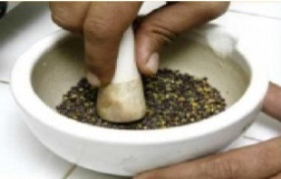
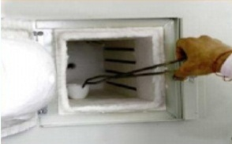
Testing & Certification
Right assessment of the quality of agri-commodities is a major challenge in rural distribution network. SSLL has formed the Analysis and Certification Laboratory (ACL) to tackle this challenge and benefit the agri-sellers, buyers and the financial intermediaries.
24 fully operational labs More than 25,000 samples tested.
An ISO 9001 & 22000 Certified Company.
ACL has designed standard operating procedures for the testing and certification services.
Processes are carried out by trained professionals at each location.
ACL has labs at 10 ALPs & 14 RSWC locations have SAP - web based online data capturing system for real time data.
World class Central Lab established at Jodhpur Basni Mandi.
Commodities tested such as Guar seed, Guar Split, Cotton Seed Oil Cake, Sesame Seed, Wheat, Barley, Castor Seeds, Cumin seed, Mustard, Coriander, Guar Gum and many other commodities.
Facilities available for testing of soil, water, minerals, etc.
Key Features
Inspection and Sampling Services. | Collateral Management Services.
Stock Monitoring Services. | Trade Solution Services.
Testing and Grading Services. | Pre-Shipment and Shipment Services.
Pest Management and Fumigation Services.
Testing fees are charged based on lot size to be certified.

Slide 9
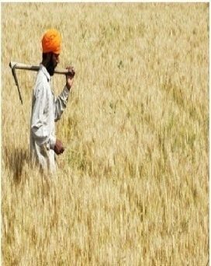
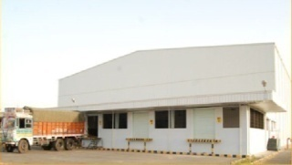

Collateral Management for Warehouse Receipt Financing
SSLL through its tie-ups with various banks assists the farming and trading community in sourcing funding against their stock stored at the ALPs & 3rd party warehouses managed by SSLL.
SSLL offers Collateral Management services which primarily include :
Keeping Commodities under the custody and management of SSLL.
Daily monitoring of the commodities.
Fortnightly inspection and verification of the stock.
Stock worth Rs. 2600 crs under custody, Over Rs. 1000 crs disbursed as loans with the help of SSLL.
Farmer
Tie up with Banks
SSLL
Bank
Seeks
funding
Provides Warehouse
Receipts (WHR) & Negotiable Warehouse Receipts (NWHR) accredited by WDRA
Bank Provides funding to farmer backed by WHR
SSLL has tied up with the following banks to facilitate collateral funding, : Union Bank, ICICI Bank, State Bank of India, Axis Bank, Development Credit Bank, Induslnd Bank, IDBI, HDFC Bank, Yes Bank, OBC & PNB.
It has also approached the Warehouse Regulatory and Development Authority (WRDA) for accreditation to issue negotiable warehouse receipts at 10 locations and has received the same for 3 locations (others are in process).
Collateral Management Income is a pre determined percentage of the value of the loan amount to be disbursed.

Slide 10

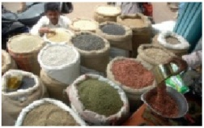



Commodity Procurement
SSLL has started to provide Commodity Procurement services from FY 12 for large to medium corporates.
SSLL acts as buying agents to procure agri commodities on their behalf based on quality specifications required by the client.
Experienced team which ensures that the right product is bought from the right place at the right time and right price.
Auction Platform
Procurement services
Delivery
Trader
Corporates
Weighing
Testing
Storage & Preservation
Collateral Funding
Farmer
For procurement purposes, SSLL focuses on commodities such as Cumin, Mustard, Wheat, Soyabean Chana Pulses, Cotton Seed Oil Cake, Coriander, and many other commodities.
Target Locations : States of Rajasthan, Gujarat, MP and Maharashtra.
Procurement fees is a pre determined % of the value of the goods to be procured.

Slide 11
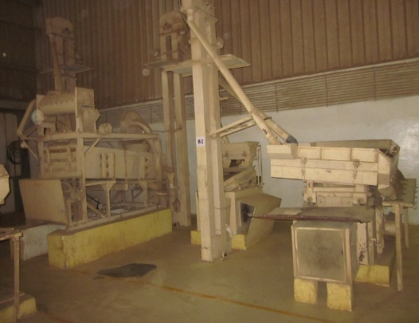
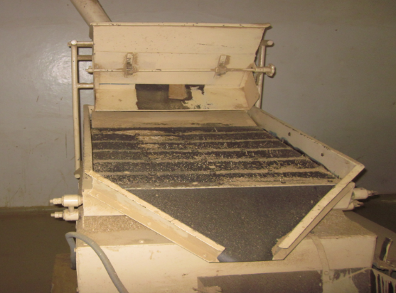
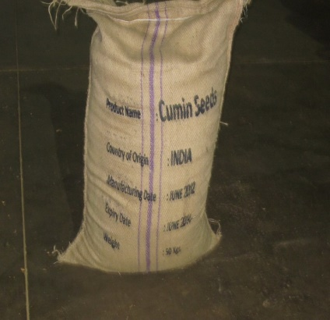
Primary Processing
SSLL also provides primary processing facilities for various products to prepare these products for domestic or export markets
Primary processing adds a lot of value to existing products by cleaning, grading, sorting and testing
SSLL has state of the art processing plants which are ISO 22000 certified and particularly specializes in processing cumin seed, almonds and peanuts
Each of these plants are well equipped and structured, conforming with international quality standards and running at maximum capacity and efficiency
SSLL can provide any type of packaging (gunny bag, paper bag, PP bag, box pack, etc.) in any specified weight and size
Processing plants which are well equipped and structured to conform with international standards.

Slide 12




Domestic & International Trading (DIT)
SSLL is involved in the Trading (Domestic and International) of various types of bulk agri-commodities.
Experience coupled with In-depth knowledge of Indian commodity market provides an edge in trading activities.
International Market
Auction Platform
SSL’s buys
commodities
Sold to
Trader
Primary Processing
Domestic Market
Farmer
Primary Processing & Trading sales amount will be recorded as revenue.

Slide 13
Our Tie-Ups

Slide 14
Tie-Up with RSWC
First of its kind State and Private sector partnership in Agri-logistics sector.
Under the Public Private Partnership model, SSLL has signed an MOU with the Rajasthan State Warehousing Corporation for management & operations of its warehouses at 38 Locations in the state of Rajasthan.
Managing operations of RSWC's warehouses at 38 locations with a storage capacity of 4.30 Lakhs MT.
SSLL has upgraded the warehouses, with electronic weigh bridges of 60 MT each, testing & certification laboratories, computerization & various other infrastructure facilities resulting in better storage for an efficient warehousing system.
All 38 warehouses are computerized and connected to RSWC head office through SAP at RSWC warehouses.
15 RSWC Locations are accredited by NCDEX/NSPOT as delivery centers for various commodities traded on the electronic trading platform.
All 90 warehouse have been approved by PSU’s and Private Sector Banks to provide the Warehouse receipt financing.

Slide 15


Tie-Up with NCDEX & NSPOT
SSLL has been approved as an assayer and a warehouse service provider to market participants of NCDEX & NSPOT for storage of goods as well as delivery of goods from SSLL and other NCDEX & NSPOT accredited warehouses/delivery centers.
15 ALPs and 16 RSWC warehouses are accredited by National Commodity & Derivatives Exchange (NCDEX) and NCDEX Spot Exchange (NSPOT) as delivery centers.
A platform to give the farmers the benefits of electronic trading.
National Commodity & Derivatives Exchange Limited (NCDEX) is a professionally managed on-line multi commodity exchange offering contracts in 59 commodities.
With a market share of ~ 11% in Indian Commodity Futures Exchange Industry, NCDEX has an annual trading volume of ~INR 14 lacs cr. Approximately 80% of the volume is generated from agri commodities.
NCDEX Spot Exchange Ltd. (NSPOT) is a professionally managed leading online commodity spot exchange.
NCDEX Spot Exchange has an annual trading volume of INR 31,922 lacs.
The users of the commodities have simultaneous access to the exchange on the buy side and procure at the best possible price for 47 new commodities introduced in FY11.
Source: NCDEX, NCDEX Spot Annual Report FY11.

Slide 16
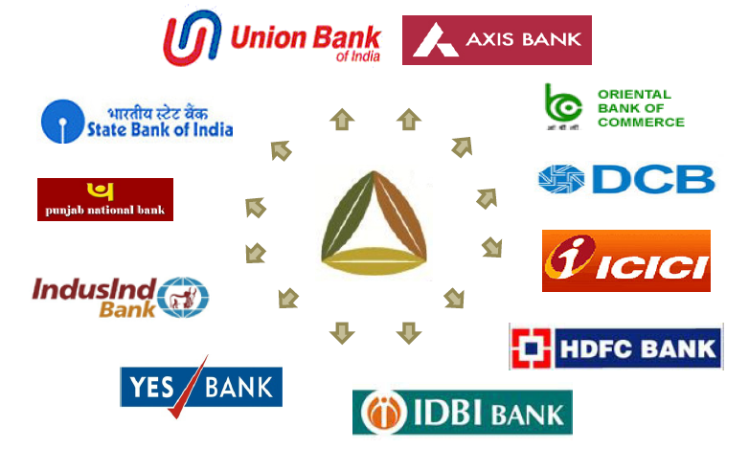

Tie-Up with Banks
SSLL has tie-ups with various public & private banks and works jointly with them to facilitate funding against the warehouse receipts.
They provide liquidity to farmers against their produce stored at SSL's ALPs & RSWC warehouses managed by SSLL.
Tie-up with large PSU & Private sector banks enables customized financing solutions.

Slide 17
The Road Ahead

Slide 18
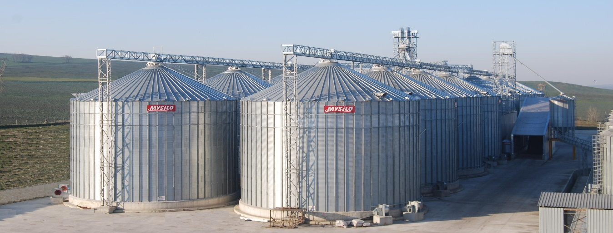
Bulk Handling
The principal advantages of bulk handling are:
  Great saving in time and cost of handling the grain
  Saves the cost of providing hags every season.
  Greater reduction in the quantity of lost and damaged grain.
  Greater expedition in loading and unloading railway trucks, thus increasing the effective throughput
  Greater expedition in loading and unloading ships, thus, reducing shipping charges.
  Greater ease in cleaning and grading
Silos form an integral part of bulk handling of commodities
Bulk Handling creates cost and operational efficiencies

Slide 19
Bulk Handling – Silos
Are silos the way forward in the Indian context?
 | Advantages of SILO | Disadvantages of WH
1 | Silos require lesser area for installation and hence lower land cost | Warehouses require more area for storage and hence higher land cost
2 | 2 Sq Ft/MT | 5-8 Sqft/ MT
3 | Silos provide grain raw with a larger storage life span | The storage life span in ware house is comparatively shorter
4 | Silos has inbuilt system to protect grain from Bacteria/ insect infestation, thereby preventing losses in stored grain | Bacteria/ Insect infestation amount to nearly 2- 6% losses in grain stored in WH
5 | Silos are easy to ship, erect & commission, thereby reducing the downtime | Warehouse projects require longer downtime for completion
6 | Silos can be provided with inbuilt temperature control system thereby preventing unfavorable changes in grain due to temp moist variation | Varying Temp / moisture levels in diff part of warehouse causes unfavorable change in properties of grain stored
7 | Silos involve lesser labour involvement. | WH requires intensive labour
8 | Silos provide no wastage of grain & is based on all in all out principle | Wastage is unavoidable in WH due to various factor including human interface

Slide 20
Bulk Handling – Silos
Although silos have many advantages there are major issues in adoption of these bulk handling systems
Needs a complete overhaul of logistics infrastructure right from the farm to the end processor (carriages, transport, port facilities, etc. ) to handle these goods in bulk
Small scale farming, fragmented production and varied farming practices prevent significant aggregation
Separate Silos are required for each commodity
Requires qualified manpower and special tools to build and run silos
Futures trading is grade dependent and hence prevents mixing of various qualities within a single storage
Availability of electricity and technological knowhow
Many miles to go before bulk handling and use of silos is pervasive

Slide 21
Post Harvest Management
Effective Post Harvest Management Techniques for Maize:
    Low moisture content
    Good quality storage infrastructure
    Comprehensive spectrum of value added services provided under one roof
    These value added services also includes primary processing which will further prevent undue movement of goods
    Price discovery and risk management tools
    Gearing up for bulk handling techniques and creating the requisite infrastructure across the value chain
Bulk Handling systems will be an important denominator for the success or failure of PHM for maize

Slide 22
SSLL – Photo Gallery

Slide 23
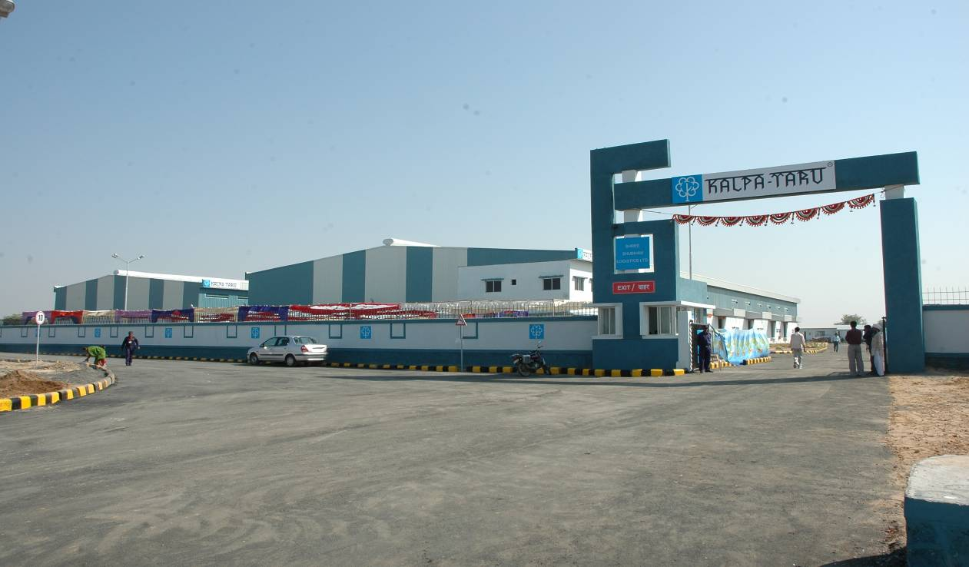
SSLL – Agri Logistics Parks

Slide 24
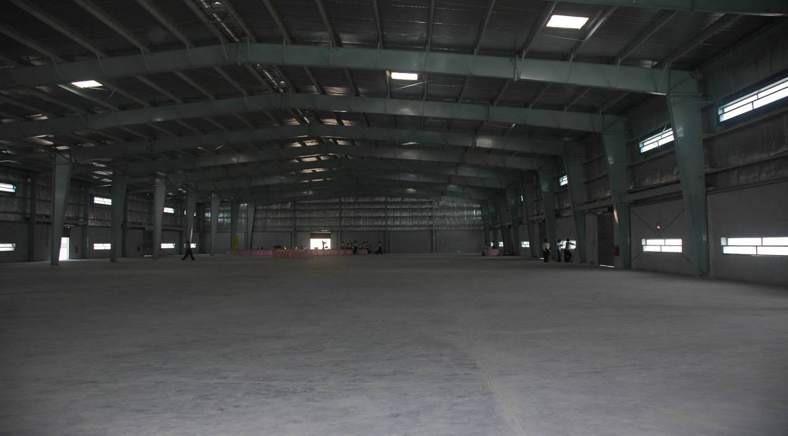
SSLL – Agri Logistics Parks

Slide 25
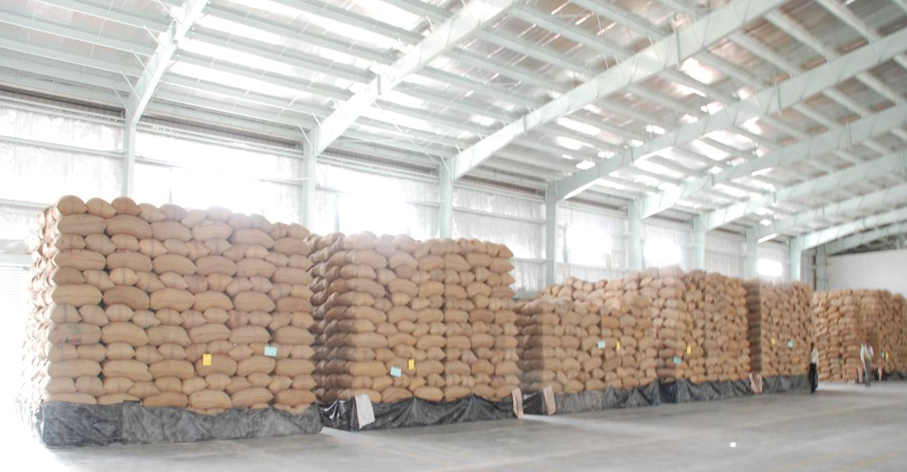
SSLL – Agri Logistics Parks

Slide 26
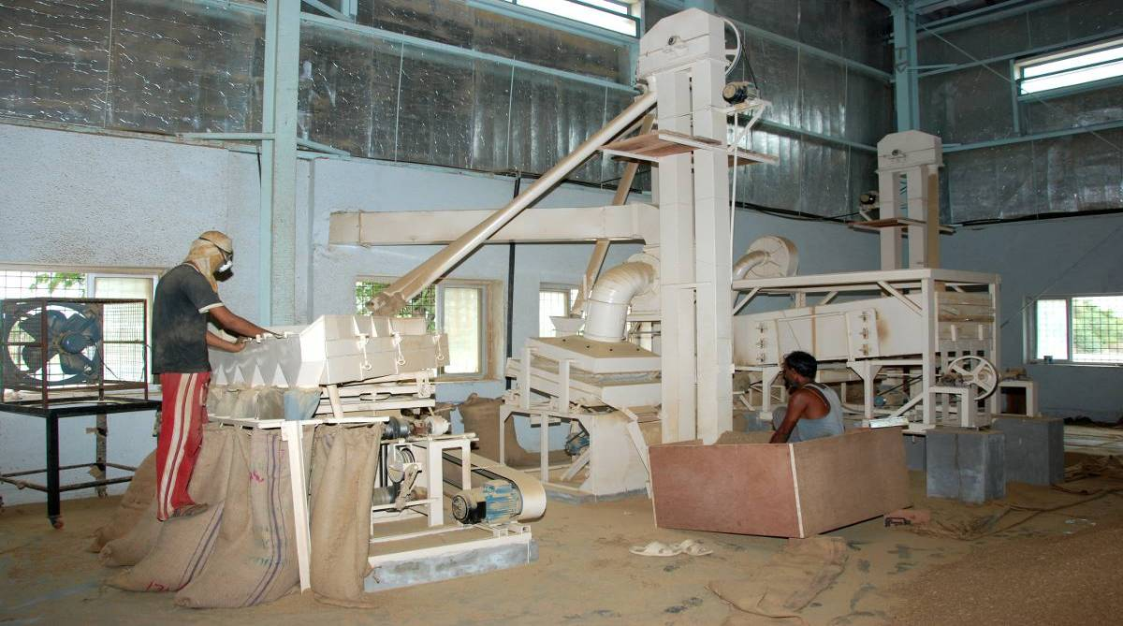
SSLL – Agri Logistics Parks

Slide 27
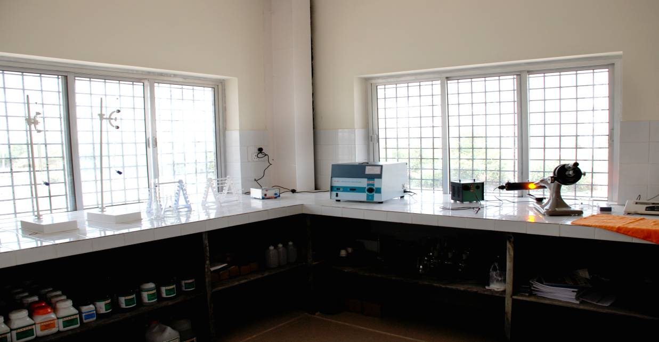
SSLL – Agri Logistics Parks

Slide 28
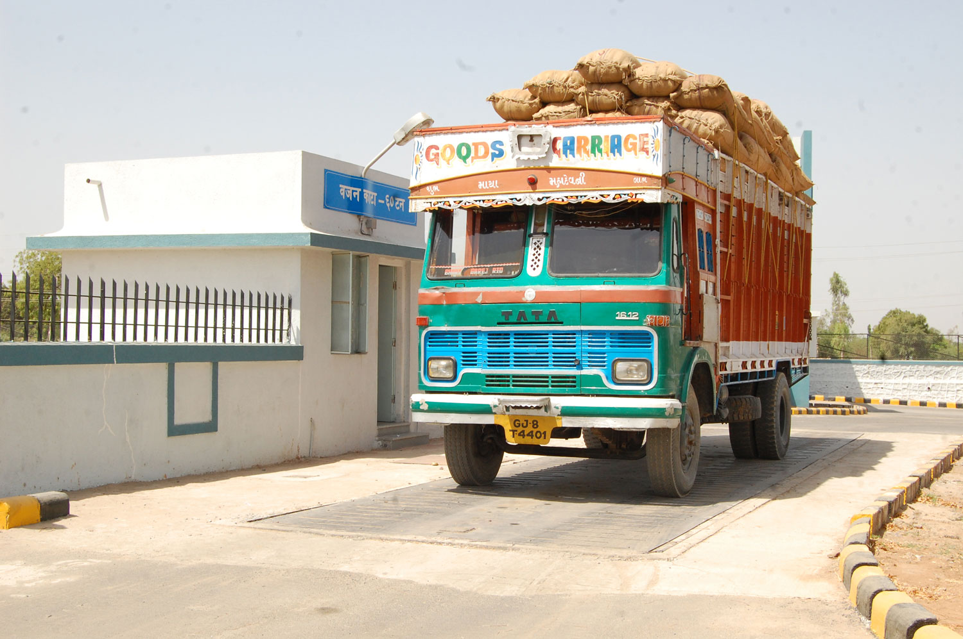
SSLL – Agri Logistics Parks

Slide 29
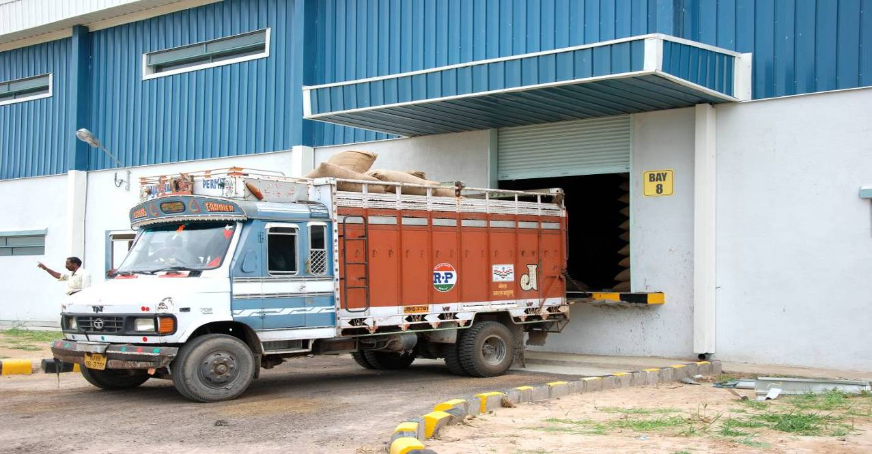
SSLL – Agri Logistics Parks

Slide 30

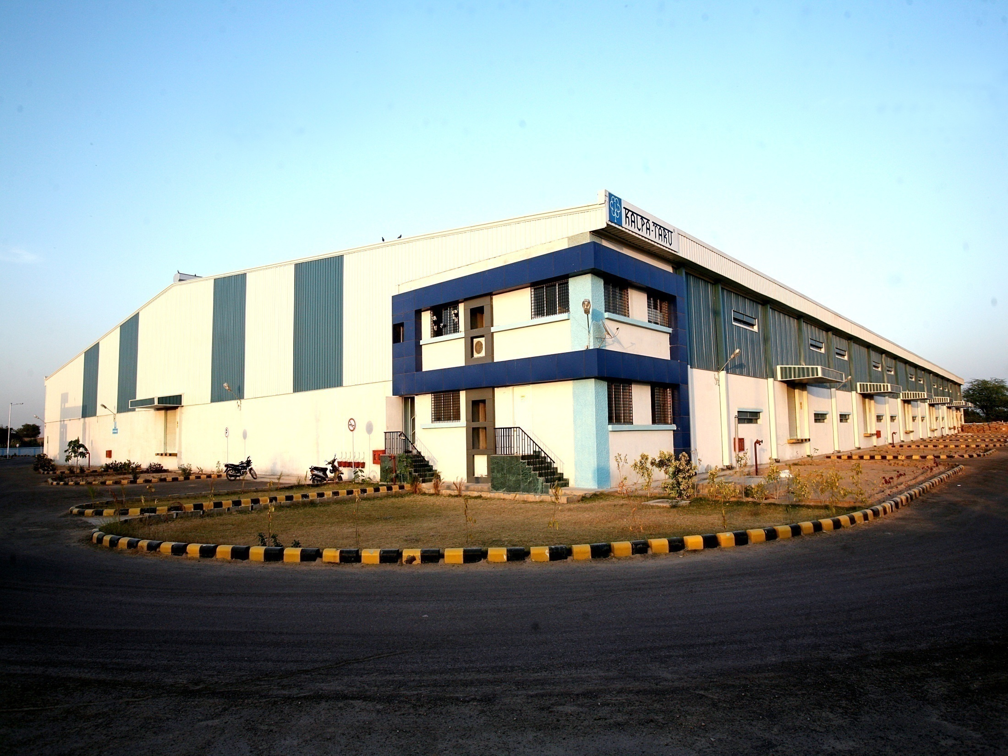
Comprehensive Logistics Solutions
Under One Roof
Shree Shubham Logistics Limited
An ISO 9001: 2008 Certified Company
Thank you
SHREE SHUBHAM LOGISTICS LIMITED
An ISO 9001 & 22000 Certified Company

