Slide 1
Integrating MSMEs with Global Value Chain
Improving Competitiveness of value chains
Dr. Rajesh Bheda
CEO, Rajesh Bheda Consulting Pvt. Ltd.
WWW.rajeshbheda.com
drbheda@rajeshbheda.com

Slide 3
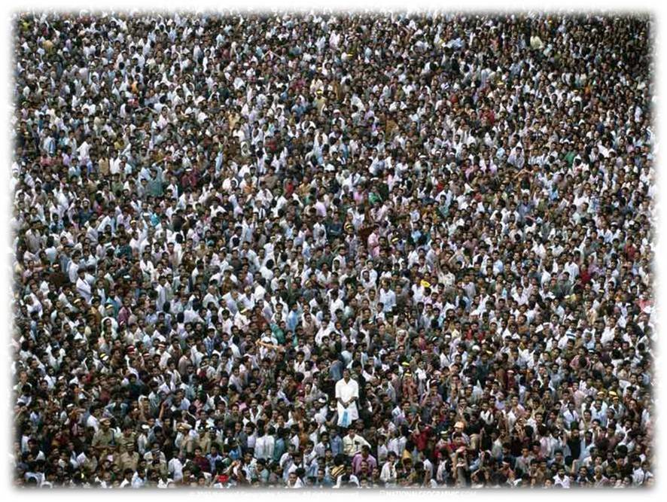

Slide 5
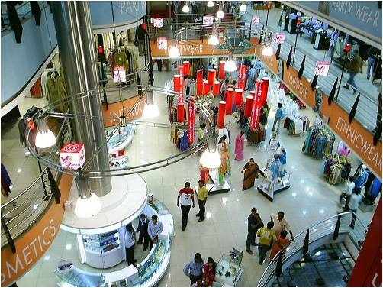

Slide 6
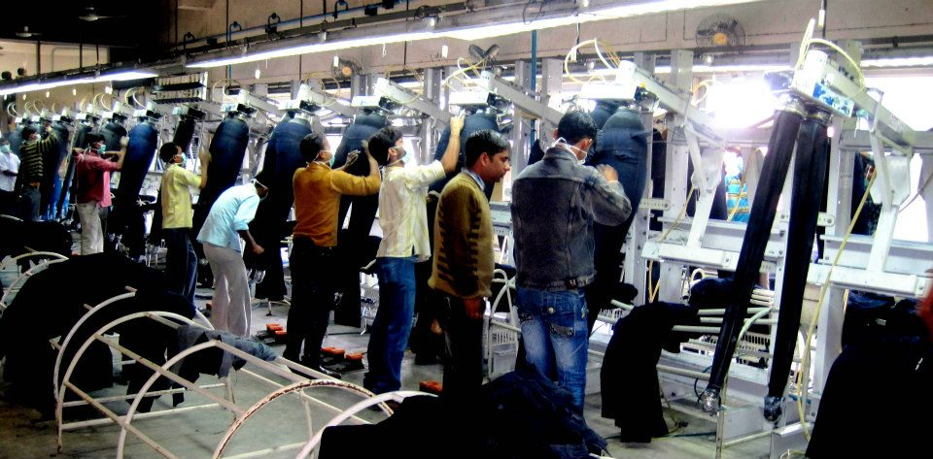

Slide 7
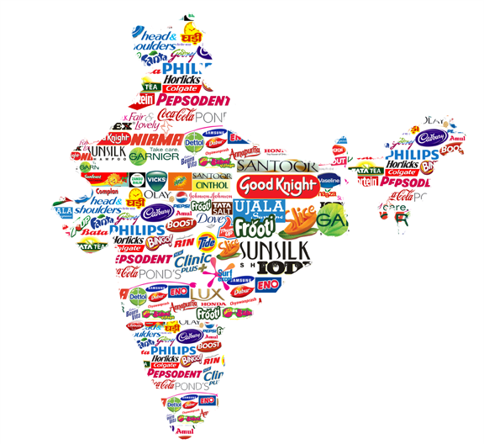
Emerging market

Slide 9
Opportunities for Indian MSMEs
Huge Domestic Market
+
Slice of international market
Notes:
Source:

Slide 10
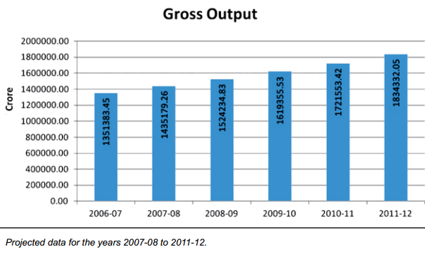
Gross Output in MSME Sector
Source: Annual Report 2012-13, Ministry of MSME
Notes:
Source:

Slide 11
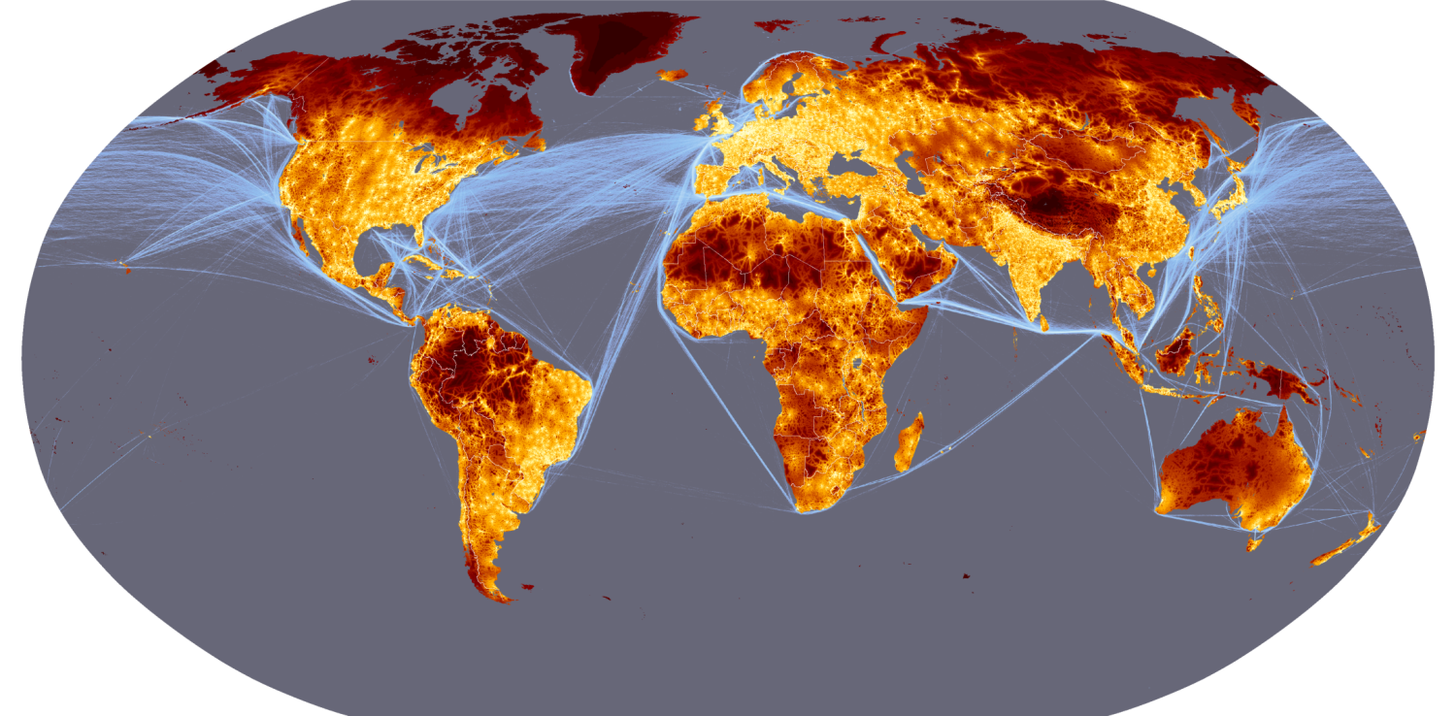
Global Value Chains offer opportunities for competitive players

Slide 12
But what about Profitability ?

Slide 13
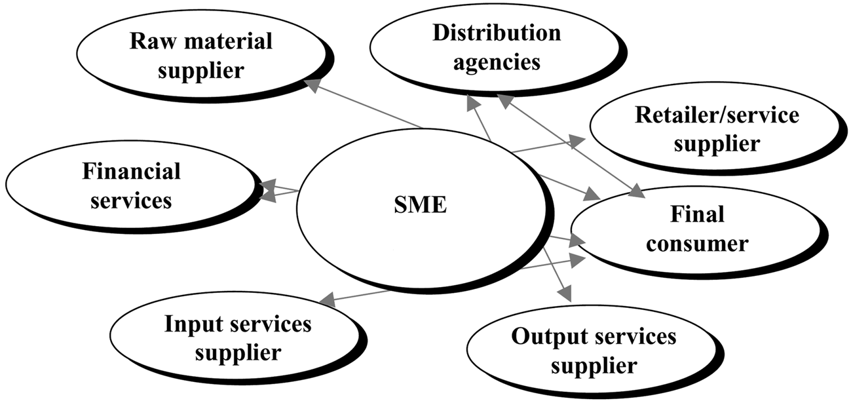
International Supply Chains: Some of the Challenges
Getting it right first time
Cost competitiveness
Improved quality
Speed to market
Replenishment
Mark downs
Geopolitical uncertainties
Ethical Sourcing
Legal Compliances
High rate of customer returns

Slide 14
Must for Effective Supply Chain Management!
Mutual Trust and respect among the supply chain partners
Transparency- Information sharing
Sharing of vision for win-win strategy
We have an example to share

Slide 15
RAGS Challenge Fund
Benefits for Business and Workers (BBW)
Project implemented by Impactt and RBC
Supporting good businesses and great jobs
Covered 77 factories in India and Bangladesh

Slide 16
BBW Streams of work
Productivity
Quality
Human Resources
Absenteeism
Communication
Business case for listening to workers’ voice
Supply procurement
IE
Standard time
Line balancing
Operation standardisation
Production planning
Data management and analysis
Turnover
Social Benefits
Pay & Working Hours
Recruitment design
Staff Training
Performance management and target setting
Data management and analysis
Communication systems and approaches
Grievance procedures and feedback systems
Worker committees
Incentive-setting
Problem Solving

Slide 17
Manufacturers
Retailers
Government
Professional Agencies
Workers

Slide 18
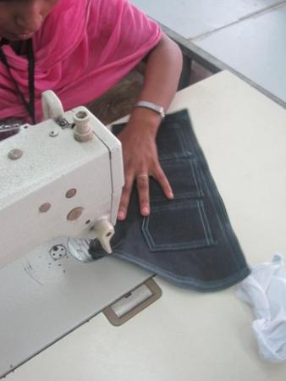
"Mam, when I handed over my last month salary to my daughter she counted it twice and told that there must be a mistake as she has never seen so much money in her life and I was proud to say that this is the money I have earned last month.“
An operator who has been promoted a s sample tailor as a result of skill up-gradation training under the Benefit for Business and Workers program

Slide 19
BBW Results: NCR, Bangalore and Tirupur (13 factories)
38.3% improvement
27.7% improvement

Slide 20
BBW Results: NCR, Bangalore and Tirupur (13 factories)
27.2% improvement

Slide 21
BBW Results: NCR, Bangalore and Tirupur (13 factories)
Reduced by 23%
Reduced by 33%

Slide 22
BBW Results: NCR, Bangalore and Tirupur (13 factories)
7% increase

Slide 23
The good news!!
We hope to extend the program to more MSMEs from other sectors very soon apart from textile and apparel

Slide 24
Points to remember:
Competitiveness of supply chains is important
There are huge opportunities in
Quality-through out the supply chain
Product development
Productivity (about 15 to 50)
Worker engagement
Waste reduction - Lead time (over 20%)
Supply chain collaboration- Win-win is must

Slide 25
The Mantra for
Sustained Competitiveness
Collaboration for success

