Slide 1
MEASURES TO BE TAKEN AT DESIGN STAGE FOR
IMPROVING QUALITY
GATED PROCESS
Anirban Ghosh
Senior Manager- Quality Assurance
CAIRN INDIA LIMITED

Slide 2
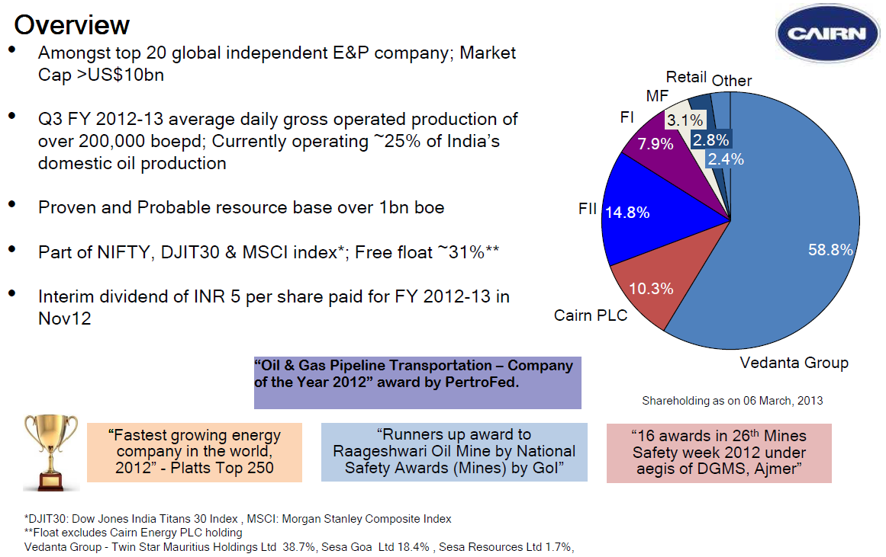

Slide 3
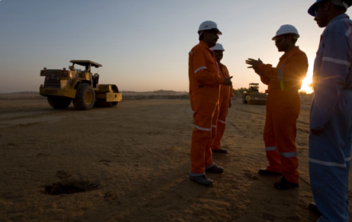
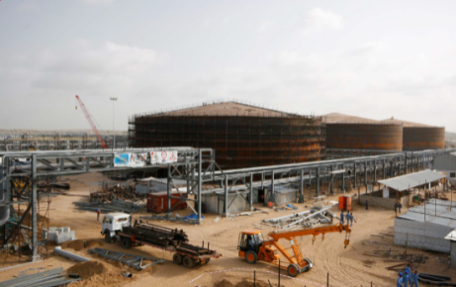
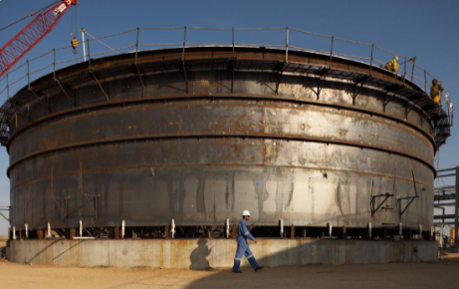
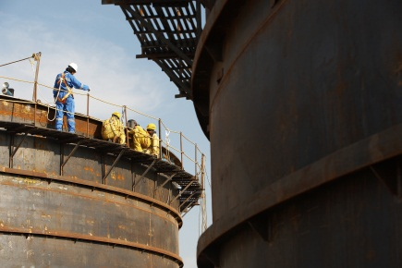
GATED PROCESS:
Gated process is fundamental to the way Cairn brings major Capital developments to commercial operation.
It is a process to establish Governance and Control check points to provide specific and consistent metrics so that all projects are judged objectively and rigorously.
Gated process ensures that all aspects of the development in question align in terms of reservoir/ resource development, engineering maturity, approvals and other stake holder requirements are met with all key assurance activities and reviews identified and undertaken.

Slide 4

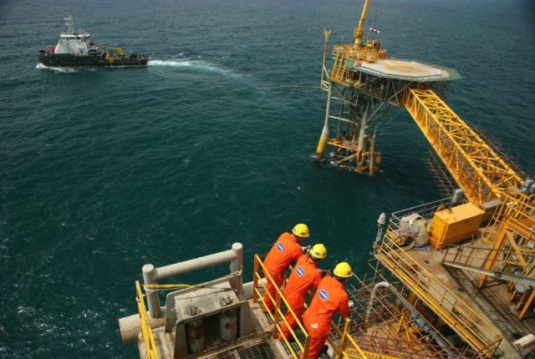
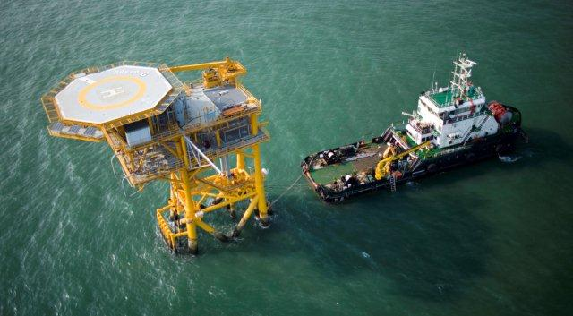

GATED PROCESS:
From conceptualization to Decommissioning, the whole review process have been divided into Seven different Phases. Each phase is called “A Gate”. Specific Check Lists are prepared with regard to each GATE and audits are conducted at each stage. Audit observations, depending upon the severity category are needed to be closed appropriately prior to move on to next level of activities.

Slide 5
GATED PROCESS:
G&G, Petroleum Engineering, HSE, Quality, Legal Assurance
G&G, Petroleum Engineering, HSE, Quality, Legal Assurance
PHSER - I
Exploration &
Appraisal
Engineering, Quality, HSE, Projects, Legal Assurance
PHSER - VII
Abandonment /
De-Commissioning
PHSER – II
Development
PHSER – VI
Start-up
PHSER – III
Design
PHSER – V
Pre- Commissioning
PHSER – IV
Construction
Engineering, Quality, HSE, Projects
Engineering, Quality, HSE,
Projects, Operation,
Asset Integrity
Engineering, Quality, HSE, Projects, Operation
Engineering, Quality, HSE, Projects
Note : PHSER (PROJECT HSEQ REVIEW) CYCLE

Slide 6
GATED PROCESS:
Discovery
Commerciality
Concept Select
Sanction
RFSU
6–12 Months
PIA
Explore
1
Appraise
2
Assess / Select
3
Define
4
Execute
5
Operate
6
3a
4a
Stage Gate
Plan
Stage Gate
Plan
Stage Gate
Plan
Stage Gate
Plan
Exploration Manager establishes stage gate plan for the specific investment.
Development Manager updates the stage gate plan for Gate – 2, Gate – 3 and Gate – 4a
Project Manager updates the stage gate plan for Project for Gate – 4 and Gate – 5
Asset Manager updates the stage gate plan and closes it out after project investment review (Gate -6)

Slide 7
GATED PROCESS:
Discovery
Commerciality
Concept Select
Sanction
RFSU
6–12 Months
PIA
Explore
1
Appraise
2
Assess / Select
3
Define
4
Execute
5
Operate
6
Exploration activities, Seismic, Well Testing, Drilling Etc.,
3a
4a
Field Development Planning
Drilling / Well Completion
Feasibility Studies
Pre-Engg.
FEED
Detailed Design
Procurement
Construction
Approved, Detailed Exploration Work Program & Budget
Commissioning
Start-up
Appraisal strategy & program
SOP’s for actual performance Vs. business proposal
Field Development Plan
Certification to build up facilities
Building facilities & Hand over to Operation
De-commissioning plan, Execution and Env. impact

Slide 8


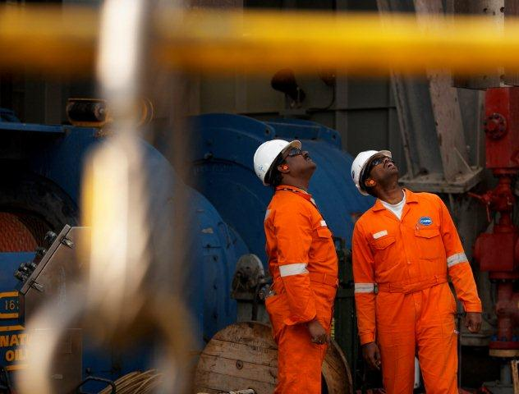

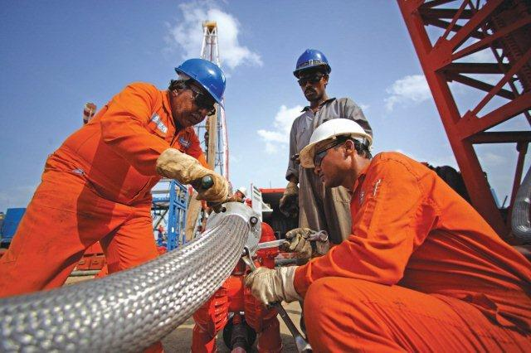
GATED PROCESS: - Advantages
Thorough Review of each Stage by panel experts
All recommendations are appraised at a particular stage only
A transparent governance is established
Helps Timely Completion of Projects
Instantly addressing technical queries, deviation
Helps assuring a qualitative quotient with the stake holders

Slide 9
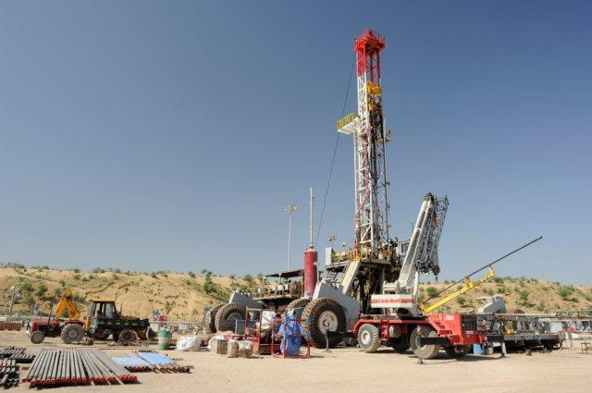
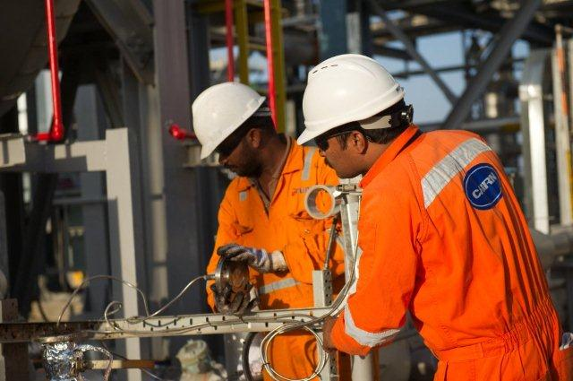
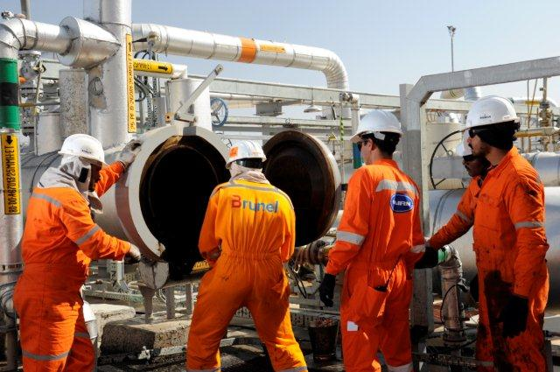
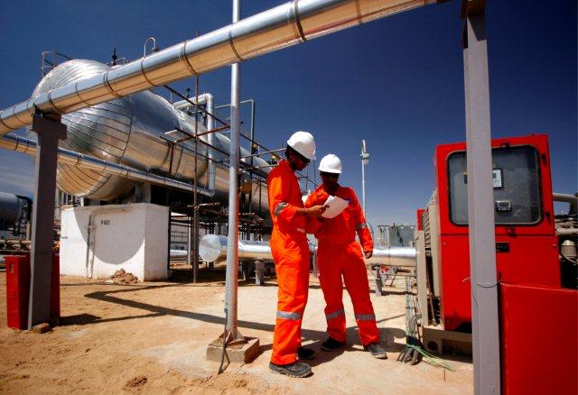
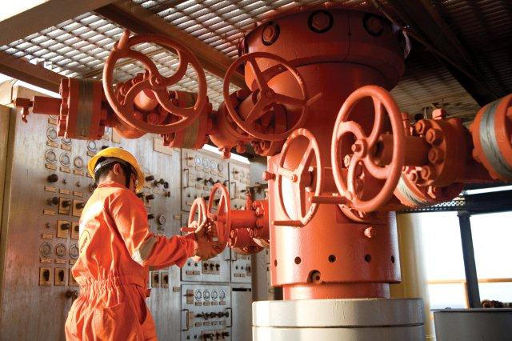
GATED PROCESS: - Challenges
Put together all panel experts at the same time.
Constituting a competent bench strength for the activity.
Timely closure of all the observations.
Prevention of repetitive re-occurrence.

Slide 10
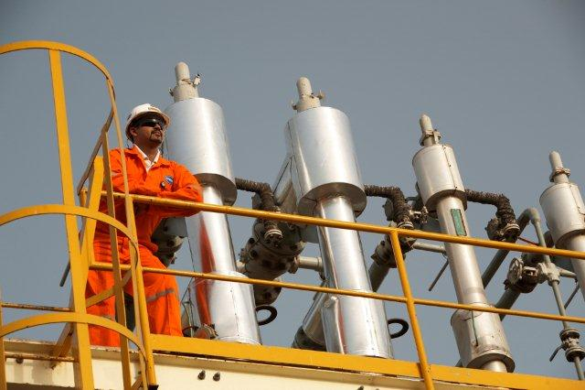
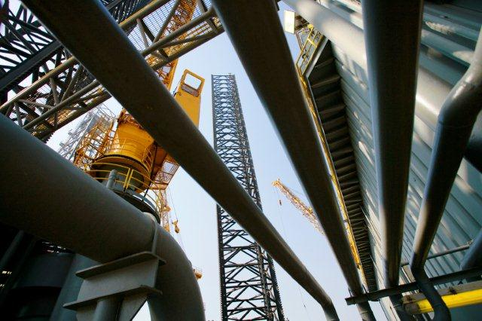
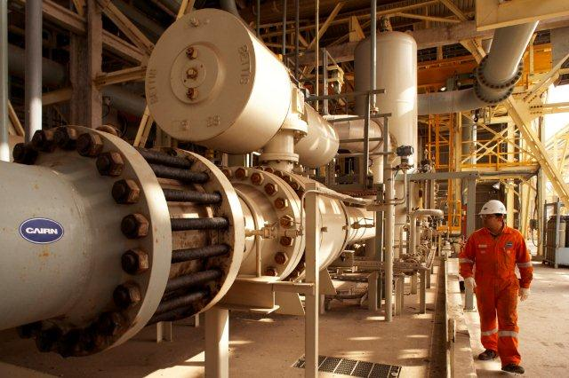
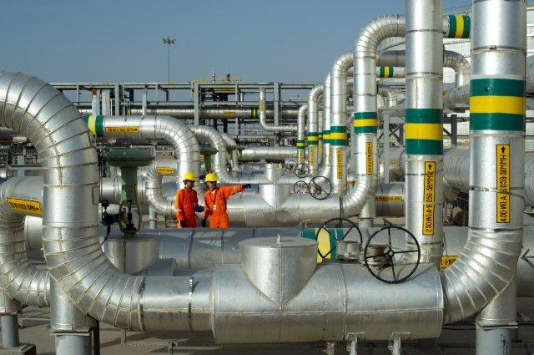
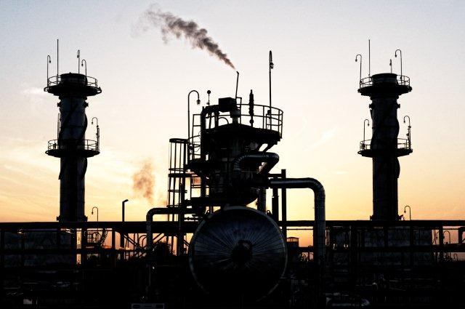
GATED PROCESS: - Mitigation to the Challenges :
A well planned schedule in Advance
Empowerment on respective Gate Keepers
Engaging Consultants
Lesson Learnt data base for reference

Slide 11
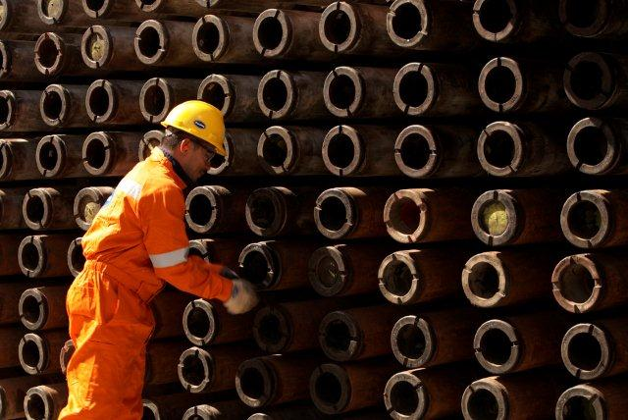
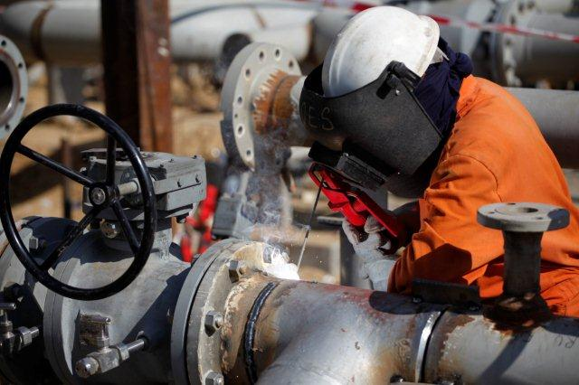
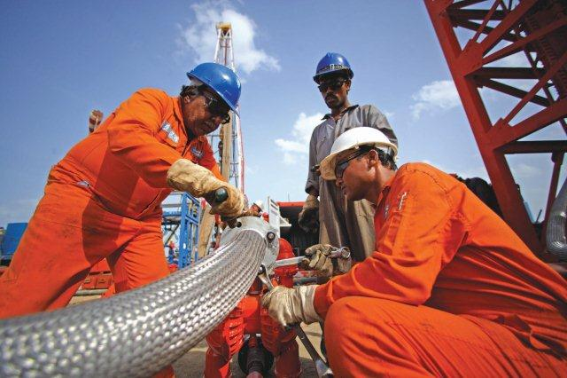
Benefits reaped through GATED Process:
Assuring the proper material, welding and NDT procedures at the design stage itself
Adhering the recommendations of the Jaipur and Hazira Fire Incidents in design
Ensuring Implementation of requirements from codes, standards, specifications
Compliance to all regulatory and legal requirements
Ensuring proper utility coverage of critical equipments and instruments

Slide 12
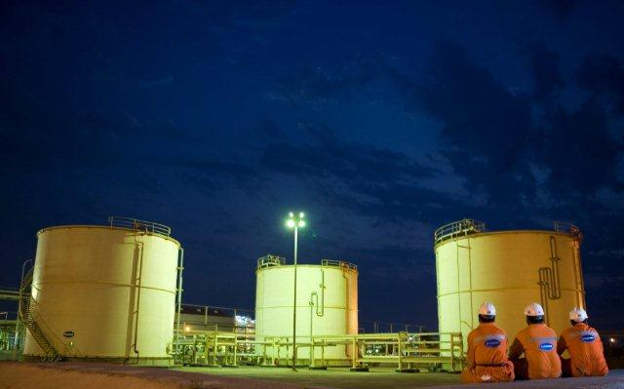
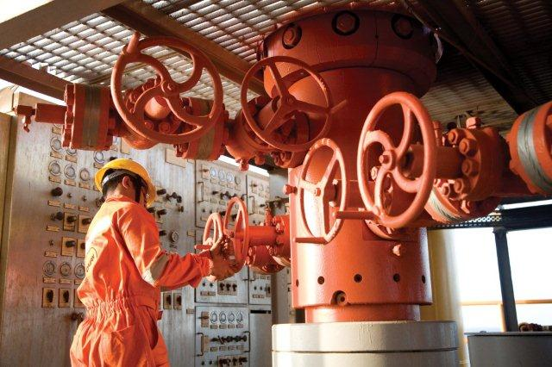
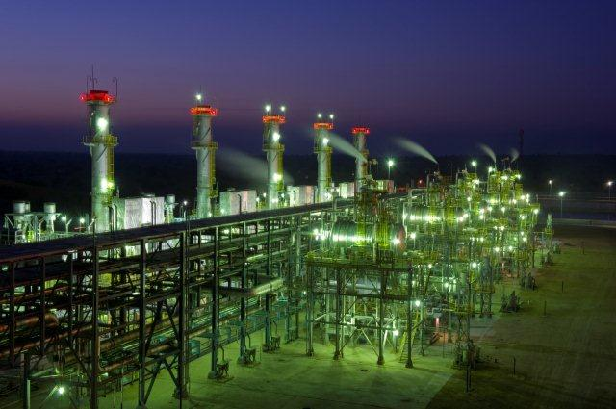

Thank You

