Slide 1
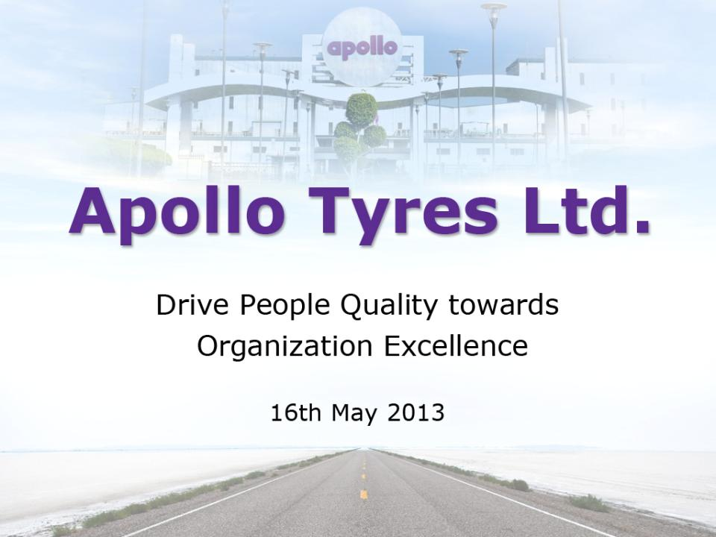

Slide 2
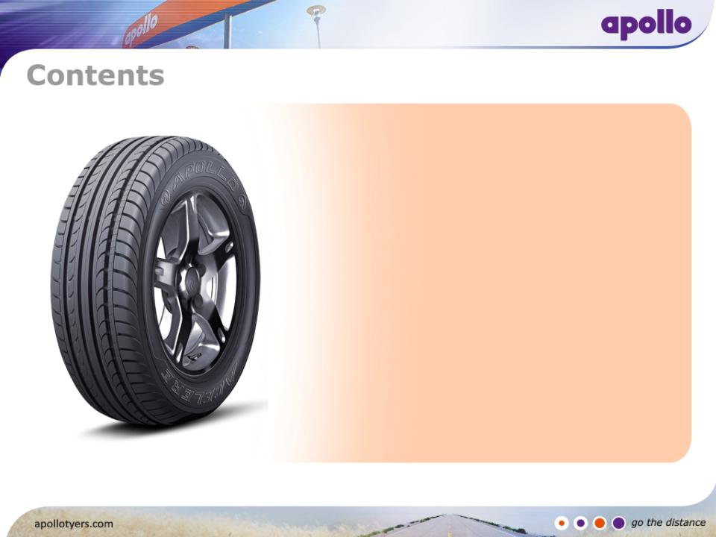
Apollo Tyres
Vision
Overview
Products & Partners
Chennai Plant
Quality Strategy
People Quality
  Talent Acquisition
  Talent Development
  Talent Retention
  Talent Engagement
Result

Slide 3


Customer First
Business Ethics
Care for Society
Empowerment
One Family
Communicate openly
“A significant player in the global tyre Industry and a brand of choice, providing customer delight and continuously enhancing stakeholder value”

Slide 4
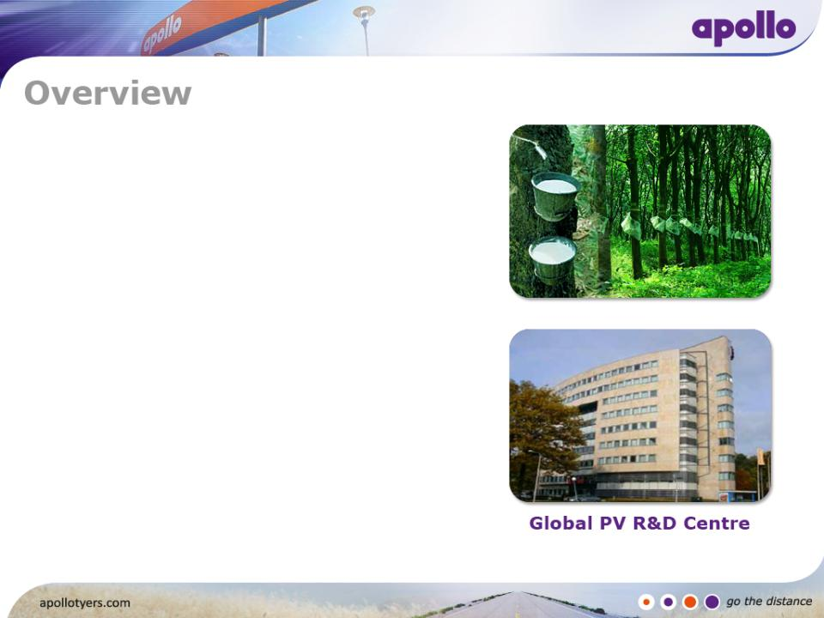
Snapshot
Established in 1976 in the natural rubber growing state of Kerala
Started with 40 tonnes a day, now 1,500 tonnes a day (US $ 2.5 Billion)
Over 17,000 employees
Operates through 3 Zones with headquarters in India, South Africa & The Netherlands
Manufactured out of 9 facilities across 3 continents
Global Passenger Vehicle R&D centre in Enschede, The Netherlands and Commercial Vehicle R&D at Chennai
Apollo was conferred with Tire Manufacturer of the Year 2012 by Tire Technology International

Slide 5
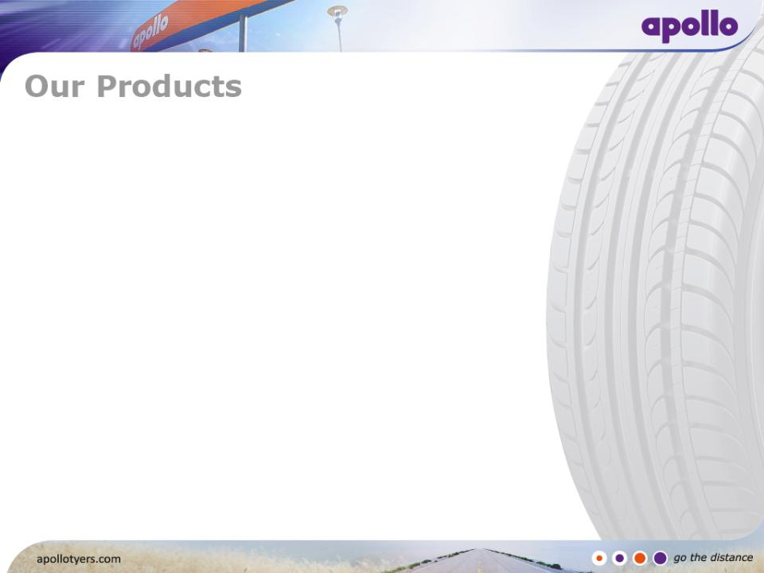
Apollo for passenger vehicles, commercial
vehicles & off highway
Dunlop for passenger vehicles, commercial
vehicles & off highway
32 countries in Africa
Vredestein for passenger vehicles,
commercial vehicles, off highway & bicycle
Maloya for passenger vehicles
Regal for passenger and commercial vehicles
Kaizen for commercial vehicles

Slide 6
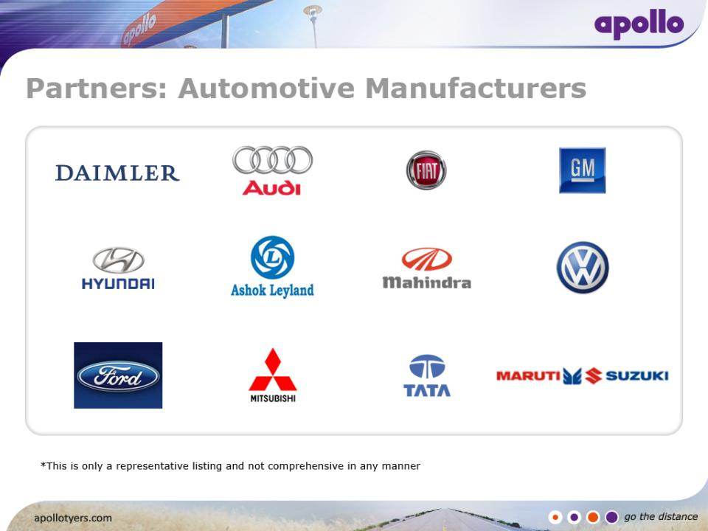

Slide 7
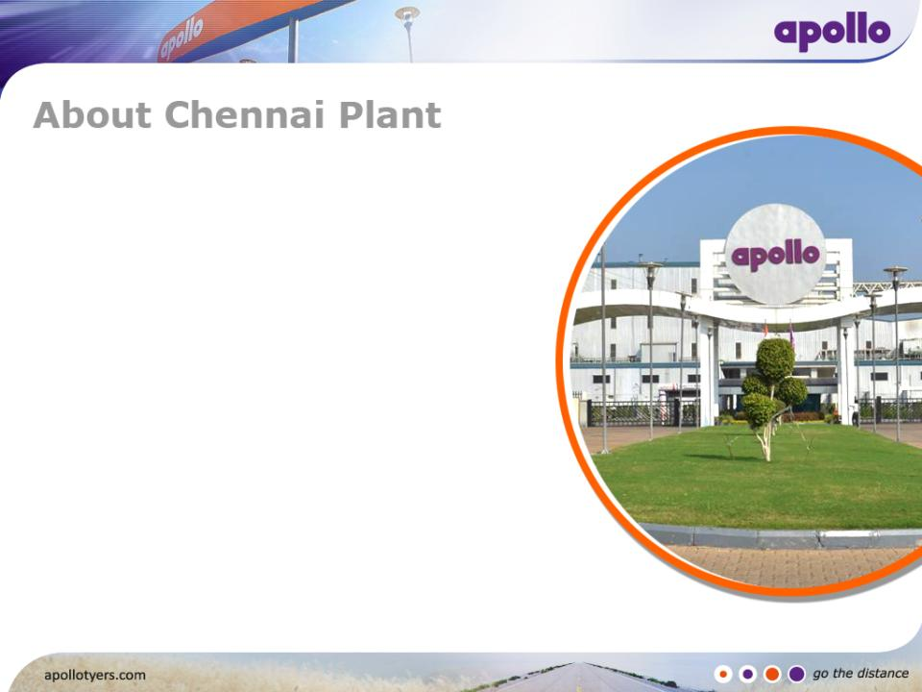
130 Acre green campus located in the SIPCOT
Industrial Area – 50 Km from Chennai City
Capacity – PCR: 16000 Tyres/Day & TBR: 6000 Tyres /day
and Tonnage 500 MT/Day
1,670 Employees
3 Level organizational structure
State-of-the-art Technology and Machinery
I T - Nerve Centre
AGILE – Q Pillar - TQM
Safety – BBS was launched in November 2011

Slide 8
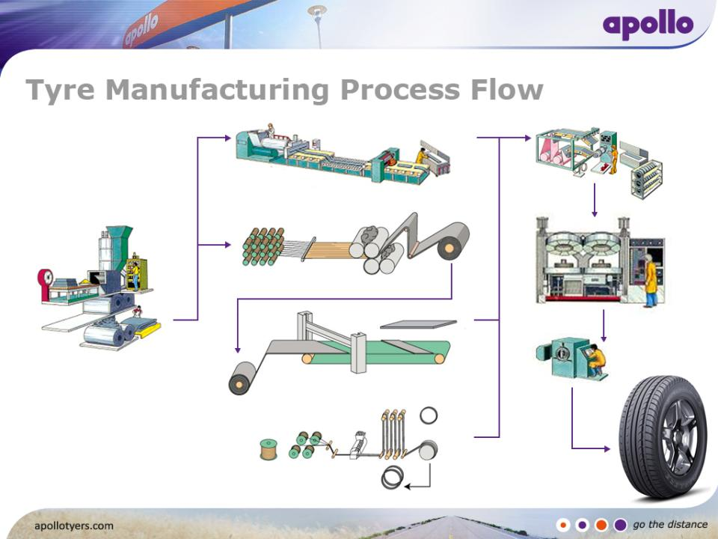
BUILDING
EXTRUSION
CURING
MIXING
CALENDERING
X-RAY
CUTTER
FINISHED TYRE
BEAD APEX

Slide 9
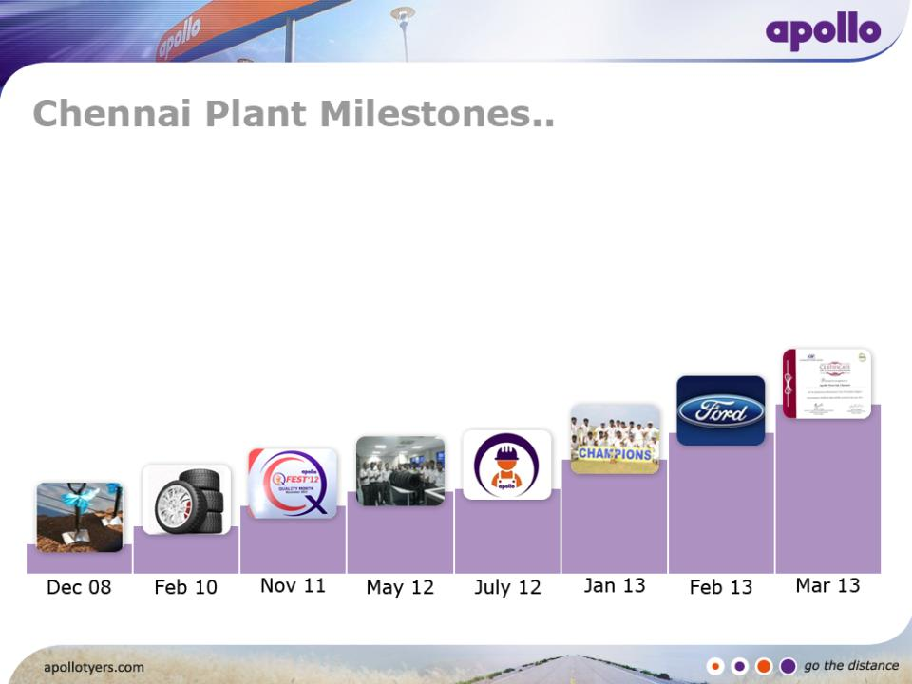
CII EHS Award –
Certificate of Commendation
Won Corporate
Cricket Championship
Ford Q1 Award
1st Winter Tyre
produced
LTIFR – Zero
1st Q-Fest
1st Tyre
Ground Breaking

Slide 10
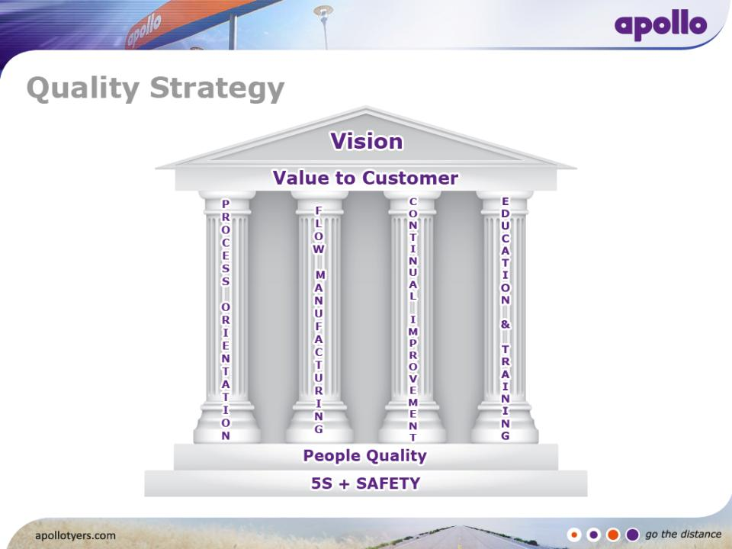

Slide 11
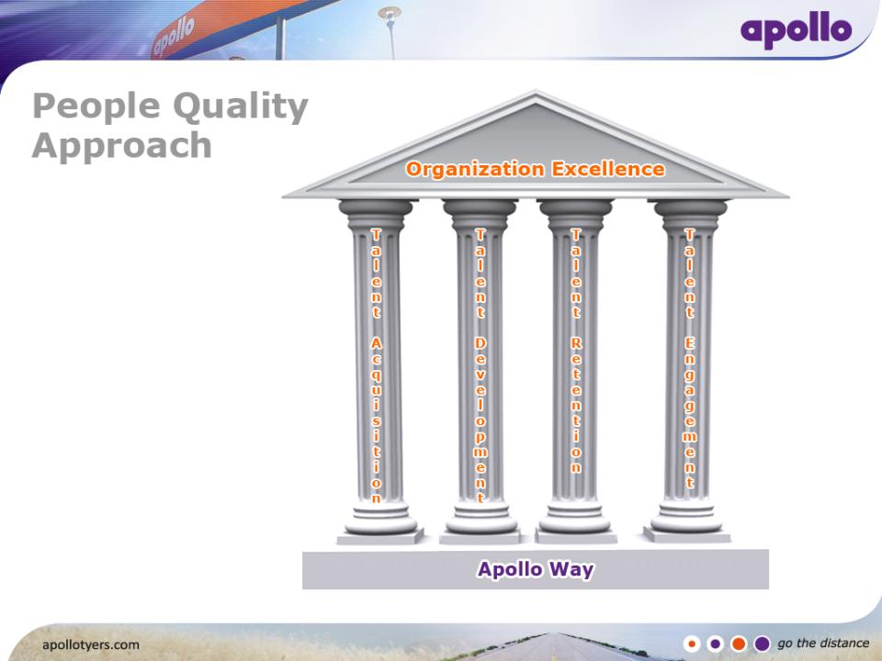

Slide 12
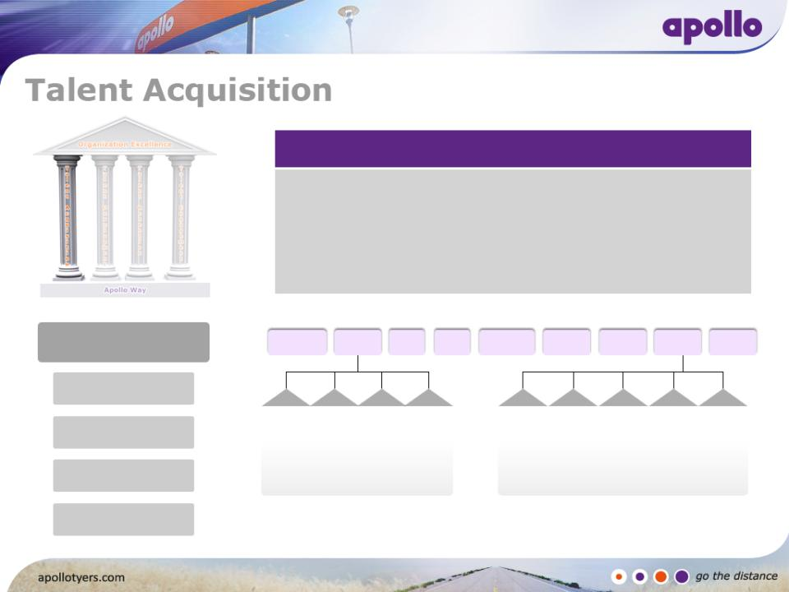
Strategic Business Units – Ownership Building
Business Divided into 2 SBU’s ( PCR & TBR)
4 Business Units within PCR SBU & 5 Business Units within TBR SBU
7 Support Business Units (HR, Engineering, Manufacturing Systems,
QA, Commercial, PCR Tech. & TBR Tech.)
Lean Structure
PCR Tech
PCR SBU
QA
HR
Mfg
Systems
Comm.
Engg.
TBR SBU
TBR Tech
Unit Head
Group Leaders
Mixer
BU
PCR
Stock
BU
PCR
TBM
BU
PCR Cr
& FF
BU
TBR
Extr
BU
TBR
Cal
BU
TBR
Bead
BU
TBR
TBM
BU
TBR Cr
& FF
BU
Team Leaders
Team Members

Slide 13
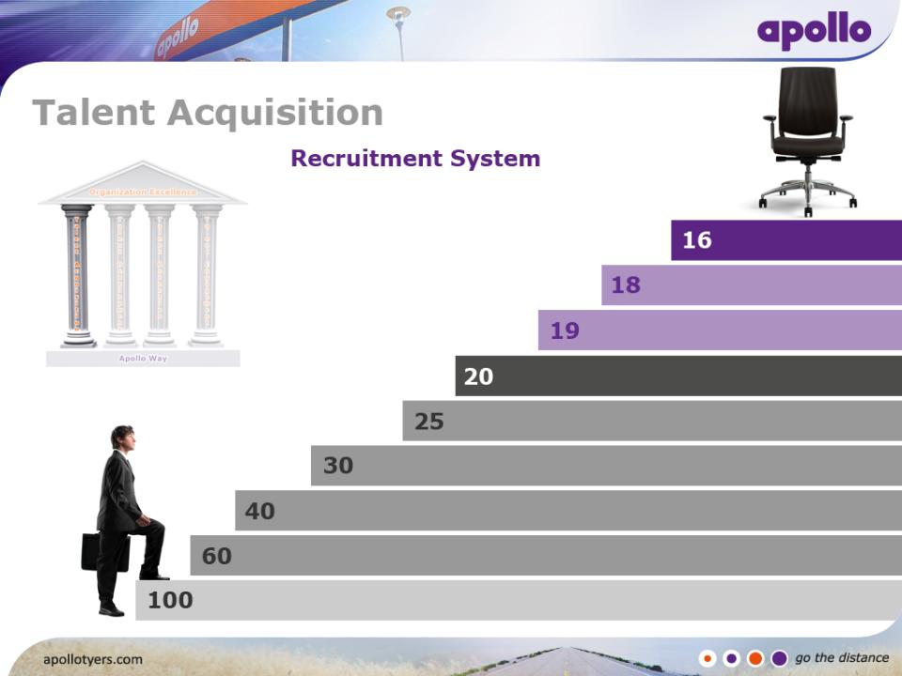
Robust Recruitment system for SMT members
Minimum Qualification –Diploma with 60 % Marks
Campus drives
FINAL JOINING
Antecedent Verification
Pre employment Medical
Final Interview
Technical Interview
Psychometric test
Aptitude Test
Physical Test
Appear for Recruitment

Slide 14
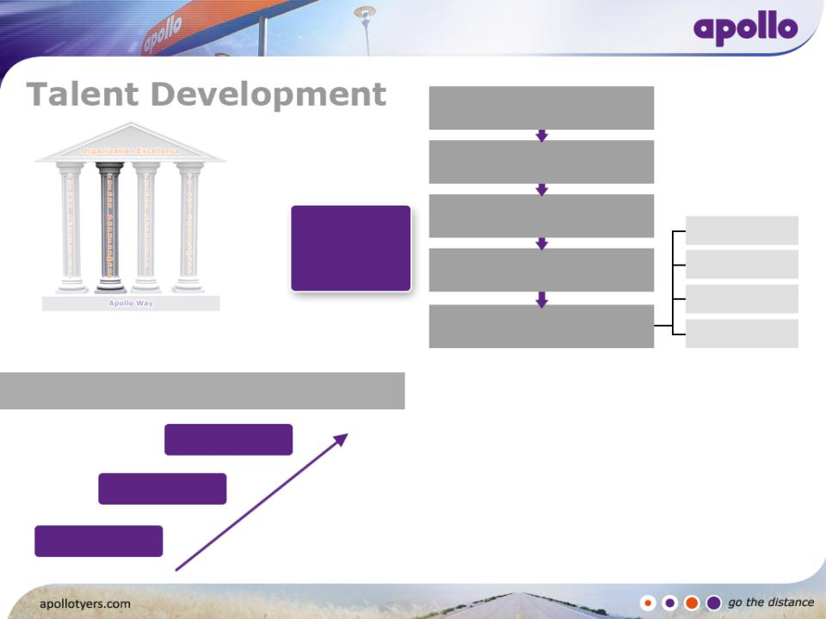
Training Need Identification
Consolidation of Needs
Kirpatrick Model
Preparation of Training
Calendar
Training
Process
Flow
Reaction
Conduct Training
Learning
Behavior
Training Effectiveness
Results
Training Need Identification (Level wise)
Group Leader
PACE (PMS)
Team Leader
PACE (PMS)
Team Member
Skill Matrix Need Assessment Form Annual Appraisal

Slide 15
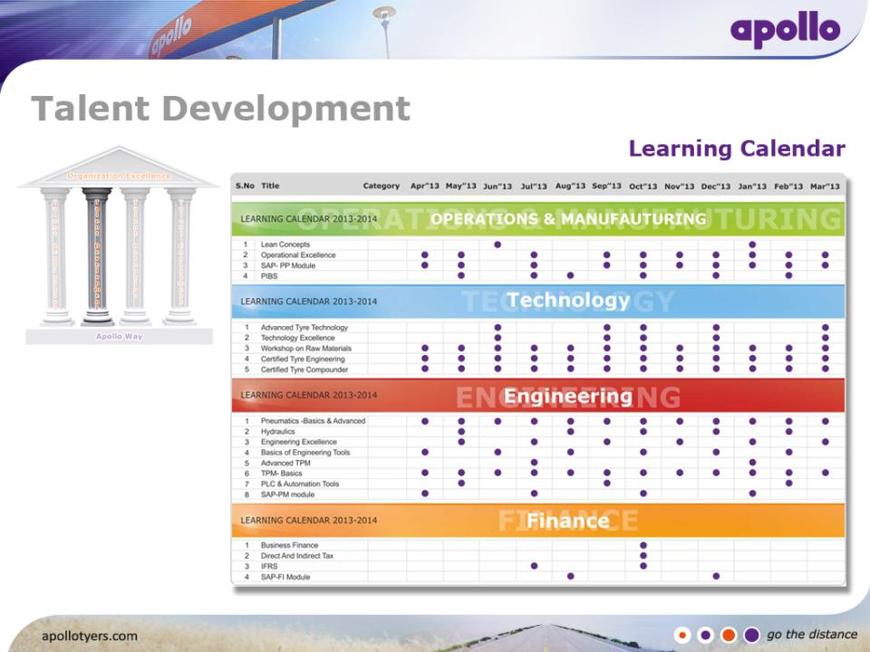

Slide 16
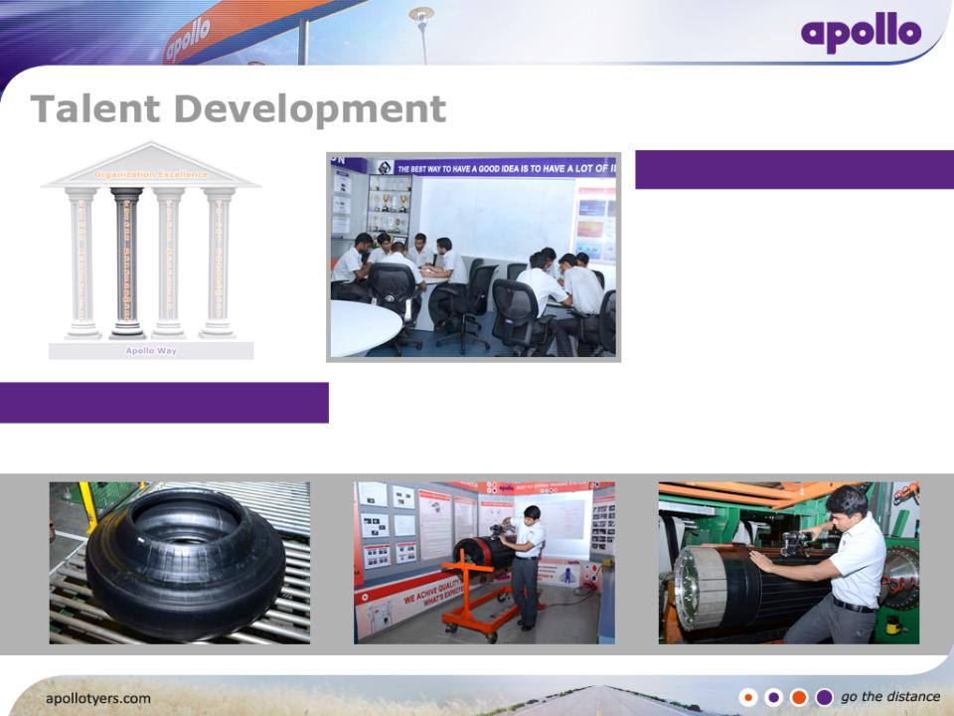
Innovation Centre
Knowledge Library
Problem Solving Tools & Methods
Success Story Case studies
Quality circle meetings
Quality Simulation Lab
Critical Task Model
Hands-on Training
Simulating the actual process

Slide 17
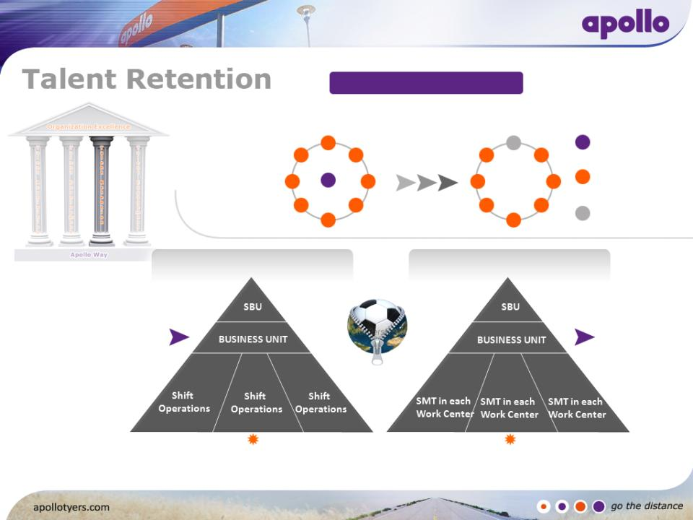
Self Managed Team
CONVENTIONAL MODEL
SMT MODEL
Shift In-charge
Team Member
/ Trainee
Rotational
Captain
Conventional Structure
SMT Structure
BU Leader
supported by
Specialists
BU Leader
supported by Specialists &
Shift In-charges
Team Members/ Trainees
working in shifts (Under Shift In-charge)
Self Managed Team
with Rotational Captain

Slide 18
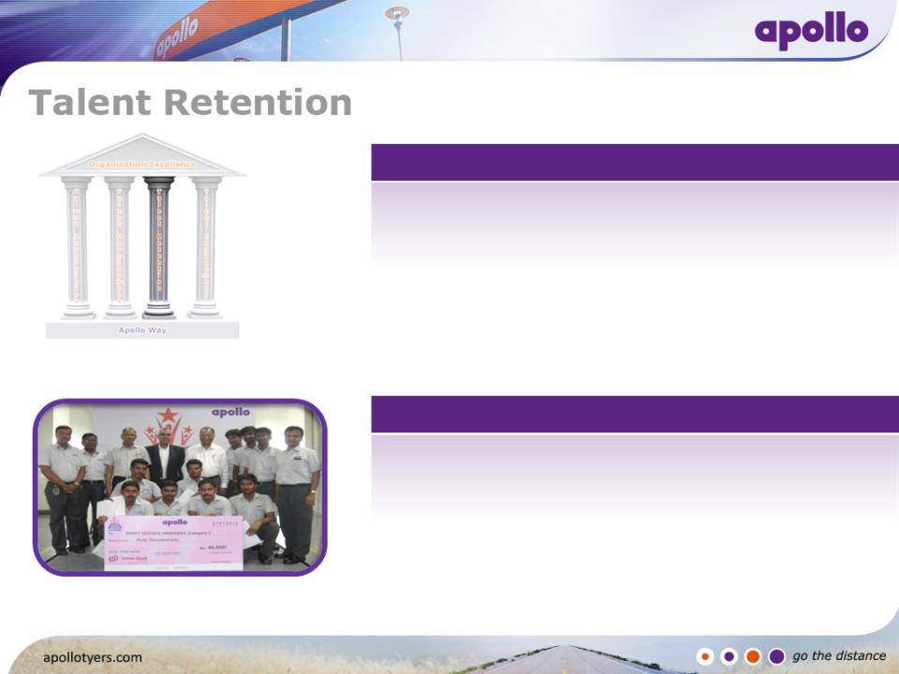
Apollo Continuing Education
Opportunities for Development
For pursuing higher studies - Apollo Continuing Education Scheme
    Courses for B Tech (Mechanical ) & B Tech (Electrical)
    Tie up with B S Abdur Rehman University
    Opportunity for 120 People
Career Opportunities in Marketing & Sales, Technical Services
Short Service Award
Retention Program
Short Service Award
An amount of Rs.1,00,000 within a span of 5 years

Slide 19
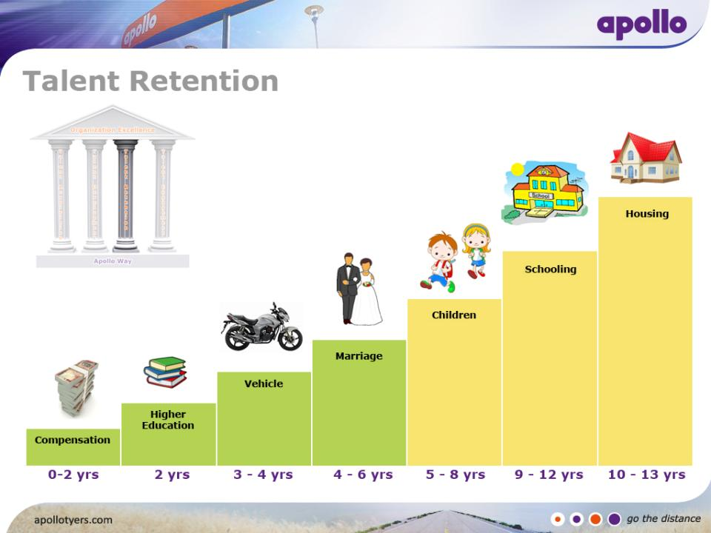
Employee Life Cycle
Housing Assistance
School Support
Medical Support
Marriage
Assistance
Two Wheeler
Based on Comp
& Ben Survey
Apollo Continuing
Education (ACE)

Slide 20
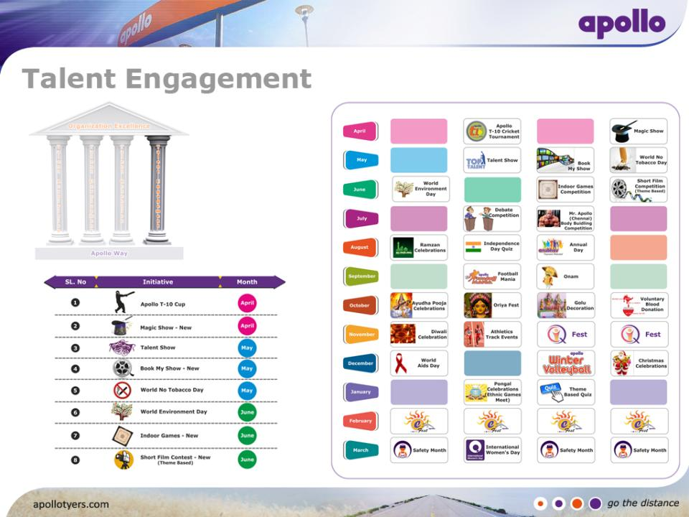
Employee Engagement Calendar

Slide 21
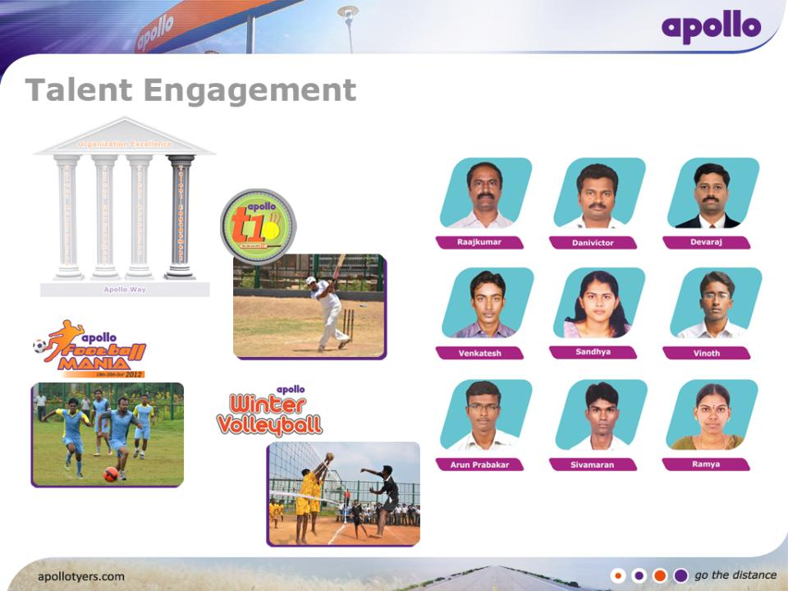
Sports Advisory Team

Slide 22
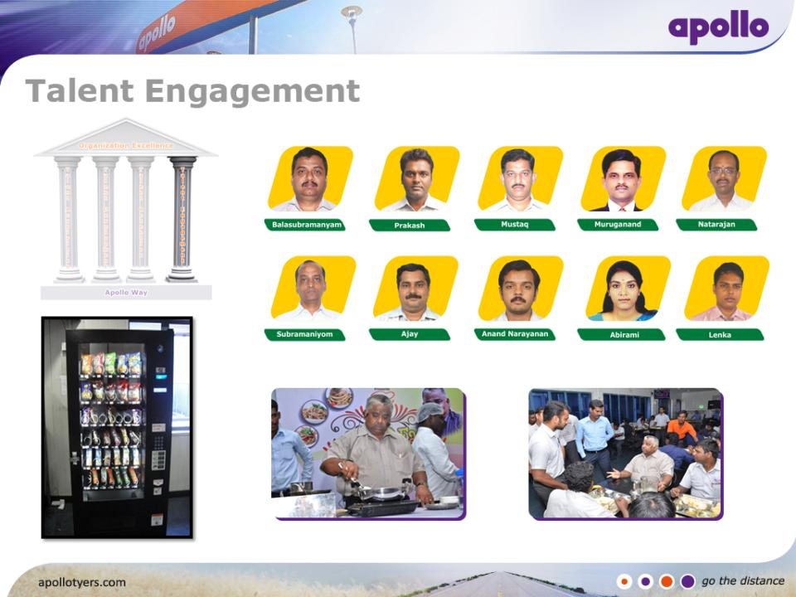
Cafeteria Advisory Team

Slide 23
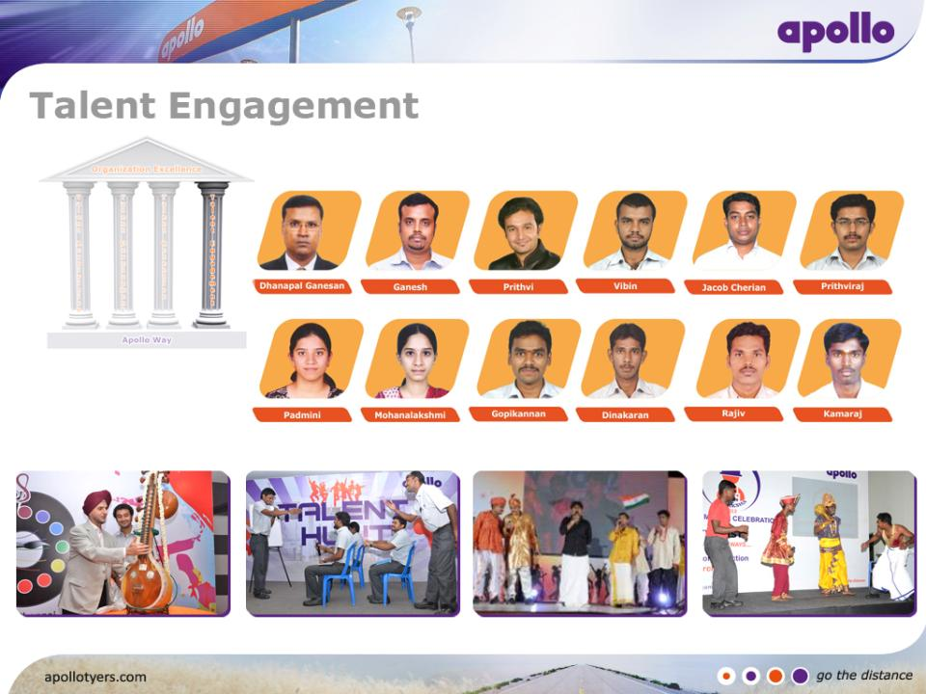
Arts Advisory Team

Slide 24
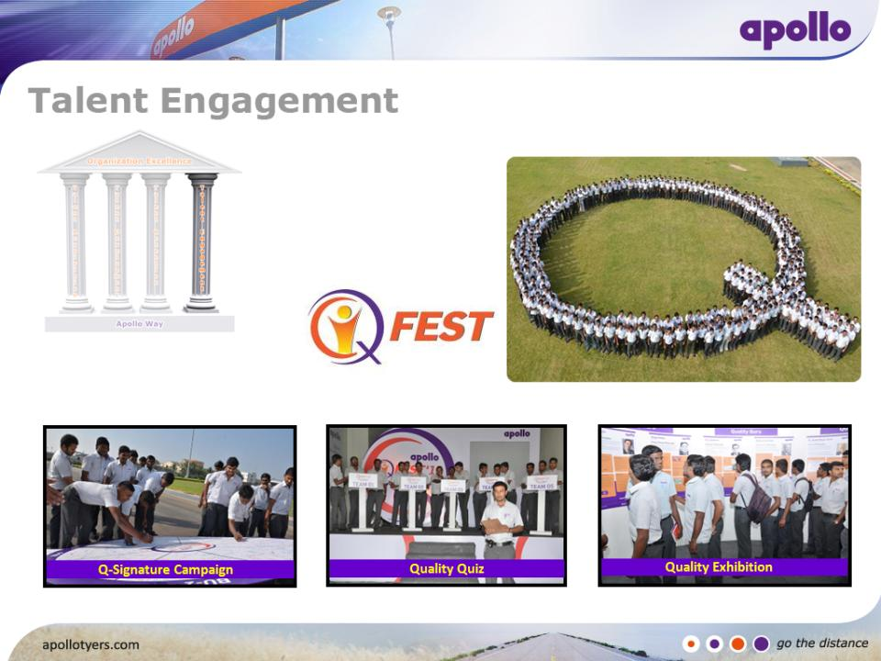
Q -Fest

Slide 25
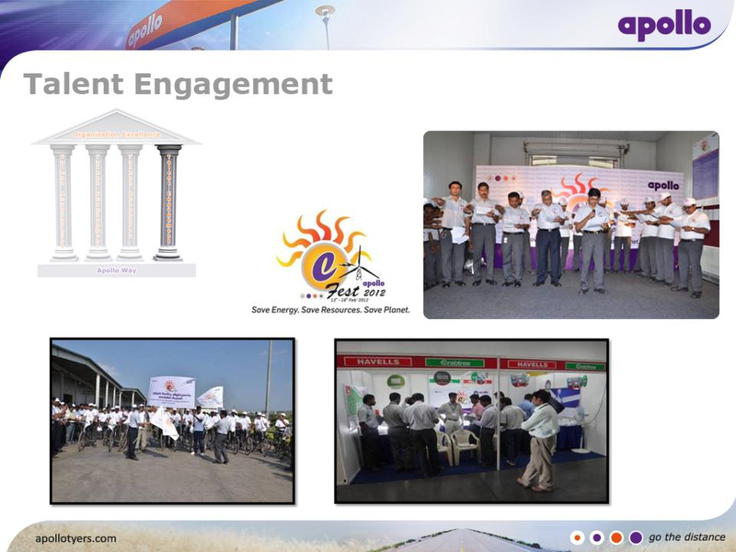
E -Fest

Slide 26
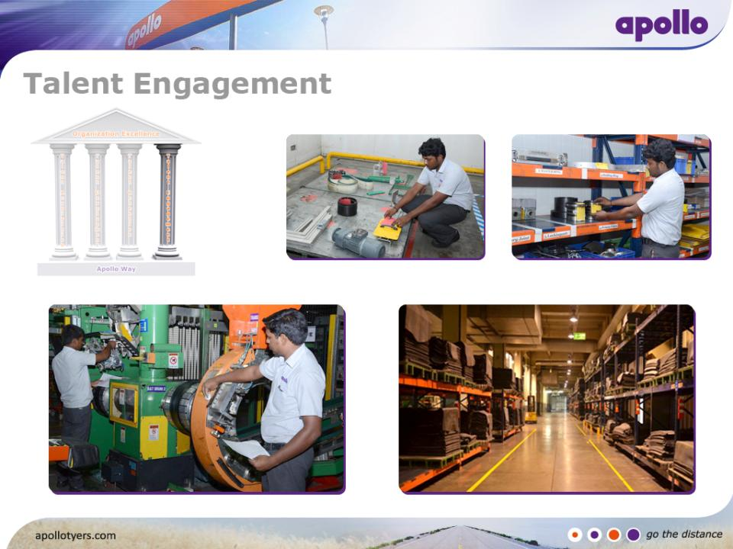
5S & JH Involvement

Slide 27
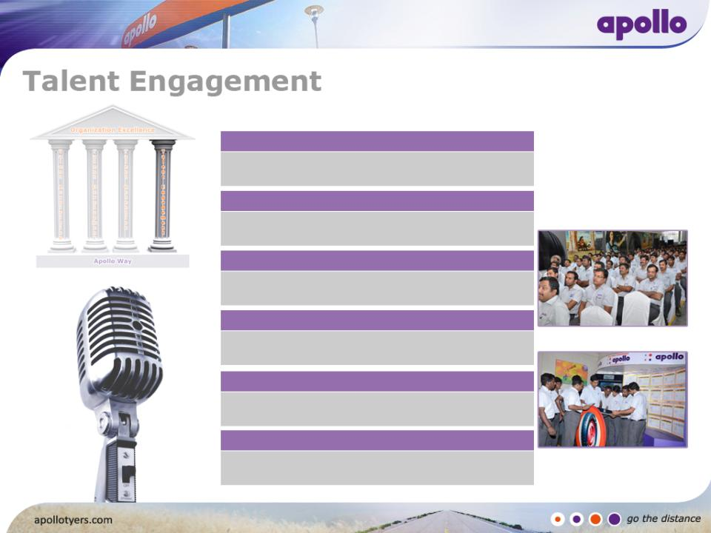
Communication
Yearly Communication
Strategy Setting
Quarterly Communication
Performance Review Quarterly Planning
Apollo Touch – Internal Newsletter
Monthly Communication
Communication Meeting
Weekly Communication
PA System
Daily Communication
Daily Work Management
Shift Communication
Tool Box Talk

Slide 28

Attrition Trend (SMT Members)
Employee Engagement Score
Number of Suggestions/Employee/Year
Employee Participation % in (6Sigma,QCC,SIP,Innovation)

Slide 29
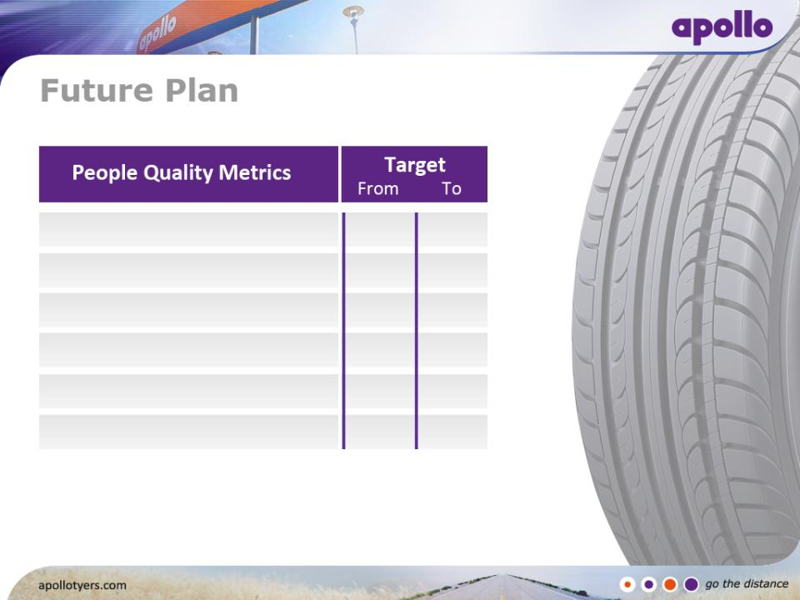
Employee Engagement Score %
82.5
90
Number of Suggestions / Innovation /
Kaizen per employee / Year
13.2
15
Training Mandays Per employee / Year
4
6
Employee Participation % in 6 Sigma, QCC, SIP
62
75
No. Of 6 Sigma Green Belts
32
300
LTIFR
2.18
0
“Quality through Total Employee Involvement ”

Slide 30


