Slide 1
National Conference On 10 Years of EA 2003
01.08.2013

Slide 2
Agenda
Power Sector Model Post Unbundling
Challenges
PPP Model Vs Franchisee
Multiple licensing
PPP Model in Delhi
Success story of PPP Model in Delhi

Slide 3
Power Sector Model Post Unbundling

Slide 4
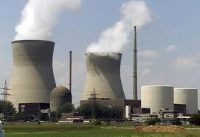
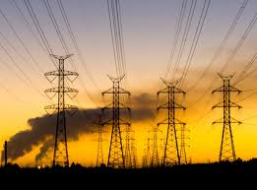
Power Industry – Value Chain
Power Industry – Value Chain Post Unbundling
Generation
Transmission
Distribution

Slide 5
Key Challenges

Slide 6
Key Challenges
Delayed Clearances on account of Land Acquisition
Against an assessed hydro power potential of 2.5 lac MW installed capacity is only 0.39 lacs MW
Absence of peaking capacities
Transmission
Inadequate Inter-regional transmission capacity
Southern Region – Congestion
Generation
During the year 2010-11, Power Utilities reported a generation loss of 8.1 BU due to shortage of coal.
CEA estimated total coal shortfall of 30% in next FY leading to increased dependency on imported coal
63% (i.e 11250 MW) of the Thermal Capacity Addition target was achieved

Slide 7
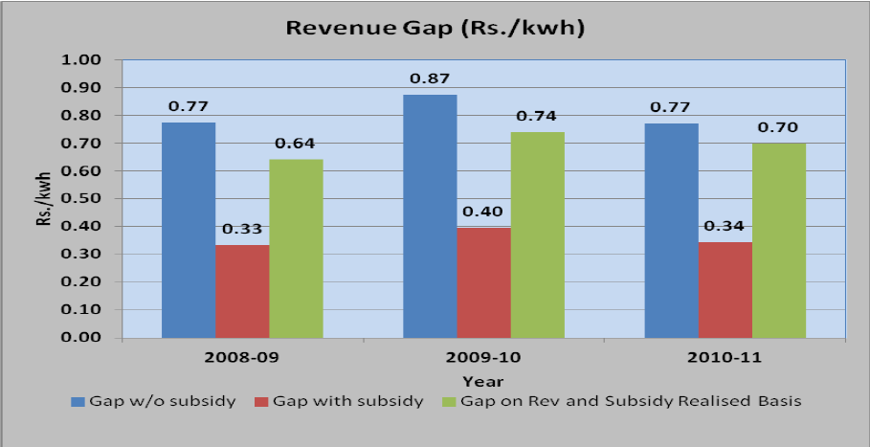
Key Challenges
Distribution
High AT&C Losses affecting commercial viability - National average of 26-27% vis-à-vis single digit in developed countries.
Absence of Cost Reflective Tariffs - Lack of commercial principles.
Huge Revenue Gaps for DISCOMs on account of Deferred Tariffs.
Accumulated Distribution losses in 2010 : Rs 1,07,000 Cr ; Rs 2,45,000 Cr in 2012; Expected to increase to Rs 2,90,000 Cr by end of XII Plan in 2017. (Planning Commission High Level Panel Report)
Power tariffs need to be raised by 47% for the DISCOMs to break even. (CRISIL Report)
Limited or no competition in Distribution space despite Regulatory Framework.
Source: PFC Report on Performance of State Utilities
Significant increase in tariff by SERCs across India in the last 2 years
Tariff hiked in 28 states in FY 13 & 15 states in FY 14 (20% to 37% )
Appellate Tribunal of Electricity has directed all SERCs to issue Tariff Orders annually, even suo-moto without requiring approval of Govt.
Source: PFC Report on Performance of State Utilities

Slide 8
Tariff – Comparative Scenario
Domestic Tariff Comparative Sheet Mou : Rs./Unit
States / Units | 100 | 200 | 300 | 400 | Hrs. of Load Shedding
Delhi (Revised w.e.f Aug 1, 2013) | 3.10 | 2.90 | 4.40 | 4.55 | Nil
Haryana | 4.04 | 4.90 | 5.02 | 5.16 | 4-6
Uttar Pradesh | 5.50 | 4.75 | 4.67 | 4.63 | 6-8
Kolkata | 5.04 | 5.69 | 5.93 | 6.44 | Nil
Mumbai | 3.26 | 4.51 | 4.86 | 5.04 | Nil
Andhra Pradesh | 2.93 | 4.09 | 4.94 | 5.55 | 6-8
Ahmedabad, Gujarat | 3.63 | 3.69 | 3.98 | 4.12 | Nil
Madhya Pradesh | 4.28 | 5.71 | 5.41 | 5.41 | 6-8
Bangalore, Karnataka | 3.94 | 4.40 | 4.88 | 5.12 | 4-6
Despite Improvement in Supply & Consumer Services, Lowest Average Tariff Among All Metros & Neighboring States

Slide 9
Distribution Sector

Slide 10
Distribution Sector
Distribution is a licensed activity under the EA 2003.
SERCs award distribution license.
85% of Distribution sector largely dominated by State Owned Electricity Boards.
TPDDL (Distribution) is Regulated by Delhi Electricity Regulatory Commission (DERC) who is responsible for determination of tariffs chargeable to consumers.
Mumbai, Kolkata, Ahmedabad, Surat, Greater NOIDA
Pvt
Orissa , Delhi
PPP
Govt. DISCOMs
Maharashtra (Bhiwandi, Nagpur, Jalgaon, Aurangabad), UP (Agra), MP (Gwalior, Ujjain, Sagar), Jharkhand (Jamshedpur & Ranchi)
DF
State-owned
DF – Distribution Franchisee; PPP-Public-Pvt Partnership

Slide 11
Reforms Model PPP Vs. Franchisee
Key Parameters
PPP Model
Franchisee
Control over Distribution
Govt Holding can safeguard the public interest
Franchisee is accountable to only the Discom
Network Strengthening & Loss Reduction
Capital investment made for sustainable improvement of the network and infrastructure
Capital investment only for meeting short term targets.
Reliable Supply
Based on requirement Licensee can procure additional energy subject to regulatory approval.
Current legal framework does not support Franchisee for procuring additional power.

Slide 12
Reforms Model PPP Vs. Franchisee
Key Parameters
PPP Model
Franchisee
Consumer Convenience
Performance parameters with regulatory control are built into the License conditions as per provisions of Act.
As Franchise is just a mere contractor under the DISCOM, so regulator can not monitor the performance .
Term of Engagement
The term of agreement to coincide with the period of license agreement as stipulated in the EA 2003
Shorter period not sufficient for Distribution Reform.
Employees
The employees can be transferred to the SPV and being a part of the joint venture, will be more motivated to perform.
Employees will remain with Discom.

Slide 13
Reforms Model Parallel Licensing
EA 2003 ….14… “Provided also that the Appropriate Commission may grant a license to two or more persons for distribution of electricity through their own distribution system within the same area….”
Could not pick up due to non-submission of network rollout plan and availability of information from the incumbent licensee etc..
Post Supreme Court Judgement dated 8th July 2008 unique successful case study of RInfra-D and TPC-D of have operationalized parallel distribution without duplicating the network.
The Electricity Act, 2003 has not envisaged distribution wires and retail supply as separate licenses, neither is the distribution wires business defined as an area monopoly. To what extent is retail supply competition envisaged in the Electricity Act, 2003???
In the absence of a competitive wholesale market, is there a case for introduction of competition in retail supply? Would competitive retail supply be sustainable?

Slide 14
Reforms Model Parallel Licensing
Need for Wire & Retail Supply Segregation
Approach to Wire & Retail Supply Segregation
Segregation of Accounts and Reporting Requirements
Possible ways to ring-fence wires and retail supply businesses, so as to avoid cross-subsidization between the two businesses
In the case of multiple distribution licensees, should all the licenses be regulated under the cost-plus regime OR only the incumbent licensee should be regulated under the cost-plus regime? OR should none of the distribution licensees be regulated under the cost-plus regime?Tariff Celing or not?
Migration of subsidizing consumers and financial implication on the distribution licensees
Standards of Operations & Operating procedures

Slide 15
TPDDL Case Study

Slide 16
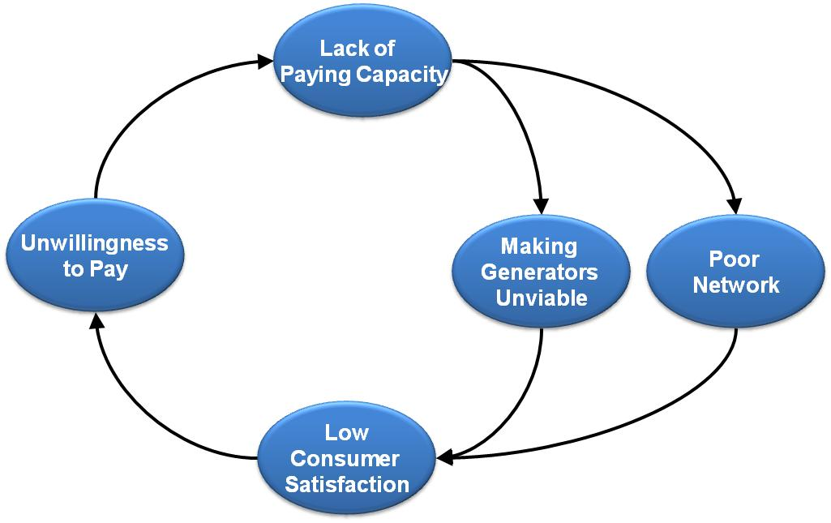
Scenario in Delhi Pre-Reforms 2002
AT&C/Theft losses range between 53% to 60% of Input
Govt. Subsidies approx. Rs 15,000 cr per annum to bridge Revenue Gap
Condition of Network pathetic
Billing Receivables close to 1 year outstanding
Poor Condition of Consumer Records
Consumer nowhere in focus/Regular - black outs and brown-outs of 4-6 hours
Investment needed to improve Network
Subsidies - not a long term solution; Sector to be made Self Sufficient
AT&C loss reduction and sector efficiency
Improvements required
Enhance consumer satisfaction
Introduce Best Practices, enhancing employee skill sets and
morale
Need for Reforms
Financially unhealthy utilities

Slide 17
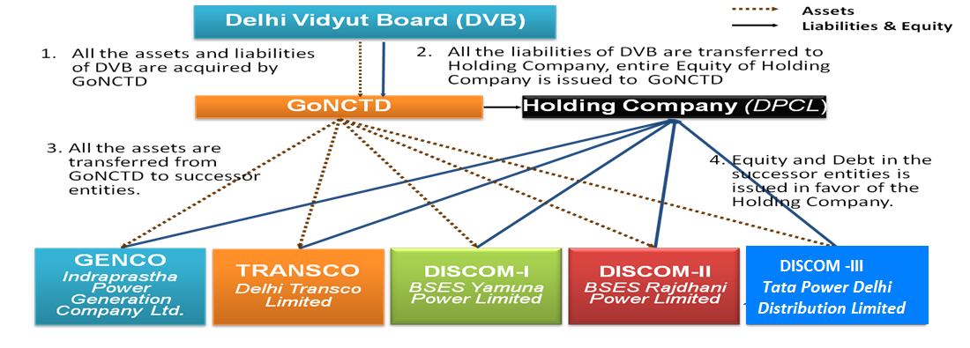
Privatization Model
License-based Regulated business for 25 years.
Guaranteed 16% RoE on meeting AT&C Targets.
Tariff set by regulator on cost plus RoE basis.

Slide 18
Key Drivers Impacting Business
Linked to investment of capital in the network
Return on Capital Employed
Profit Drivers
Reduction of AT&C Losses below stipulated norms
Incentives due to Over Achievement of Losses
Cost Optimization
Direct impact on Bottom Line
Additional Revenue Generation Opportunities
Enhancement of Bottom Line
Key Imperatives
AT&C Loss Reduction
Network Reliability and Availability
Consumer Service Improvement
Power Availability at Optimal Costs
Cost Optimization
Compliance to Performance Standards
Additional Growth Avenues

Slide 19
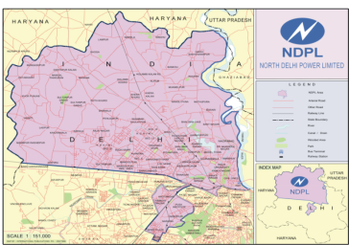
About TPDDL
About TPDDL
Parameter | FY 13
Turnover | INR 5644 Cr
Peak Load | 1573 MW
Annual energy requirement | 7762 MUs
Total registered consumers | 13.35 Lacs
Number of employees | 3612
Area | 510 Sq Kms
Population serviced in Network area (approx) | 6 Million
Number of consumers per Sq.Km | 2618
Joint Venture of Tata Power Company and Govt. of NCT of Delhi (51: 49)
Licensed for distribution of power in North and North West Delhi
Certifications : ISO 9001, 14001, 27001 ; SA 8000 ; OHSAS 18001
UN Global Compact Reporting

Slide 20
Turnaround Snapshot (1/4)
Parameter | Unit | Jul-02 | Mar-13 | % change
Operational Performance
AT&C Losses | % | 53.1 | 10.78 | 393%
System Reliability – ASAI -Availability Index | % | 70 | 99.94 | 43%
Transformer Failure Rate | % | 11 | 0.72 | 1428%
Peak Load | MW | 930 | 1573 | 69%
Length of Network | Ckt. Km | 6750 | 10364 | 54%
Street Light Functionality | % | 40 | 99.57 | 149%

Slide 21
Turnaround Snapshot (1/4)
Parameter | Unit | Jul-02 | Mar-13 | % change
Consumer Related Performance
Consumers | Lacs | 7 | 13.3 | 90%
New Connection Energization Time | Days | 51.8 | 6 | 763%
Meter Replacement Time | Days | 25 | 6 | 317%
Mean Time to Repair Faults | Hours | 11 | 1.2 | 817%
Payment Collection Avenues | Nos. | 20 | 5377 | 26785%
Consumer Satisfaction Index | % | - | 88

Slide 22
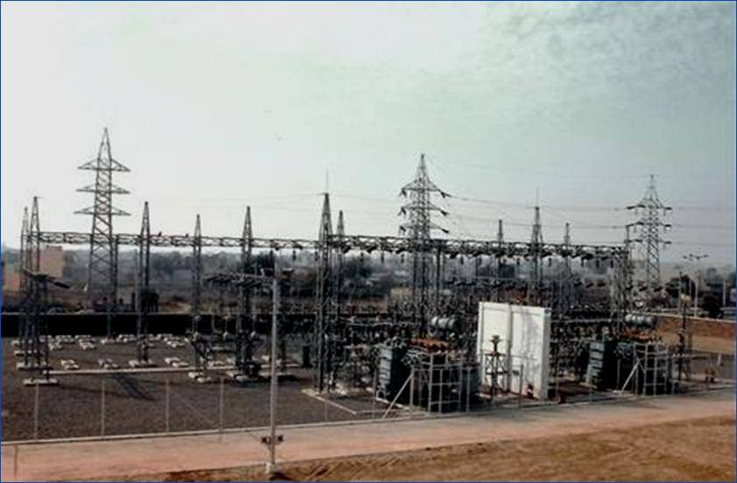
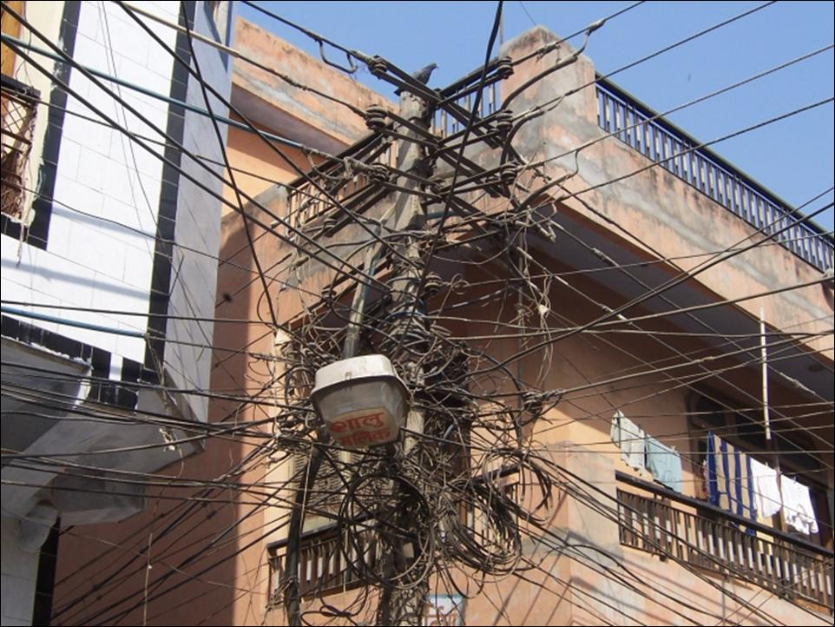
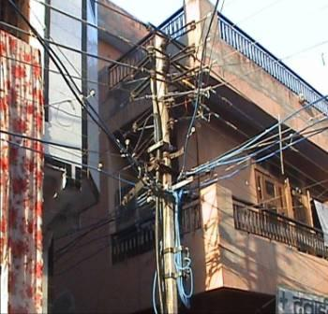
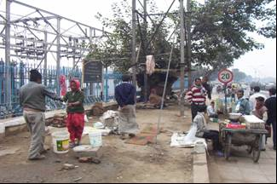
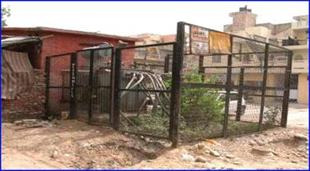
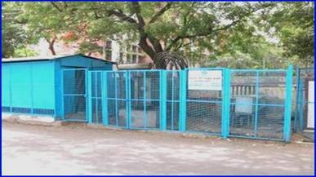
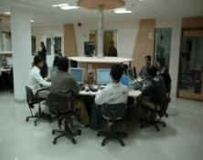
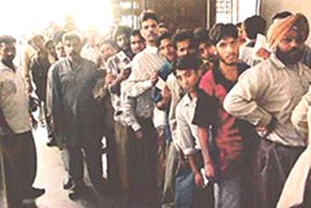
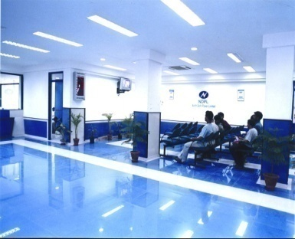
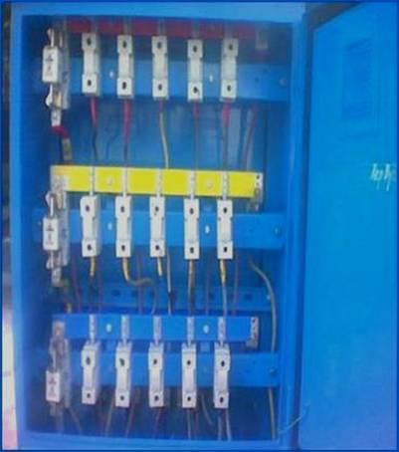
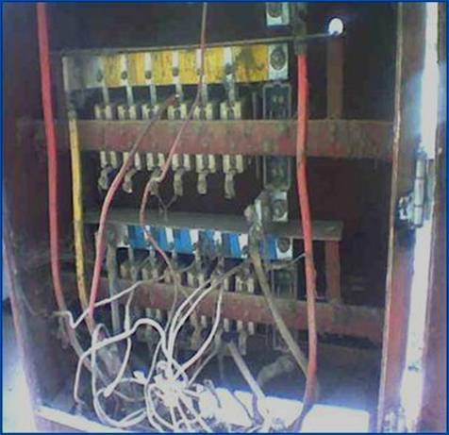
Turnaround Snapshot
Key initiatives to reduce losses : HVDS Implementation, Spot Billing, Instant Connections , LT ABC, Energy Auditing upto 4 level , GSM Based AMR, Mass Raids Replacement of Electromechanical meters with Electronic meters, creation of Special Consumer Group to take of Jhuggi Jhopri residents etc..
Key Technologies adopted: integrated GIS, SCADA, OMS, DMS,DA,AMI,SAP ISU etc..
Key initiatives to enhance consumer services like Integrated Call Centre, 24x7 Payment avenues, Client Managers, Dedicated consumer meets, SMS Based pull services, 14 Fully networked consumer care centers, Video Conferencing for Consumers etc..
This is a proprietary item of TPDDL. Any disclosure, copying or distribution is strictly prohibited

Slide 23
Initiatives: AT&C Loss Reduction
Smart Grid
Automated Demand Response
Prioritizing Focus
Outage Management System
Special Consumer Group
Aggressive Enforcement
Controlling theft through Community pressure
Automated Meter Reading for High Revenue Consumers
Unique Efforts appreciated nationally and internationally
High Voltage Distribution System & Low Tension Aerial Bunched Conductor
Electronic Meters
Energy Audit upto Distribution Transformer Level
Front runner in Technology Implementation to improve efficiency and consumer service delivery

Slide 24
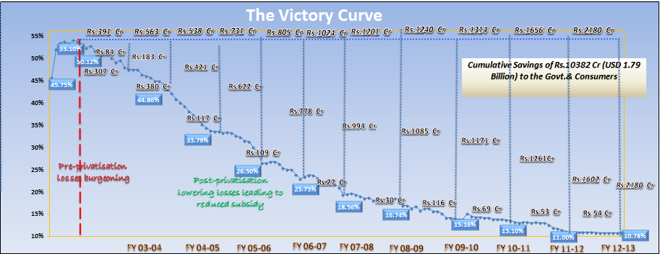
AT&C Loss Reduction – Benefit to Government
Saved over Rs. 10000 Crs. for Govt. in 11 years; facilitated development of other infrastructure; lower taxes
Repaid Rs. 550 Cr. loan to Govt.
Paid Dividends to Govt. and Tata Power for four years (FY 2005-06 to FY 2008-09)
Amongst lowest Tariffs in the country with highest availability and reliability of power

Slide 25
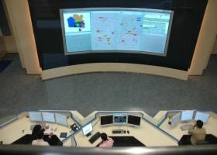
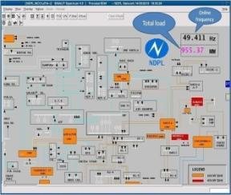
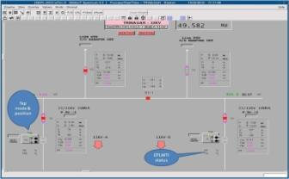
Adoption of Technology - Many firsts
SCADA
Monitoring of total load through SCADA
Cap on Tap
100% Automatic Voltage Regulation

Slide 26
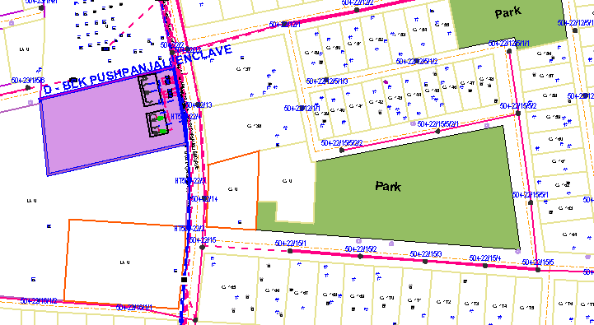
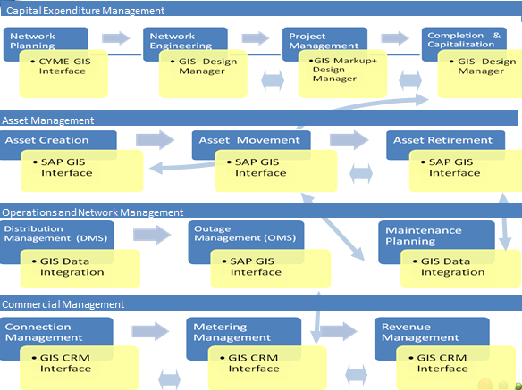
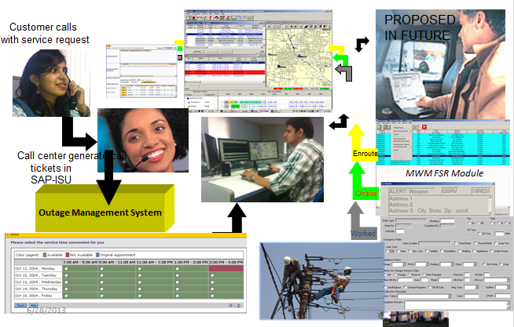
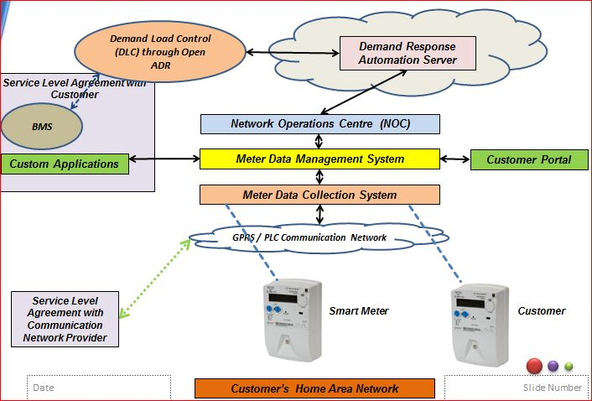
Adoption of Technology-Many firsts
Geographical Information System
Integration of GIS with Operational and Commercial Sys.
Integrated Call Center with BCM
Smart Grid Pilot Architecture
Integrated Outage Management System

Slide 27
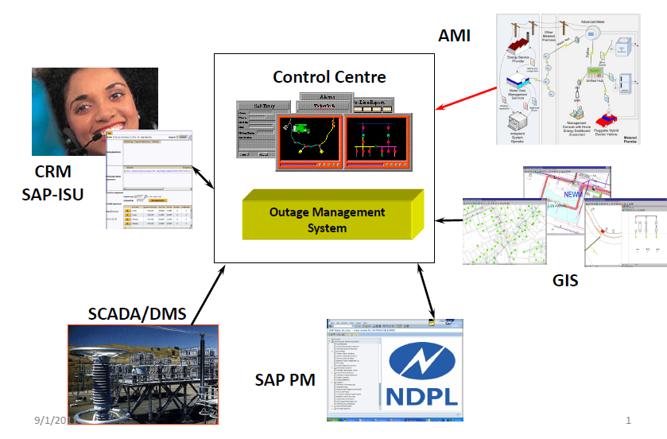
Initiatives: Outage Management System
TPDDL is the only utility in India to implement the INTEGRATED OUTAGE MANAGEMENT SYSTEM (OMS)
Geo referenced network details along with trouble order to the field crew
Prediction of the outage device thus curtaining diagnostic time
Management of crews assisting in restoration
Updation of CRM with status of on going and planned outages for intimation to customers
Actionable intelligent reports.

Slide 28
How Outage Management System Works
Localization of Faulty Section by Patrolling Line by Breakdown staff
Fault occurrence
Upstream Breaker Opens
FPI indicate fault
NO

Slide 29
Manual Isolation of Faulty Section
How Outage Management System Works
Manual isolation of the faulty section
Close NO point
NO

Slide 30
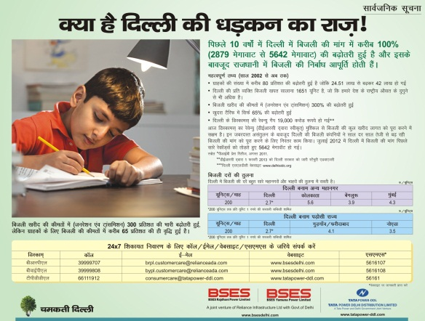
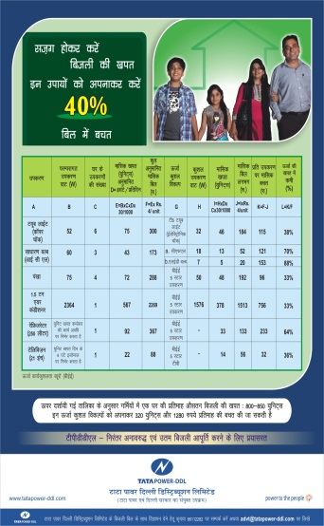
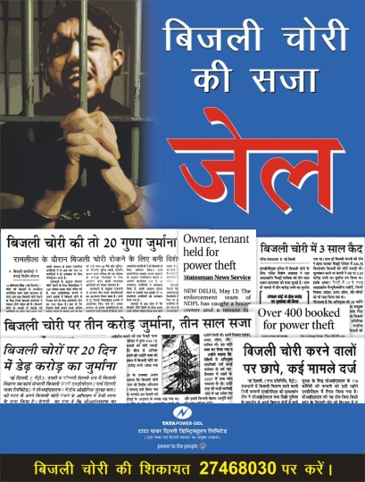
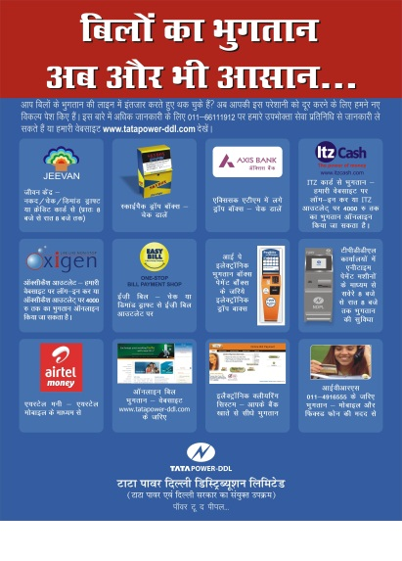
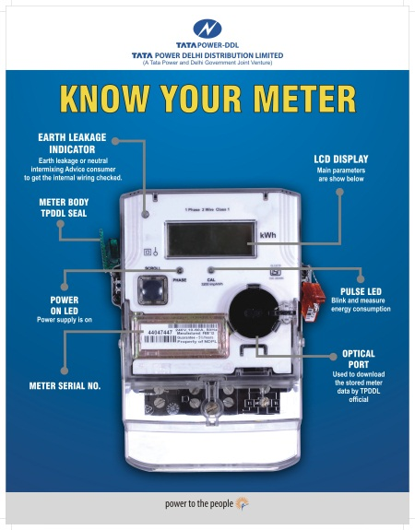
CONSUMER SERVICE INITIATIVES

Slide 31
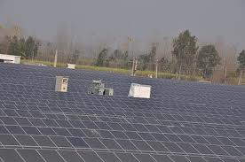
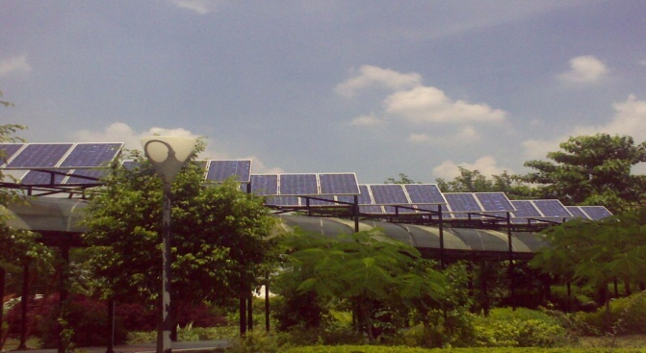
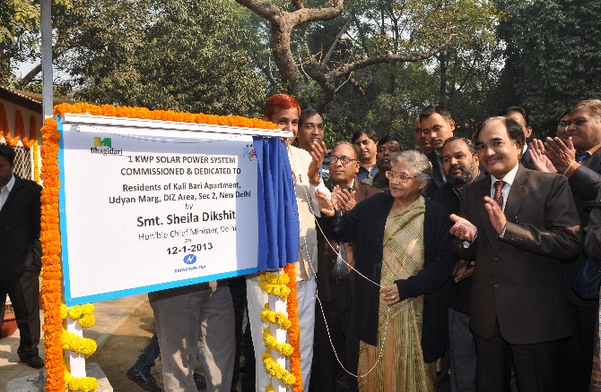
For Planet – Solar Generation
Initiated to meet Group Commitments on CC & Renewable Purchase Obligation (RPO) on the Delhi Electricity DISCOMS
Demonstrate the technical feasibility & economic viability of renewable generation in big cities like Delhi.
Installations:
1 MW solar roof-top plant – 1st in India
15 grid connected solar plants (total capacity – 1.65 MW) across TPDDL
Generation in FY 13 from solar plants – 20,84,400 units
12 plants in NDMC area for porta cabins & feasibility study on for street lighting
100 KW plant as consultant in Chotu Ram College in Haryana

Slide 32
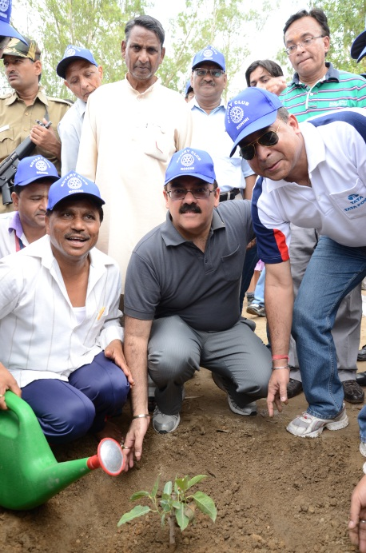
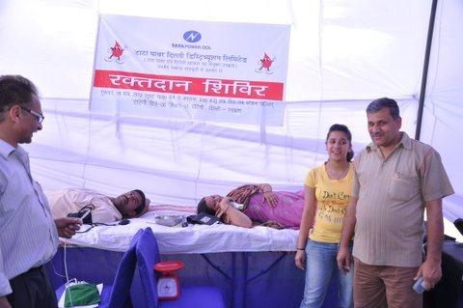
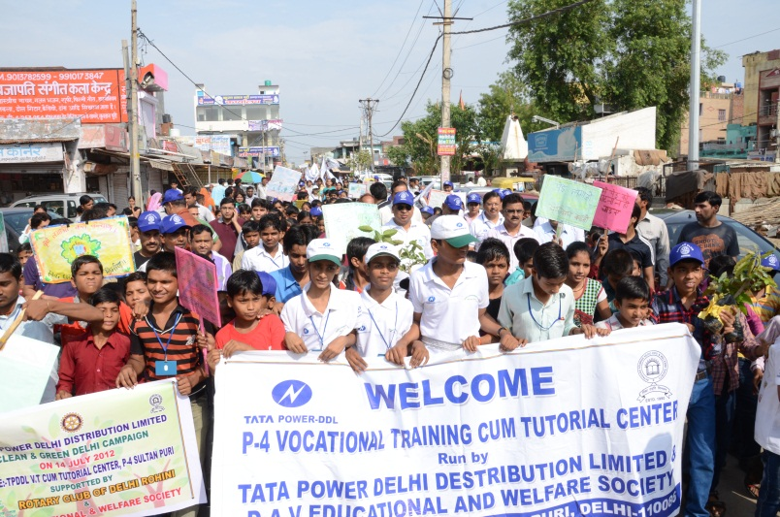
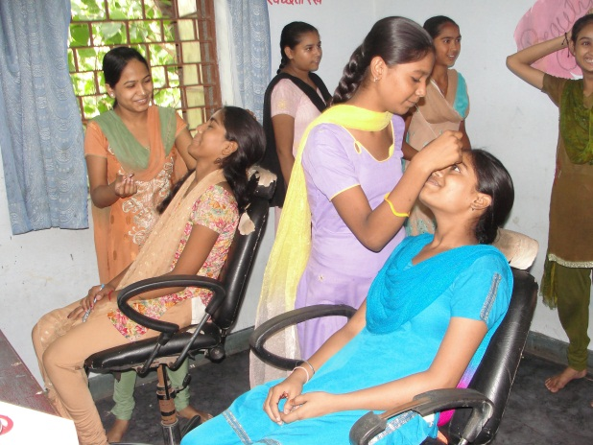
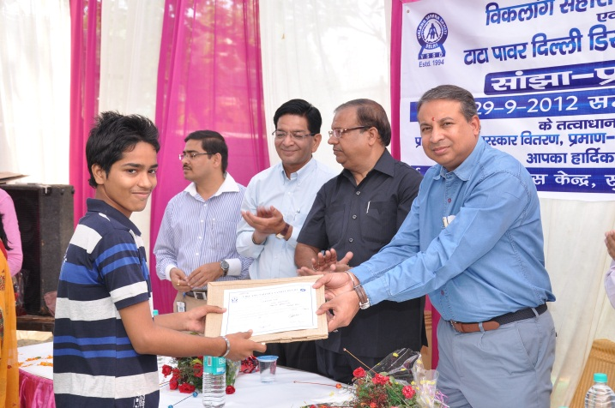
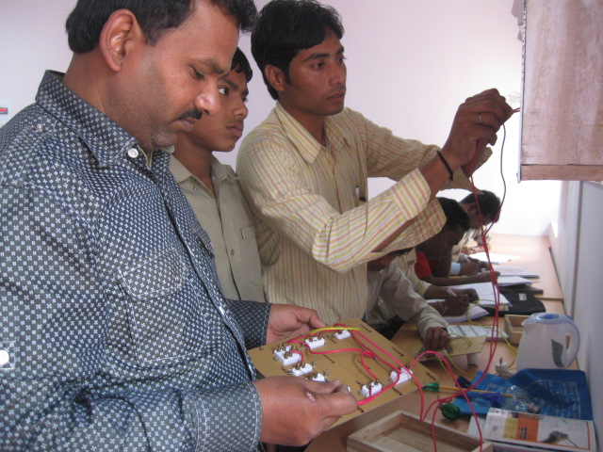
SUSTAINABILITY INITIATIVES

Slide 33
Vision towards Smart Utility

Slide 34
THANK YOU

