Slide 1

NATIONAL CONFERENCE
ON
“10 YEARS OF THE ELECTRICITY ACT, 2003: A CRITICAL REVIEW”
Role of Smart Grids in the Indian Power Sector: Current Developments, Challenges and Way Forward
Vikas Gaba
New Delhi, June 11, 2003

Slide 2
Structure
India’s energy realities and emerging needs
Smart Grids – Concept and Application Areas
Global Developments
Developments in India
Challenges to Accelerated Deployment
Way Forward

Slide 3
India’s Energy Realities and Emerging Need

Slide 4
India’s Energy Sector Realities and Emerging Needs
National Priorities | Current Situation | Implications
Meeting Demand Shortage | Chronic power shortages Rapid demand growth Inadequate energy access | Augmentation of generation capacity; efficiency improvement Power evacuation and grid access
Clean Energy Deployment | RE capacity increasing ~ 3000+ MW added each year | Require smarter systems for power balancing to deal with variability & unpredictability
Operational Efficiency Improvement | Poor operational efficiency High system losses R-APDRP has provided much needed support | Need for ability to control and monitor power flow till customer level
Enhancing Consumer Service Standards | Poor system visibility Lack of reliability | Real time system to enable better system visibility and consumer participation
Smart Grids can transform the existing grid into a more efficient, reliable, safe and enable address sector challenges.

Slide 5
What is Smart Grid?

Slide 6
Understanding Smart Grid
  System (G, T, D) with an advanced two-way communications system
  Enables real-time monitoring and control
  Provide greater visibility and transparency
  Consequently, enables cost reduction and efficiency improvement
Notes:
6

Slide 7
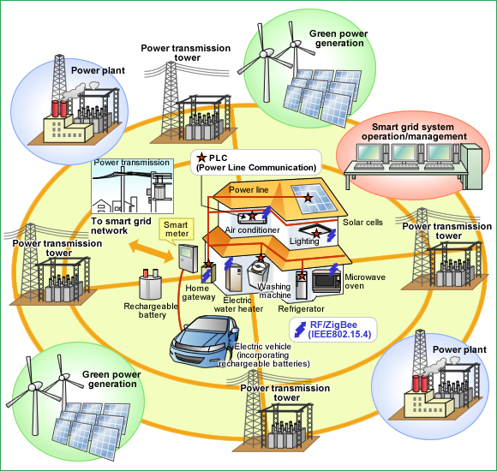
Several Potential Application areas exist
Electricity Distribution
Electricity Markets
Renewable Energy
Energy Storage
Transport
Industrial Energy Efficiency
Building Energy Efficiency
Source: http://www.renesas.eu/ecology/eco_society/smart_grid/

Slide 8
Globally, a number of initiatives have already started, most of it through strong support from the Government

Slide 9
Global Market Trends
Country | National Smart Grid Initiatives
China | The Chinese government has developed a large, long-term stimulus plan to invest in water systems, rural infrastructures and power grids, including a substantial investment in smart grids. China’s State Grid Corporation outlined plans in 2010 for a pilot smart grid programme that maps out deployment to 2030. Smart grids investments will reach at least USD 96 billion by 2020.
United States | USD 4.5 billion was allocated to grid modernisation under the American Recovery Reinvestment Act of 2009, including: USD 3.48 billion for the quick integration of proven technologies into existing electric grid infrastructure USD 435 million for regional smart grid demonstrations USD 185 million for energy storage and demonstrations
Japan | The Federation of Electric Power Companies of Japan is developing a smart grid that incorporates solar power generation by 2020 with government investment of over USD 100 million.

Slide 10
Global Market Trends
Country | National Smart Grid Initiatives
United Kingdom | OFGEM has set up a Low Carbon Networks fund that will allow up to GPB 500m support to distribution network operator projects that test new technology, operating and commercial arrangements.
France | The electricity distribution operator EDF is deploying 300000 smart meters in a pilot project based on an advanced communication protocol named Linky. If the pilot is deemed a success, ERDF will replace all of its 35 million meters with Linky smart meters from 2012 to 2016.
Brazil | Several utilities are managing smart grid pilots, including Ampla, a power distributor in Rio de Janeiro State owned by the Spanish utility Endesa, which has been deploying smart meters and secure networks to reduce losses from illegal connections. AES Eletropaulo, a distributor in São Paulo State, has developed a smart grid business plan using the existing fibre-optic backbone. The utility CEMIG has started a smart grid project based on system architecture developed by the IntelliGrid Consortium, an initiative of the California-based Electric Power Research Institute.

Slide 11
India guided by the developments at the global level, is slowly gearing up

Slide 12
Institutional Set-up for Smart Grids in the country
 | Indicates direct interaction among the entities
 | Indirect interaction among the entities

Slide 13
14 pilots supported by Govt. of India as “Proof of Concept”
National Priorities
Smart Grid Interventions proposed by the Utilities
Power Demand Shortage | Demand Side Management |  |  | Demand Response
 | Peak Load Management |  |  | Crew Management
Clean Energy | Renewable Energy Integration |  |  | Demand Response
Operational Efficiency Improvement | Theft Management & Tamper Detection |  | Asset Monitoring |  |  | Meter Data Management System
 | Substation Automation |  |  |  | AMI
Consumer Service Standards | Power Quality | Work Force Management |  |  |  | Outage Management
 | Automatic Billing |  |  |  | Consumer portal
Lot of additional work is happening on issues such as Demand response, Micro-Grids, etc beyond the 14 pilots

Slide 14
Challenges do exist

Slide 15
Key Challenges
Government Support – funding and to ensure coordinated development
National Road Map adopted but implementation wherewithal missing
Access of financial resources particularly due to poor financial health of the power utilities
Lack of Policy and Regulation related to Smart Grid applications
  No proven commercial viability of large scale smart grid implementation – Cost and benefit assessment (Most of the initiatives are pilots)
Development of Smart Grid Standards including pilot models that can be adopted by discoms based on their level of maturity to handle such applications
Ability of users to absorb implementation of advanced technology
Lack of awareness requiring knowledge creation, training and capacity building of both the utility and consumers
Electricity Act 2003 and the underlying policies does provide for introducing all of the above, however implementation mechanism have to be ensured

Slide 16
Way Forward
Goals in the National Road Map to be accompanied by implementation structure and mechanisms
Need for coordinated development nationally as well with international bodies
Development of SG Regulations: Optimal regulatory response is of immense importance to make the overall initiative successful and attractive to all parties
Need for creating awareness and acceptance of Smart Grid technologies
Process support to demonstrate commercially viable pilots to demonstrate success and dissemination of such initiatives to other utilities/users
Need to undertake initiatives to encourage indigenous vendor development for reduction of costs and ensure long-term service support

Slide 17
Thank You

Slide 18
Development Potential and Issues across application areas

Slide 19
Development potential & issues across various application areas
Application Area (Current Status) | Business Issues | Potential/Importance of Smart Grids
Distribution Inefficient Huge Theft Poor customer service & reliability | Lack of measurements and controls Antiquated technologies Poor business orientation | High (can bring rapid technological upgradation) Supports loss reduction and demand response
Markets >10% of overall electricity sale Affected efficiency gains Send price signals to consumption (distribution) | Poor networks. Problems in open access Inadequate Business Processes and Controls Poor cost signaling | High (Open access and controls can be very effectively supported)
Industrial Energy Efficiency Improving rapidly Signalled by environmental market | Lack of awareness | High (SG enables better load management through DSM and DR)

Slide 20
Development potential & issues across various application areas contd…
Application Area (Current Status) | Business Issues | Potential/Importance of Smart Grids
Environmental Markets (REC, PAT) Nascent, developing fast Closely linked to energy efficiency & renewables | Nascent, does not provide confidence to investments Baseline definition issues in (PAT) and monitoring Trading system needs refinement | High (SG can provide a strong information and controls base and also enable response to price signals)
Renewable Energy Fast developing Fills India’s Energy void | Variability management & storage Transmission networks and controls | Very High (SG can assist in grid integration, forecasting, balancing and storage)
Energy Storage Nascent in India Closely linked to RE & EE | Expensive Technological upgradation Space requirements | High (Has applications in energy storage, enabling provision for balancing power & islanding during blackouts)

Slide 21
Development potential & issues across various application areas contd…
Application Area (Current Status)` | Business Issues | Potential/Importance of Smart Grids
Transport Largest energy sub-sector after electricity Pollution a significant issue Only Hybrid Vehicles (fossil fuel + EV) available Current focus only on mobility and associated environmental issues | EVs are expensive Inadequate infrastructure for deployment and proliferation Regulatory Issues | High SG can integrate with grid and reduce short term power purchase; use as balancing resource; peak load management)
Building Energy Efficiency Fastest growing energy consuming sector Widely varying energy efficiency levels | Lack of awareness among builders and consumers High initial cost of EE appliance | High. Smart Grid can enable real time consumption monitoring and control;, enabling reduction of wasteful consumption

