Slide 1
NATIONAL CONFERENCE ON: “10 YEARS OF THE ELECTRICITY ACT, 2003: A CRITICAL REVIEW”
SECTOR PERFORMANCE AND REGULATION
Presentation
by
Prayas Energy Group
1 August 2013

Slide 2
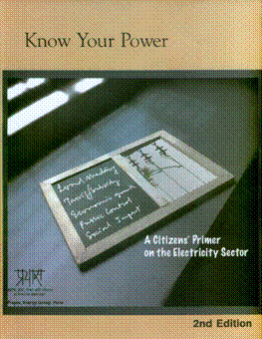
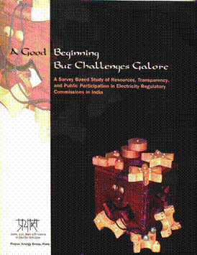
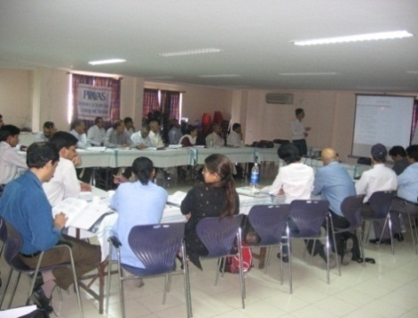
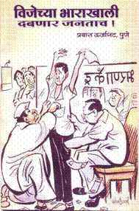
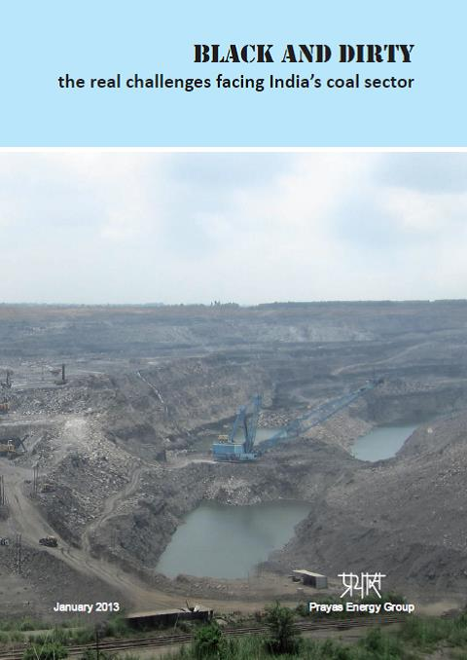
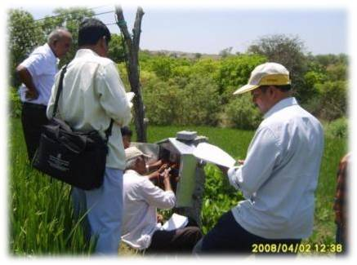
Prayas - Energy Group
Energy (Policy, Planning & Governance)
Electricity Regulation
Rural Energy
Renewable Energy
Coal, Natural Gas Regulation
Climate Change
Energy Efficiency

Slide 3
Outline
Some of the key reform provisions in the Act
Ensuring electricity for all
Protecting consumer interest
Improving performance and encouraging efficiency
What have we achieved
Challenges and way forward

Slide 4
The ‘happening sector’
Capacity Addition
ICT applications
Renewable
Political & Policy support
Massive investment
High interest of Indian and international players
Climate & fuel challenge
Market operation
Transmission & Grid
End-use efficiency
Distribution & Supply
Rural electrification

Slide 5
Electricity Act 2003: Reform agenda
Preamble: An Act…for taking measures conducive to:
protecting interest of consumers and supply of electricity to all areas,
rationalization of electricity tariff, promotion of efficient and environmentally benign policies,
Sec 6: Rural electrification: Joint responsibility of State & Central Government
Jointly endeavour to provide access to electricity to all areas including villages and hamlets through rural electricity infrastructure and electrification of households
Sec 61: Tariff regulations
Encourage competition, efficiency, economical use of the resources, good performance and optimum investments;
Safeguarding of consumers' interest and at the same time, recovery of the cost of electricity in a reasonable manner; rewarding efficiency in performance;
Sec 86. Functions of State Commission:
Ensure transparency while exercising its powers and discharging its functions.

Slide 6
RGGVY: Major step forward
Commitment through National Electricity Policy 2005
ensure minimum lifeline consumption 1 unit/household/day as a merit good by 2012
Major GoI programme for rural grid extension
90% capital subsidy, 10% loan from REC, Total investment of ~Rs. 90,000 Cr
Discom to ensure 6-8 hrs supply to newly connected HH
Status - time and cost overruns, quality concerns
Achievement:
1.8 Cr HHs provided connection, Village electrification increased to 92%
Key challenge:
How to ensure adequate hours of supply on these rural feeders?

Slide 7
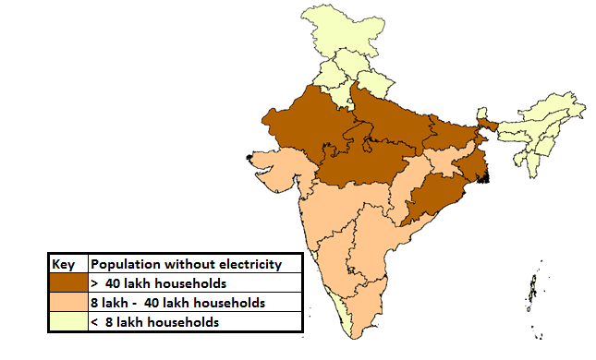
Low levels of household electrification – nearly 8 crore households to be electrified
Source: Census 2011

Slide 8
Uncomfortable truths
Slow progress of household
electrification
Large proportion of APL households without access
Source: NSSO 2008-09

Slide 9
Poor are missing the electricity bus
1 out of every 5 persons in world without electricity access lives in India
45% of India’s rural households do not have access to electricity.
Electricity supply increased 75%, household access by 11% in last decade
Most consumers poor: those paying monthly bill > Rs 150: 45% of households
Anecdotal/typical data
Average hours of supply in rural areas: 2-6 hours
De-electrification of villages: 10%
Un-authorised connections: 30%
Permanent disconnections: 15-20%

Slide 10
Structural disincentive to supply to rural households
Needs increase in overall tariff
*without accounting for the fact that this power will be required at peak hours and hence will be costlier
Marginal Power purchase cost in Rs/u | 3.5*
PP cost after accounting for Dist loss of ~20% | 4.4
Distribution margin in Rs/u | 1.0
Total cost of supply in Rs/u | 5.4
Revenue from sale to electrified HH in Rs/u | 1.5
Loss per unit | 3.9

Slide 11
Some action ideas
100 x 100 connection drive
Offer connections to all within 100 meters of the power line, incentivise staff to meet connection targets
Recover the cost through ARR or State support
Transparency and accountability in Load shedding
SERC should decide Protocol through consultative process
Address structural dis-incentive for DISCOMs to supply to rural household
Make low cost power available and ensure zero load shedding in few select areas
Third party audits of DISCOM metering and billing
80% of complaints to CGRFs on metering & billing
Underreporting of consumption of high end consumers and over-reporting of consumption of small consumers
Make grievance redressal mechanisms effective
Improve implementation through better DISCOM reporting formats, third party audit, raise compensation from employee – not ARR

Slide 12
Institutional aspects
State Regulatory Commission key institution for ensuring transparency and protecting consumer interest
Viewed from limited mandate of increasing tariffs
Appointments is the most crucial issue
CGRF and Ombudsman responsible for grievance redressal
Not appointed in timely manner
Lack of support
Non-compliance of their orders
CEA: Collate and analyse key sector data and develop plans and report
more comprehensive status of generation capacity addition status
Need to focus on gathering more data from primary sources rather than relying on state utilities for information. Example, collating data from 11kV feeder meters to analyse actual hours of supply

Slide 13
Regulatory Appointments
Till 2008, average duration for vacancies was 19 months for members and 7 months for a chairman
Post-2008, it is 8 months for members and 6 months for chairman.
Background of SERC Member and Chairpersons
Trend in case of members
Trend in case of Chairperson

Slide 14
Public participation in regulatory processes
Only 4 commissions have appointed consumer representatives under section 94(3)
Only MH invites consumer representative for all proceedings
No funding to promote consumer participation
No institutional mechanism
More than half of the commissions do not have hearings in multiple locations for a single discom.
Large states like Rajasthan MP, Orissa, Karnataka and have hearings in a central location
11 states have multiple discoms and only 7 have hearings in areas of licensee.
Only 7 SERCs publish regulations in a regional language and upload them on their website

Slide 15
Listen to the poor: Bring their voice into regulatory forums
SERC to have Capacity building programs in line with National Electricity Policy and FOR reports
Officers to interact with small consumers and to identify, support pro-poor groups.
Public hearing on important issues at multiple locations. Separate public hearing on issues like load shedding, rural quality of service
All reports and material to be available in local languages and have audio-visuals
Consumer surveys with participation of consumer groups

Slide 16
Ensuring efficiency in performance
Planning processes
Most DISCOMs and SERCs do not undertake independent demand-supply assessment
Lack of power purchase planning leading to high cost short term power purchase
Large scale capex plans being approved but no post facto cost-benefit analysis
No third party audit or verification of efficacy and prudence of capex undertaken
Metering and billing systems
11 KV feeder data not available and/or reliable
No audit of IT systems used for billing
Division-level energy audit information is not available, many ERCs do not seek this data
Standards of performance
Compliance is still an issue, very few ERCs report this data in a useful manner
Reliability indices, no benchmarking

Slide 17
Improving regulatory capacity to improve sector efficiency
SERCs can undertake independent studies for comprehensive demand assessment, load profiles
CEA can be a knowledge partner
Undertake public consultation on power purchase planning based on well studied comprehensive background/approach paper
Tariff regulations and MYT implementation needs to reviewed with a focus on efficiency improvement
Third party independent audit of Capex implementation and its cost-benefit analysis
Undertake public process to evaluate such assessments

Slide 18
What should be done
DISCOMs, SERCs, FOR, Governments and Government agencies have roles
Efforts needed to regain credibility of regulatory institution
Ultimate aim should be to ensure good quality, affordable power supply to all people
Competition and financial viability is a means and not an end
Start by replicating ideas already implemented in some States
Relevant issues to be simultaneously taken up

Slide 19
Thank you!
Prayas Energy Group
www.prayaspune.org/peg

