Slide 1
10 years of Electricity Act 2003: Competition in Electricity
Dr. Rajiv Kr. Mishra
ED, PTC India Ltd.

Slide 2
Scenario before Electricity Act 2003
Before Electricity Act 2003, generators as well as consumers were bound to a particular discom
No choice to sell or buy from
This model was sometimes misused by discoms – payments were delayed
World over, competition and market development resulted in
Significant gains in efficiency
Lower costs
Reduced fuel use
Environmental controls
Fewer power plants needed to meet the demand
With these basic presumptions, Electricity Act 2003 was introduced

Slide 3
Electricity Act 2003 and Competition
Electricity Act 2003 introduced various enabling provisions for creating a vibrant power market in the country
“Promoting competition” one of the objectives of the Act
Recognition of ‘Electricity Trading’ as a distinct activity
‘Open Access’ was defined
Providing non-discriminatory OA – one of the functions/duties of Transmission Utilities & Licensees (Section 38)
OA to be provided to everyone having load more than 1 MW within 5 years from notification of the Act (Section - 42)
Appropriate Commission to consider factors which would encourage competition while specifying terms and conditions of tariff determination (Section- 61)
Promotion of competition – one of the functions of Commissions (Section 79)

Slide 4
Competitive Bidding
Case-1, case-2 bidding were viewed as fundamental change to attract private sector and discover competitive prices
However, serious issues persists
Lack of capacity/inadequate preparation for handling competitive process at utility level
Inequitable risk sharing
Fuel risks and foreign currency risks passed on to bidders
Long drawn negotiation process
Frequent changes and non-finalization/cancellation
Numerable cases where commitments were not fulfilled as per LOI or even LOI was cancelled either by procurer or by developer resulting in shortage of power for procurer and loss of opportunity for developer
Lock-in period for developers
Investments stuck up
There are few successes and the process of procurement through case-1 bidding has either stalled or has not given optimum benefits
Examples

Slide 5
Open Access
Two types of OA
OA in Transmission (for Generators and Distributors)
OA to consumers (for retail or industrial consumers – having load more than 1 MW)
Benefits
Enable competition in generation & supply – choice to discoms and bulk consumers
Would facilitate power trading and redistribution of surplus across the system
Higher techno-economic efficiencies
Optimal utilization of wires
Essential for much needed private investment
Quality and reliable power supply
Difficulties in full scale implementation of OA

Slide 6
Open Access contd…
Provided on month to month basis
States invoked Section 11 of the Electricity Act to disallow OA to generators within the state which is meant to be invoked only in extraordinary circumstances, not to restrict open access
Distribution companies (Discoms) are resistant to giving OA to industrial consumers (bulk consumer category), since industrial supply rates are usually high
Since most of distribution utilities are facing shortages, providing OA would be beneficial to them as they would be provide more reliable supply to existing customer
High cross-subsidy and wheeling charges are one of the major deterrents in availing OA
Sometimes, metering infrastructure and mechanism to settle deviations not in place
Congestion in transmission another bottleneck

Slide 7
Way Forward
Best system is one where consumer has a choice that comes out of competition
Competition and markets do not have to wait for shortages in supplies to be overcome
Trading is a bridge even in shortage situations
Immediate need for strengthening transmission network
Bottled up capacities of IPPs and CPPs need to be tapped in a commercial way
Vital necessities for competition (lessons from around the world):
Adequate availability of power
Its unrestricted flow across geographical boundaries
Strong commercial mechanism
Paying ability of consumers
Enabling rules and regulations at each level (intra and inter state)
Reasonable wheeling, cross-subsidy and other charges

Slide 8
Visit us at www.ptcindia .com

Slide 9
Indian Power Market
Power Trading growth
Absolute volume has grown from 22 BUs in 2008 to 99 BUs in FY13
As percentage of total generation, ST market has grown from 3% in 2008 to 11% in FY13
Power Exchanges started in 2008
Two exchanges – IEX and PXIL
PTC co-promoter of first National PX Indian Energy Exchange (IEX) – has > 97% market share
Type of Trades
Day Ahead Market (DAM) – 95% of PX trades
Term Ahead Market (TAM) – 5% of PX trades
Renewable Energy Certificates (RECs)
Development of Power Trading has created Market Structure facilitating private investment in the sector

Slide 10
Power Market Over the Last Two Fiscals
Growth of Different Components of ST Market
Year | Bilateral (Traders + TAM) | Direct Bilateral | Power Exchanges (PX) (Only DAM) | Unscheduled Interchange (UI) | Total Volume in ST
2011-12 (MU) | 35840 | 15370 | 15550 | 27760 | 94510
2012-13 (MU) | 36638 | 14519 | 23024 | 24759 | 98940
Growth (%) | 0.21 | -5.55 | 55.34 | -10.80 | 4.69
Share of Different Segments in Total ST Volume
Source: CERC

Slide 11
Bilateral vs Power Exchange Prices (Rs./kWh)
Buyers ready to pay premium for certainty in Bilateral contracts
Bilateral prices more or less stable whereas PX prices highly volatile
Source: CERC Market Monitoring Cell’s reports

Slide 12
Power Exchange Rate in NEW & SR (Rs./kWh)
Fragmented market
SR facing deficit, higher prices
Interconnection expected by Mar’14
Source: IEX website

Slide 13
State-wise Power Demand (MUs)
Source: CEA

Slide 14
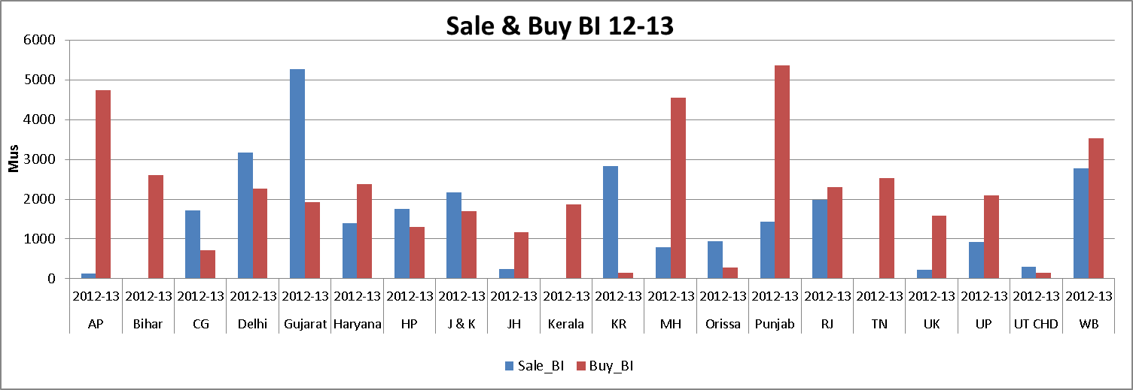
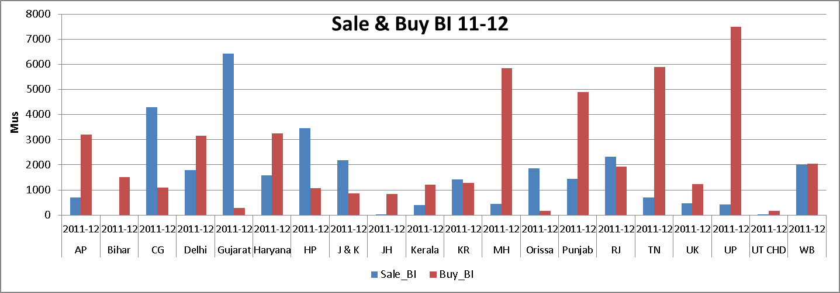
State-wise Power Trade: Bilateral
Source: CERC MMC Reports

Slide 15
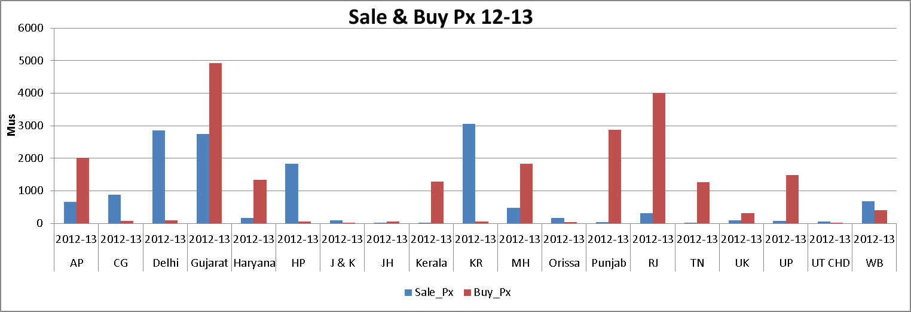
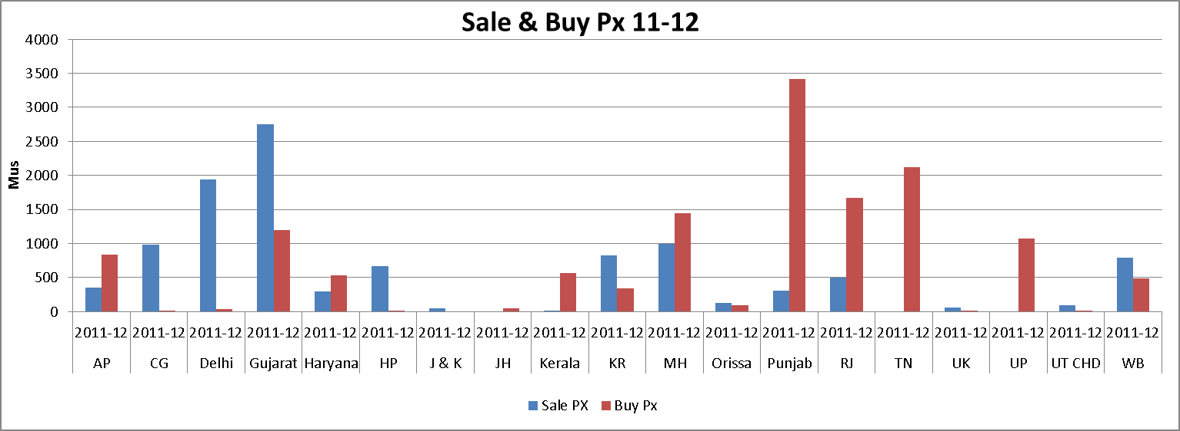
State-wise Power Trade: Power Exchanges
Source: CERC MMC Reports

Slide 16
State-wise Power Trade: UI
Source: CERC MMC Reports

Slide 17
Competitive Bidding: Examples
Maharashtra (300 MW)
JSW (Ratnagiri) won bid for 300 MW – PPA signed in 2010
It was asked to install Flue Gas Desulphurization System (FGD) by government authorities which it cited as ‘Change of Law’ and want to get out of PPA
Adani’s Mundra Project
PPA with Gujarat (1000 MW) and Haryana (1425 MW)
In December 2009, it unilaterally terminated the said PPA citing unavailability of coal from Gujarat Mineral Development Corporation (GMDC)
Tata’s Mundra Project
Country’s first UMPP (4000 MW)
Petitioned before CERC to increase tariff citing change of law in foreign country
CERC Order
CERC has concluded that there is a case for compensation on account of change in law in foreign country but the order is yet to be implemented
Back

