Slide 1
African Agricultural and Mechanization Trends

Slide 2

Mechanization Trends in Africa
  Macro Economic Review
  Growth
  Demand
  Crop Value

Slide 3
Global Macro Economy
World GDP growth
Source: International Monetary Fund (IMF), World Economic Outlook , October 08, 2013
Notes:
Last Checked: 4/16/2013
Frequency: WEO database is release each April and October (twice a year) – updated in January and June/July
Data Source: IMF, World Economic Outlook Update, Oct. 2012
Site: http://www.imf.org/external/ns/cs.aspx?id=28
Data File: JBP Presentations\Data\Current\IMF GDP.v2.xlsx
Instructions:
1. Visit IMF Website: http://www.imf.org/external/ns/cs.aspx?id=28
2. Select Country Groups
3. Select World (might as well download World, EU, Africa, Central & Eastern Europe, Commonwealth of Mongolia, Developing Asia, Middle East, Western Hemisphere)
4. Select the first option of GDP constant prices, annual percent change
5. Select the appropriate years and hit produce report
Amended Instructions:
- Download GDP annual percent change, constant prices for:
- All regions/Groups
- All countries

Slide 4
Sub-Saharan Africa
GDP Growth
2000/12 Avg.
= 5.5%
Source: International Monetary Fund (IMF), World Economic Outlook , October 08, 2013
Notes:
Last Checked: 4/16/2013
Frequency: WEO database is release each April and October (twice a year) – updated in January and June/July
Data Source: IMF, World Economic Outlook Update, Oct. 2012
Site: http://www.imf.org/external/ns/cs.aspx?id=28
Data File: JBP Presentations\Data\Current\IMF GDP.v2.xlsx
Instructions:
1. Visit IMF Website: http://www.imf.org/external/ns/cs.aspx?id=28
2. Select Country Groups
3. Select World (might as well download World, EU, Africa, Central & Eastern Europe, Commonwealth of Mongolia, Developing Asia, Middle East, Western Hemisphere)
4. Select the first option of GDP constant prices, annual percent change
5. Select the appropriate years and hit produce report
Amended Instructions:
- Download GDP annual percent change, constant prices for:
- All regions/Groups
- All countries

Slide 5
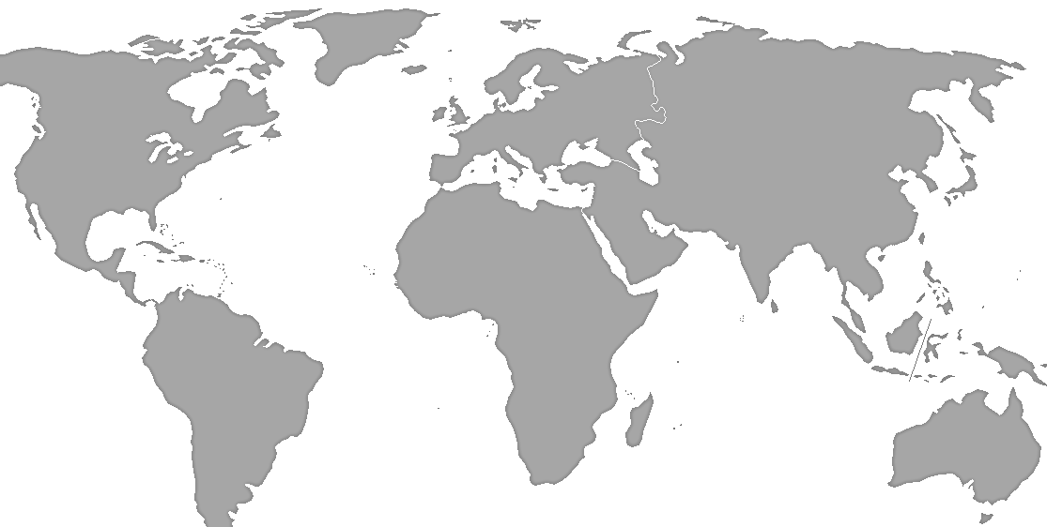
Population Growth in Emerging Markets
Geographic Distribution of Population Growth, 2000 to 2013
2050
2000
2013
9.6B
6.1B
7.2B
1.1B
1.2%
4%
56%
30%
9%
*More Developed Regions: Europe, North America, Japan, Australia, New Zealand
Source: United Nations, World Population Prospects 2012 Revision
Notes:
Spreadsheet – population for ppt – under Population folder on shared drive
Spreadsheet should automatically update after 1st population spreadsheet is updated.
Last Checked: 5/5/11
Frequency: Every 2 years, in March-May timeframe
Source/Report: United Nations, World Population Database – 2010 Revision
Website last updated: May 3, 2011
Site: http://esa.un.org/unpp/
Data File Name: population for ppt – under Population folder on shared drive
Instructions:
Spreadsheet should automatically pull from updated UN Population spreadsheet.
Update links on the following 2 hidden slides.
Regularly copy/paste from following 2 hidden slides.
Manually update data tables.

Slide 6
Global Grains
Production and Consumption
Consumption has exceeded production 8 of the last 14 years
Source: USDA/WASDE, September 2013
Notes:
Data based on 5/10/13 Grains release of data in the PSD database (updated monthly around between 10th and 12th of month)
Website to download data is the USDA production, supply and distribution database. Perform a custom query and select the grains identified below: http://www.fas.usda.gov/psdonline/psdQuery.aspx
Select grains and pulses under the commodity filter
Select the first nine grains including Barley, Corn, Millett, Mixed Grain, Oats, Rice (milled), Rye, Sorghum, Wheat – only skipping the last grain of “wheat – durum”. Click the summarize button
Select production and domestic consumption (select Ending Stocks as well to get all data for next slide).
Select “World Total”
Select the desired years
Export data to Excel and copy and paste updated data into existing file
Upcoming Releases of data:
Sept 10, 2010 9:00 AM Grains: Production Supply and Distribution
Oct 8, 2010 9:00 AM Grains: Production Supply and Distribution
Nov 9, 2010 9:00 AM Grains: Production Supply and Distribution
Complete schedule of releases:
http://www.fas.usda.gov/psdonline/psdSchedule.aspx

Slide 7
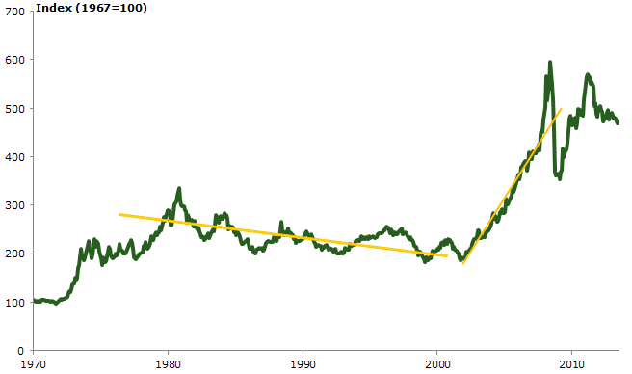
CRB Futures Index – All Commodities
January 1970 – September 2013
Source: Informa Economics, September 2013

Slide 8
Key Messages
The potential for increased Ag production in Africa is enormous and some countries matter more than others
Factors other than agronomic potential will enable or constrain each country’s growth potential.
Notes:
8

Slide 9
Key Messages
The potential for increased Ag production in Africa is enormous and some countries matter more than others
Factors other than agronomic potential will enable or constrain each country’s growth potential.
Notes:
9

Slide 10
Gross value of crop production in SSA* totaled $201 Billion in 2010, and was largely the result of a few key crops
Yams | $30.9 billion | (15.4%) |  | Sorghum | $8.8 billion | (4.4%)
Cassava | $24 billion | (11.9%) |  | Fruit | $29.6 billion | (14.7%)
Rice | $17.8 billion | (8.8%) |  | Vegetables | $22.5 billion | (11.2%)
Maize | $13 billion | (6.4%)
Cereals
Roots & Tubers
Fibre Crops
Oilcrops
Pulses
Treenuts
Vegetables + Melon
Fruit
Production Value
Harvested Area
Source: FAO, Harvested Area (185M ha) * 26 countries reporting
Notes:
File: Crop Production Value.xls
Source, FAO

Slide 11

18 countries account for 85% of the harvested area of all crops in SSA with high agriculture potential and macroeconomic and geopolitical stability.
Africa
2007-2011 Average Harvested Area (Million Hectare)
*
SOURCE: FAO, 2007-2011 Average
* Data representative of Sudan (former), majority of harvested area in current South Sudan
Notes:
Source of chart: Key Crop Summary.xls, Tab: Top 18 country harvest area

Slide 12
Current yield attainment is generally higher in developed countries as a result of better agronomic practices. Potential yield is driven by the climatic fit of each crop.
Maize
Rice
Ton/ha
Ton/ha
Potential Yield
(ton/ha)
Current Yield
(ton/ha)
Yield
Attainment %
Source: Foley at al. nature10452-s1.pdf
Notes:
File: Potential Yield total by key regions and crops

Slide 13
Smallholders manage the vast majority of farmland in SSA
They account for 80% of the harvested area
 | Harvested Area (M Ha) | % of Total Area
Cereals | 92.2 | 50%
Oil Crops | 27.5 | 15%
Roots & Tubers | 23.9 | 13%
Pulses | 20.6 | 11%
Fruit | 9.1 | 5%
Vegetables | 5.2 | 3%
Fiber Crops | 4.2 | 2%
Tree Nuts | 2.2 | 1%
Total | 185
Africa
Customer Segment | Harvested Area (M Ha) | % of Total Area
Smallholder (working up to 10 Ha) | 148 | 80%
Commercial | 37 | 20%
SOURCE: FAO Smallholder Factsheet

Slide 14
Asia & Africa Agricultural Customer Census Data
Less than 12% of African farmers own 4 wheeled tractors,
40% of them are also working as contractors
% of Contractors
19%
5%
22%
5%
China
87%
12%
1%
0.3%
India
3%
52%
41%
3%
0.2%
Asia
98%
1%
0.2%
0.8%
SSA
(Less
RSA)
8%
84%
9%
0 0.25 0.5 1 2 5 10 25 100 (in Hectare)
Land Holding Size
Subsistence Famer | Micro Holders | Small Holder | Medium Holders | Large Holders
Cano not afford mechanization/ outsourcing | Starting Mechanization Ownership (0-20%) | Mechanization Ownership at (20% - 80%) | Mechanized (80%-100%) | Fully mechanized (100%)
Note:
Land holding size includes the land customers owned, rented or leased land
Mechanization is measured by either a. owning a 2 axle Ag equipment or b. outsourced to a mechanized method.
SSA uses different criteria: 10% for outsourcing and 20% for self servicing
Notes:
Contractors

Slide 15
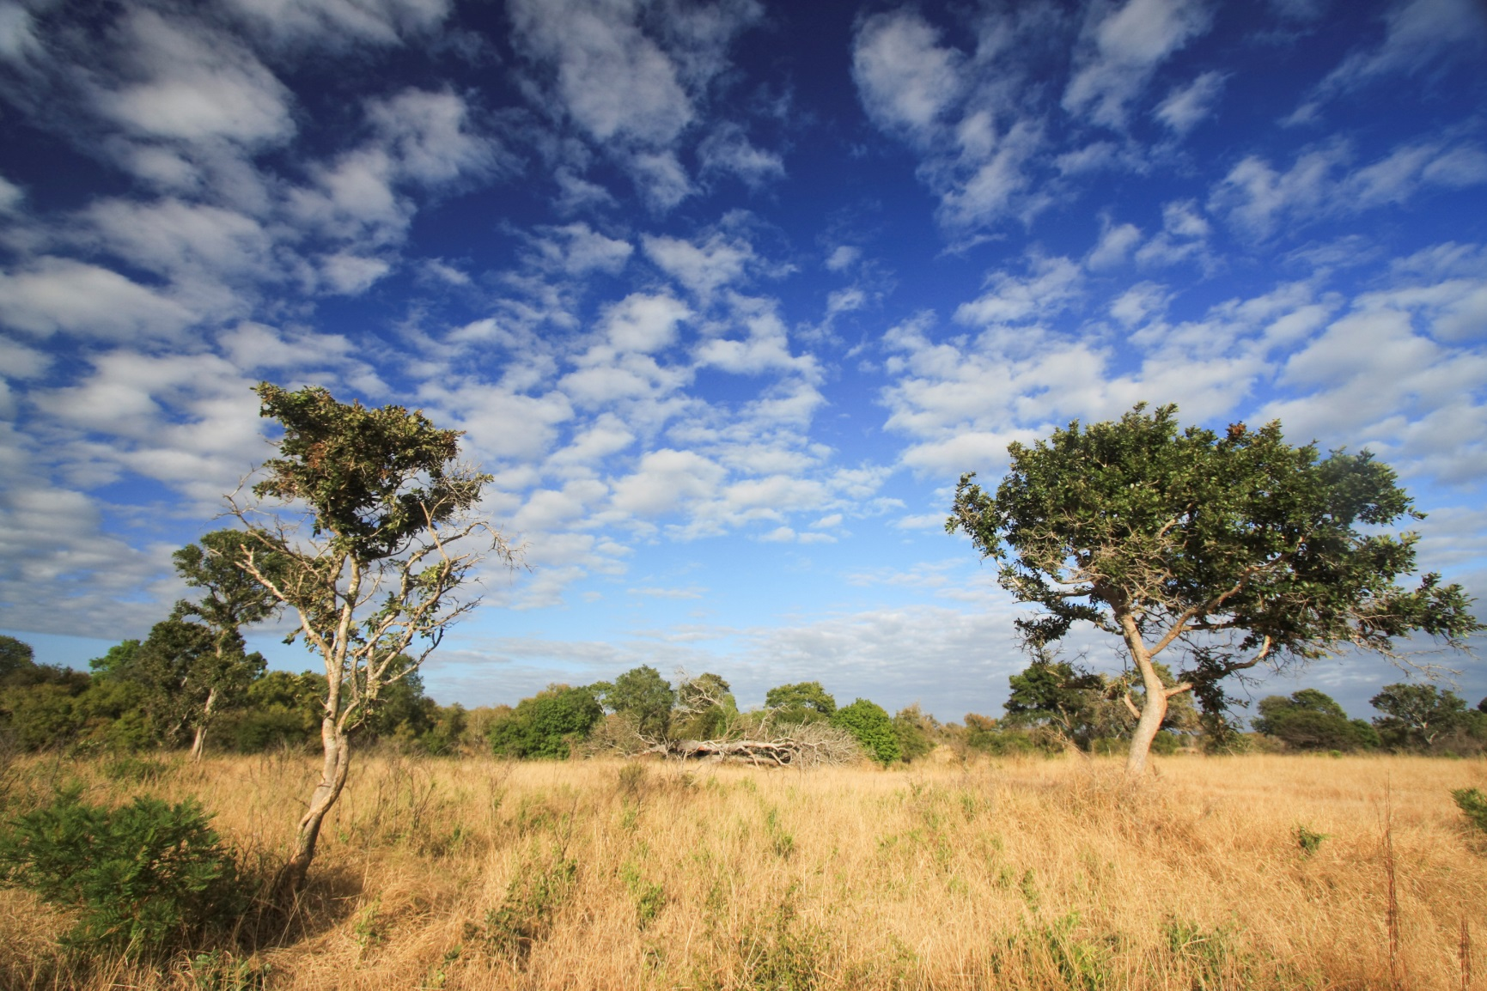
Improving agricultural output requires the management of these agronomic fundamentals.
Agronomic
Fundamentals
Input
Placement
Application
Timing
Application
Rate
Input
Form

Slide 16
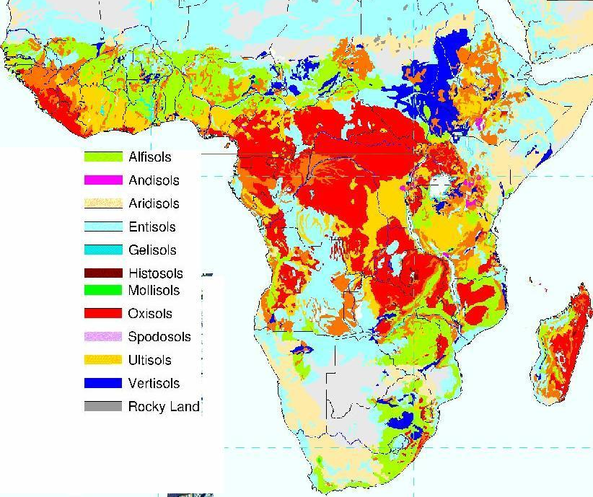
Low natural soil fertility levels impact on yield is compounded by annual mining of soil N-P-K.
On average, 13 kg/ha of nutrients are applied compared to 38kg/ha of nutrients removed through the harvesting of grain.
Total Fertilizer Applied kg/ha (N + P₂O₅ + K₂O)
Agronomic
Fundamentals
Input Placement
Application Timing
Application Rate
Input Form
Alfisols
Oxisols
Ultisols
* Maize Grain and Biomass only
Source: World Bank
Notes:
File: Fertilizer use vs actual yields 16 Countries.xls Tab: Graph
Quotes & Statistics:
Usage is 8kg/ha versus a target (CAADP) of 50kg/ha. At the minimum, mineral fertilizer use should be increased to at least 50 kg of nutrients per hectare by 2015 as per recommendations of the Abuja Summit on fertilizer use in Africa (International Fertilizer Development Center [IFDC], 2006)
Fertilizer production in SSA represents less than 1% of global fertilizer production in 2007.
The amount of nutrients consumed is 10x the amount produced, which is very low.
Production of fertilizer in Africa is basically concentrated in four countries; Zimbabwe, Senegal, Nigeria, Mauritius.
No more than four fertilizer producing firms are operating in any of the producing countries in SSA, in most cases only one firm is operating.
Kenya is the main consumer (16% of consumption), Nigeria (15%).
Since 1990 Kenya’s fertilizer policy has focused on favoring free markets by decontrolling prices and liberalizing imports and distribution. This has led to a dramatic increase in consumption.
Fertilizer usage could be increased by moving it into remote rural areas using efficient commercial channels, increase affodability, create incentives for use (better output markets, improved effectiveness through research).
Fertilizer cost is up to 3x the cost in Brazil, India, or Thailand. Key to this is reducing the high costs of fertilizer, which are often in the range of US$800–US$1,000 per ton at farm gate and the most expensive in the world.
Soil nutrient losses are estimated to be about 8 million metric tons and are valued at more than US$4 billion (Toenniessen, Adesina, & Devries, 2008). These losses combined with soil erosion have led to soil degradation, with more than 80% of Africa’s soils having chemical or physical limitations that impede crop production (Lal, 2010). This is, indeed, the case with many smallholder fields in Africa, where application of fertilizer and manure inputs have been too low for too long.

Slide 17
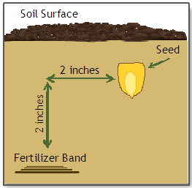
Mechanization for the placement of fertilizer is critical to making more nutrients available to the crop, especially in tropical soils.
Broadcast Fertilizer
Agronomic
Fundamentals
Input Placement
Application Timing
Application Rate
Input Form
Banded Fertilizer
Notes:
Because P is so reactive with other chemicals in the soil, it tends to get tied up easily in complex molecules and becomes unavailable. At low pH, soil aluminum levels increase and P binds with aluminum. At high pH, P binds with available calcium.
In acid soils, iron and aluminum in solution and in oxide and hydroxide forms react strongly with added P, binding it so that it is unavailable to plants.

Slide 18
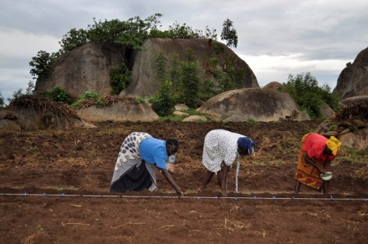
Timing of planting to capture early season rains can have a significant impact on yield.
Timing can be optimized with mechanization compared to hand planting, which is limited to after the rains have started due to hard ground conditions.
Agronomic
Fundamentals
Input Placement
Application Timing
Application Rate
Input Form
High Temp ºC
Low Temp ºC
Central Zambia
Precipitation (cm)
Ideal planting window
Current planting window

Slide 19

Open-Pollinated Variety conversion to Hybrid seeds
Agronomic
Fundamentals
Input Placement
Application Timing
Application Rate
Input Form
Sales Agronomist
Retailer
Pioneer Extension Partners
Distribution
Sales, Education & Support
Farmer
Pioneer Extension Partners
Commissioned Sales
Quantity growing 3x to nearly 11,000 employees in next 5 years
Notes:
With inputs playing a key role in realizing yield potential, Derek and I have met with DuPont Pioneer to gather industry expertise and discuss their strategy in Africa.
The initial push Pioneer is aggressively driving toward is for hybrid adoption which they estimate is between 15-20% across SSA.
They realize with 80% of the land being managed by smallholders and 80% of the decisions being made by word of mouth – they needed to develop a strong customer-facing approach and address the education component alongside their sales strategy. Therefore Pioneer is rapidly growing their sales force by adding a new model of doing business by introducing Pioneer Extension Partners (PEP’s). These resources will offer a much more hands-on approach, largely due to the large volume being hired and their rural-focused coverage – an innovative complement to their traditional sales and distribution model. The PEP’s will manage sales and support along with an education component teaching and demonstrating the importance of hybrids. These resources are hired based on commissioned sales and will be grown to 11K-20K employees in the next 5 years.
With 15-20% hybrid adoption today – they consider a modest goal to increase by 3 percentage point gains each year early in the plan, increasing to 6% point gains once their local infrastructures (PEP’s) are in place. This equates to nearly 40% hybrid adoption in the next 5 years.

Slide 20
The limited access to knowledge of agronomic fundamentals and financing to acquire inputs and mechanization is contributing to the yield attainment gaps in Sub-Sahara Africa.
Agronomic
Fundamentals
Input Placement
Application Timing
Application Rate
Input Form
Notes:
Pioneer’s strategy and our own analysis reveals that the linchpin in realizing the successful management of all these agronomic fundamentals lies with the educational component. Farmers can not adopt practices they don’t understand or know nothing about. For those of you who heard Agnes share during the worldwide leadership meeting – she referenced that the majority of farming practices are practiced due to having always been done a certain way in the past. There are many misconceptions about fertilizer, the timing of plowing and planting and the role of mechanization which must be addressed through training.
We talk a lot about creating an enabling ecosystem for the African agriculture sector to thrive. And this may lead to partnering with other players in the industry or participating in new and unique ways which stretch beyond traditional approaches in order to drive market development vs. waiting for the market to mature.

Slide 21
Key Messages
The potential for increased Ag production in Africa is enormous and some countries matter more than others
Factors other than agronomic potential will enable or constrain each country’s growth potential.
Notes:
21

Slide 22
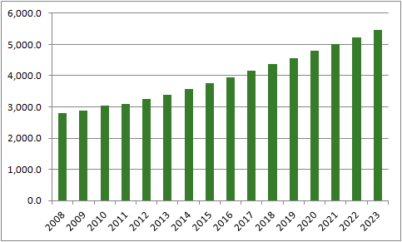
Africa’s projected CAGR growth is forecasted at approximately 4.6 % between 2008 and 2023. The forecasted growth is second only to emerging Asia.
African GDP,
2005 $ billion PPP
Compound annual growth rate, %
Compound annual GDP growth, 2008–23
%, 2005 PPP$
Emerging Asia
4.6
Middle East
4.6
4.5
4.4
Africa
4.1
3.8
4.1
Central and
Eastern Europe
Latin America
World
Developed
economies
SOURCE: Global Insight
Notes:
22
JOH-ZZJ205-20100430-CS-P2
GDP CAGR is an indicator of a markets ability to grow. As you’ll see the projected CAGR is strong in the region at 4.6%, 2nd to emerging Asia.
________________________________________
2000-2010 data showed 5% growth

Slide 23
GDP per Capita for the top and middle 6 countries remains reasonably strong relative to the immense population growth during this time period.
Top 6
Middle 6
Bottom 6
30,908
SOURCE: Global Insight
Notes:
It’s often perceived with large population growth even with GDP growth that GDP per capita would be small – however we see that in some countries that’s not necessarily true – especially in our top and middle categories. You can see the CAGR’s represented by the triangles – the scale on the right.
GDP is based on real GDP vs. nominal
Implications: We haven’t studied but a question worth pursuing – what impact do the absolute values of GDP per capita have? Enough to drive advancements in ag markets?

Slide 24

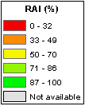

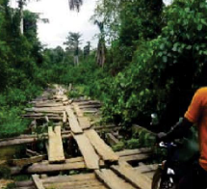
The infrastructure deficit in Africa is significant, particularly in rural areas.
Rural Access Index
SSA Electricity access is only 25%
1 in 3 rural Africans have access to an all-season road.
Source: The World Bank Group

Slide 25
Sub-Sahara Africa has great need for infrastructure and it’s impact on Ag can be significant
Top 6
Middle 6
Bottom 6
NA
SOURCE: CIA.gov
Delivered Fertilizer Price (US$)
SOURCE: Alliance for a Green Revolution in Africa, 2013
Notes:
Infrastructure another factor that inhibits or enhances growth and the government plays a huge role to address.
If you look at infrastructure in terms of percent paved roads – generally low in all countries. Specific example of impact infrastructure has is realized in this fertilizer example – comparing delivered fertilizer prices for a ton of fertilizer in the US vs. Zambia Identical products – delivered at grossly different prices.
Fertilizer importers in Zambia face significant transaction costs (e.g., financing costs, corruption and red tape, transport and storage costs) amounting to as high is 83% of the cost consumers in the United States incur. Transport and storage cost seems to be particularly high.
But as infrastructure is improved, those prices will decline.
We’ve looked at several factors other than agronomic potential which will enable or constrain each country’s growth potential. The key is to be present and prepared when those elements come together. Now we’d like to take an example of 2 countries – hand to Len.

Slide 26
Improving rural accessibility would entail a huge expansion of Africa’s road network. The cost of addressing Africa’s infrastructure needs is around $93 billion a year, about one-third of which is for maintenance.
R² = 0.97
Rural Accessibility Index
Thousands of kilometers of all season road needed
Source: Africa’s Infrastructure, A Time for Transformation; Foster and Briceno-Garmendia

Slide 27
Zambia, the tipping point.
Zambia FRA implemented premium price for smallholder corn together with seed and fertilizer subsidies.
CORT = Cereals, Oilseeds, Root and Tubers
FRA = Food Reserve Agency

Slide 28
In Conclusion
  Sub-Sahara Africa has enormous potential and when the catalysts of agricultural development act, growth can be rapid
  Small holder success is the key to unlocking agricultural productivity across the region
  Mechanization is key a key facilitator of small holder success
  Governments are a critical enabler of the development of agriculture. Their ability and effectiveness vary by country, but once they engage, advancement can be rapid.

