Slide 1


Agricultural Development and Mechanization in 2013: A Comparative Survey at a Global Level
S. Böttinger, R. Doluschitz, J. Klaus,
University of Hohenheim
&
C. Jenane, N. Samarakoon
United Nations Industrial Development Organization

Slide 2

Outline
Part 1
Socio-economic impact of agricultural machinery
  Agriculture development - Impact on poverty
  Productivity and economic gains
  Future challenges
Part 2
Overview of agricultural mechanization in different regions of the world
  Data sources and their limitations
  General status
Future trends and evolution of agricultural mechanization
  Impact factors/drivers
  Status and projection of agricultural mech. in surveyed regions
  Cross regional comparison
Conclusions

Slide 3
Outline
Part 1
Socio-economic impact of agricultural machinery
  Agriculture development - Impact on poverty
  Productivity and economic gains
  Future challenges
Part 2
Overview of agricultural mechanization in different regions of the world
  Data sources and their limitations
  General status
Future trends and evolution of agricultural mechanization
  Impact factors/drivers
  Status and projection of agricultural mech. in surveyed regions
  Cross regional comparison
Conclusions

Slide 4
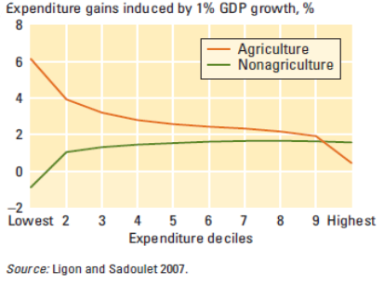
Agriculture and development – Impact on poverty
Developing the agricultural sector benefits the poorest more than any other sector of society
Cross country analysis:
Growth originating in agriculture is 2-3 times more effective for the poor than growth originating in non-agriculture

Slide 5
Agriculture and development – Impact on poverty
Correlation between human development and the agribusiness/agriculture ratio
1
0.9
United States
The HDI measures development by combining indicators of:
  Life expectancy
  Educational attainment
  Income
0.8
0.7
Mostly Urbanized
Countries
0.6
0.5
Human Development Index - HDI
0.4
0.3
Mostly Agriculture-based countries
0.2
0.1
Source: J. Wilkinson & R. Rocha (2009)
0
0.0
2.0
4.0
6.0
8.0
10.0
12.0
14.0
Agri-business-to-Agriculture Ratio

Slide 6
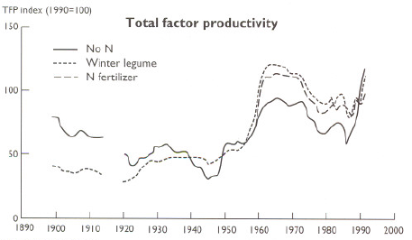
Productivity and economic gains
Agricultural mechanization has palyed a major role in:
Increasing productivity and convenience for the farmers.
Achieving economical gains
And will continue to be a key factor to achieving the global objective of feeding a growing population.
The biggest event impacting TFP was the
introduction of the mechanical harvester
Example of cotton production and the impact of mechanization on TFP
Source: Michell, C.C. et al. (1996)
http://www.aaes.auburn.edu/comm/pubs/specialreports/old_rotation.pdf

Slide 7
Productivity Enhancement
Removing constraints and making efficient use of time
Timeliness of operations
Efficient use of agricultural inputs

Slide 8
Economic gains
Agricultural productivity gains
Higher rural incomes and reductions in rural poverty
Enabling sustainable production system
Investments in human and physical capital in rural economy

Slide 9
Challenges - World population
In the next 40 years, the world population is expected to increase by 1/3 to more than 9 billion people.
Feeding such population, which may require doubling agricultural productivity,
will only be possible with significant, even ground-breaking, improvements in agricultural machines and processes.

Slide 10
Challenges– depleting natural ressources – improved management is a must
Case of water resources:
By 2025, 1.8 billion people are expected to be living in areas with absolute water scarcity, and 2/3 of the world population will live in water-stressed areas.
Improving water management solutions will have to be developed:
More efficient irrigation systems and higher efficiencies in whatever technologies farmers are presently using.

Slide 11
Challenges - Enabling a sustainable agricultural production system – the future role/impact of mechanization
Through further development of precision agriculture, sensor capabilities, etc.,
and application of ICT into production systems
the impact of agricultural production on the environment can be substantially reduced and eventually environmental sustainability can be achieved.

Slide 12
Outline
Part 1
Socio-economic impact of agricultural machinery
  Agriculture development - Impact on poverty
  Productivity and economic gains
  Future challenges
Part 2
Overview of agricultural mechanization in different regions of the world
  Data sources and their limitations
  General status
Future trends and evolution of agricultural mechanization
  Impact factors/drivers
  Status and projection of agricultural mech. in surveyed regions
  Cross regional comparison
Conclusions

Slide 13
2. Overview of agricultural mechanization in different regions of the world – topics investigated
1. General development tendencies likely to affect the future demand of agri. Mech.
2. Most important staple crops and major drivers for mech. of such cropping systems
3. Trade related to agricultural machinery – including implements, tractors and combines
4. The impact that selected issues will have on the demand for agricultural mechanization
6. The technological trends for the sector over the next 10-20 years.

Slide 14
2. Overview of agricultural mechanization in different regions of the world – Data sources
Statistical data: Worldbank and UN data (FAO and UNIDO) and manufacturer association sources
Two surveys (2009 and 2013): Agricultural machinery manufacturer associations and other institutions
The underlying assumption is that responses received to the survey questions would provide a reliable indication of the evolution and trends of
the targeted sector.

Slide 15
2. Overview of agri. mechanization in diff. regions of the world – Data sources for 2013
Country | Association and/or Institution | Region
Germany | VDMA – Verband Deutscher Maschinen- und Anlagenbaue | European Union
Italy | UNACOMA – Unione Nazionale Costruttori Macchine per l’Agricultura
France | AXEMA – Union des Industriels de l‘Agro-Equipment
Finland | Federation of Finnish Technology Industries
USA | AEM – Association of Equipment Manufacturers | North America
Japan | JFMMA – Japan Farm Machinery Manufacturer’s Association | Japan
China | CAAMM – China Association of Agricultural Machinery Manufacturers | Asia
India | FICCI – Federation of Indian Chambers of Commerce and Industry IARI – Indian Agricultural Research Institute CIAE - Central Institute of Agricultural Engineering
Morocco | Institut Agronomique et Vétérinaire Hassan II | North Africa/Middle East
Cameroon | The University of Dschang | Sub-Saharan Africa
Botswana | Botswana College of Agriculture
South Africa | SAAMA – South African Agricultural Machinery Association

Slide 16
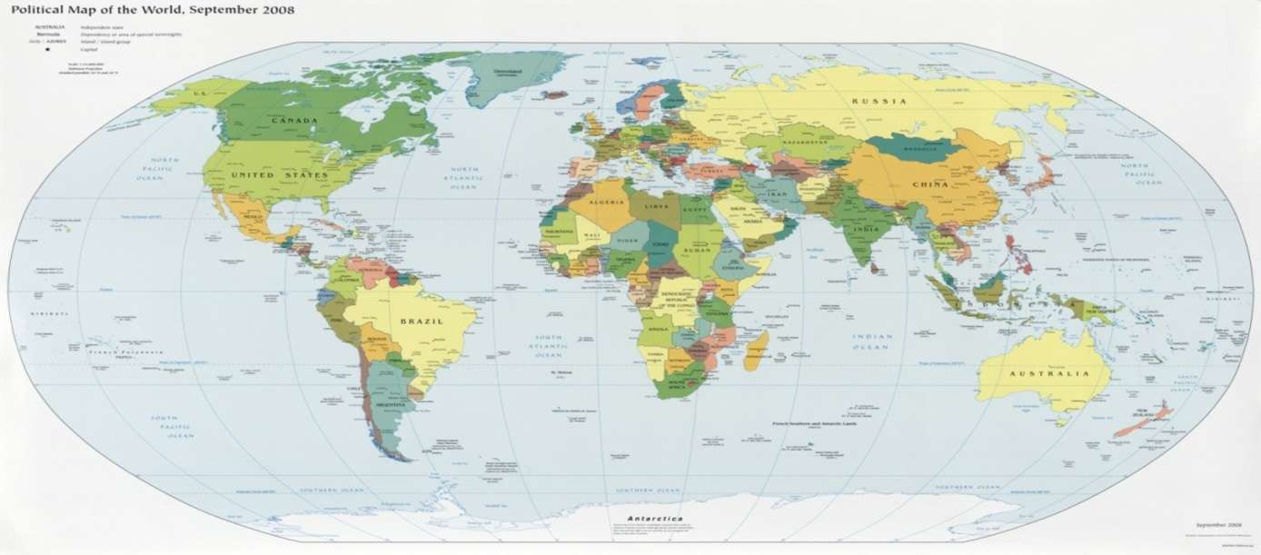
2. Overview of agri. mechanization in different regions of the world – Data limitations
  Data availability
  Global perspective <> Regional / local accuracy
  Relatively limited response rate (questionnaire survey)
2
7
1
3
5
4
8
6
9
Respondents of the 2013 questionnaire survey

Slide 17
2. Overview of agricultural mechanization in different regions of the world – Status
Europe/EU
  High numbers of machines per ha reflecting over mechanization and a great variety of farm structures
  Tendency to fewer and higher powered machines
  Strong industry with high rate of export
USA
  Completely mechanized farms
  Trend towards larger and higher horsepower equipment
  Further technical progress tends towards automation

Slide 18
2. Overview of agricultural mechanization in different regions of the world – Status
Japan
  The agri. sector has been diminishing in recent decades (agricultural land, population working in agriculture, etc.).
  However, the sector is highly mechanized with about 461 tractors and 237 harvesters per 1,000 ha.
  Mostly small, sophisticated and specialized machines.
  Further technical progress tends towards more automation.
  Strong industry with export to whole Asia and other regions of the world.
India/China
  Agriculture contributes large shares to the GDP and more than one third of the population gains income from agriculture.
  Small scale farm operations (~ 0,5 to 1.5 ha) are predominant.
  Structural change with tendencies to larger farms is increasing.
  Rapid increase in number of machines and of mech. custom-hire services.
  Fast growing tractor production: from 2002/03 to 2007/08 the production capacity doubled to reach 364,205 units in India.

Slide 19
2. Overview of agricultural mechanization in different regions of the world – Status
Russia
  Developing market but still insufficient compensation of aging machines/tractors
  Local machinery manufacturing capacity being upgraded
  Additional taxes limiting import of machines
Latin America/Brazil
  The numbers of tractors per 1,000 ha are fairly constant over the last three decades, but a significant trend towards tractors of larger scale
  Developing machinery manufacturing sector, mainly by international companies
  The production of bio-ethanol from sugarcane plays a very important role in Brazil which in turn may be a driver for accelerating demand for agricultural machinery

Slide 20
2. Overview of agricultural mechanization in different regions of the world – Status
North Africa / Middle East
  The levels of mechanization are significantly higher than SSA. The average number of tractors per 1000 ha is 11.
  Large disparities can be observed in the region, for example:
    in Morocco the Nbr of tractors per 1,000 ha averages 6.
    in Egypt the data observed are on avg 31 tractors.
Sub-Saharan Africa
  Land productivity is the lowest in the world. Average grain and maize yields range at about 1 ton/ha.
  80% of agricultural area cultivated with only human power.
  5% of agricultural area with tractor.
  70% of all tractors are in South Africa and Nigeria.
  Increasing imports from India and China.

Slide 21
Outline
Part 1
Socio-economic impact of agricultural machinery
  Agriculture development - Impact on poverty
  Productivity and economic gains
  Future challenges
Part 2
Overview of agricultural mechanization in different regions of the world
  Data sources and their limitations
  General status
Future trends and evolution of agricultural mechanization
  Impact factors/drivers
  Status and projection of agricultural mech. in surveyed regions
  Cross regional comparison
Conclusions

Slide 22
Impact Factors/Divers on the demand of agri. mechanization *
Natural conditions | Low (+/-)
Climate change | Low (+/-)
Land (availability, condition) | Low (+/-)
Water availability | Med. (+/-)
Economic conditions | Strong (+/-)
Technical progress | Med./Strong (+)
Economic growth and welfare | Med. (+)
Oil price | Med. (+/-)
Economic crises, | Med. (-)
Energy supply | Med. (+/-)
Political conditions | Medium (+)
Food safety goals | Low (+)
Education of farm operators | Med. (+)
Research | Low (+)
Subsidies | Med. (-)
Farm structure development | Med. (+)
Biofuel production | Low/Med. (+)
Demographic conditions | Med. (+/-)
Population growth | Med. (+)
Population age in rural areas | Med. (+/-)
Change in diets, consumer concerns | Low (+)
Urbanization and industrialization | Med. (+)
*
Values for all 8 surveyed countries

Slide 23
Status and projection of agr. mechanization in surveyed regions: Twelve levels of agricultural mechanization
Level | Farm power characteristics | hand | Draught animal | tractors
1 | Predominantly hand power | > 80 | <= 20 | <= 5
2 | Significant use of draught animal power | 46 – 80 | 21 – 39 | <= 10
3 | Significant use of tractors | 15 – 45 | >= 40 | <= 19
4 | Tractors predominant | 20 – 50 | 15 – 30 | 20 - 49
5 | Fully motorized technology level I | <= 25 | <= 25 | 50 - 75 | Nomin. speeds (km/h) |  | No. of speeds | Shift | PTO
 |  |  |  |  | forw. | rev. | forw./rew. |  | speeds rpm
6 | Fully motorized technology level II | <= 10 | <= 10 | > 75 | 2 – 20 (25) | 3 - 8 | 6/2 – 8/2 | SG, CS | 540
7 | Fully motorized technology level III | “ | “ | “ | 2 - 30 | 3 - 10 | 8/4 – 12/4 | CS, SS | 540/(1000)
8 | Fully motorized technology level IV | “ | “ | “ | (0,5) 2 – 30 (40) | 3 - 15 | 12/4 – 16/8 | SS, HL | 540/1000
9 | Fully motorized technology level V | “ | “ | “ | (0,3) 2 – 40 (50) | 2 - 20 | 16/12 – 36/36 | SS, PPS, FPS | 540/1000 (750/1250)
10 | Fully motorized technology level VI | “ | “ | “ | 0 – 50 (60) | 0 - 25 | ∞ | autom.
11 | Moderate share of autonomous vehicles
12 | Significant share of autonomous vehicles
Source: Clarke et al. (2002) / Renius (2005), modified.

Slide 24
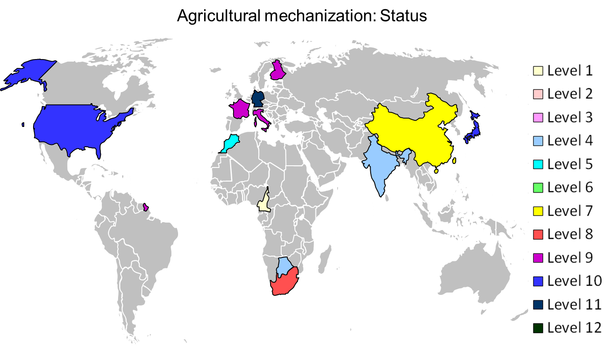
Status and projection of agr. mechanization in surveyed regions: Current status (2013)

Slide 25
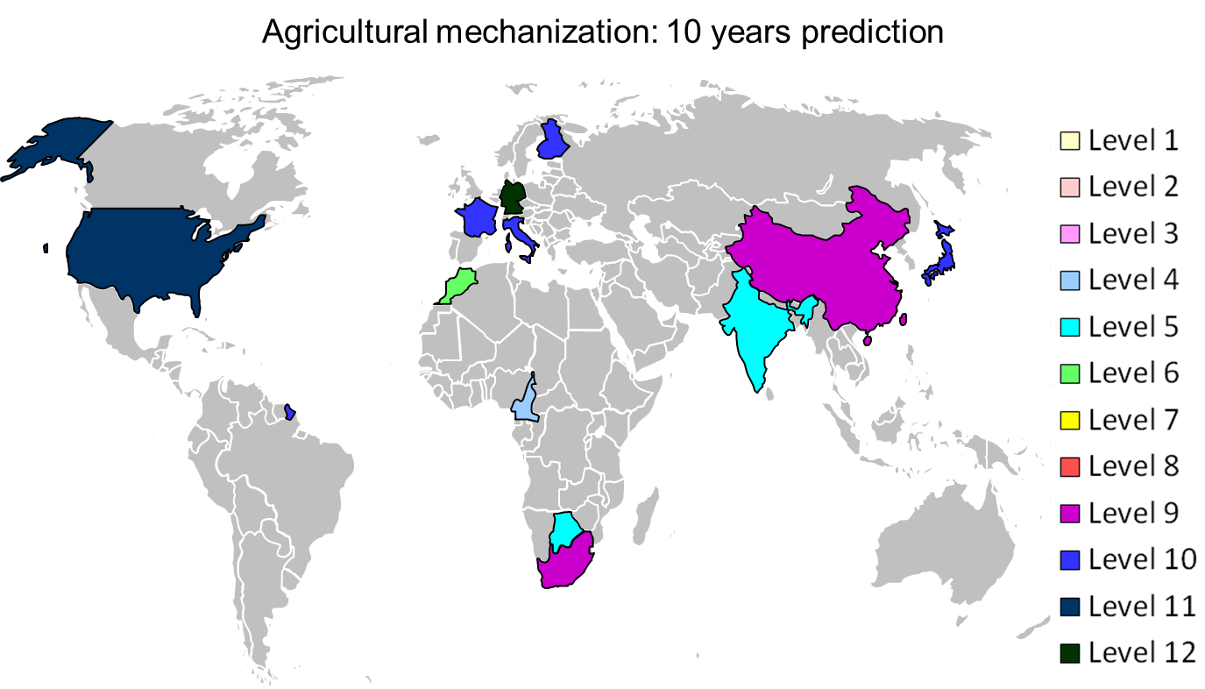
Status and projection of agr. mechanization in surveyed regions

Slide 26
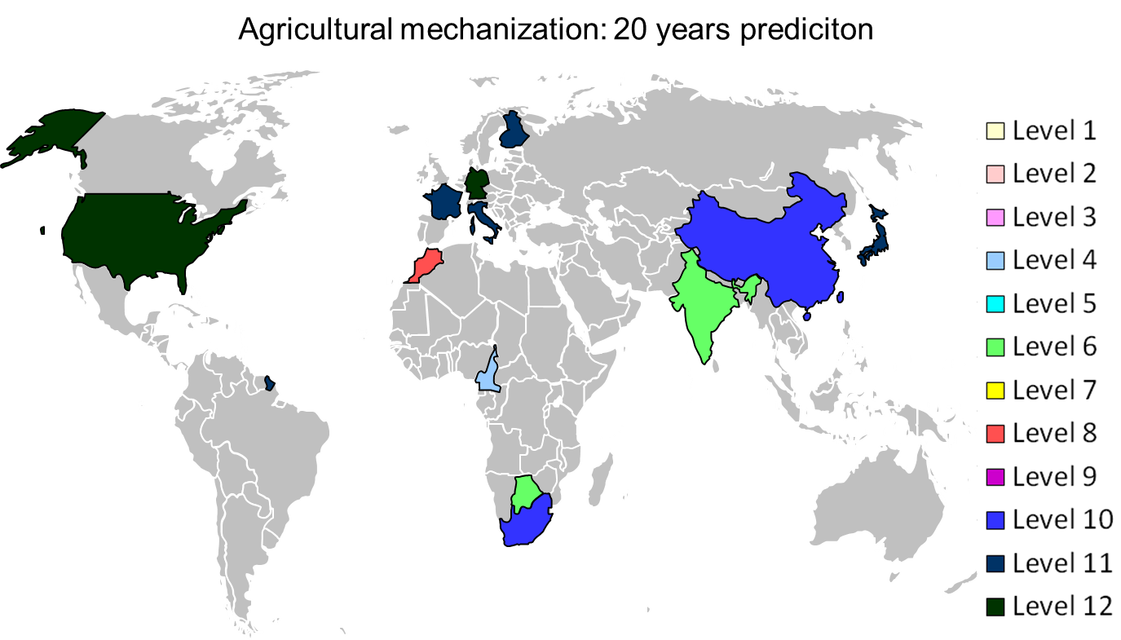
Status and projection of agr. mechanization in surveyed regions

Slide 27
Cross regional comparison: Domestic demand over the next 10 years
 | Germany | Italy |  | France |  | Finland |  | USA |  | Japan |  | China |  |  | India |  | Morocco | Cameroon |  | Botswana |  | South Africa
Small size tractors (=< 40 hp) | → | ↗ |  | ↗ |  | ↗ |  | ↗ |  | ↘ |  | ↗ |  |  | ↗ |  | → | ↗ |  | ↗ |  | →
Medium size tractors (=< 100 hp) | → | ↗ |  | ↗ |  | ↘ |  | ↗ |  | ↗ |  | → |  |  | ↗ |  | ↑ | ↗ |  | ↗ |  | ↗
Big size tractors (> 100 hp) | ↗ | ↗ |  | ↗ |  | ↗ |  | ↗ |  | ↗ |  | ↑ |  |  | / |  | ↗ | ↗ |  | ↗ |  | ↗
Spare parts for tractors | → | ↗ |  | ↗ |  | → |  | ↗ |  | ↗ |  | ↗ |  |  | ↗ |  | ↑ | ↑ |  | ↑ |  | ↗
Self propelling combines | → | ↗ |  | → |  | ↘ |  | ↗ |  | ↗ |  | → |  |  | ↗ |  | ↗ | ↗ |  | ↗ |  | ↗
Forage harvesters | → | ↗ |  | → |  | → |  | ↗ |  | → |  | ↑ |  |  | ↗ |  | ↗ | → |  | ↗ |  | ↗
Reapers | → | ↗ |  | → |  | → |  | / |  | / |  | → |  |  | ↗ |  | ↗ | ↗ |  | ↗ |  | ↗
Threshers | / | ↗ |  | → |  | / |  | / |  | ↘ |  | ↘ |  |  | ↗ |  | ↗ | ↑ |  | ↗ |  | ↗
Irrigation systems | → | ↗ |  | ↗ |  | ↘ |  | ↑ |  | ↘ |  | ↗ |  |  | ↗ |  | ↑ | ↗ |  | ↑ |  | ↗
Diesel engines | → | ↗ |  | ↗ |  | ↘ |  | ↗ |  | ↘ |  | ↗ |  |  | ↗ |  | ↑ | ↗ |  | ↑ |  | ↗
Power tillers | → | ↗ |  | → |  | → |  | → |  | ↘ |  | → |  |  | ↗ |  | ↑ | ↗ |  | ↑ |  | ↗
Food processing technique | → | ↗ |  | → |  | → |  | ↗ |  | / |  | ↗ |  |  | ↑ |  | ↑ | ↗ |  | ↗ |  | ↗
Spare parts in general | → | ↗ |  | ↗ |  | ↗ |  | ↗ |  | ↘ |  | → |  |  | ↗ |  | ↑ | ↑ |  | ↑ |  | ↗
Hand implements | / | / |  | → |  | ↘ |  | ↘ |  | / |  | → |  |  | ↗ |  | → | ↑ |  | ↑ |  | ↗
Draught animal implements | / | / |  | → |  | / |  | / |  | / |  | / |  |  | → |  | / | ↗ |  | ↑ |  | ↗
Soil preparation | → | - |  | ↗ |  | ↗ |  | ↗ |  | → |  | → |  |  | ↗ |  | ↗ | ↗ |  | ↑ |  | ↗
Seeding | → | - |  | ↗ |  | ↗ |  | ↗ |  | → |  | → |  |  | ↗ |  | ↗ | ↗ |  | ↑ |  | ↗
Plant protection | → | - |  | ↗ |  | ↗ |  | ↗ |  | → |  | ↗ |  |  | ↗ |  | ↗ | ↗ |  | ↑ |  | ↗
Legend
[↑] >= 10% annual growth rate | [↘] -10% to 0 % annual growth rate |  |  |  |  |  |  |  |  |  |  |  |  | [-] not specified
[↗] 0% to 10% annual growth rate | [↓] <= -10% annual growth rate
[→] -/+ 0% annual growth rate | [/] not relevant

Slide 28
Cross regional comparison: Import dev. over the next 10 years
 | Germany | Italy | France | Finland | USA | Japan | China | India | Morocco | Cameroon | Botswana | South-Africa
Small size tractors (=< 40 hp) | ↗ | ↗ | ↗ | ↗ | ↗ | ↗ | ↓ | → | → | ↗ | ↑ | →
Medium size tractors (=< 100 hp) | ↗ | ↘ | ↗ | ↘ | ↗ | ↗ | ↓ | → | ↑ | ↗ | ↑ | ↗
Big size tractors (> 100 hp) | ↗ | ↘ | ↗ | → | → | ↗ | → | / | ↗ | ↗ | ↑ | ↗
Spare parts for tractors | → | ↗ | ↗ | → | ↗ | ↗ | → | → | ↑ | ↑ | ↑ | ↗
Self propelling combines | → | ↘ | → | ↘ | → | → | → | → | ↗ | ↗ | ↑ | ↗
Forage harvesters | → | ↘ | → | ↗ | → | → | ↗ | - | ↗ | → | ↑ | ↗
Reapers | → | ↘ | → | ↘ | / | / | → | - | ↗ | ↗ | ↑ | ↗
Threshers | / | ↘ | → | / | / | / | → | - | ↗ | ↑ | ↑ | ↗
Irrigation systems | → | ↘ | → | ↘ | → | → | ↗ | - | ↑ | ↗ | ↑ | ↗
Diesel engines | → | ↗ | ↗ | ↘ | → | → | → | - | ↑ | ↗ | ↑ | ↗
Power tillers | → | ↘ | → | ↘ | → | ↘ | → | ↑ | ↑ | ↗ | ↑ | ↗
Food processing technique | → | ↘ | → | → | ↗ | / | → | ↗ | ↑ | ↑ | ↑ | ↗
Spare parts in general | → | ↘ | ↗ | ↗ | → | ↗ | → | - | ↑ | ↑ | ↑ | ↗
Hand implements | / | / | → | ↘ | ↗ | / | / | → | → | ↗ | ↑ | →
Draught animal implements | / | / | → | / | - | / | / | → | / | ↗ | ↑ | →
Soil preparation | → | - | ↗ | → | ↗ | / | → | → | ↗ | ↗ | ↑ | ↗
Seeding | → | - | ↗ | ↗ | ↗ | → | → | → | ↗ | ↗ | ↑ | ↗
Plant protection | → | - | - | ↗ | ↗ | → | ↗ | → | ↗ | ↗ | ↑ | ↗
Legend
[↑] >= 10% annual growth rate | [↘] -10% to 0 % annual growth rate |  |  |  |  |  |  | [-] not specified
[↗] 0% to 10% annual growth rate | [↓] <= -10% annual growth rate
[→] -/+ 0% annual growth rate | [/] not relevant

Slide 29
Cross regional comparison: Export dev. over the next 10 years
 | Germany |  | Italy |  | France |  | Finland |  | USA |  | Japan |  | China |  | India |  |  | Morocco | Cameroon |  | Botswana |  | South Africa
Small size tractors (=< 40 hp) | → |  | ↘ |  | ↗ |  | / |  | ↑ |  | ↗ |  | ↑ |  | ↗ |  |  | / | / |  | → |  | /
Medium size tractors (=< 100 hp) | → |  | ↗ |  | ↗ |  | → |  | ↑ |  | → |  | ↑ |  | ↗ |  |  | / | / |  | → |  | /
Big size tractors (> 100 hp) | ↗ |  | ↗ |  | ↗ |  | ↗ |  | ↑ |  | → |  | ↗ |  | / |  |  | / | / |  | → |  | /
Spare parts for tractors | → |  | ↗ |  | ↗ |  | → |  | ↑ |  | → |  | ↗ |  | ↗ |  |  | / | / |  | → |  | /
Self propelling combines | ↑ |  | ↗ |  | → |  | ↗ |  | ↑ |  | ↘ |  | ↗ |  | ↗ |  |  | / | / |  | → |  | /
Forage harvesters | ↑ |  | ↗ |  | → |  | → |  | ↗ |  | → |  | → |  | ↗ |  |  | / | / |  | → |  | /
Reapers | → |  | ↗ |  | → |  | → |  | / |  | / |  | → |  | - |  |  | / | / |  | → |  | /
Threshers | / |  | ↗ |  | → |  | / |  | / |  | → |  | → |  | - |  |  | / | ↗ |  | → |  | ↗
Irrigation systems | → |  | ↗ |  | ↑ |  | → |  | ↗ |  | → |  | → |  | ↗ |  |  | / | → |  | → |  | ↗
Diesel engines | → |  | ↗ |  | ↗ |  | ↗ |  | ↗ |  | ↗ |  | → |  | ↗ |  |  | / | - |  | → |  | /
Power tillers | → |  | ↗ |  | ↗ |  | / |  | ↗ |  | ↗ |  | → |  | - |  |  | / | - |  | → |  | /
Food processing technique | ↗ |  | ↗ |  | ↑ |  | → |  | ↗ |  | / |  | → |  | ↗ |  |  | / | ↗ |  | → |  | ↗
Spare parts in general | ↗ |  | ↗ |  | ↗ |  | → |  | ↗ |  | ↗ |  | → |  | ↗ |  |  | / |  |  | → |  | /
Hand implements | / |  | / |  | ↗ |  | → |  | ↘ |  | / |  | → |  | ↗ |  |  | / | ↗ |  | → |  | ↗
Draught animal implements | / |  | / |  | ↗ |  | / |  | / |  | / |  | / |  | ↗ |  |  | / | ↗ |  | → |  | ↗
Soil preparation | ↗ |  | - |  | ↗ |  | ↗ |  | ↗ |  | / |  | → |  | ↗ |  |  | / | → |  | → |  | ↗
Seeding | ↗ |  | - |  | ↗ |  | → |  | ↗ |  | → |  | → |  | ↗ |  |  | / | → |  | → |  | ↗
Plant protection | ↗ |  | - |  | ↗ |  | → |  | ↗ |  | → |  | ↗ |  | ↗ |  |  | / | → |  | → |  | /
Legend
[↑] >= 10% annual growth rate |  | [↘] -10% to 0 % annual growth rate |  |  |  |  |  |  |  |  |  |  |  |  |  | [-] not specified
[↗] 0% to 10% annual growth rate |  | [↓] <= -10% annual growth rate
[→] -/+ 0% annual growth rate |  | [/] not relevant

Slide 30
Cross regional comparison: Market penetration of selected technologies
 |  | Precision farming |  |  |  |  |  |  |  |  |  |  |  |  |  | Driverless tractors |  | Fleet management (telematics) |  |  | Smart implements |  | ISOBUS |  | Remote diagnostics |  |  | Use of sensor technology |  | Robotics
 |  | Overall | Tillage | N-fertilizer application | Other fertilizer application |  |  | Plant protection |  |  | Guidance systems |  | Yield mapping
Germany | status | 4 | 5 | 5 | 5 |  |  | 5 |  |  | 4 |  | 4 |  |  | 1 |  | 2 |  |  | 1 |  | 3 |  | 3 |  |  | 4 |  | 3
 | 10 years | 5 | 5 | 5 | 5 |  |  | 5 |  |  | 5 |  | 5 |  |  | 1 |  | 5 |  |  | 2 |  | 4 |  | 4 |  |  | 5 |  | 4
Italy | status | 2 | 2 | - | - |  |  | 4 |  |  | 2 |  | 2 |  |  | 1 |  | 2 |  |  | 1 |  | 1 |  | 1 |  |  | 1 |  | 1
 | 10 years | 3 | 3 | - | - |  |  | 5 |  |  | 3 |  | 3 |  |  | 2 |  | 2 |  |  | 2 |  | 3 |  | 3 |  |  | 2 |  | 2
France | status | 2 | 1 | 2 | 1 |  |  | 2 |  |  | 1 |  | 2 |  |  | 1 |  | 2 |  |  | 2 |  | 2 |  | 1 |  |  | 2 |  | 1
 | 10 years | 3 | 2 | 4 | 3 |  |  | 4 |  |  | 3 |  | 4 |  |  | 2 |  | 3 |  |  | 4 |  | 4 |  | 3 |  |  | 4 |  | 2
Finland | status | 2 | 1 | 2 | 2 |  |  | 1 |  |  | 2 |  | 2 |  |  | 1 |  | 1 |  |  | 2 |  | 2 |  | 1 |  |  | 2 |  | 1
 | 10 years | 3 | 2 | 3 | 3 |  |  | 4 |  |  | 5 |  | 3 |  |  | 1 |  | 2 |  |  | 4 |  | 4 |  | 4 |  |  | 4 |  | 2
USA | status | 5 | 5 | 5 | 5 |  |  | 5 |  |  | 5 |  | 4 |  |  | 1 |  | 3 |  |  | 2 |  | 2 |  | 3 |  |  | 3 |  | 2
 | 10 years | 5 | 5 | 5 | 5 |  |  | 5 |  |  | 5 |  | 5 |  |  | 3 |  | 4 |  |  | 4 |  | 4 |  | 5 |  |  | 5 |  | 4
Japan | status | 1 | 5 | 1 | 5 |  |  | 5 |  |  | 2 |  | 1 |  |  | 1 |  | - |  |  | - |  | 1 |  | 1 |  |  | 1 |  | 2
 | 10 years | 3 | 5 | 1 | 5 |  |  | 5 |  |  | 3 |  | 1 |  |  | 1 |  | - |  |  | - |  | 4 |  | 2 |  |  | 3 |  | 3
China | status | 1 | 1 | 4 | 4 |  |  | 3 |  |  | 1 |  | 1 |  |  | 1 |  | 1 |  |  | 1 |  | 1 |  | 1 |  |  | 1 |  | 1
 | 10 years | 3 | 2 | 5 | 5 |  |  | 5 |  |  | 2 |  | 2 |  |  | 2 |  | 3 |  |  | 3 |  | 3 |  | 2 |  |  | 3 |  | 2
India | status | 1 | 3 | 4 | 2 |  |  | 3 |  |  | 1 |  | 1 |  |  | 1 |  | 1 |  |  | 1 |  | 1 |  | 1 |  |  | 1 |  | 1
 | 10 years | 2 | 4 | 5 | 3 |  |  | 4 |  |  | 1 |  | 1 |  |  | 1 |  | 1 |  |  | 2 |  | 1 |  | 1 |  |  | 1 |  | 1
Morocco | status | 1 | 4 | 3 | 3 |  |  | 3 |  |  | 1 |  | 1 |  |  | 1 |  | 1 |  |  | 1 |  | 1 |  | 1 |  |  | 1 |  | 1
 | 10 years | 2 | 5 | 4 | 4 |  |  | 4 |  |  | 2 |  | 2 |  |  | 1 |  | 2 |  |  | 2 |  | 2 |  | 2 |  |  | 2 |  | 2
Cameroon | status | 1 | 2 | 1 | 1 |  |  | 1 |  |  | 1 |  | 1 |  |  | 1 |  | 1 |  |  | 1 |  | 1 |  | 1 |  |  | 1 |  | 1
 | 10 years | 1 | 2 | 2 | 2 |  |  | 1 |  |  | 1 |  | 1 |  |  | 1 |  | 1 |  |  | 1 |  | 1 |  | 2 |  |  | 2 |  | 1
Botswana | status | 1 | 1 | 1 | 1 |  |  | 1 |  |  | 1 |  | 1 |  |  | 1 |  | 1 |  |  | 1 |  | 1 |  | 1 |  |  | 1 |  | 1
 | 10 years | 2 | 3 | 3 | 2 |  |  | 3 |  |  | 1 |  | 2 |  |  | 1 |  | 1 |  |  | 1 |  | 1 |  | 1 |  |  | 1 |  | 1
South Africa | status | 3 | 5 | 5 | 5 |  |  | 5 |  |  | 2 |  | 2 |  |  | 1 |  | 1 |  |  | 1 |  | 1 |  | 1 |  |  | 1 |  | 1
 | 10 years | 4 | 5 | 5 | 5 |  |  | 5 |  |  | 3 |  | 3 |  |  | 2 |  | 2 |  |  | 2 |  | 3 |  | 3 |  |  | 3 |  | 2
 | Legend: |  |  |  |  | 1 |  |  |  |  | 2 |  |  |  | 3 |  |  |  |  | 4 |  |  |  | 5
 |  | Market penetration: |  |  | 0 to 2 % |  |  |  |  | 2 to 10 % |  |  |  | 10 to 30 % |  |  |  |  | 30 to 50 % |  |  | > 50%

Slide 31
Outline
Part 1
Socio-economic impact of agricultural machinery
  Agriculture development - Impact on poverty
  Productivity and economic gains
  Future challenges
Part 2
Overview of agricultural mechanization in different regions of the world
  Data sources and their limitations
  General status
Future trends and evolution of agricultural mechanization
  Impact factors/drivers
  Status and projection of agricultural mech. in surveyed regions
  Cross regional comparison
Conclusions

Slide 32
4. Conclusions
  Agricultural mechanization has increased productivity and convenience for the farmers. Moreover, it has contributed to significant economic gains.
  The need for further mechanization to improve productivity in agriculture and to feed the world cannot be overemphasized in particular in the light of expected demographic developments.
  The political conditions and also expected socio-development factors seem to be very favorable for investments in agricultural mechanization.
  The use of precision farming will become standard in the short to the mid-term range, but also the use of control and automation systems will become common and offer new growth opportunities for the corresponding industries.

Slide 33
4. Conclusions
  The emerging countries such as India, China and South-Africa are seeing significant economic growth with associated technology transfer and progress in agricultural production.
  They are becoming important players on the world markets for agricultural machinery and also represent promising markets with high demands for further mechanization.
  Strong advances towards high levels of mechanization can be expected in these regions, however, this support that:
    the current trends of technology transfer is pursued as part, for example of joint-ventures.
    issues like e.g. property rights, taxation practices across countries, market access, etc. are further dealt with.

Slide 34
4. Conclusions
  The most challenging region for agricultural mechanization development remains Africa.
  While only limited progress has been achieved in terms of increased number of machines and market expansion, the predictions over the next ten years are positive.
  This supposes that increased investments are needed both from the national governments and the private sector to develop the sector.

Slide 35
Thank you for your attention

