Slide 1
Global Agriculture Markets: Today and Tomorrow AgriEvolution Summit New Delhi, India JB Penn – Chief Economist December 5, 2013

Slide 2
Global Agriculture Markets: Today and Tomorrow
Brief Historic Review (2000-2013)
Subtle Market Structure Shifts Occurring
Looking Beyond 2013
Concluding Observations

Slide 3
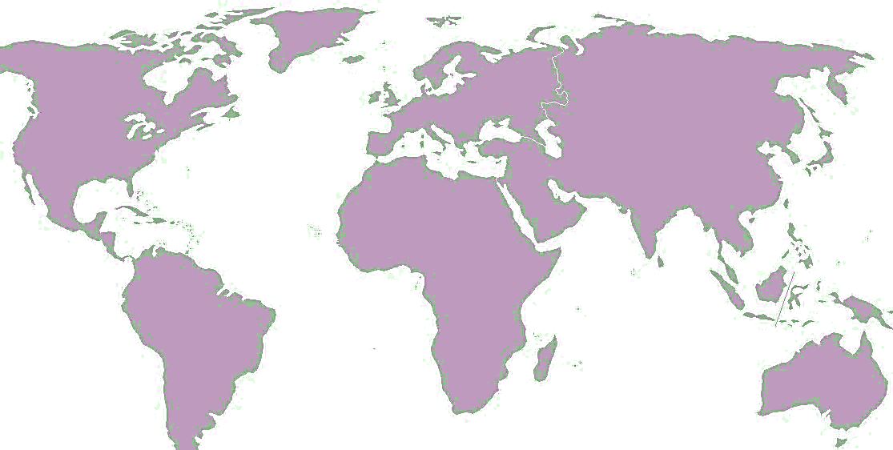
Brief Historic Review

Slide 4
Brief Historic Review Global Agriculture Markets
Period of unprecedented prosperity in developed country agriculture
Key drivers: population and income growth, urbanization - Dietary shifts - Renewed attention to developing country agriculture
Now, another market transition?
Fourth World Summit on Agriculture Machinery
December 5-6, 2013 ~ New Delhi, India
Notes:
Last Checked: 4/16/2013
Frequency: WEO database is release each April and October (twice a year) – updated in January and June/July
Data Source: IMF, World Economic Outlook Update, Oct. 2012
Site: http://www.imf.org/external/ns/cs.aspx?id=28
Data File: JBP Presentations\Data\Current\IMF GDP.v2.xlsx
Instructions:
1. Visit IMF Website: http://www.imf.org/external/ns/cs.aspx?id=28
2. Select Country Groups
3. Select World (might as well download World, EU, Africa, Central & Eastern Europe, Commonwealth of Mongolia, Developing Asia, Middle East, Western Hemisphere)
4. Select the first option of GDP constant prices, annual percent change
5. Select the appropriate years and hit produce report
Amended Instructions:
- Download GDP annual percent change, constant prices for:
- All regions/Groups
- All countries

Slide 5
Global Macro Economy World GDP growth rates
Source: International Monetary Fund (IMF), World Economic Outlook , October 08, 2013
Fourth World Summit on Agriculture Machinery
December 5-6, 2013 ~ New Delhi, India
Notes:
Last Checked: 4/16/2013
Frequency: WEO database is release each April and October (twice a year) – updated in January and June/July
Data Source: IMF, World Economic Outlook Update, Oct. 2012
Site: http://www.imf.org/external/ns/cs.aspx?id=28
Data File: JBP Presentations\Data\Current\IMF GDP.v2.xlsx
Instructions:
1. Visit IMF Website: http://www.imf.org/external/ns/cs.aspx?id=28
2. Select Country Groups
3. Select World (might as well download World, EU, Africa, Central & Eastern Europe, Commonwealth of Mongolia, Developing Asia, Middle East, Western Hemisphere)
4. Select the first option of GDP constant prices, annual percent change
5. Select the appropriate years and hit produce report
Amended Instructions:
- Download GDP annual percent change, constant prices for:
- All regions/Groups
- All countries

Slide 6
GDP Growth Rates
Source: International Monetary Fund (IMF), World Economic Outlook , October 08, 2013
Fourth World Summit on Agriculture Machinery
December 5-6, 2013 ~ New Delhi, India

Slide 7
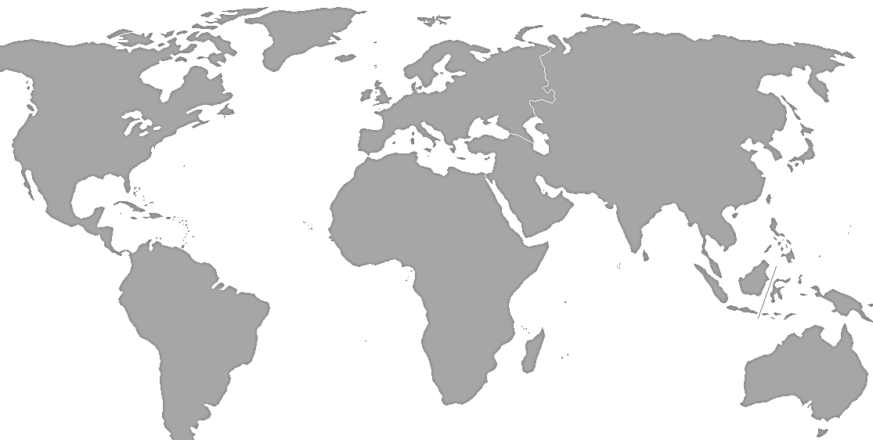
Population Growth and Distribution 2000 to 2013
2050
2013
2000
9.6B
6.1B
7.2B
1.1B
1.2%
4%
56%
30%
9%
Source: International Monetary Fund (IMF), World Economic Outlook , October 08, 2013
Fourth World Summit on Agriculture Machinery
December 5-6, 2013 ~ New Delhi, India

Slide 8
Urbanization: Rural-Urban Population Shift
Source: UN World Urbanization Prospects, The 2009 Revision Population Database

Slide 9
Commodity Index Prices, Jan 1990 – Nov 2013
Commodity Metals Price Index, 2005 = 100, includes Copper, Aluminum, Iron Ore, Tin, Nickel, Zinc, Lead, and Uranium Price Indices
Commodity Fuel (energy) Index, 2005 = 100, includes Crude oil (petroleum), Natural Gas, and Coal Price Indices
Commodity Food Price Index, 2005 = 100, includes Cereal, Vegetable Oils, Meat, Seafood, Sugar, Bananas, and Oranges Price Indices
Source: IMF Primary Commodity Prices

Slide 10
Subtle Market Structure Shifts Occurring

Slide 11
Global Grain Market Dynamics
Major shifts underway since 2000 not widely recognized
Competitiveness among producing regions slowly shifting – due to: On farm technology – cost/ton at farm gate Infrastructure investment – cost/ton at export location
Government policies shifting: Subsidies policies shifting in developed and developing
Fourth World Summit on Agriculture Machinery
December 5-6, 2013 ~ New Delhi, India
Notes:
Last Checked: 4/16/2013
IMF:
Country Groups:
Frequency: WEO database is release each April and October (twice a year) – updated in January and June/July
1) Make sure no new countries added or delete – for all roughly 187
Site: http://www.imf.org/external/ns/cs.aspx?id=28
Data File: JBP Presentations\Data\Current\IMF GDP.v2.xlsx
1. Visit IMF Website: http://www.imf.org/external/ns/cs.aspx?id=28
2. Select Country Groups
3. Select World (might as well download World, EU, Africa, Central & Eastern Europe, Commonwealth of Mongolia, Developing Asia, Middle East, Western Hemisphere)
4. Select the first option of GDP constant prices, annual percent change
5. Select the appropriate years and hit produce report
Amended Instructions:
- Download GDP annual percent change, constant prices for:
- All regions/Groups
- All countries
IMF Country Specific:
1. Visit IMF Website: http://www.imf.org/external/ns/cs.aspx?id=28
2. Select Country Groups
3. Select World (might as well download World, EU, Africa, Central & Eastern Europe, Commonwealth of Mongolia, Developing Asia, Middle East, Western Hemisphere)
4. Select the Second option of GDP constant prices, annual percent change
5. Select the appropriate years and hit produce report
Amended Instructions:
- Download GDP annual percent change, constant prices for:
- All regions/Groups
- All countries
Population/GDP Slides:
File: Pop.gdp.v3
Same IMF Data as above
Make sure all countries are included.
Population data is from 2010 census
Conditional formatting in Red is above 6%, green is above 8% - just make sure the total sums in the data cell aggregate the total population for the countries within the GDP growth (6-8% thresholds)
Make sure green bars are forecasts, red are negative

Slide 12
Major Grain Exporter Market Shares Shifting
Source: Foreign Agricultural Service, Official USDA Estimates , September 2013
Fourth World Summit on Agriculture Machinery
December 5-6, 2013 ~ New Delhi, India
Notes:
Last Checked: 4/16/2013
IMF:
Country Groups:
Frequency: WEO database is release each April and October (twice a year) – updated in January and June/July
1) Make sure no new countries added or delete – for all roughly 187
Site: http://www.imf.org/external/ns/cs.aspx?id=28
Data File: JBP Presentations\Data\Current\IMF GDP.v2.xlsx
1. Visit IMF Website: http://www.imf.org/external/ns/cs.aspx?id=28
2. Select Country Groups
3. Select World (might as well download World, EU, Africa, Central & Eastern Europe, Commonwealth of Mongolia, Developing Asia, Middle East, Western Hemisphere)
4. Select the first option of GDP constant prices, annual percent change
5. Select the appropriate years and hit produce report
Amended Instructions:
- Download GDP annual percent change, constant prices for:
- All regions/Groups
- All countries
IMF Country Specific:
1. Visit IMF Website: http://www.imf.org/external/ns/cs.aspx?id=28
2. Select Country Groups
3. Select World (might as well download World, EU, Africa, Central & Eastern Europe, Commonwealth of Mongolia, Developing Asia, Middle East, Western Hemisphere)
4. Select the Second option of GDP constant prices, annual percent change
5. Select the appropriate years and hit produce report
Amended Instructions:
- Download GDP annual percent change, constant prices for:
- All regions/Groups
- All countries
Population/GDP Slides:
File: Pop.gdp.v3
Same IMF Data as above
Make sure all countries are included.
Population data is from 2010 census
Conditional formatting in Red is above 6%, green is above 8% - just make sure the total sums in the data cell aggregate the total population for the countries within the GDP growth (6-8% thresholds)
Make sure green bars are forecasts, red are negative

Slide 13
US Dominant Role Declining Sharply
Source: Foreign Agricultural Service, Official USDA Estimates , September 2013
Fourth World Summit on Agriculture Machinery
December 5-6, 2013 ~ New Delhi, India
Notes:
Last Checked: 4/16/2013
IMF:
Country Groups:
Frequency: WEO database is release each April and October (twice a year) – updated in January and June/July
1) Make sure no new countries added or delete – for all roughly 187
Site: http://www.imf.org/external/ns/cs.aspx?id=28
Data File: JBP Presentations\Data\Current\IMF GDP.v2.xlsx
1. Visit IMF Website: http://www.imf.org/external/ns/cs.aspx?id=28
2. Select Country Groups
3. Select World (might as well download World, EU, Africa, Central & Eastern Europe, Commonwealth of Mongolia, Developing Asia, Middle East, Western Hemisphere)
4. Select the first option of GDP constant prices, annual percent change
5. Select the appropriate years and hit produce report
Amended Instructions:
- Download GDP annual percent change, constant prices for:
- All regions/Groups
- All countries
IMF Country Specific:
1. Visit IMF Website: http://www.imf.org/external/ns/cs.aspx?id=28
2. Select Country Groups
3. Select World (might as well download World, EU, Africa, Central & Eastern Europe, Commonwealth of Mongolia, Developing Asia, Middle East, Western Hemisphere)
4. Select the Second option of GDP constant prices, annual percent change
5. Select the appropriate years and hit produce report
Amended Instructions:
- Download GDP annual percent change, constant prices for:
- All regions/Groups
- All countries
Population/GDP Slides:
File: Pop.gdp.v3
Same IMF Data as above
Make sure all countries are included.
Population data is from 2010 census
Conditional formatting in Red is above 6%, green is above 8% - just make sure the total sums in the data cell aggregate the total population for the countries within the GDP growth (6-8% thresholds)
Make sure green bars are forecasts, red are negative

Slide 14
Soy Market Shares Also Shifting
Source: Informa Economics, Weekly Soybean Complex, June 2013
Fourth World Summit on Agriculture Machinery
December 5-6, 2013 ~ New Delhi, India
Notes:
Last Checked: 4/16/2013
IMF:
Country Groups:
Frequency: WEO database is release each April and October (twice a year) – updated in January and June/July
1) Make sure no new countries added or delete – for all roughly 187
Site: http://www.imf.org/external/ns/cs.aspx?id=28
Data File: JBP Presentations\Data\Current\IMF GDP.v2.xlsx
1. Visit IMF Website: http://www.imf.org/external/ns/cs.aspx?id=28
2. Select Country Groups
3. Select World (might as well download World, EU, Africa, Central & Eastern Europe, Commonwealth of Mongolia, Developing Asia, Middle East, Western Hemisphere)
4. Select the first option of GDP constant prices, annual percent change
5. Select the appropriate years and hit produce report
Amended Instructions:
- Download GDP annual percent change, constant prices for:
- All regions/Groups
- All countries
IMF Country Specific:
1. Visit IMF Website: http://www.imf.org/external/ns/cs.aspx?id=28
2. Select Country Groups
3. Select World (might as well download World, EU, Africa, Central & Eastern Europe, Commonwealth of Mongolia, Developing Asia, Middle East, Western Hemisphere)
4. Select the Second option of GDP constant prices, annual percent change
5. Select the appropriate years and hit produce report
Amended Instructions:
- Download GDP annual percent change, constant prices for:
- All regions/Groups
- All countries
Population/GDP Slides:
File: Pop.gdp.v3
Same IMF Data as above
Make sure all countries are included.
Population data is from 2010 census
Conditional formatting in Red is above 6%, green is above 8% - just make sure the total sums in the data cell aggregate the total population for the countries within the GDP growth (6-8% thresholds)
Make sure green bars are forecasts, red are negative

Slide 15
Non-traditional Exporters Are Less Stable Production Regions
Argentina
& Brazil
Russia
Kazakhstan
Australia
Ukraine
US
Canada
World Average
EU-28
Growing market instability likely as importance of non-traditional suppliers grows – price volatility, political instability, trade disruptions
Source: Informa Economics, Weekly Soybean Complex, June 2013
Fourth World Summit on Agriculture Machinery
December 5-6, 2013 ~ New Delhi, India
15
Notes:
Last Checked: 4/16/2013
IMF:
Country Groups:
Frequency: WEO database is release each April and October (twice a year) – updated in January and June/July
1) Make sure no new countries added or delete – for all roughly 187
Site: http://www.imf.org/external/ns/cs.aspx?id=28
Data File: JBP Presentations\Data\Current\IMF GDP.v2.xlsx
1. Visit IMF Website: http://www.imf.org/external/ns/cs.aspx?id=28
2. Select Country Groups
3. Select World (might as well download World, EU, Africa, Central & Eastern Europe, Commonwealth of Mongolia, Developing Asia, Middle East, Western Hemisphere)
4. Select the first option of GDP constant prices, annual percent change
5. Select the appropriate years and hit produce report
Amended Instructions:
- Download GDP annual percent change, constant prices for:
- All regions/Groups
- All countries
IMF Country Specific:
1. Visit IMF Website: http://www.imf.org/external/ns/cs.aspx?id=28
2. Select Country Groups
3. Select World (might as well download World, EU, Africa, Central & Eastern Europe, Commonwealth of Mongolia, Developing Asia, Middle East, Western Hemisphere)
4. Select the Second option of GDP constant prices, annual percent change
5. Select the appropriate years and hit produce report
Amended Instructions:
- Download GDP annual percent change, constant prices for:
- All regions/Groups
- All countries
Population/GDP Slides:
File: Pop.gdp.v3
Same IMF Data as above
Make sure all countries are included.
Population data is from 2010 census
Conditional formatting in Red is above 6%, green is above 8% - just make sure the total sums in the data cell aggregate the total population for the countries within the GDP growth (6-8% thresholds)
Make sure green bars are forecasts, red are negative

Slide 16
Global Grain Market Dynamics
- In addition to new consumers 1.1B since 2000 – mostly in lower latitudes
- New export producers also emerged
Fourth World Summit on Agriculture Machinery
December 5-6, 2013 ~ New Delhi, India
Notes:
Last Checked: 4/16/2013
IMF:
Country Groups:
Frequency: WEO database is release each April and October (twice a year) – updated in January and June/July
1) Make sure no new countries added or delete – for all roughly 187
Site: http://www.imf.org/external/ns/cs.aspx?id=28
Data File: JBP Presentations\Data\Current\IMF GDP.v2.xlsx
1. Visit IMF Website: http://www.imf.org/external/ns/cs.aspx?id=28
2. Select Country Groups
3. Select World (might as well download World, EU, Africa, Central & Eastern Europe, Commonwealth of Mongolia, Developing Asia, Middle East, Western Hemisphere)
4. Select the first option of GDP constant prices, annual percent change
5. Select the appropriate years and hit produce report
Amended Instructions:
- Download GDP annual percent change, constant prices for:
- All regions/Groups
- All countries
IMF Country Specific:
1. Visit IMF Website: http://www.imf.org/external/ns/cs.aspx?id=28
2. Select Country Groups
3. Select World (might as well download World, EU, Africa, Central & Eastern Europe, Commonwealth of Mongolia, Developing Asia, Middle East, Western Hemisphere)
4. Select the Second option of GDP constant prices, annual percent change
5. Select the appropriate years and hit produce report
Amended Instructions:
- Download GDP annual percent change, constant prices for:
- All regions/Groups
- All countries
Population/GDP Slides:
File: Pop.gdp.v3
Same IMF Data as above
Make sure all countries are included.
Population data is from 2010 census
Conditional formatting in Red is above 6%, green is above 8% - just make sure the total sums in the data cell aggregate the total population for the countries within the GDP growth (6-8% thresholds)
Make sure green bars are forecasts, red are negative

Slide 17
China Emerges As Major Soy Importer (circa 2000)
Source: Foreign Agricultural Service, Official USDA Estimates , September 2013
Fourth World Summit on Agriculture Machinery
December 5-6, 2013 ~ New Delhi, India
Notes:
Last Checked: 4/16/2013
IMF:
Country Groups:
Frequency: WEO database is release each April and October (twice a year) – updated in January and June/July
1) Make sure no new countries added or delete – for all roughly 187
Site: http://www.imf.org/external/ns/cs.aspx?id=28
Data File: JBP Presentations\Data\Current\IMF GDP.v2.xlsx
1. Visit IMF Website: http://www.imf.org/external/ns/cs.aspx?id=28
2. Select Country Groups
3. Select World (might as well download World, EU, Africa, Central & Eastern Europe, Commonwealth of Mongolia, Developing Asia, Middle East, Western Hemisphere)
4. Select the first option of GDP constant prices, annual percent change
5. Select the appropriate years and hit produce report
Amended Instructions:
- Download GDP annual percent change, constant prices for:
- All regions/Groups
- All countries
IMF Country Specific:
1. Visit IMF Website: http://www.imf.org/external/ns/cs.aspx?id=28
2. Select Country Groups
3. Select World (might as well download World, EU, Africa, Central & Eastern Europe, Commonwealth of Mongolia, Developing Asia, Middle East, Western Hemisphere)
4. Select the Second option of GDP constant prices, annual percent change
5. Select the appropriate years and hit produce report
Amended Instructions:
- Download GDP annual percent change, constant prices for:
- All regions/Groups
- All countries
Population/GDP Slides:
File: Pop.gdp.v3
Same IMF Data as above
Make sure all countries are included.
Population data is from 2010 census
Conditional formatting in Red is above 6%, green is above 8% - just make sure the total sums in the data cell aggregate the total population for the countries within the GDP growth (6-8% thresholds)
Make sure green bars are forecasts, red are negative

Slide 18
China Leaves Global Wheat Market
Forecast to import 8.5 MMT in 2013/2014
Source: Foreign Agricultural Service, Official USDA Estimates , September 2013
Fourth World Summit on Agriculture Machinery
December 5-6, 2013 ~ New Delhi, India
Notes:
Last Checked: 4/16/2013
IMF:
Country Groups:
Frequency: WEO database is release each April and October (twice a year) – updated in January and June/July
1) Make sure no new countries added or delete – for all roughly 187
Site: http://www.imf.org/external/ns/cs.aspx?id=28
Data File: JBP Presentations\Data\Current\IMF GDP.v2.xlsx
1. Visit IMF Website: http://www.imf.org/external/ns/cs.aspx?id=28
2. Select Country Groups
3. Select World (might as well download World, EU, Africa, Central & Eastern Europe, Commonwealth of Mongolia, Developing Asia, Middle East, Western Hemisphere)
4. Select the first option of GDP constant prices, annual percent change
5. Select the appropriate years and hit produce report
Amended Instructions:
- Download GDP annual percent change, constant prices for:
- All regions/Groups
- All countries
IMF Country Specific:
1. Visit IMF Website: http://www.imf.org/external/ns/cs.aspx?id=28
2. Select Country Groups
3. Select World (might as well download World, EU, Africa, Central & Eastern Europe, Commonwealth of Mongolia, Developing Asia, Middle East, Western Hemisphere)
4. Select the Second option of GDP constant prices, annual percent change
5. Select the appropriate years and hit produce report
Amended Instructions:
- Download GDP annual percent change, constant prices for:
- All regions/Groups
- All countries
Population/GDP Slides:
File: Pop.gdp.v3
Same IMF Data as above
Make sure all countries are included.
Population data is from 2010 census
Conditional formatting in Red is above 6%, green is above 8% - just make sure the total sums in the data cell aggregate the total population for the countries within the GDP growth (6-8% thresholds)
Make sure green bars are forecasts, red are negative

Slide 19
Whither China and the Global Corn Market?
Corn: from 3 MMT (2012) to 20 - 30 MMT (2022)
Forecast 7 MMT for 2013/2014
Will corn be added to soy as a basic import? Or import pork?
Source: Foreign Agricultural Service, Official USDA Estimates , September 2013
Fourth World Summit on Agriculture Machinery
December 5-6, 2013 ~ New Delhi, India
Notes:
Last Checked: 4/16/2013
IMF:
Country Groups:
Frequency: WEO database is release each April and October (twice a year) – updated in January and June/July
1) Make sure no new countries added or delete – for all roughly 187
Site: http://www.imf.org/external/ns/cs.aspx?id=28
Data File: JBP Presentations\Data\Current\IMF GDP.v2.xlsx
1. Visit IMF Website: http://www.imf.org/external/ns/cs.aspx?id=28
2. Select Country Groups
3. Select World (might as well download World, EU, Africa, Central & Eastern Europe, Commonwealth of Mongolia, Developing Asia, Middle East, Western Hemisphere)
4. Select the first option of GDP constant prices, annual percent change
5. Select the appropriate years and hit produce report
Amended Instructions:
- Download GDP annual percent change, constant prices for:
- All regions/Groups
- All countries
IMF Country Specific:
1. Visit IMF Website: http://www.imf.org/external/ns/cs.aspx?id=28
2. Select Country Groups
3. Select World (might as well download World, EU, Africa, Central & Eastern Europe, Commonwealth of Mongolia, Developing Asia, Middle East, Western Hemisphere)
4. Select the Second option of GDP constant prices, annual percent change
5. Select the appropriate years and hit produce report
Amended Instructions:
- Download GDP annual percent change, constant prices for:
- All regions/Groups
- All countries
Population/GDP Slides:
File: Pop.gdp.v3
Same IMF Data as above
Make sure all countries are included.
Population data is from 2010 census
Conditional formatting in Red is above 6%, green is above 8% - just make sure the total sums in the data cell aggregate the total population for the countries within the GDP growth (6-8% thresholds)
Make sure green bars are forecasts, red are negative

Slide 20
Brazil Gains Preeminence as Global Agriculture Exporter (circa 2000)
Captures much of global soy trade growth
Rapidly expands grain, meat, poultry export sales
Third-largest agricultural exporter (value) after US and EU
#1 exporter: coffee, soy, beef, sugar, ethanol and frozen chickens
Source: Foreign Agricultural Service, Official USDA Estimates , September 2013
Fourth World Summit on Agriculture Machinery
December 5-6, 2013 ~ New Delhi, India

Slide 21
Increasing Reliance on South American Exports
Source: Foreign Agricultural Service, Official USDA Estimates , September 2013
Fourth World Summit on Agriculture Machinery
December 5-6, 2013 ~ New Delhi, India

Slide 22
Black Sea Sector Stabilizes After USSR Breakup and Late 1990s Crisis – Enormous Potential
Source: Foreign Agricultural Service, Official USDA Estimates , November 2013
Fourth World Summit on Agriculture Machinery
December 5-6, 2013 ~ New Delhi, India

Slide 23
Looking Beyond 2013

Slide 24
Looking Beyond 2013: Global Grains
Source: USDA/WASDE, November 2013

Slide 25
Global Grains Stocks to Use: 74 Days
Source: USDA/WASDE, November 2013

Slide 26
Northern Hemisphere Harvesting Large Grain Crops
India produced 239 MMT in 2012/13, and 240 MMT in 2013/14 – 1% increase
Large Southern Hemisphere Crops Again in Prospect
for 2013/2014
Planting conditions in Southern Hemisphere Now Market Focus
Temperature, moisture, and soil conditions dominate next few weeks
Source: USDA PSD report, November, 2013.

Slide 27
Ag Commodity Prices Seeking New Trading Range
US Wheat Prices Received by Farmers, 1908 - 2013
$280/mt
$220/mt
1970 to 2005
Average = $115.8
1940 to 1969
Average = $61.8
1908 to 1939
Average = $38.8
Source: USDA Feed Grains Database, November 2013

Slide 28
Ag Commodity Prices Seeking New Trading Range
US Corn Prices Received by Farmers, 1900 - 2012
$220/mt
1970 to 2005
Average = $89.6
$160/mt
1940 to 1969
Average = $48
1900 to 1939
Average = $26.2
Source: USDA Feed Grains Database, October 2013

Slide 29
Observations

Slide 30
Concluding Observations
Period of unprecedented prosperity – driven by largely external forces
Sector structure/markets changed significantly – still not widely recognized – calls for new mental models
After 2013 – few parallels – entirely new situation
Ag commodity markets seeing new trading range – worldwide weather will be key determinant for 2014

Slide 31
Global Agriculture Markets: Today and Tomorrow AgriEvolution Summit New Delhi, India JB Penn – Chief Economist December 5, 2013

