Slide 1
Mechanization Trends in India
Sanjeev Goyle
Mahindra and Mahindra
December 2013
Fourth World Summit on Agriculture Machinery
December 5-6, 2013 ~ New Delhi, India

Slide 2
Agenda
Snapshot
Mechanization Story So Far
Mega Trends in Mechanization
Challenges in mechanization and the way forward

Slide 3
Snapshot…
Arable Land :- 163 m Ha (50% of Land Area)
Net Cropped Area :- 140 m Ha (88% of Arable Land)
Gross Cropped Area :- 192 m Ha (35% of Area Sown Twice – 50 m Ha)
Net Irrigated Area :- 68 m Ha (48 % of Net Crop Area)
Gross Irrigated Area :- 82 m Ha (43 % of Gross Crop Area)
Av. Size of Land Holding:- 1.3 Ha (80 % farms are Small & Marginal)
Indian Agriculture :- Contributes 15 % of GDP and employs 52 % of working Population
Annual Report of the Ministry of Agriculture

Slide 4
Mechanization Story…
There has been a sustained increase in the adoption of mechanization to
ensure greater return on investment (RoI)
sustainability of agriculture.
Mechanization primarily driven by increased use of tractors, which is replacing manual and animal labour.
Tractor Sales
Implements | 2009 | 2010 | 2011 | 2012 | 2013
Rotavator | 60000 | 80000 | 100000 | 123000 | 103775
Harvester Self Propelled | 1500 | 2400 | 2400 | 1800 | 2250
Tractor Mounted Harvester | 3000 | 3200 | 3600 | 3300 | 1151
Rice Transplanter | 100 | 350 | 220 | 300 | 300

Slide 5
General pattern in the growth of the mechanization in India...
Farm operations requiring high power inputs and low control are mechanized first (tillage, transport, water pumping, milling, threshing, etc.).
Farm operations requiring medium levels of power and control are mechanized next (seeding, spraying, intercultural operations, etc.).
Farm operations requiring high degree of control and low power inputs are mechanized last (transplanting, planting of vegetables, harvesting of fruits and vegetables, etc.).
Power intensive work, can be done faster mechanically and at a lower cost.
Converting human knowledge into machine knowledge is difficult and costly

Slide 6
Mega Trends
Drivers of mechanization in India

Slide 7
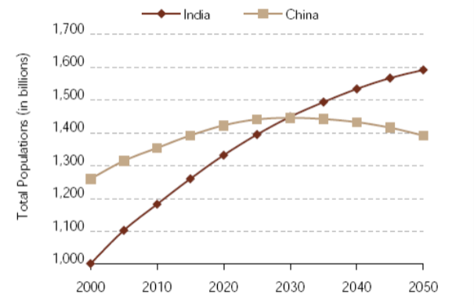
Demand to outstrip current productivity levels…
Source: Agricultural Statistics at a Glance 2011, Ministry of Agriculture, Government of India.
India’s population is expected to be 1.6 bn by 2050 calling for an annual food grain production of 333 mn tonnes which represents an increase in production of more than 1/3rd
There will be a huge stress on land resources calling for greater production with lesser land

Slide 8
Relatively low yield gives scope for improvement…
India has one of the lowest crop yields in both Rice and Wheat as compared to US and China
With an urgent need in increase of production, the yields need to increase dramatically to march up to the global standards
To produce more with lesser land will call for technologies that can improve yield

Slide 9
Land holdings patterns call for smaller mechanization solutions…
Source: Agricultural Statistics at a Glance 2011, Ministry of Agriculture, Government of India.
Land Fragmentation has gone up with number of marginal farmers increasing from 56K in 1985-86 to 94K in 2011, an increase of 67.3%
Land available for agriculture has remained constant around 140 m Ha since 1970s
Land fragmentation and no new creation of land available for agriculture
will call for flexible machinery adaptable to changing crop patterns

Slide 10
Shortage of agricultural labor triggering mechanization drive
MGNREGS wages are providing 'choice of work' to casual labour in rural areas
Other factors
contributing to shortage of labor
Shift into services sector for
better working condition
Increasing urbanization and
migration of villagers in
search of greater opportunities
Rise of rural entrepreneurs
who are looking to set up
businesses of their own
Peak Agriculture Season (39%)
Source: Impact of MGREGA on Farm Mechanization, FICCI, 2011.
39% of annual employment under MGREGA is provided during the peak agricultural season creating shortage of unskilled labor..
Shortage of Labor in the Agri Sector will drive need for mechanization and will call for Machines with minimal human intervention

Slide 11
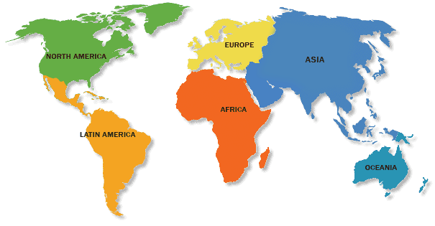
Population Engaged in Agriculture vis-à-vis Level of Farm Mechanization...
Western Europe
3.9%, 95%
Russia
14.4%, 80%
USA
2.4%, 95%
China
64%, 38%
India
55%, 30%
60%, 20%
Brazil
14%, 75%
Argentina
14%, 75%

Slide 12
Challenges in Mechanization and the Way Forward

Slide 13
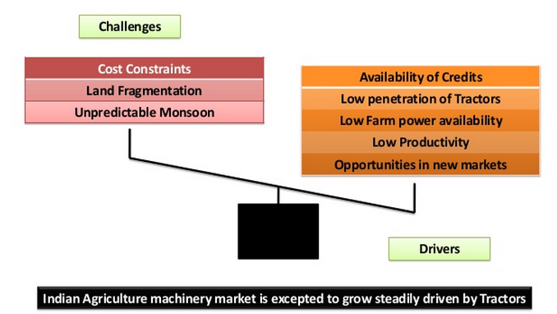
Challenges and Drivers...

Slide 14
Tractors + Implements
Representing a huge opportunity

Slide 15
Tractors: Opportunity
Capturing the full potential

Slide 16
Rising opportunities to increase tractorization
India lags far behind in tractor penetration by global standards
Hiring
Low hourly usage and high cost of ownership prevents tractor usage
Increasing focus on co-operative led tractor rental models
Value Tractors
Increasingly fragmented land holdings and skewed economies of scale
Need for a low cost, low HP tractor. Eg: Yuvraj
Solution Selling
Mechanization limited to land preparation through tractors
Mechanization solutions for entire value chain
Potential for addressing the gap through alternate models of tractor usage

Slide 17
Crop Specific Opportunities
Going beyond land preparation

Slide 18
Non uniform mechanization: Skewed towards land preparation…
Seed Bed Preparation
Sowing & Planting
Crop Management
Harvesting
Post Harvest Operations
Agro Processing

Slide 19
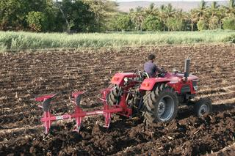
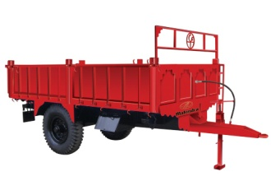
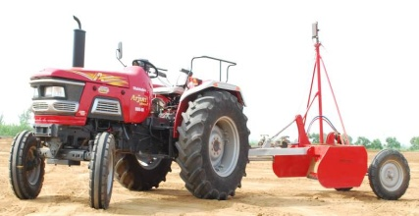
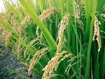
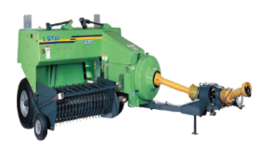
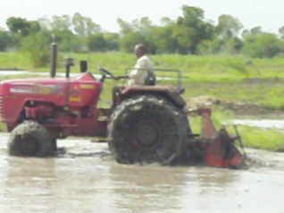
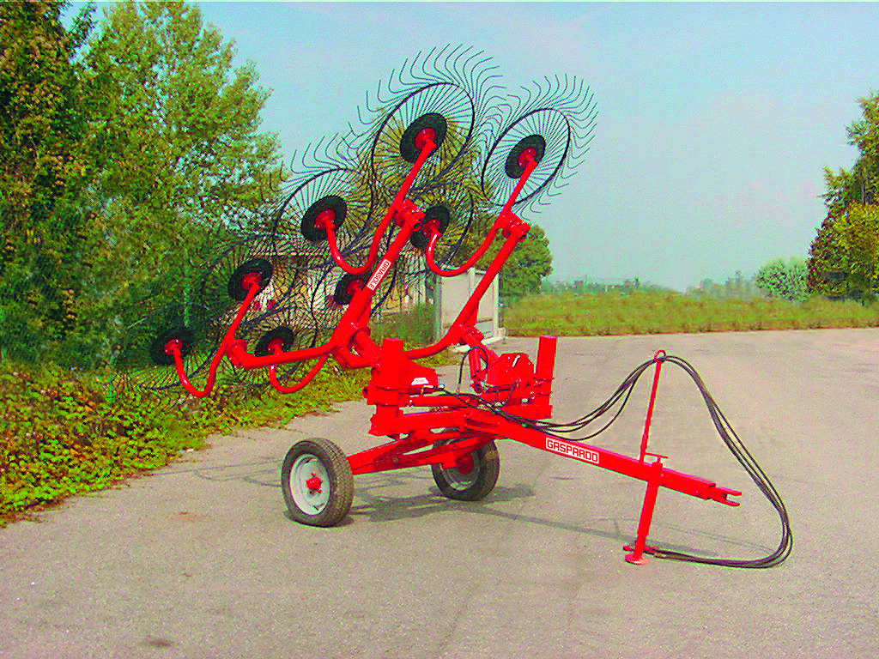
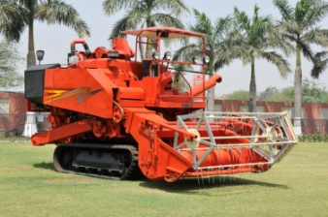
Complete Mechanization Solutions for Rice
Primary Tillage
Transportation
Land Leveling
Residue Handling
Puddling
Harvesting
Nursery & Planting

Slide 20
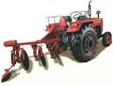
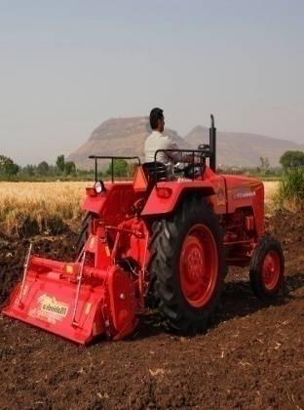
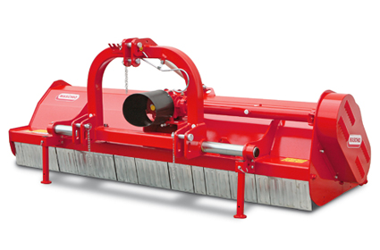
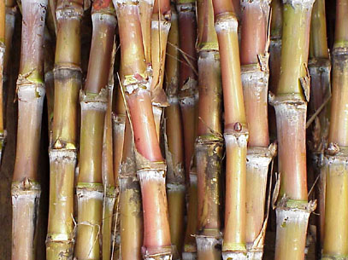
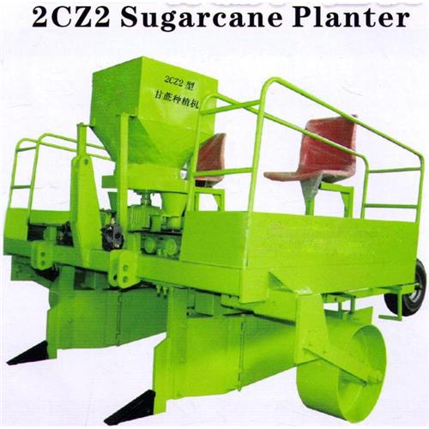
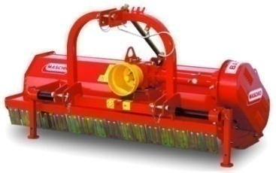
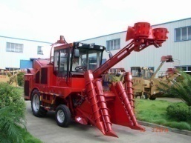
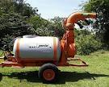
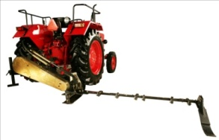
Sugarcane Mechanization
Primary Tillage
Transportation
Secondary
Tillage
Residue Handling
Seeding
Harvesting
Crop
Care

Slide 21
The way forward for India…
Identify
Appropriate technology requirement
Source
Adapt
Evaluate adaption
Indigenize for cost competitiveness
Validate
Performance validation
Propagate for adoption
Domestic and Global
Creating an eco-system for farm mechanization
Main source of supply and repair for farmers
Closest to the farmers leading to high trust
Village Craftsmen
Organized Farm Machinery Companies
Small Scale Industries
Capability to carry out R&D for productivity increase and technology adaption
Bulk of farm machinery today is manufactured by them
Located in clusters with wide reach

Slide 22
Thank you
Visit us at www.mahindra.com

