Slide 1
Theme Presentation National Conference on Re-Energising Indian Coal Sector: Interventions through Policy, Competition and Technology 11-11-2013
S.Ravishankar
Metis Energy Consulting

Slide 2
Agenda
Domestic Coal Scenario
Key Challenges
Rising Coal Imports
Strategy for Re-Energising Coal Sector
2
Notes:
2

Slide 3
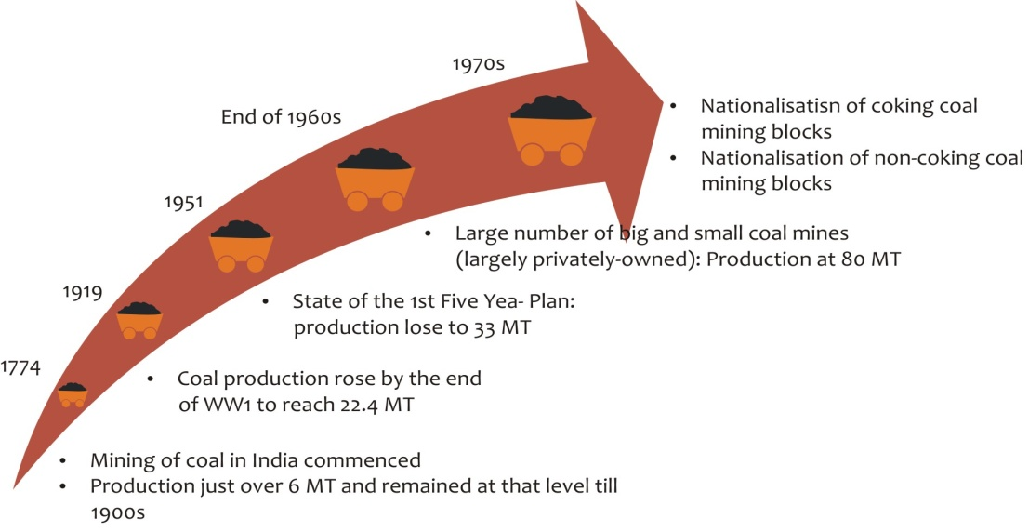
Indian Coal Scenario- Growth Path
Major Milestones in Coal Sector
Coal accounts for 53% of primary energy mix in India, followed by oil at 30%, whereas globally coal share averages to 30%
5th largest proven coal reserve base at 60 BT.
Coal production from 33 MMT in the 1st five year plan to 557 MMT in 2012-13
Post nationalisation in 1973, four-fold rise in production between 1980 & 2010
Coal Production over the years (MMT)

Slide 4
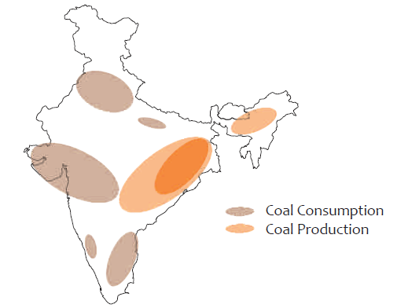
Indian Coal Scenario- Demand Supply Dynamics
India among top global coal producers, however the growth has slowed down
Rise in demand-supply gap : Imports137 MMT in FY 13, 155 MMT required in FY 14.
Lack of planning is a major constraint. Coal production not keeping pace with demand increase – led by power sector growth.
Coal production is limited to mostly the Eastern Region whereas major demand zones exist across the country
Coal Demand-Supply Zones
Demand-Supply Trend (MMT)

Slide 5
Key Challenges
Delay in Block Development: Delays in statutory clearances - FC, EC, mining lease, etc., land acquisition, inadequate infrastructure. Captive production - target 104 MMT vs actual- 37 MMT 2012
Infrastructure and logistics: Major coal producing areas in India viz, Talcher, IB, North Karanpura, Mand Raigarh and Hasdeo – Arand coal fields have very poor Rail infrastructure.
Ports Capacity and connecting infrastructure needs to be developed.
Focus areas for infrastructure & logistics include:
Current Mode-wise Coal Despatch
Completion of 4 key rail links: Industry report - timely completion of the key railway links - 300 MMT of additional coal. Coal movement via railways expected to increase to 58% by FY 17.
Help transport significant production from Odisha & Chhattisgarh
Timely availability of EC and coordination between CIL, Railways & state Govt to be tracked

Slide 6
Key Challenges….
Exploring inland waterways: More Imports - IWT to be explored. NTPC has begun using IWT for transporting coal from Haldia Port to its Farakka TPP
Optimisation of Coal Flow: Re-allocation of coal linkage - Coastal plants are getting domestic coal and inland plants are increasingly relying on imported coal. Major savings can be achieved.
Port Capacity: Major expansion is required at ports to handle larger cargo vessels.
Coal handling facilities should be augmented at Paradip and Vizag Ports.
Challenges to be overcome include low efficiency, low productivity of equipment, inadequate draught, capacity constraints and lack of specialized berths.

Slide 7
Rising Coal / Fuel Imports
Coal Import Trend (MMT)
Optimistic
Oil : 77% ; Gas : 47% and Coal : 37 % by 2016-17
266 MMT D/S Gap 2016-17
Normal
Impact of rising imports:
High Price levels and 33% Rupee depreciation in the last one year
Volatile Global Prices
Pressure on competitively bid power projects.
Compounding impact on the distribution end of the power value chain
CAD Impact
Risks in Imports: Pricing and price volatility, - Infrastructure and port constraints - Competition from other global buyers such as China and Japan - Political and regulatory risks in source country and Policy change

Slide 8
Rising Coal Imports- Import Options
Coal Sourcing in 2012
Indonesia Australia & S. Africa have been major suppliers of India.
Country | Favour | Against
Indonesia | Low Freight Cost to India Low Labour cost Early to mid-stage assets with large potential reserves High grade of coal with 5100 kcal -6100 kcal | High Moisture Content Underdeveloped Infrastructure Political Risks Increasing Domestic Demand DMO and other controls on production and exports planned
Australia | High Grade of Coal with Large resource base Political stable and good governance Skilled manpower with Latest technology and equipments available | High Freight Cost Relatively expensive labour Infrastructural constraints (Ports) Imposed Minerals Resource Rent Tax Imposition of carbon tax (currently under consideration to be repealed)
South Africa | Large Resource base Relatively lower cost of labour as compared to Australia Government encouraging foreign investment though no incentives are offered. | Week Rail Infrastructure High Freight cost to India May necessitate beneficiation to reduce ash content Regulatory Environment – BEE requirements
Other options include Mozambique and Columbia.
Mozambique: Geographically well placed, weak infrastructure, still developing taxation and regulatory policies
Columbia: 12-14 BT of economically recoverable coal reserves, requires huge investments in rail, road and expansion of ports

Slide 9
Strategy for Re-Energising Coal Sector
Need for Integrated Energy Sector Policy – Re-energisng coal Sector is one of the major steps
Focus Area 1: Policy
Need to fast-track major policy implementation
Policy to attract and enhance investments in Coal Mining
Coal Regulator- Clearly defined roles & responsibilities ; enough power to facilitate the growth of the sector
No controlling role but a facilitating role
Independent enough to discharge its role – should not be a bureaucratic impediment
Should be able to address inefficiencies such as sub-optimal linkage , captive block allocation & developmental delays, coal quality issues, facilitate restructuring from monopoly to a competitively driven market and illegal mining
Competitive auction of captive coal blocks: help speed-up the development of coal blocks. Select serious developers -. Accountability and Time frame
Surplus Coal disposal: Need to finalise the methodology for dealing with surplus coal. Currently coal banking and direct sale to CIL are the two options being proposed; UMPP issue

Slide 10
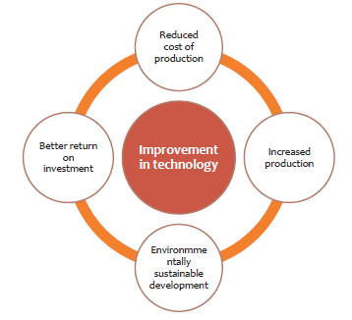
Strategy for Re-Energising Coal Sector
Focus Area 2 : Technology
Ratio for OC and UG production stands at 40:60 globally – In India it is 90:10.
Indian surface reserves are depleting fast - Need for UG mine development & deep opencast mining
Technology collaboration
Coal Quality issues : Coal Seams and Washed Coal
Fast-tracking investment in washeries. CIL has
proposed to set up 20 washeries in the 12th Plan
Labour health & safety
Training – New Skills – Enhanced productivity
Notes:
This highlights not only the inefficiencies but also the scope of improvement & attract investment from experienced miners

Slide 11
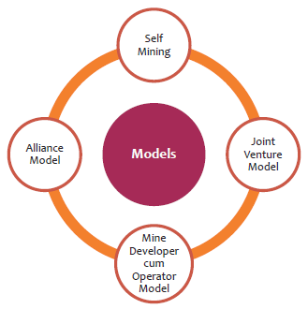
Strategy for Re-Energising Coal Sector
Focus Area 3 : Market Restructuring & PPP Framework adoption
Currently coal mining is done via Govt. led cos. and captive miners – need to step up production
lack of experience
poor infrastructure availability
Controls
uncertainty and additional project management risks.
Coal Market Restructuring : leading to a efficient and competitive market
CIL restructuring process has begun
Restructuring areas : Enhancing Private participation ; implementation of PPP Model in mining
Private Participation
Contract mining - MDO, captive mine development, coal
beneficiation and JVs for exploration have seen private
participation in India.
Global Experience : Competitive / private ownership in USA,
Australia ; Developing nations such as South Africa, Indonesia
- government control / ownership – Attract foreign
investments
Captive Mining Models

Slide 12
Strategy for Re-Energising Coal Sector
Issues faced by MDOs
PPP Framework & MDO
PPP model at the very basic level exists in the form of the
MDO system and the JV model.
The PPP model proposed by MoC envisages a broader role
for private players though in its essence, it is still an MDO
Model.
Contractor/MDO will be responsible for designing, financing,
procurement, construction, operation and maintenance of
the project
Land Acquisition
Shortage of skilled manpower
Availability of Adequate Finance
PPP model would involve more direct involvement of the private player in the project
– probably in terms of Equity partnership in a JV model.
Commitment of the private player is full in terms of finance, technology, expertise
and project execution and success.

Slide 13
In Summary…
Need to step up coal production – Efficiently, Economically and Expeditiously
Policy Interventions
- Competitive Auction of blocks – Accountability and Time target for completion
- Implementation of the coal regulator – Independent – Facilitating role
- Framework to speed-up EC & FC clearances
Restructuring – Strategy to moving away from a monopolistic model
Attracting Private participation with technology / manpower capabilities
Technology Interventions – OC / UG mining
Logistics and Infrastructure : Rail / Inland Waterways
Coal Linkage and Logistics optimisation
Long Term Strategy 2030 : Enhancing Domestic Fuel production and Energy Security

Slide 14
Thank You
14
Notes:
14

