Slide 1
Indian Coal Sector –
Changing Landscape & Immediate Challenges
08.11.2013/SK

Slide 2
Overview- Coal
Global estimated coal resources > 861billion tonnes.
Indian reserves > 293 billion tonnes
India is the fifth largest coal reserves in the world.
The power sector is the largest consumer of coal(70 % of total coal).
About 70 % (more than 200 billion tonnes) of the total reserve is in the state of Jharkhand, Orissa & Chhattisgarh.

Slide 3
  Coal- Current Scenario
Thers is Acute shortage of coal in the country & many power plants are either idle or operating at sub-optimal level.
Substantial Quantity is being met by import which is putting further strain on Balance of Payment Position in country.
Even though significant growth has been achieved in coal production, still lot has to be done to bridge the gap between demand & availability.

Slide 4
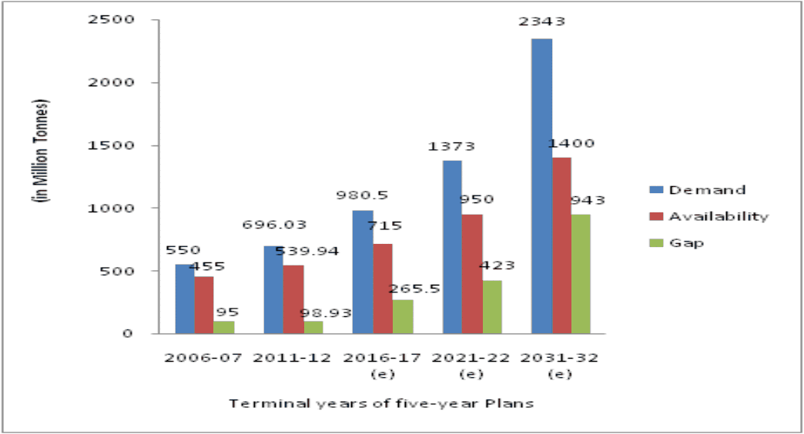
Coal demand, availability & Gap

Slide 5
  Major issues affecting the coal productions
Delay in obtaining requisite clearances
Land acquisition
R&R
Law and order
Coal Evacuation infrastructure from mines to plant

Slide 6
Coal Evacuation infrastructure
Coal fields of Raigarh-Mand(SECL), IB Valley(MCL) & North Karanpura (CCL) together can produce nearly 300MT in a year against very meager production at present.
These coalfields are unable to enhance their production mainly on account of inadequate or no coal evacuation infrastructure.
There is overdependence on Railways for coal transport. Major problem in development of railway network are
identification and acquisition of railway corridor,
long period in obtaining Environmental Clearance & problems associated with forest clearance (if any).
long gestation period in construction of Railway project..

Slide 7
Alternate options for coal evacuation
Cross Country Pipe Conveyor (CCPC)
Cable belt conveyors
Coal Transport in form of slurry
Harnessing of water ways for coal transport
Advantages from the above -
less land requirement to the extent of foundations for overhead conveyor or pipe pedestals as against Railways
less construction period
More eco-friendly.

Slide 8
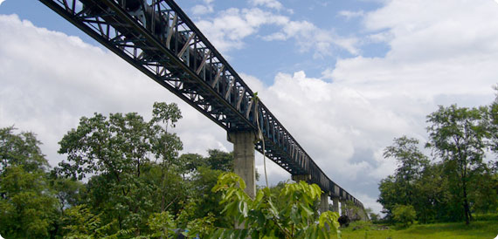
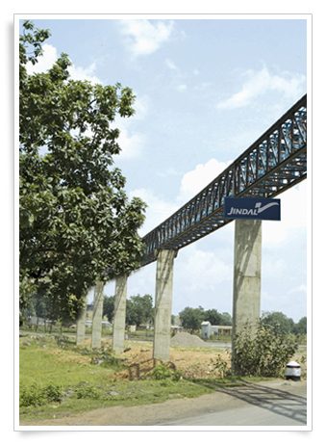
Cross Country Pipe Conveyor (CCPC)

Slide 9
Cross Country Pipe Conveyor – Merits & Demerits
MERITS of CCPC:
Pipe conveying system is environmental friendly as compared to Railways.
No material spillage -material being completely enclosed within the belt pipe there is no spillage.
Non-exposure to atmosphere results in retention of material properties while conveying
Curvature possible in both horizontal and vertical planes associated with steeper angle of inclination
Possibility of transporting second material like ash in the return side of pipe conveyor system, thereby reducing capital and operating cost.
DEMERITS over Railways:
The coal conveying cost by Railways is approximately half of conveying by Pipe conveyor.
Power consumption in pipe conveyor is more due to high friction between idler rollers & belt as compared to railways where only rolling friction is present.
Pipe conveyor maintenance cost is high due to frequent replacement of idlers and complete belt replacement after 6-7 years of operation whereas in railways maintenance is less.
Capacity addition is possible in railways whereas pipe conveyor is designed for fixed tonnage of coal.

Slide 10
Comparison CCPC & railways
A typical comparison has been made between coal evacuation via rail, road & pipe conveyor for meeting 14 MTPA requirement for 37 kms. conveying.
 | Railways | CCPC | Road
Land | 325 Ha | 180 Ha | 150 Ha
Capital cost | 15-17 Cr/ Kms. (571 cr. for 37 kms) | 20 – 22 Cr/ Kms (720 Cr for single conveyor of 3000 TPH) | 2.5 Cr /kms
Operating cost | Rs. 1.5/tonnes/kms | Rs.3/tonnes/kms | Rs.5-8 /tonnes/kms

Slide 11
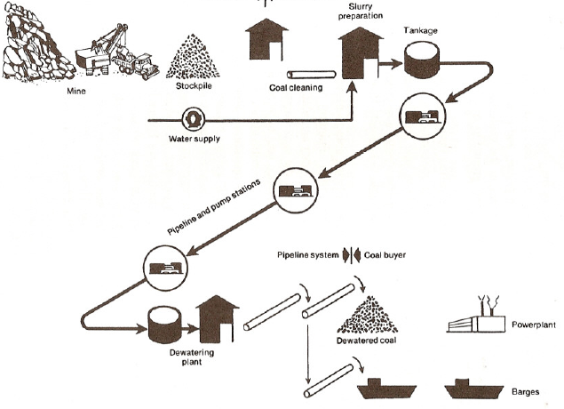
Coal slurry pipeline - Flow diagram

Slide 12
Coal Slurry Pipeline - System
In absence of suitable railway or waterway to transport coal to a very long distances, it may be appropriate to transport coal by coal slurry pipeline.
Coal slurry pipelines require coal-liquid slurry preparation at the upstream end, coal-liquid separation facilities at the downstream end, and intermittent pumping stations along the route of the pipeline at suitable intervals .
Coal slurry is prepared by mixing crushed coal with water and pumped to the receiving station by a single or multiple pumping stations. The ratio of coal to water is about 1 to 1.
Coal slurry is dewatered & dried before utilizing in the plant. To dry the coal, the water is evaporated or separated in a centrifuge.
The pipeline can be either a non-recirculating (one-way) or recirculating (two­ way) system in which Separated water is either disposed off or returned to the point where the coal is added to the pipeline

Slide 13
Coal Slurry Pipeline - Limitations
Not many references across the globe in coal application.
Needs further Research and Development in developing economies like ours for economical & feasible scheme in Indian conditions .
Requires huge amount of water which is already a scarce commodity in our country.
Dewatering & water reutilization is a challenge. Lots of energy is wasted in dewatering & drying of coal.
Storage & transportation of this coal in the boiler is another challenge.
This fine coal(less than 8 mm) is to be essentially stored in the silos & fired directly to boiler.
Losses in the boiler will increase because of the high moisture in coal.
Boiler manufacturers shall develop the mills & other associated firing equipment for utilizing such coal with out compromising on the efficiencies.
Boiler manufacturers to identity & develop equipment suitable for direct firing of pulverized coal with high moisture content.

Slide 14
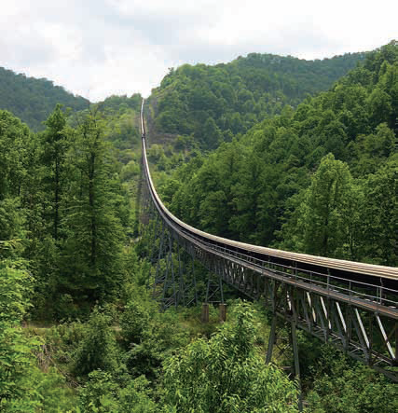
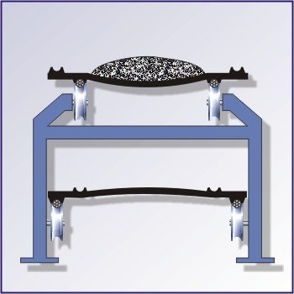
Cable Belt Conveyor

Slide 15
Cable Belt Conveyor
Merits
Minimum Rotating Components
No belt wander due to tension variations,
alignment error or off-center loading.
No loss of belt capacity through curves
Less absorbed power and cover wear due
to material disturbance in transit.
Horizontal direction change possible with single drive unit
Mechanical belt joints used regardless of drive tension. Belt cannot be ripped.
Demerits
Cable belt conveyor are associated with problems like cable wear, sheave wear and spillage, excessive noise etc, which shall be addressed suitably..

Slide 16
Harnessing of Water Ways
India’s existing water ways is under-utilized and this can be exploited for coal transportation
by identifying & strengthening the perennial networks
building small interconnectivity railway network, expansion of ports,
deepening of water ways near sea-mouth,
use of barges for coal transportation,
construction of unloading system along the water ways etc.

Slide 17
Concluding Remark
Uncertainty in fuel supply security and rising coal prices have created near term uncertainty for the power sector.
There is a need to ramp up domestic production by addressing various issues involved.
Lot is desired in the field of developing/ strengthening evacuation infrastructure by utilizing latest technologies.
For the project in Chhattisgarh, Odisha & Jharkhand region which are in vicinity of mines (35 to 40 kms) long term linkage shall be given from these identified dedicated mines for implementation of proper evacuation plan.
Private participation in developing these infrastructure should be encouraged & due weightage shall be given to those developers for coal allocation, who are willing to take these developmental activities.
Since the current fuel security uncertainty would severely hamper capacity additions, the Government is expected to take necessary steps to ensure private sector participation

Slide 18
Thank You

