Slide 1
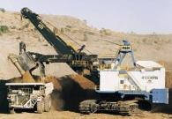
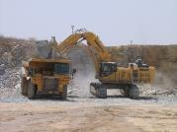
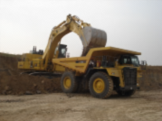
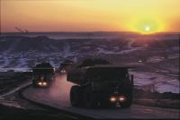
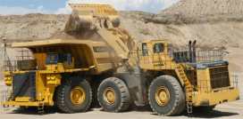
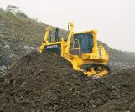
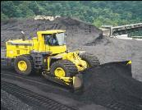
LARSEN & TOUBRO
OPENCAST MINING EQUIPMENT TECHNOLOGY TRENDS
REENERGISING INDIAN COAL SECTOR
NOV 12th , 2013 : New Delhi

Slide 2
Trends
Mining Equipment Size
Equipment Operating Systems
Equipment Tracking Systems
Equipment Management Systems.
Safety Features.

Slide 3
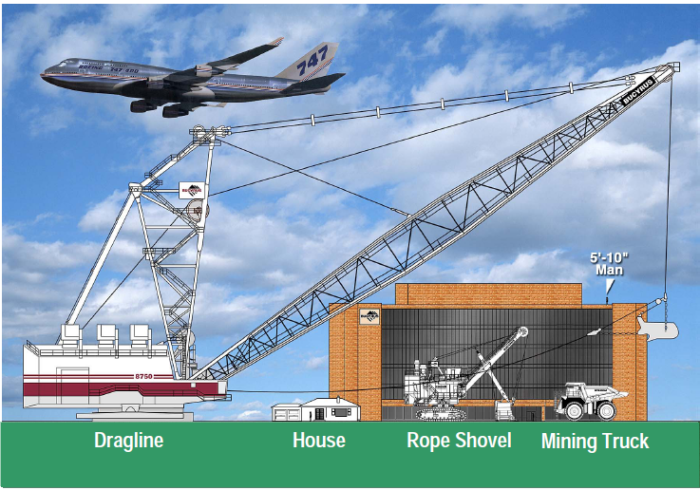
In Mining, Size matters….

Slide 4
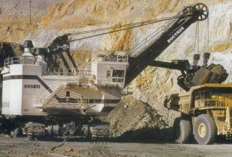
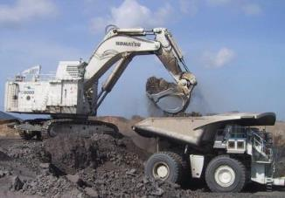
Loading Tool : Shift
Electric Rope Shovels
Hydrualic Excavator
Electric Rope Shovels deployed by PSU Mining Cos.
Hyd. Backhoes / Shovel (10-34 Cu.M. Class) – Private sector Indian Mining Cos. e.g. Hindustan Zinc, EMTA, Jaypee group, Electro steel, Essel Mining, Mahaan Coal.
PSU Mining Co. (SECL, NCL, SCCL, NMDC) started procuring (10-12 Cu.M.) class HEX.
Tendency to shift to Hyd. Backhoes due to selective mining capability and higher productivity.

Slide 5
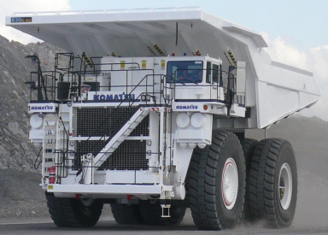
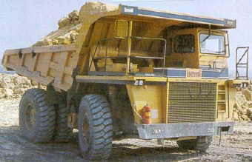
Hauling Equipment – Increasing size
30 T / 40 T Payload dump trucks
100 T to 240T Payload dump trucks
Industry moving to larger payload (up to 240T class) Dump trucks.
Shift took place at PSU mining Cos. like SECL as well as Pvt. Mining Cos (HZL, Reliance, Essar ).
Deployment of large capacity trucks due to significant improvement in Productivity with less manpower.

Slide 6
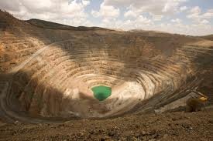
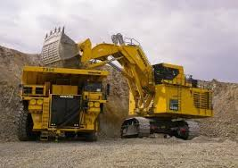
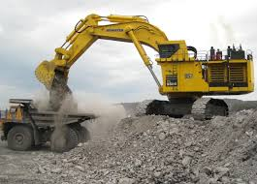
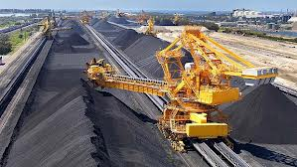
Benefits – Large Capacity Equipment
Higher economic life.
Enhanced productivity.
Reduced Manpower.
Reduced Cost per ton.
Reduced in pit Traffic congestion.
Enhanced in pit Safety.
Enhanced Reliability due to proven global technology.

Slide 7
Equipment Operating Systems

Slide 8
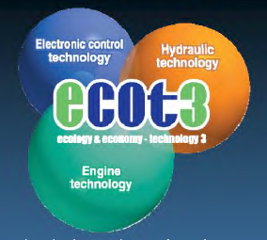
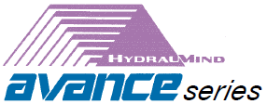
Intelligent Machine Control.
HYBRID

Slide 9
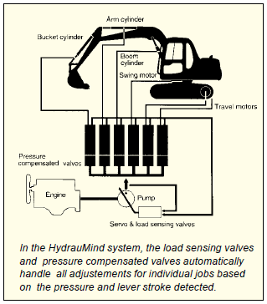
Hydraumind : “Hydraulic-Mechanical Intelligent New Design
Integrated Hydraulic & mechanical systems, which supervises the excavators operations.
Not computer dependent & not even essentially electronically controlled.

Slide 10
Genuine Answers for Land & Environment Optimization
Provided optimal solutions benefiting from IT
Reduced environmental impact
Assured safer operating conditions
Supplied powerful, superior-quality equipment
Notes:
Building on the technology and expertise Komatsu has accumulated during more than 85 years of successful business operations: - GALEO presents customers worldwide with a strong, distinctive image of technological innovation and exceptional value. Designed with high productivity, safety and environmental considerations in mind, as it is expressed in "Genuine Answers for Land & Environment Optimization", the machines in this line reflect Komatsu's commitment to contributing to the creation of a better world.
Four elements are contained with the GALEO name, each an essential theme for our business:
Providing optimal solutions benefiting from information technology;
Reducing environmental impact;
Assuring safer operating conditions; and
Supplying powerful, superior-quality equipment.

Slide 11
Integrates Electronic , Engine and Hydraulic Technology.
Meets and exceeds latest emission requirements & optimises fuel consumption.
Helps perform heavy duty jobs at all times.

Slide 12
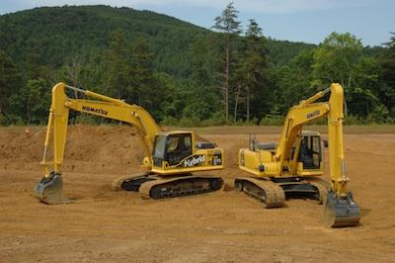
Hybrid Hydraulic Excavator
Uses electrical components not found in its conventional counterpart : a generator motor, inverter, capacitor and electric swing motor.
Converts large amounts of energy lost in swing motor braking into electric energy & stores it in the capacitor.
Stored energy used to power swing motor or the generator motor.
The generator motor assists the engine in driving the hydraulic pumps.
Saves fuel consumption up to 25%.

Slide 13
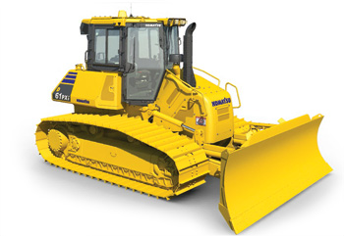
Intelligent Machine Control
Fully Automatic Blade Control For Rough And Fine Dozing
Can perform both rough dozing & finish grading with ease.
Seamless transition from rough dozing to finish grading operation.
Increased efficiency & productivity.

Slide 14
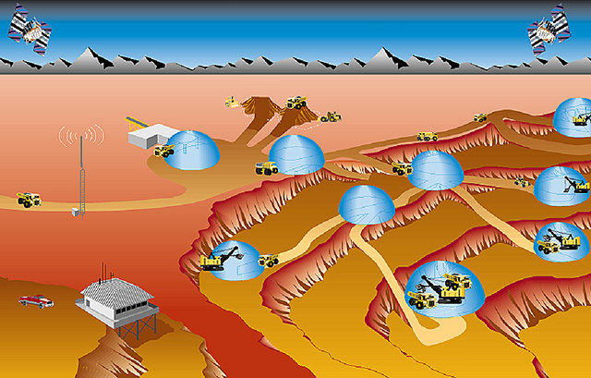
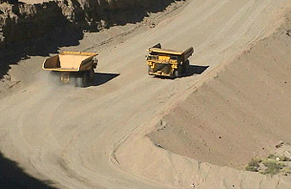
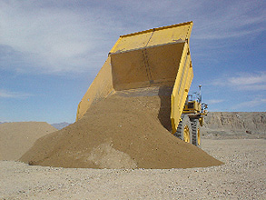
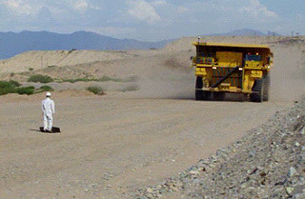
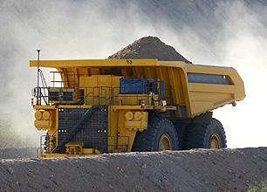
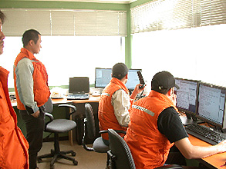
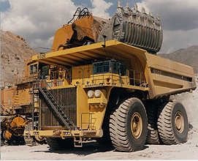
High Technologies (AHS) –Unmanned Dump Trucks
How Komatsu’s Autonomous Haulage System Works
GLONASS Satellite
GPS Satellite
4) Fleet Control
- Flexible and expandable
- Manual vehicle interaction
- Grader interaction
5) Safety
Obstacle detection by millimeter wave radar
3) Dumping site
- Paddock dump (Auto path generation)
- Crusher dump (Designated location)
Water Truck
Motor Grader
Master LinkTM
6) Operation
- High availability
- Economical
- Reliable
1) Hauling
- Precise navigation
- High speed and robust control
Central Office
2) Loading Site
Automatic path generation to loading machine
Notes:
Komatsu promotes the research and development of original leading-edge technologies for commercialization in many areas. One such effort includes the development of an autonomous haulage system (AHS). In this system, unmanned dump trucks equipped with state-of-the-art technologies, such as a high-precision GPS and millimeter wave radar, automatically approach loading equipment and travel along the assigned road to the designated point for dumping. AHS has a high-tech manual interaction function to maintain the safety of vehicles in the AHS area, including other manual vehicles, such as motor graders and water trucks. If a person comes close to the truck, it detects the person with an on-board radar and stops automatically. We believe that this kind of advanced technology will contribute to the improvement of our customer's operations, especially in terms of safety and productivity.
This AHS is just one example of our advanced technologies that we will continue to conduct research and development on into the future.

Slide 15
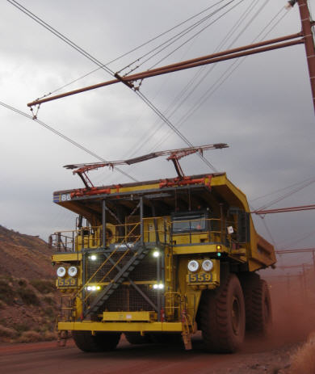
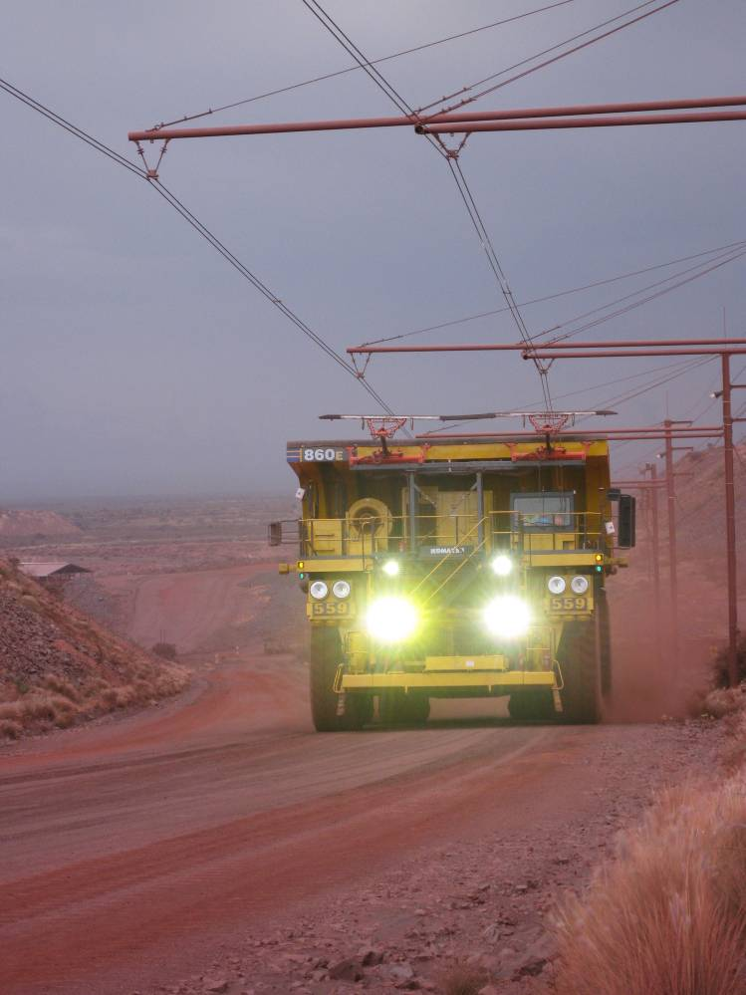
Trolley Assist
Power Supply from a Transmission Line rather than a Diesel Engine
Benefits
Increased Productivity
Lower Fuel Consumption
Higher Speed on Grade
Typical Application:
Uphill Haul Segments
Established Travel Routes
Large Diesel Fuel vs. Electric Power Cost Difference
> 100 Operating Trucks Worldwide
Notes:
No. of Clicks: 2 - (1) Major Benefits/Increased Productivity (2) Next Slide
Presentation Notes:
- transmission line provides additional power to take advantage of the extra wheelmotor capacity that current diesel engines cannot fulfill.
- maximum 860E wheelmotor capacity ~5200 hp
- Electric wheelmotor design practices address both propel and retarding applications.
* retarding application results in greater power quantities than propel.
* thus extra hp capacity not typically used in propulsion.
#1 – Let’s see how this extra wheelmotor power is used.

Slide 16
Application Zones
Diesel vs. Trolley
0.20
Example 2:
Energy cost $0.10 kwh
Diesel cost: $0.80 / L
Example 1:
Energy cost $0.15 kwh
Diesel cost: $0.50 / L
Diesel Application
Zone
0.15
Diesel
Power
($/kwh)
0.10
Lowest Cost
Option
Trolley
Trolley Application
Zone
0.05
Lowest Cost
Option
0
0.20
0.40
0.60
0.80
1.00
1.20
Slope Length:
1000 m
Diesel
($/liter)
2000 m
Notes:
No. of Clicks: 4 - (1) Diesel App. Zone (2) Example 1 (3) Example 2 (4) Next Slide
Presentation Notes:
#1 - Primary Graph Concept is to define lowest cost/ton option for two key variables:
* Diesel Fuel Cost
* Electric Power Cost
- Trolley Feasibility Readily apparent based on large size of 1000 meter application.
- Trolley Segment Grade = 8% + 1%.
- Diesel Fuel Cons. = 35 lph
- Power Cons. = 3420 kw (1800 v x 1900 amps)
- Trolley System Avail. = 80%

Slide 17
Equipment Tracking Systems

Slide 18
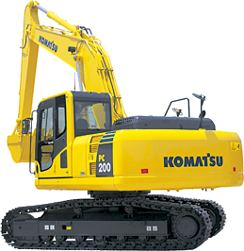
KOMTRAX:
Machine Tracking System
How KOMTRAX works
GPS
Communication Satellite / Mobile Phone
KOMTRAX Terminal
Machine
Data server
Communication antenna
GPS antenna
Web Application Server
KOMTRAX Controller
Modem
Pump controller
Internet
Engine controller
Machine
User
Distributor / Customer
This service is not available in certain area.
Notes:
KOMTRAX is a machine management system for construction equipment, utilizing web technology.
The main purpose of this system is to reduce customer's operating cost by monitoring service meters, machine positions, working records, warnings, fuel level and others.
The total lifecycle cost of machines consists of machine cost and operating cost. The operating cost includes maintenance, fuel, and the operator's wage. In general, the operating cost is as much as two to three times higher than the machine cost. KOMTRAX aims to lower the operating cost.
The chart at the center of this slide, shows how KOMTRAX works:
Machines are equipped with computers such as a pump controller and an engine controller. Information concerning operating conditions gathered through these controllers is sent to the KOMTRAX terminal. As for machine positioning, KOMTRAX receives the information from GPS satellites.
The collected information is then converted into a data format which our customers can easily see after analyzing the data with web applications. Then the information is transmitted to customers and distributors all over the world.
In 2009, the number of KOMTRAX-equipped machines has topped the 140,000 mark.

Slide 19
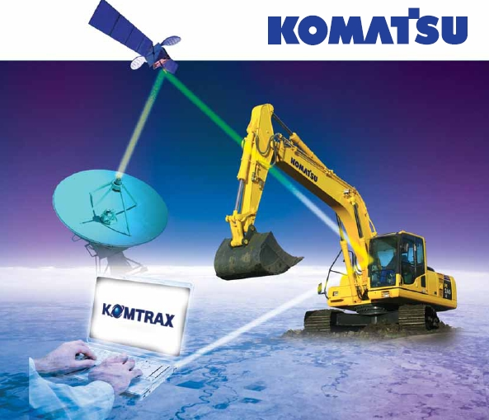
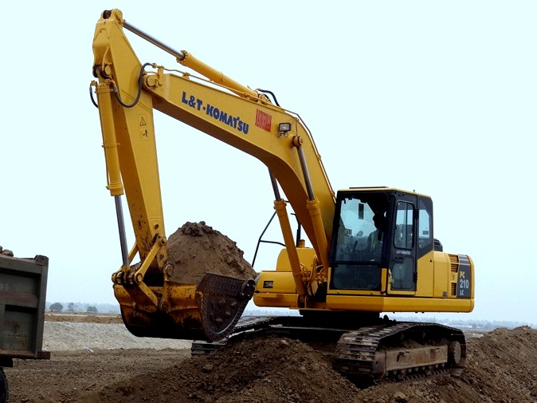
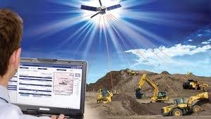
KOMTRAX : Machine Tracking System
Full Machine Monitoring
Complete Machine Status
Total Fleet Management
KOMTRAX Reports
EXPERIENCE
IMAGINATION
AN
BEYOND

Slide 20
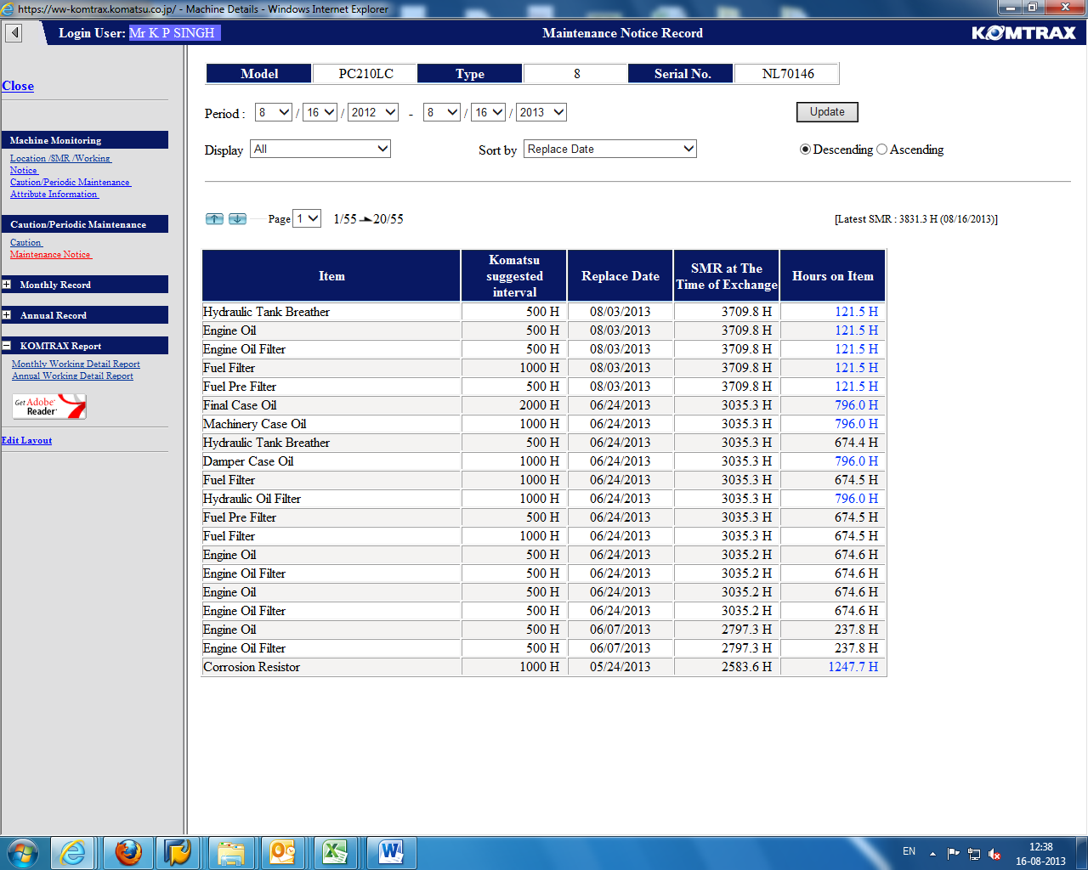
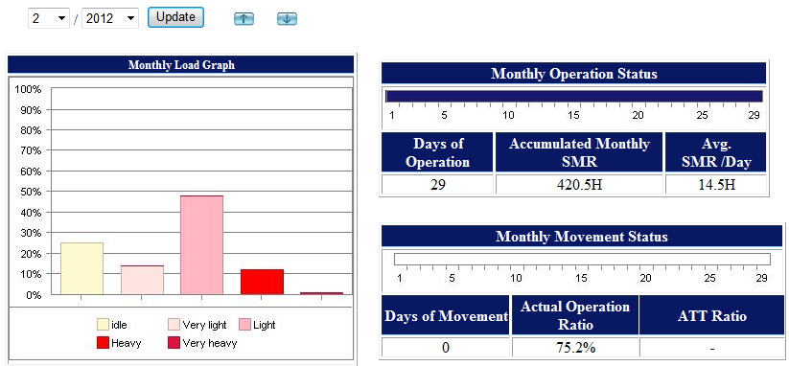
KOMTRAX : Machine Tracking System

Slide 21
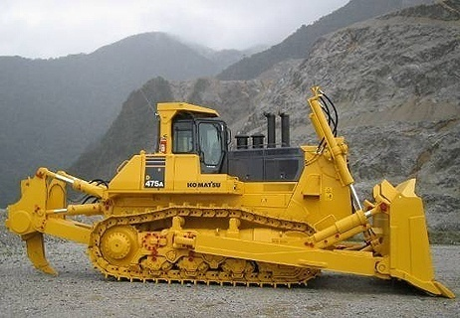
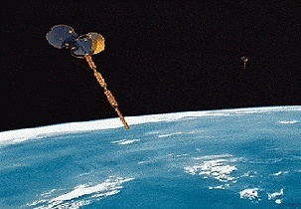
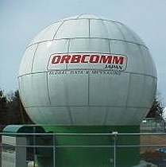
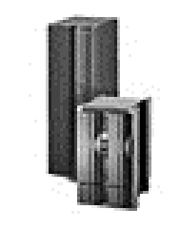
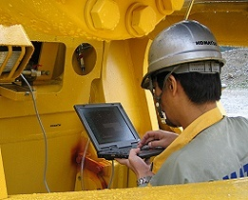
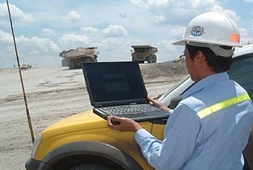
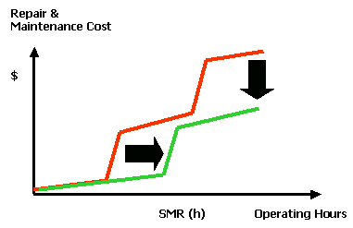
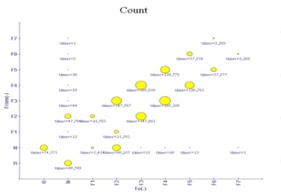
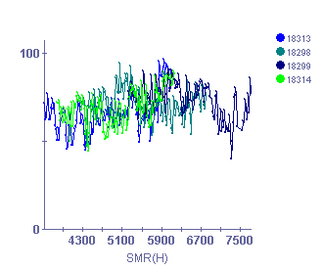
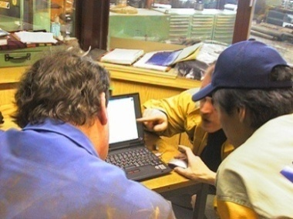
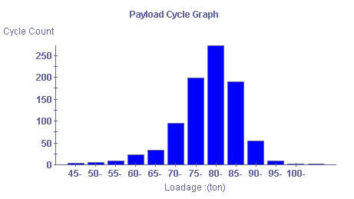
KOMTRAX Plus
Integrates KOMTRAX & VHMS ( Vehicle Health Monitoring System) for component condition & operation data monitoring on a continuous basis.
Machine condition data
Machine operation data
Satellite Communication
Gateway Control Center
KOMTRAX Plus data download
KOMTRAX Plus data Wireless download
Prompt communication:
Reduce unscheduled repair.
Accurate forecast:
Extend and optimize major component life.
KOMTRAX Plus
Database
T/M Severity
KOMTRAX Plus
DATA ANALYSIS
Engine Severity
Internet
Payload Data
Reduce cost for repair and maintenance
Keep high machine availability
Proactive Support
At Distributor
8

Slide 22
Equipment Management Systems

Slide 23
MINES MANAGEMENT SYSTEM
Modulur Mining
GPS Collection
GPS Signal
Digging Operation System
Bulldozer Operation System
Dump Truck Dispatch System
Survey
Notes:
DISPATCH is the management system for mining operation. DISPATCH is developed by Modular Mining Systems, one of Komatsu group companies. Positioning of machines can be easily identified by GPS-based DISPATCH and enables you to dispatch the right machine to the right place, and optimizes the assignment of the fleet. DISPATCH is used in many mining sites and is the de facto standard on a worldwide basis.

Slide 24
Mine Management Packages

Slide 25
Safety Features

Slide 26
SAFETY FIRST: Features
Rear View Camera and Monitor
Payload Meter
Vehicle Health Monitoring System (VHMS)
Auto Spin Regulator (ASR)
Auto Fire Suppression System (AFSS)
Auto Centralized Lubrication (ACLS)
Antilock Brake System (ABS)

Slide 27
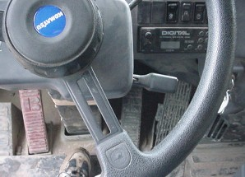
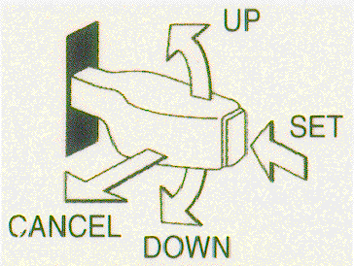
ARSC (Automatic Retarder Speed Control)
HD785-7
ARSC
Descending down hill in constant speed without retarding control
Descending speed can be set from 10 km/h to 55km/h
Adjusting pre-set speed ±1 km/h
With Retarder Overheat Caution
Operation feels like auto-cruise control on automobiles
Concentrates on steering control
Improves Efficiency
Reduces operator fatigue
Pre-set vehicle speed
Up speed
Down speed

Slide 28
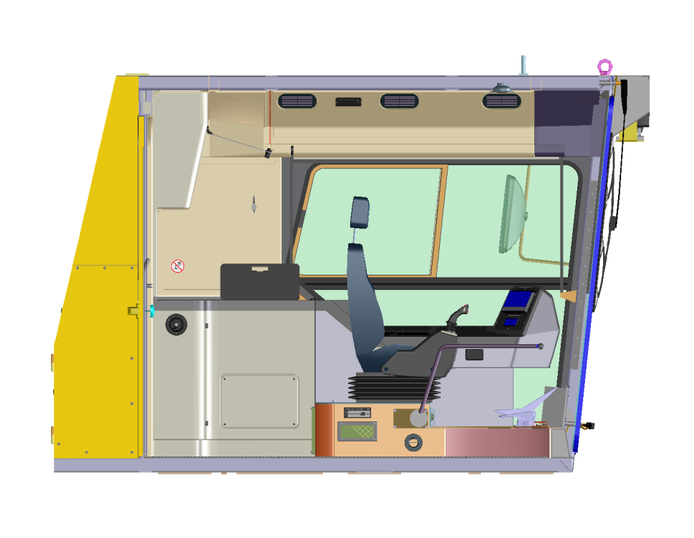
Operator Cabin With Integrated FOPS
FOPS according to ISO 3449
Falling Objects Protective Structure
protects operator from injury
Test Procedure: 227 kg ( 500 lb )
falling from 5,3 m ( 17‘4“ ) onto
FOPS structure
A mass with the energy of 11600 Joule falling onto the cab roof, should not cause penetration of any part of the FOPS structure
Test result:
positively no penetration

Slide 29
Control Panel :
Security in Operation and Machine Handling
Continuous display of operating status.
Stored and accessible precise service information for quick trouble shooting, timely service and repairs.
Plain text display for continuous monitoring
Additional acoustic warning with, if necessary, engine shut down
Fault messages stored and can be downloaded
Memory protected with battery back-up
Fault Monitoring and Storage
ETM System
ECS System
VHMS System

Slide 30
Thank You
30

