Slide 1
Syngenta’s contribution to the corn business in India
March 20, 2014

Slide 2
A leading agri-business - Broadest crop exposure in the industry
-7%
$0.7bn
-1%
$2.0bn
+4%
$1.7bn
Lawn and
Specialty
crops
77%
Garden
+16%
$0.7bn
Vegetables
Rice
+11%
$1.4bn
Diverse field
+11%
$2.6bn
Soybean
crops
23%
Sugar cane
Cereals
+15%
$0.3bn
+12%
$1.8bn
Seeds
Crop
Protection
Corn
$14.7 bn
Group sales 2013
0%
$3.6bn
Percentages reflect sales growth in 2013 versus 2012.
Growth at constant exchange rates. Source: Syngenta estimates
Notes:
Notes:
Group sales of $14.7 bn in 2013
Crop Protection: $10.8 bn (excl. Sales to Seeds) $10.9 bn (incl. Sales to Seeds)
Seeds: $3.2 bn

Slide 3
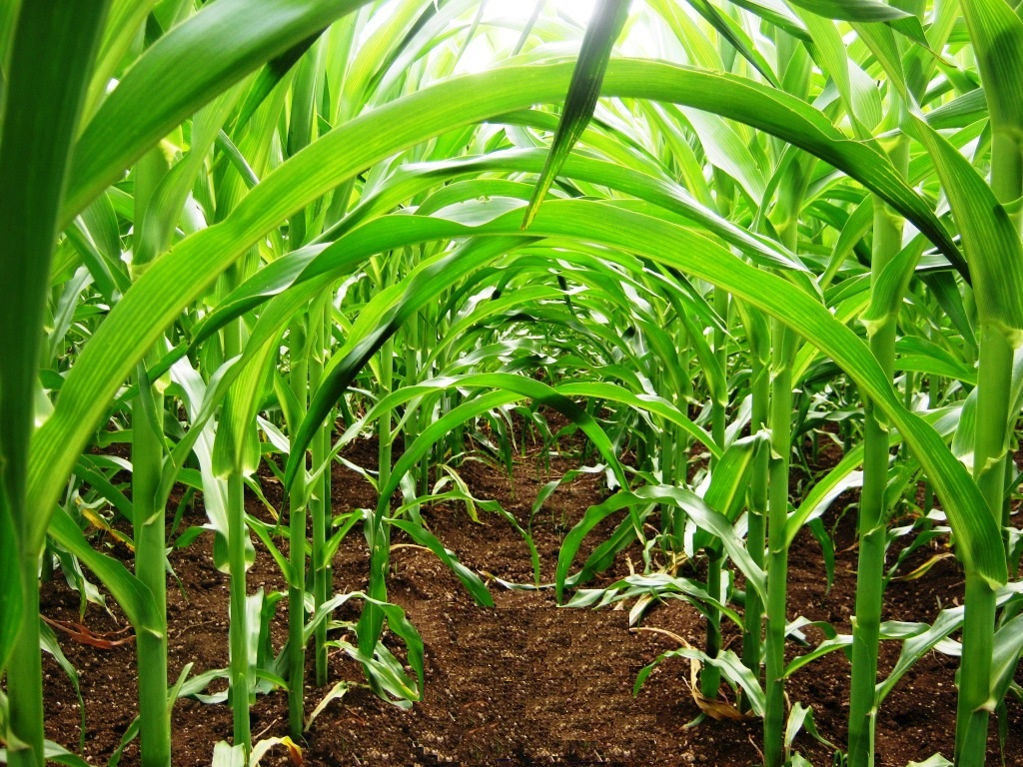
Syngenta in India is….
One of the leading agri-inputs company
Providing Integrated solutions
Engaging with growers at every step
Focusing on 8 strategic crops
World-class R&T centre and Manufacturing site in Goa
Research stations across India
Seed manufacturing facilities
Classification: PUBLIC

Slide 4
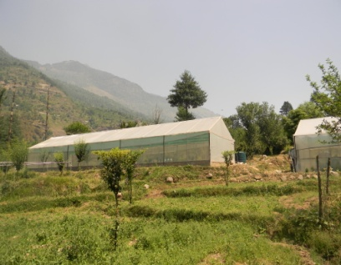
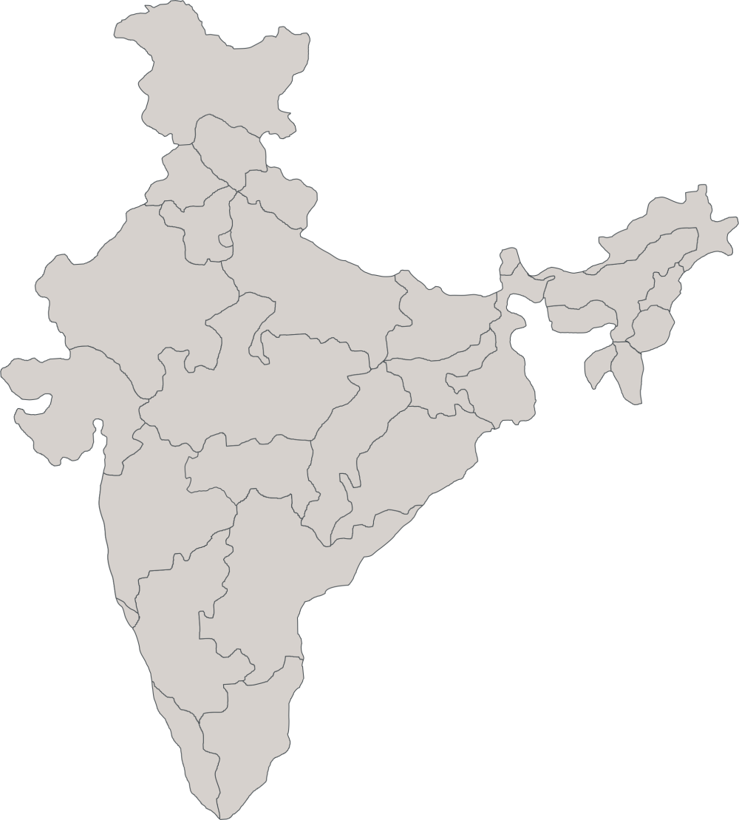
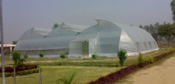
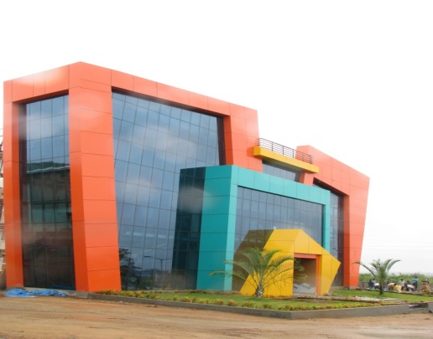
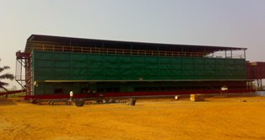
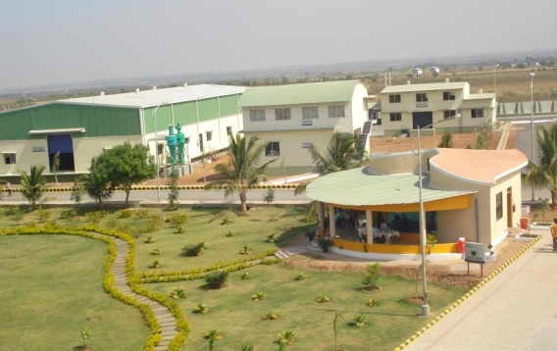
We are spread across India
Katrain
Karnal
Aurangabad
Goa
Indore
Hyderabad
Pune (HQ)
Eluru
Ranebenur
Guntur
Nuthankal
Bengaluru
Kadambankulam
Locations of Research Farms, Seed Processing farms, major facilities in India
Classification: PUBLIC

Slide 5
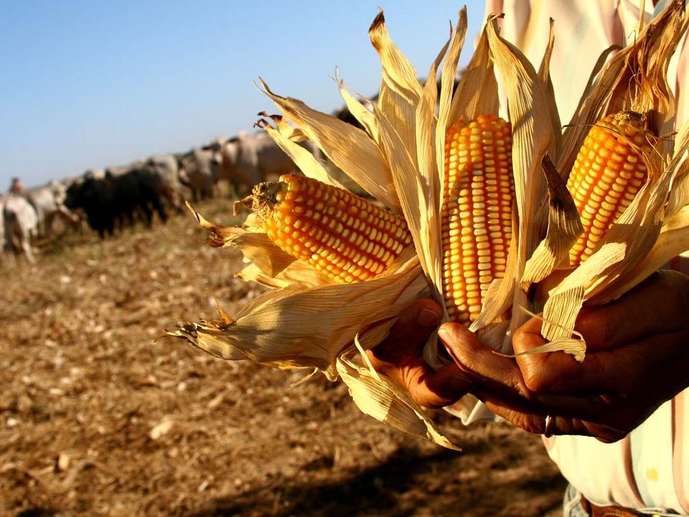
The big picture Yields have advanced – but more is needed
Corn: a global and highly technified crop
Notes:
Corn is a global corn and responds well to good management
Around 60 percent of global corn production is used for animal feed. This means that the global importance of corn is expanding particularly in emerging markets, where growth in meat consumption is increasing. Corn growers are also supplying other end uses such as sweeteners, plastics and – particularly in the US – biofuels.
Corn is one of the most productive crops: plant one seed, and you get over 500 kernels in return. Hybridization over many years has allowed enormous productivity gains, and this has been complemented in the last decade by the development of biotech traits in North America, Latin America, Asia and South Africa. As a result, the value of corn seed has risen, and seed selection has become a key grower decision. In addition, to safeguard their substantial investment in seed, growers need a range of solutions to protect their crop from weeds, insects and environmental stress.

Slide 6
Population growth, per capita GDP rise: Major Demand Drivers
CAGR 10-20 6.3%
Corn Grain Demand*
Mio tons
CAGR 10-20 7.6%
Feed
CAGR 10-20 3.4%
Food
Feed demand
Food & industrial demand
Income growth (GDP/capita): Steady growth with 8.4% CAGR 2010-20,
Corn for Feed driven by
diet protein increase: meat, egg and dairy, high purchasing power
Poultry meat consumption higher than cattle meat consumption
Corn for Food and Industry driven by
12% Food, 37% Textiles, 51% for others (Chemical Industry)
Corn as food to decline, but artificial sweeteners HFCS to enhance
Industrial: Upside case of Corn consumption for starch and alcohol currently present, a key factor may provoked by Govt of India which might be swing between sorghum and corn depending on political and social factor
* 2003 Updates: 17 Starch Units with 3400TPD Corn Consumption in process under production

Slide 7
Government aim for self sufficiency: requires substantial yield increase with no area expansion
CAGR 10-20 6.3%
Market drivers
Corn Grain Production Forecast* (m MT)
Govt. aim for corn self sufficiency to be sustained
Spot opportunity for exports
Area assumed to be flat
OPV to hybrid conversion to increase, hybrid penetration to increase from 54% in 2010 to % in 67% in 2020
Yield must increase by ~2 MT / Ha to meet the demand of 37mn Tons in 2020
Area CAGR 10-20 0.00%
Yield CAGR 10-20 3.0%
Post-harvest losses *
2.5% | 2.5% | 2.5% | 2.5%
Gross farm yield (t/ha)
2.0 | 2.7 | 3.5 | 4.6
Net output yield (t/ha)
1.9 | 2.6 | 3.4 | 4.5
Source : Marketable Surplus and Post Harvest Losses of Maize in India, 2002, Directorate of Marketing & Inspection, Nagpur.

Slide 8
Corn: Wide differences in technology use
North America 34 Mha
EU-27 8 Mha
CIS 4 Mha
China 32 Mha
INIDA 9 Mha
Brazil 13 Mha
Arg 3 Mha
Technification status:
Mechanization
Genetics and molecular breeding
GM
Seed treatment
Early season weed control
Abiotic stress control

Slide 9
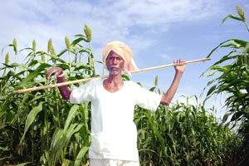
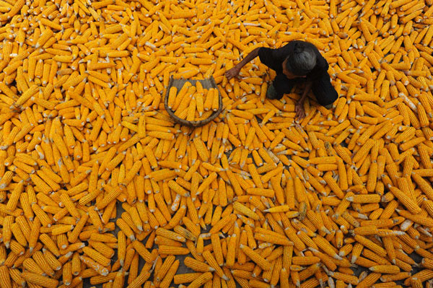
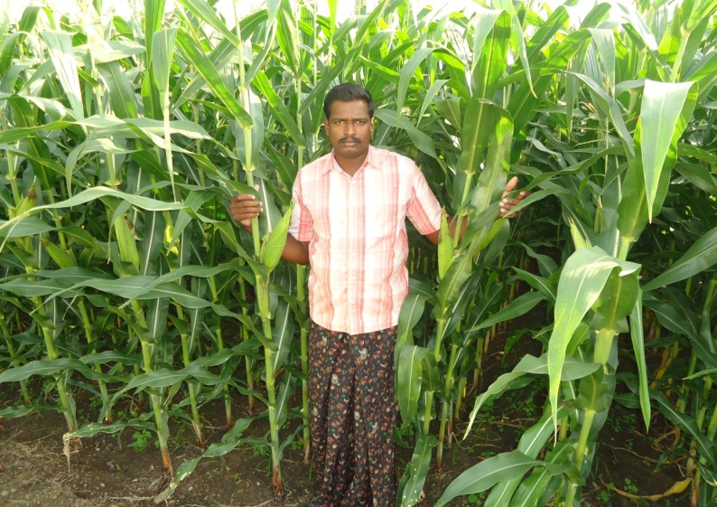
Corn growers in India
Est. 10 Mn corn growers
Avg Land Holding ~1 Ha
Young Farmer
Off farm income is important
Yield level increasing but well below developed world
Rural labor shortage ; increasing labor price
Classification: PUBLIC
Notes:
Corn growers in INDIA. Very many, small, aging with many families supplementing their livelihood with off farm income. Emergence of contract farming services

Slide 10
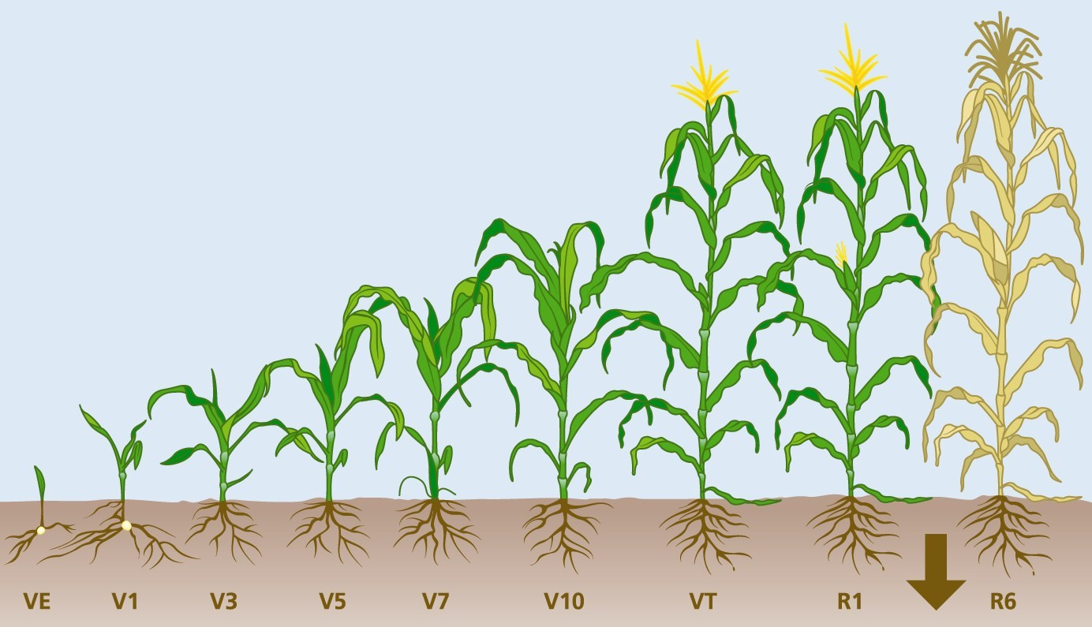
India Grower issues: multiple and driven by small farm size
Before farm
On the farm
After farm
Financing for inputs
Labor shortage for land preparation
Weather related concerns
Need to have off-farm income to support family
Uncertainty on which inputs to buy: fake products
Infrastructure and transport issues
Crop loss after harvest
Managing financial cash flow issues
No have post harvest facilities
Little bargaining power means limited options in terms of pricing
Sub-optimal farm management
Low level mechanization / Labor shortage
Yield potential
Realized yield
Multiple pain points driven by small farm size and sub-optimal growing practice

Slide 11
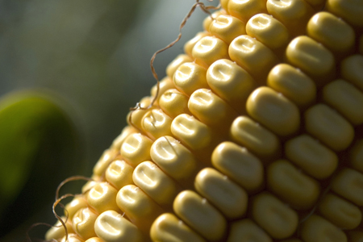
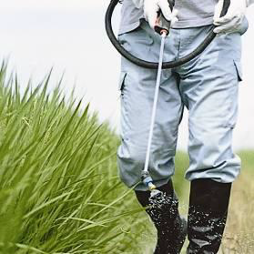
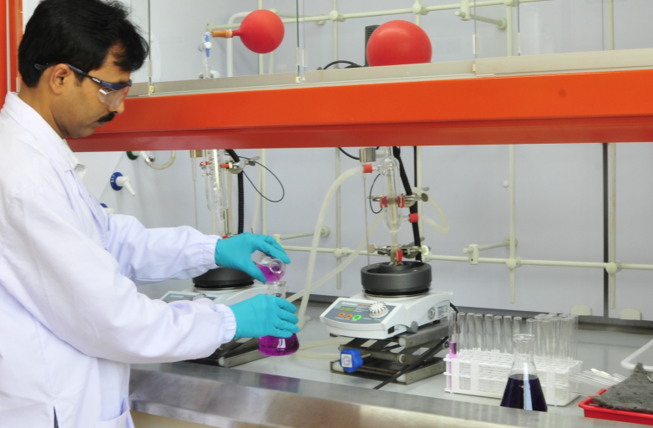
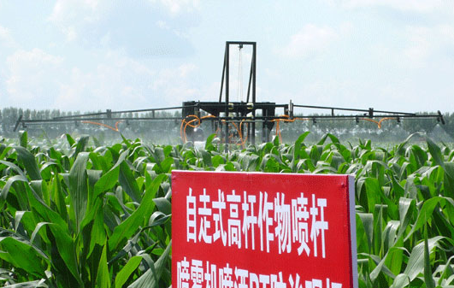
Technology is transforming corn growing in India
Genetics
Crop Protection
Crop Husbandry
Integrated Corn Solution
Biotechnology
Adjacent Technology
Classification: PUBLIC
Notes:
Lets look at the technology combination that is transforming corn production in INDIA.
From Genetics and crop protection, to Biotechnology traits and improved agronomic practices using more mechanization
I would like to take this opportunity to highlight the fact that Syngenta is a leader in agriculture because we are able to bring together technologies from different areas of science. I briefly reviewed our crop protection pipeline which highlights our capabilities in the field of chemical solutions.
Now I would like to turn to Corn and Soy Seed R&D, where we are well positioned to unite two technologies to develop products to meet our grower customers’ needs.
There are two important technologies for moving forward crops which can meet the needs of today’s growers: genetic modification and precision breeding. Genetic modification introduces genes from other species, which wouldn’t normally be found in that particular crop. The resulting crop is a transgenic, or genetically modified, crop.
Precision breeding utilizes techniques that help us understand the genetic makeup of crops. We can then use that information to identify useful traits, as well as improve the efficiency of breeding desirable traits into the crop species, while breeding out the undesirable traits. Precision breeding capitalizes on technology to get products to growers faster and more efficiently. It is particularly well-suited to complex, multi-gene traits that are native to the crop species.
Syngenta has leadership expertise in both of these technologies. That makes a world of difference in the quality of our products that we can offer to growers.

Slide 12
Start Right: A new experience in growing corn for a better life.
1. Optimize resources for success
Financial & farm resource planning ; land preparation ; Hybrid Selection & Input Allocation
A new experience in growing corn for a BETTER LIFE.
2. Adopt Technology in the Bag
Use NK® hybrids with technologically advanced seed enhancement solutions
Popular NK Brands
Advanced Seed Care Solution
Recommended Agronomy & Fertilization
4. Protect and Boost the yield for higher Q&Q
Protect the crop to enhance yield and maximize profitability.
More cobs ; increased cob length and size ; strong crop health
3. Establish Strong Crop Foundation for higher yields
Crop Care Solution through advanced Crop Protection Chemicals
NK® Hybrid becomes more Smarter & Stronger
Classification: PUBLIC

Slide 13
The Good Growth Plan
More food
Less waste
More biodiversity
Less degradation
More health
Less poverty
Make crops
more efficient
Rescue more farmland
Help biodiversity flourish
Empower smallholders
Help people stay safe
Look after every worker
Increase average productivity of the world’s major crops by 20% without using more land, water or inputs
Improve the fertility of 10 million hectares of farmland on the brink of degradation
Enhance biodiversity on 5 million hectares of farmland
Reach 20 million smallholders and enable them to increase productivity
by 50%
Train 20 million farm workers on labor safety, especially in developing countries
Strive for fair labor conditions throughout our entire supply chain network
One planet. Six commitments.
Notes:
We are launching The Good Growth Plan which includes six specific commitments to address critical challenges the world faces in feeding a growing population.
By 2020, we commit to:
Make crops more efficient: Increase average productivity of the world’s major crops by 20 percent without using more land, water or inputs
Rescue more farmland: Improve the fertility of 10 million hectares of farmland on the brink of degradation
Help biodiversity flourish: Enhance biodiversity on 5 million hectares of farmland
Empower smallholders: Reach 20 million smallholders and enable them to increase productivity by 50 percent
Help people stay safe: Train 20 million farm workers on labor safety, especially in developing countries
Look after every worker: Strive for fair labor conditions throughout our entire supply chain network

