Slide 1
USDA MaizeOutlook India Maize Summit March 20, 2014
Allan Mustard and Dr. Santosh K. Singh
U.S. Department of Agriculture, American Embassy, New Delhi

Slide 2
First, the usual caveats….
Source: www.dilbert.com
Notes:
Before I begin, I would like to show you this little cartoon. If you can’t see it well, let me read it. The boss tells his employees, “I’ve decided to move to a rolling forecast.” One of the employees replies, “So, the problem is that forecasts are worthless, and your solution is to do more of them?” Of course, forecasts are not worthless, but we need to remember that they are what they are: forecasts, and not guarantees. Uncontrollable factors that come into play over the course of a marketing year can and will force us to change our forecasts. As farmers will tell you, you never know how much you have until it is harvested.
The first part of my presentation will focus on the United States, which is the world’s largest producer and exporter of maize. In certain respects, the United States maize market exerts the greatest influence of all, although as we shall see, other exporters are becoming more influential. We will then move to a more global view of where we see the maize market going over the coming year.

Slide 3
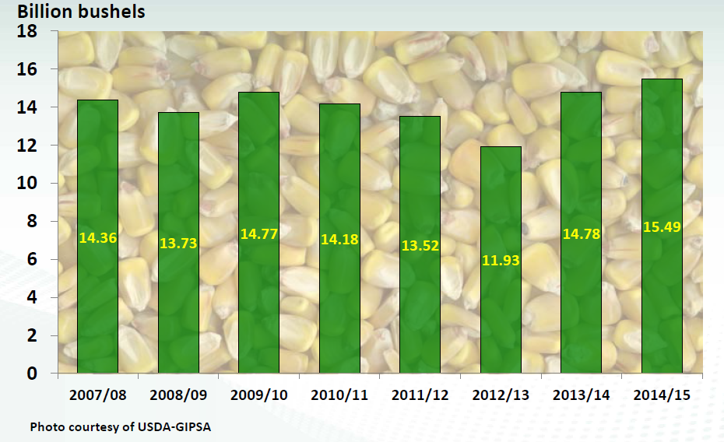
Steady expansion in U.S. corn supplies
Source: USDA Economic Research Service
Notes:
Higher corn yields are seen offsetting the lower acreage so the projected gain for 2014 U.S. production would total almost 80 million metric tons. However, the major contributor to the gain in overall supplies is related to an increase in carry-in stocks of 22 million metric tons. Supplies would then expand to 391 million metric tons or by 30 percent from the 2012 drought. The outlook for corn demand, however, is not as bright.

Slide 4
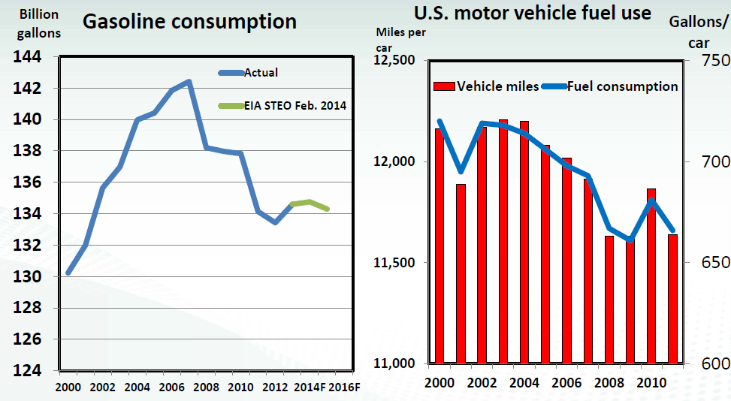
U.S. gasoline consumption has declined
Source: USDA Economic Research Service
Notes:
Ethanol use has now arrived at a major juncture. The figure on the left shows that U.S. gasoline consumption peaked in 2006 and has since declined. Two main reasons are illustrated by the figure on the right. The red bar shows the average number of miles that Americans drive in a year, which has declined more than 4 percent between 2002 and 2011. While the recent recession was a contributing factor, this decline is also correlated with an aging population—since older Americans tend to drive less. In line with the decline in miles driven, the blue line shows a corresponding decline in the volume of gasoline used per car in a year. This decline also reflects the effect of improving vehicle fuel economy in miles per gallon. The Energy Information Administration is projecting a further decline in gasoline consumption for 2015. With falling gasoline consumption, the maximum level of ethanol that can be blended—the so-called blend wall—has come sooner than anticipated. The red line here shows that ethanol is now very close to 10 percent of gasoline consumption. The blue bar shows that despite a 6.4-percent reduction in ethanol blending last year, the blend rate is still close to the maximum rate. Lower ethanol prices have not been able to reverse this downward trend.

Slide 5
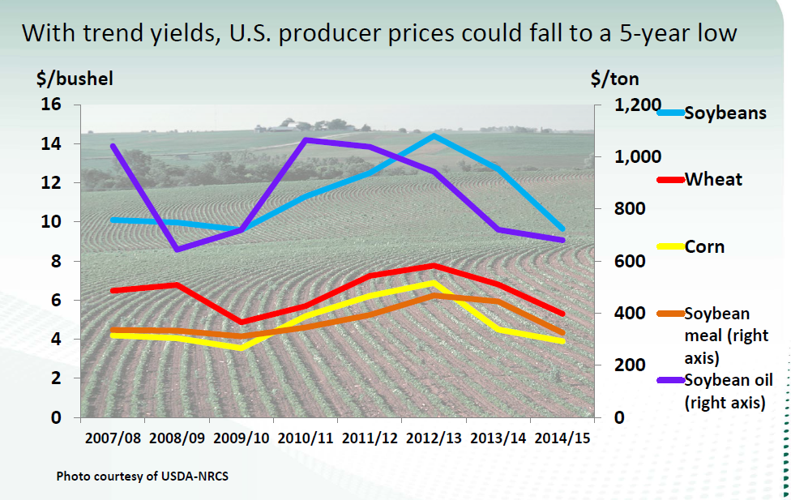
Source: USDA Economic Research Service
Notes:
This slide shows that for the major agricultural commodities, improved supplies in 2014 could push prices down toward 5-year lows. As recently as a month ago, Chicago nearby maize contracts were trading at around four and a half dollars per bushel, which equates to about $177 per metric ton. In the last few weeks, however, export quotes have climbed to around $232 FOB Gulf, due to a combination of the absence of competition from Argentina and political turmoil in Ukraine. This may be a temporary phenomenon – we’ll have to wait and see.

Slide 6
Source: USDA Foreign Agricultural Service
Notes:
Now let’s turn to a more global view of the maize market. This figure shows a declining stocks-to-use ratio for global stocks of wheat, corn, rice and soybeans over the past 5 years. But a succession of bumper harvests worldwide may put an end to that trend in 2014/15.
We foresee maize ending stocks growing by over 20 million metric tons by the end of this marketing year, due mainly to excellent crop outlooks in China and the United States. If our forecasts hold, these two countries will add 22 million tons to ending stocks, more than offsetting drawdowns elsewhere. As we all know, ending stocks are inversely related to prices, so as ending stocks go up, prices go down.

Slide 7
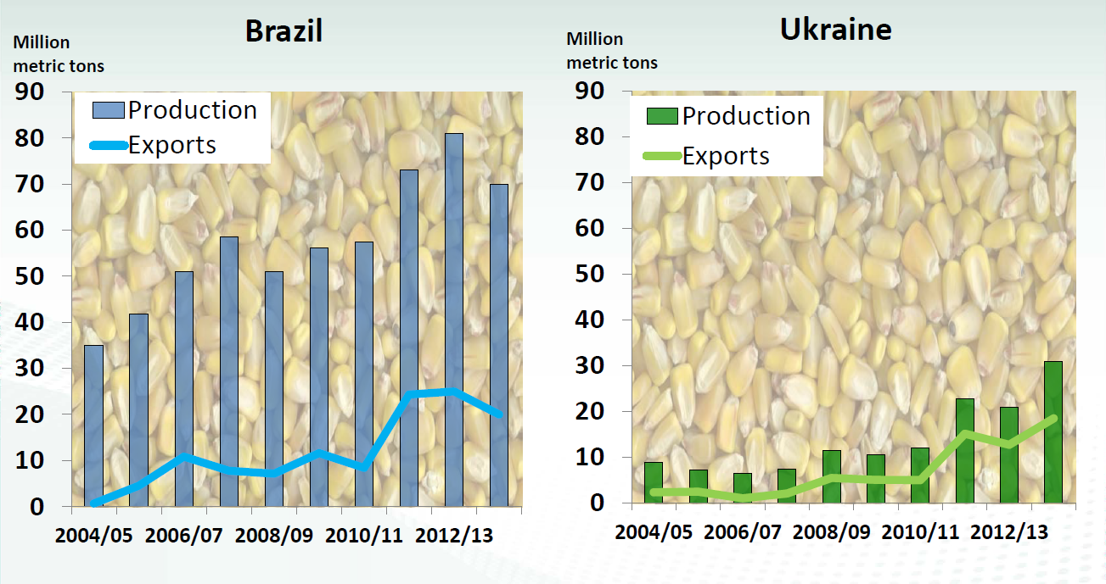
Export competition in maize strengthens
Source: USDA Foreign Agricultural Service
Notes:
U.S. dominance of the maize export market has sharply eroded in recent years with tight domestic supplies and strong production gains by other exporters. On the left, see how quickly that maize production in Brazil has grown over the last decade. Brazil has now surpassed Argentina as the world’s second-largest exporter of maize. However, lower prices are likely to slow Brazilian maize production in 2014.
Likewise, the right hand chart shows that—over a short period—Ukraine has also emerged as a major maize exporter. Ukraine is now the world’s third-largest exporter, producing about 30 million metric tons per year and exporting almost two-thirds of that.
Where does India fit in? India last year (MY 2012/13) exported a record 4.7 MMT of corn, largely due to strong international price, depreciation in the value of Indian rupee in 2013 and sufficient domestic supplies on record production and relatively weak domestic offtake. Exports this year are on track to decline to 3 MMT due to weak international prices and strong domestic demand. That makes India the fifth-largest maize exporter, after the United States, Brazil, Argentina, and Ukraine.
Export forecasts in 2013/14:
U.S. 42 mmt
Brazil 21 mmt
Argentina 13
Ukraine 18.5
India 3

Slide 8
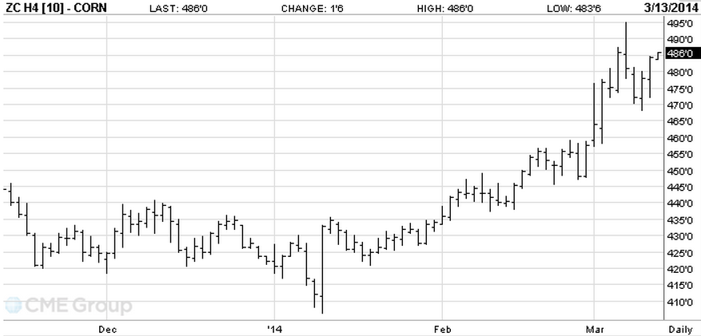
Chicago Corn, May 2014
prices in cents per bushel
Source: Chicago Mercantile Exchange
Notes:
We should also be watching for potential supply disruptions due to externalities. Global commodity markets, for example, are watching events in Crimea right now to see if Ukrainian and Russian wheat and maize exports will be affected.
This price graph from the Chicago Mercantile Exchange shows maize prices basis Chicago in cents per bushel from last December to March. You can see that corn contracts were trading in a range of roughly $4.15 to somewhere around four and a half dollars until the unrest in Ukraine got underway. Prices then spiked when Russian military forces took over the Crimean Peninsula, with Chicago maize prices suddenly trading in a range of about $4.65 to over $5.00 per bushel – a ten to fifteen percent jump in one week.

Slide 9
Key points:
Area to remain high
Corn yields to improve
Export competition high
Prices weakening
Notes:
Provided that there are no major crop failures somewhere in the world, crop prices will continue to decline throughout 2015. Area planted will remain high and we anticipate yields will be up due to recovery from the 2012-13 drought. Brazil and Ukraine will continue to compete with U.S. and Argentine maize, and all these factors will tend to push prices down.

Slide 10
Source: www.dilbert.com
www.fas.usda.gov
gain.fas.usda.gov
apps.fas.usda.gov
agnewdelhi@fas.usda.gov
Notes:
Please remember that USDA is a very good source of information at no charge on the world agricultural commodity outlook. Our world wide web home page is found at www.fas.usda.gov. Reports from our agricultural attachés can be found in the Global Agricultural Information Network at gain.fas.usda.gov. The USDA production, supply and distribution database for major agricultural commodities can be found on line at apps.fas.usda.gov. And of course, we are always available by e-mail at agnewdelhi@fas.usda.gov. Thank you for your kind attention.

