Slide 1
DELIVERING SAFE & RELIABLE OPERATION
Risk Based Inspection in Asset Integrity Management

Slide 2

DELIVERING SAFE & RELIABLE OPERATION
The American Petroleum Institute defines failure as
    The loss of containment from a pressure boundary resulting in leakage to the atmosphere or a rupture of the pressurized component.
The RBI analysis used to evaluate the probability of failure (POF) and the consequence of failure (COF) for given components in a pressurized environment.
RBI evaluation enables to cost-effective inspection plan and reduce the risk of failure.
RBI minimizes or avoid unscheduled and short term shutdowns & downtimes.
RBI minimizes the risk to Health, Safety and Environment (HSE).
RBI Increases reliability, availability and maintainability (RAM) & maximizes the resource utilization and increase the effectiveness of Asset Integrity.

Slide 3
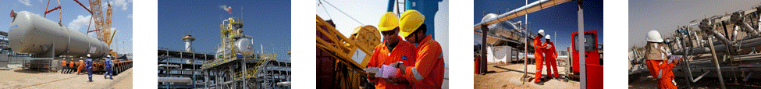
RISK MANAGEMENT – A BASIC IDEA
Risk is the combination of the probability of some event occurring during a time period of interest and the consequences, (generally negative) associated with the event.
In mathematical terms, risk can be calculated by the equation:
    Risk = Probability × Consequence
Possible consequences are:
    a) form a vapor cloud that could ignite causing injury and
    equipment damage;
    b) release of a toxic chemical that could cause health problems;
    c) result in a spill and cause environmental damage;
    d) force a unit shutdown and have an adverse economic impact;
    e) have minimal safety, health, environmental, and/or economic impact.
Probability of Failure
    The mean frequency or rate with which the specified failure event would be expected to occur in a given period of time, normally one year.
High
Probability of Failure
Medium
LOW
Consequence of Failure

Slide 4
Risk Based Asset Integrity Management – Key Elements
    Objectives & Goals
    Establish of Physical Boundaries
    & Operating Boundaries
    Data and Information Collection
Inspection plan to maintain ALARP,
Process Control and
Implementation of mitigation activities.
Risk Management
Management System
Risk Based
Asset Integrity Management
Consequence of Failure
Probability of Failure
Statement of CoF
Define mitigation plan for unmitigated PoF
Analyze of CoF
Statement of PoF
Define Time and degradation mechanisms for Failure Scenario
Determination of PoF
Determine unmitigated POF

Slide 5
Management System of Risk Based Asset Integrity
Risk Based Asset Integrity Management Objectives & Goals
    Safe and reliable operation through cost-effective inspection plan.
    Identification of the operational risks via material degradation
    Reduction in plant downtime or business interruption.
    Real Productivity = Total Capacity – { US + PS + OS + TS }
Understanding Risks and Defining Risk Criteria
  Establish Physical Boundaries of an RBI Assessment
    System
    Sub-System
    Component
    Other Components
  Establish Operating Boundaries
    Start-up and Shutdown
    Normal, Upset, and Cyclic Operation
    Operating Time Period
Data and Information Collection
    Design, Construction and Inspection records / Reports
    Process and Hazards Data, and Management of Change Records;
    Site Conditions
    Failure Data and Incident Investigations
Real
Productivity
Plant Capacity
US
PS
OS
TS
US ➔ Unscheduled Shutdowns of Equipment Failures
PS ➔ Planned Shutdowns for Maintenance & Inspections
OS ➔ Other Shutdowns like pigging, corrosion cleaning
TS ➔ Short-term Shutdowns
Notes:
System: defined by reference to meaningful equipment, and classified based on the Equipment are having a hazard from the release of the stored pressure energy -Eg. Steam, Heat etc.
Pressure vessels, Heat exchangers, Heaters, Safety devices / relief valves etc.
Equipment are having the hazard from substance(s) being handled -Eg. toxic or flammable nature etc.
Pumps, Tanks, Pipework etc.
Sub-System: defined as - components which are having common features in a system, such as
Common corrosive circuits, Process fluids, Process conditions, Environmental conditions
Materials of construction, Damage mechanisms, Modes of failure, Remaining life.
Components: defined as - segregation based on varying process conditions and materials of construction within the sub-system.
Piping sections, upstream and downstream sections etc.
Other Components: Defined as – components which may impact on overall integrity of the system
Civil structures, Support systems
Electrical equipment, Monitoring equipment
Cooling systems.

Slide 6
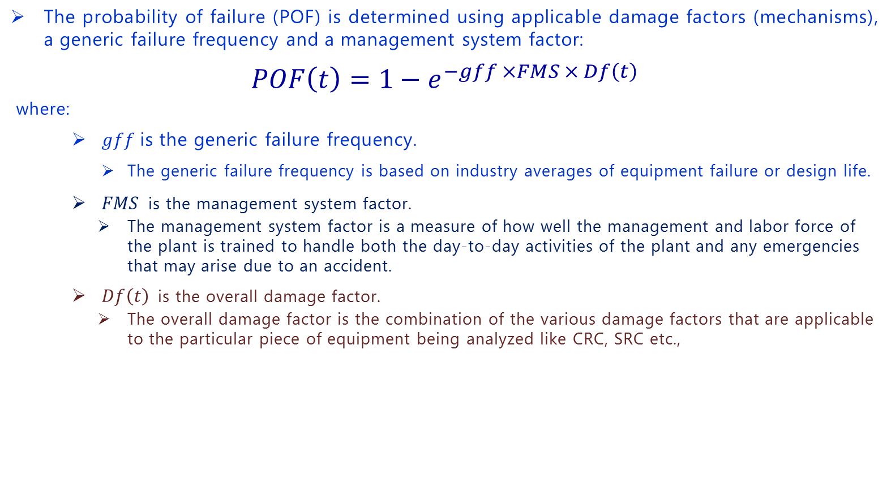
Probability of Failure
    The probability of failure (POF) is determined using applicable damage factors (mechanisms), a generic failure frequency and a management system factor:
    $$POF\left(t\right)=1−e^{−gff ×FMS × Df\left(t\right)}$$
where:
    $gff$is the generic failure frequency.
      The generic failure frequency is based on industry averages of equipment failure or design life.
    $FMS$ is the management system factor.
    The management system factor is a measure of how well the management and labor force of the plant is trained to handle both the day-to-day activities of the plant and any emergencies that may arise due to an accident.
    $Df\left(t\right)$ is the overall damage factor.
    The overall damage factor is the combination of the various damage factors that are applicable to the particular piece of equipment being analyzed like CRC, SRC etc.,
Possible Qualitative Rank | Annual Failure Probability or Frequency
Low | <0.0001
Moderate | 0.0001 to 0.01
High | >0.01

Slide 7
Consequence of Failure
    The consequence of failure is calculated as the combined values of the consequences for damage to the failed equipment, damage to the surrounding equipment, loss of production, the cost due to personnel injury and the damage to the environment.
    FC = FC_{cmd} + FC_{affa} + FC_{prod} + FC_{inj} + Fc_{environ}
    CA = max (CA_{equip}, CA_{personnel})
  Where:
  FC_{cmd} is the financial consequence to failed equipment.
  FC_{affa} is the financial consequence to surrounding equipment.
  FC_{prod} is the financial consequence due to production downtime.
  FC_{inj} is the financial consequence due to personnel injury.
  FC_{environ} is the financial consequence due to environmental damage/cleanup.
  CA_{equip} is the area consequence to surrounding equipment.
  CA_{personnel} is the area consequence to nearby personnel.

Slide 8
Risk Management with Inspection Activities
Managing Risk by Reducing Uncertainty Through Inspection
Identifying Risk Management Opportunities from RBI Results
Establishing an Inspection Strategy Based on Risk Assessment
Managing Risk with Inspection Activities
  Frequency of Inspection
  Coverage
  Tools and Techniques
  Procedures and Practices
  Internal, On-stream, or External Inspection

Slide 9
DELIVERING SAFE & RELIABLE OPERATION
THANK YOU
Presented By: Anirban Ghosh, Sr. Manager (QA/QC), Cairn India Limited
E.mail: anirban.ghosh@cairnindia.com; Mo: +91-8826392072
Web site: www.cairnindia.com

