Slide 1

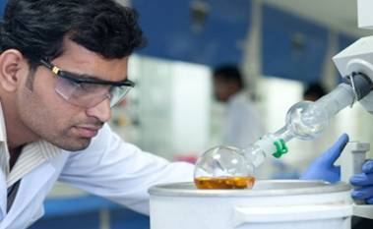



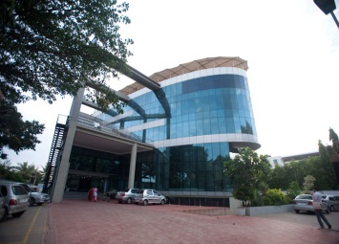
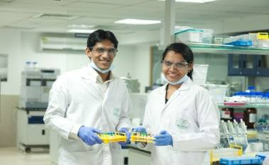
QUALITY : A WAY OF LIFE
Notes:
0
0

Slide 2
About Quality of Life
The Quality of life depends of the quality of your judgment about it - Alexander Fennis quotes
If you don’t set a baseline standards for what you will accept in life, you will find it`s easy to slip into Quality of life that`s far below what you deserve - Anthony Robbins quotes
The Quality of Life is more important than life itself - Alexis Carrel quotes
“Most people buy the highest quality television sets, only to watch the lowest quality television shows. ” - Jarod Kintz,

Slide 3
QUALITY : A WAY OF LIFE
User-Based: What consumer says it is
Mfg.-Based: Degree to which a product conforms to design specification
Product-Based: Level of measurable product characteristic
Overall Quality for Life™ means sustainability
Quality is a priority, not a value
Quality a culture that says “quality” is important around us.

Slide 4

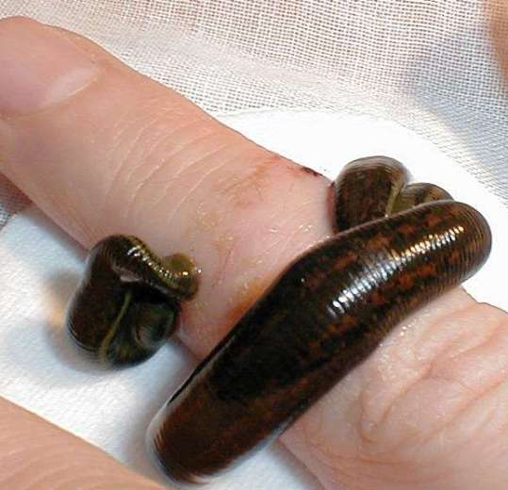
Natural / inherent Quality
Lotus
Leech
Pleasure, Feel good, Emotions, Energy,
Pain, discomfortable, itchiness,

Slide 5
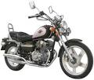
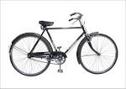
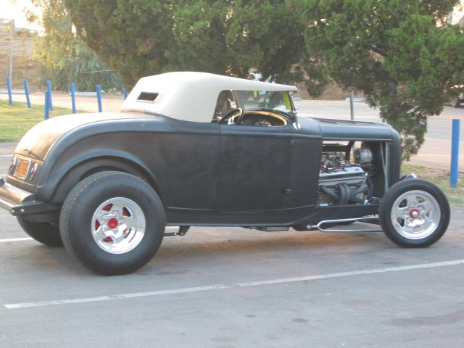
Need Based Quality
To pass through narrow places,
To keep movement fast.
To pass through narrow places,
To Feel comfort
To keep movement faster.
To pass through wide places,
To Feel more comfort
To keep movement fastest.

Slide 6
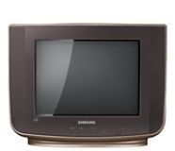
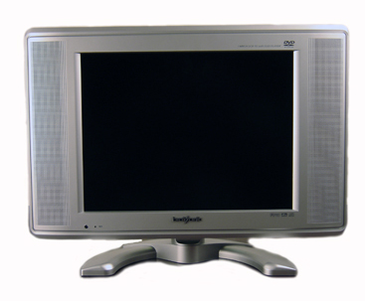
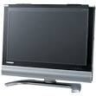
Abstractive Quality
All are 14” Television
Target audience – poor Villagers , Work Man
Target audience – Villagers , Work Man, common man
Target audience – common man & Urban society.
Kyun Ki Hindustan main thoda, “thoda” nhi hota……..

Slide 7
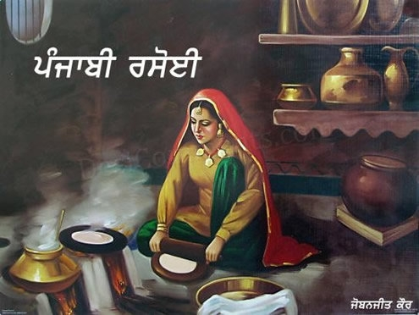


Induced Quality
Vedic Kitchen:
Cooking approch: through fire bone, old process.
Demerits – Smokey & dusty environment, Uncomfortable in rainy season etc
Common man’s Kitchen:
Cooking approach: through LPG gas, pressure cooker etc.
Merits – No Smokey & dusty environment, comfortable in rainy / other season etc
Is required

Slide 8
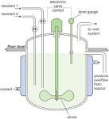

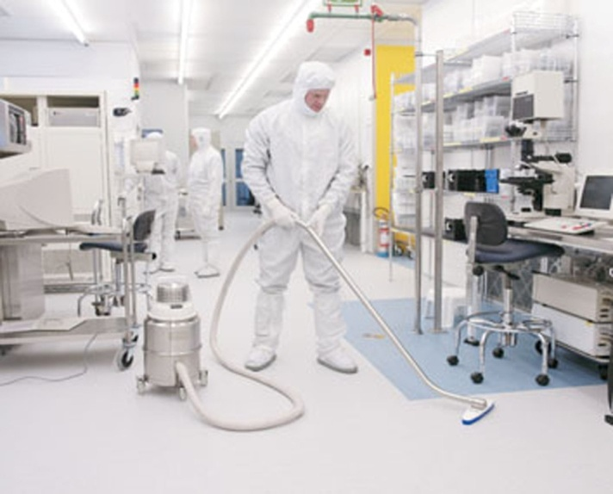
Induced Quality
Factory / manufacturing premises:
Product manufacturing /Cooking approach:through advance techniques like, high pressure, low temperature, through fast processing aid like reactor etc..
Merits – No Smokey & dusty environment, comfortable in all season etc
Sanitation & hygiene conditions are required

Slide 9

Induced Quality
Basic concepts are transferred though our daily need & practices

Slide 10
QUALITY : A WAY OF LIFE
Quality is no more just a support function,
but it’s now an integral part of any design and development.
Quality needs to be inbuilt in all functions of an organization.
There are two broad approach to Quality, Corrective & Preventive.
One is reactive and the other is pro-active.
While the option of making mistakes and learning from the mistake is always available, Quality in true sense is to prevent those mistakes from happening at the first place itself.
Through Quality Conscious only we can increase Quality of everyday life.

Slide 11
Quality is driven by Top
Home | Industry
Mother & Father | Top Management
Parenting | Training
Learning from surrounding / failure | Learning from surrounding/ failure
Emerging /Evolvement of decision making capabilities | Emerging / Evolvement of decision making capabilities
Moto – to grow the family. | Moto – to grow the company
Transfer of knowledge / experience by caring & sharing | Transfer of knowledge / experience by caring & sharing

Slide 12
QUALITY : A WAY OF LIFE
Starting with the top leadership
Truly involve in practicing Quality by all executives/managers
Commence a unique quality Journey, to achieve
sustainable excellence in quality performance.

Slide 13
WHAT MAKES OUR LIFE 100% ?
Let each letter of the alphabetic has a value equals to it sequence of the alphabetical order:
A | B | C | D | E | F | G | H | I | J | K | L | M | N | O | P | Q | R | S | T | U | V | W | X | Y | Z
1 | 2 | 3 | 4 | 5 | 6 | 7 | 8 | 9 | 10 | 11 | 12 | 13 | 14 | 15 | 16 | 17 | 18 | 19 | 20 | 21 | 22 | 23 | 24 | 25 | 26
S | K | I | L | L | S
19 | 11 | 9 | 12 | 12 | 19
=
82
K | N | O | W | L | E | D | G | E
11 | 14 | 15 | 23 | 12 | 5 | 4 | 7 | 5
=
96
H | A | R | D |  | W | O | R | K
8 | 1 | 12 | 4 |  | 23 | 15 | 18 | 11
=
98
A | T | T | I | T | U | D | E
1 | 20 | 20 | 9 | 20 | 21 | 4 | 5
=
100

Slide 14
Attitudes are inside a person’s head -therefore they are not observable or measurable however Attitudes can be changed by changing behaviors
A positive attitude can go a long way in improving your overall quality of life
Attitudes
Notes:
We often hear managers talk about an employee having a “bad attitude towards safety” or a “bad attitude about work in general” or that an employee “has a good attitude towards his/her job.” These statements reflect an overall perception that has been formed by observing a series of behaviors over time. Unfortunately they are not precise enough statements to allow us to pinpoint the specific behaviors that were being observed over time that led to this perception.
You cannot see a person’s attitude. You can see his/her behaviors and form an opinion on what is causing that “attitude” but you can never be 100% certain that you are right.
If our perception of a person’s attitude is based on our observation of his/her behaviors, remember that we just said that we can manage behaviors. If we can manage behaviors effectively enough we can get people to perform differently. If they perform differently long enough and are provided with positive reinforcement for their behavior changes, their attitude towards a particular work task will begin to change. How we manage behaviors will determine if that attitude change takes place quickly or slowly. If we use the technique of positive reinforcement we are likely to see the most rapid change. If we use mostly negative reinforcement and punishment we will probably see a slow change in attitude or perhaps very little change at all.

Slide 15
Quality Management System Interventions
Expectation
From Employee An appropriate quality A Positive attitude Caring for one another Training & education to understand own day to day activities to produce quality product. | From Management No quality failures Empowered Employees Pro-active Rather than Re-active work Process To Minimize Direct and Indirect Costs and Threat of Liability from failure of quality
Notes:
The 7 components an effective Safety Management Systems are:
Management leadership
Line responsibility and accountability
An organization for safety
Safe work practices and procedures
Safety review and improvement
Safety training
Safety communications
Under each of these components should be identified specific best practices and success factors that could objectively be evaluated. Not surprisingly, when you look at the best practices and success factors many of them are really behavioral definitions of what people should be doing to work towards that ideal of an injury free work environment.
* * Elaborate on some of the bullet points above * *

Slide 16
THANK YOU
Notes:
15

