Slide 1
Automation for Quality Growth of Organization

Slide 2
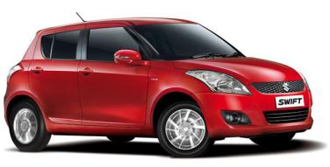
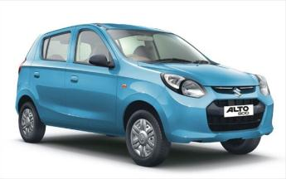
About Maruti Suzuki…
Year of inception: Setup in 1982
Equity Structure: 56.2% Suzuki, 43.8% with Public
Market Share: 43%(approx.)
Plants: 6 Plants in Gurgaon & Manesar
Models: 14 Models with over 160+ variants
Net Production/Sales : 1.15 million units p.a./ 426,448 Million Rs.
Net Profit: 27,831 Million Rs.
Manpower: 14000+ Employees
Joint ventures : 20 Joint ventures for components
Customer Satisfaction: No.1 in JD Power Customer Satisfaction
for 13 years in a row

Slide 3
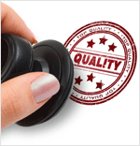
What is Quality to Us? ? ?
“ Creating Product First Time OK ”
“ No Surprises during Production ”

Slide 4
What Constitutes a Quality Product ? ? ?
Managing
Changes
People
Environment
Systems
Quality Product

Slide 5
Factors Affecting Quality Output
Process Inconsistency
Ergonomic Issues
Line Absenteeism
Handling and Transportation Concerns
Frequent Changes

Slide 6
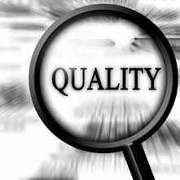
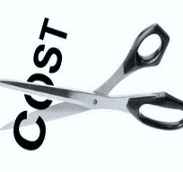
Elements of Manufacturing
PRODUCTIVITY
Notes:
These are our people and our systems.
I believe that Manufacturing is all about managing our people and systems efficiently and effectively as well
When so many parameters and human capital is involved, the journey towards excellence may always seems to be challenging.
But What I have learnt out of my 30 years of experience in Maruti, I believe that there are just 3 key elements which if practiced dedicatedly can result in Manufacturing Excellence.
I have brought about my own M3 philosophy incorporating what needs to be done .

Slide 7
Automations – Focus Areas
Improving Operations
Imbibing Technology
Enhancing Safety & Ergonomics
Empowering Operator

Slide 8
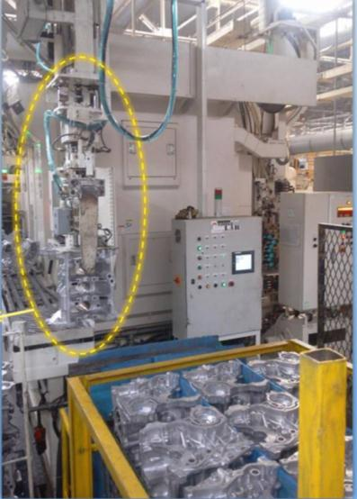
Improving Operations – Handling
Material Transfer Shuttles
Auto Cylinder Block Loading System
Multi-Level Car Parking
Handling Defects reduced by more than 70% after installation

Slide 9
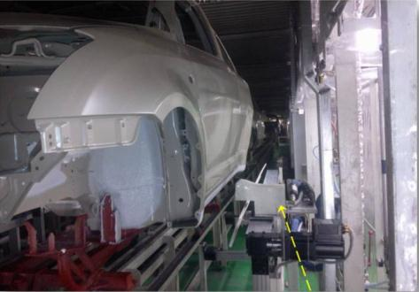
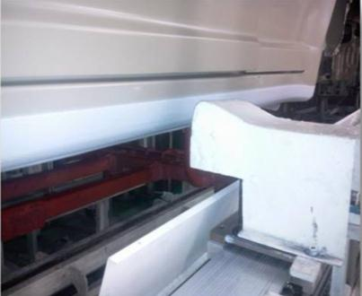
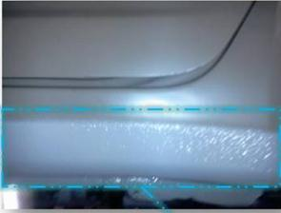
Improving Operations – Process Consistency
Improving Process Consistency of
Stone Guard Coating Operation to
Ensure uniform thickness across the surface.

Slide 10
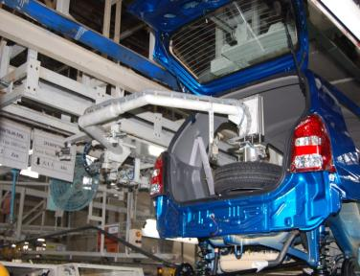
Enhancing Ergonomics – Lifting Components
Seat Transfer System – To Aid Operator in Transferring Seat from Trolley to Vehicle
Auto Spare Tyre Loading – To reduce Operator Effort for Transferring Tyre

Slide 11
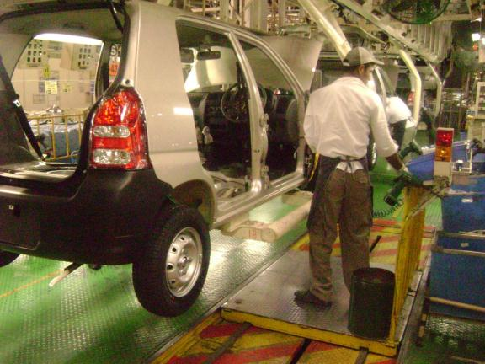
Enhancing Ergonomics – Reduction in Walking
Synchronized Trolley with Assembly Conveyor - The manual walking distance eliminated by 10 steps per cycle (~7 meter)
Synchro trolley
Elimination of at least 3.7 km walking per shift

Slide 12
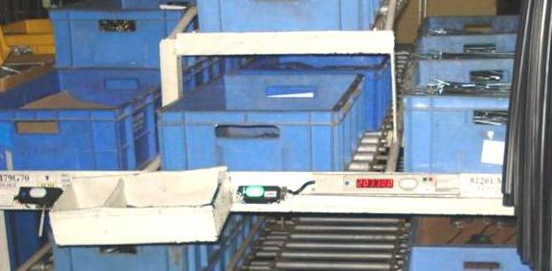
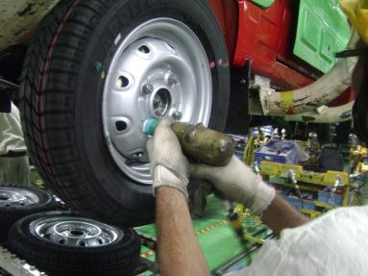
Imbibing Technology – Mistake Proofing
Pica Pica (Blink – Blink) for right component picking – Ensuring Specification Control across 150+ variants
Auto-Torque regulator to prevent over tightening

Slide 13
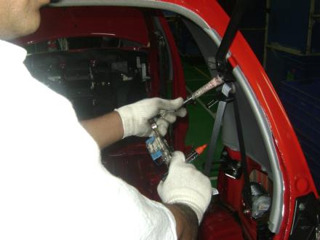
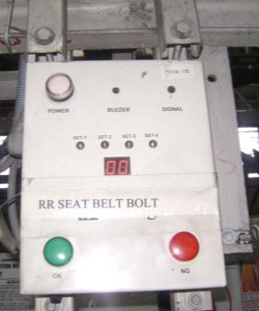
Imbibing Technology – Mistake Proofing
Transmitter
Receiver with intelligent counters
Fool-proofing of 100% critical to quality bolts done

Slide 14
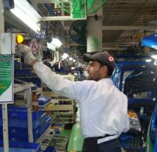
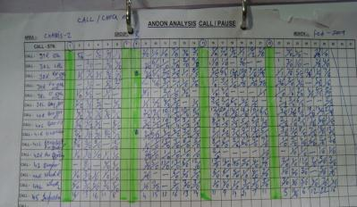
Empowering Operators - ANDON System
Any stoppage on line effects disturbs the natural rhythm of operator
Call from station
Call prompted & display on ANDON board
Call registered in the shop
ANDON analysis call / pause
Analysis of ANDON has improved line running to 97% of time per day
14

Slide 15
Automations - Highlights
100% Spot Automation in Weld Shops
100% auto transfer of heavy components
Vehicle Direct Pass Improved to 93% in FY 13-14
Process Rejection Reduced to Below 5% in FY 13-14
Handling Defects reduced by 50% in 2 years
Total Cumulative Cost Savings of 115 MRs in FY 13-14

Slide 16
| Dream
| Achieve
Perform
Connect
Share
Ownership
People
Learn
Commit
Quality Excellence is a journey, not a destination . . .
Imagine
Notes:
I would like to Thank You all once again and God bless.

