Slide 1
The Key to being Extraordinary
Presented by

Slide 2
Background
Corporate Athlete has been developed following on the from the successful coach education programmes developed by the International Coaches Institute.
The ICI has become the first worldwide organisation dedicated to offering training programmes, international certification and integral professional services and education in Sport.
The ICI have more than 25,000 qualified coaches in 121 countries that receive services from their three divisions: Europe/Africa, the Americas and Asia/Australia.
Since entering the market the ICI has now trained more than 100,000 sports coaches.
“The strength of the group is the strength of the leaders.”
Vince Lombardi. NFL Hall of Fame Coach

Slide 3
Coaching
Coaching is a true methodology which concentrates on directing, instructing and training either an individual or a group of people with the only aim to attain certain goals and objectives.
The origination of the term 'Coaching started in the latter part of the 1880s and has always been heavily associated with sport
Coaching in business didn’t reach any kind of prevalence in industry until the 1990s.
Sports coaches have more than 100 years of experience over their corporate compatriots.
“Good, better, best. Never let it rest. Until your good is better and your better is best”
Tim Duncan

Slide 4
The key to being Extraordinary
MAKE IT PERSONAL
Adrian Rattenbury
Notes:
,

Slide 5
INTRODUCTION
Corporate Mission and Vision
Personal Mission and Vision
Understanding your priorities
Planning for your priorities
Goal setting
Setting your Goals

Slide 6
Corporate Mission & Vision
Mission Statement.
Defines the organisation's purpose and primary objectives.
Vision Statement.
Communicates both the purpose and values of the organisation.
Notes:
MISSION STATEMENT - Its prime function is internal – to define the key measure or measures of the organisation's success.
VISION STATEMENT - Gives direction about how the staff are expected to behave. Inspires them to give their best.
Shared with customers, it shapes customers' understanding of why they should work with the organisation.

Slide 7
Corporate Mission Statement
Our mission is to lead by example through a commitment that empowers the organisation at every level to strive for the highest levels of quality, customer care and shareholder value.

Slide 8
Corporate Mission Statement
"eBay's mission is to provide a global trading platform where practically anyone can trade practically anything."

Slide 9
Corporate Mission Statement
"Adidas-Salomon strives to be the global leader in the sporting goods industry with sports brands built on a passion for sports and a sporting lifestyle.
We are consumer focused. That means we continuously improve the quality, look, feel and image of our products and our organizational structures to match and exceed consumer expectations and to provide them with the highest value.
We are innovation and design leaders who seek to help athletes of all skill levels achieve peak performance with every product we bring to the market.
We are a global organisation that is socially and environmentally responsible, creative and financially rewarding for our employees and shareholders.
We are committed to continuously strengthening our brands and products to improve our competitive position and financial performance.
Notes:
ADIDAS –
Strive to be Global Leader in the Sports Industry
Consumer focused
See themselves as innovative and leaders in design
Global organisation with social and environmental responsibilities
Committed to improving their competitive and financial performance
NEXT SLIDE IS VISION STATEMENTS

Slide 10
Corporate Vision Statement
"To bring inspiration and innovation to every athlete* in the world" * If you have a body, you are an athlete.

Slide 11
Corporate Vision Statement
"Our vision is to be earth's most customer centric company; to build a place where people can come to find and discover anything they might want to buy online."
Notes:
If you combined e-bays Mission statement with Amazons Vision statement you might be talking about the same company

Slide 12
Corporate Vision Statement
To help to develop better people for a better world through combining the skills we learn through sport with education together with a professional and social responsibility.
Notes:
Bollettieri story- Winning is the only thing
NEXT SLIDE PERSONAL MISSION AND VISION STATEMENT

Slide 13
Personal Mission & Vision
Mission statement
Defines your purpose.
Vision statement
More emotional.
Notes:
MISSION STATEMENT - It's what you ultimately want to achieve in your life or career, expressed in a specific, measurable way.
A succinct, easy-to-remember statement that provides direction for your life
VISION STATEMENT - Define your core values, and how you'll apply those values to your mission.
A statement of three or four sentences describing a desired future – not a predicted future.

Slide 14
Personal Mission Statement
Examples
I will live each day as if it were my last, building relationships that last a lifetime, focusing first on my marriage, second on my family and third on my friendships.
I live to create, build, nourish and grow. I will live life within the constraints that are acceptable to me. I will never live life under the control of values that are not acceptable to anyone but myself.
I will never fail in my mission to succeed.
I will never quit in my desire to achieve.
What is your Mission Statement?

Slide 15
Personal Vision Statement
Examples
Personal development is neither easy nor quick; it is filled with resistance, temptation, & discomfort… so I am resilient; I am self-disciplined.
Everyone is going through the same challenge of realising their best so I am compassionate; I am critical but understanding; I am encouraging without excuses with others and with myself.
My life is my message... there will be obstacles and failures; I will learn from mistakes; I am honest about the difference between who I am and who I want to be; I continuously seek awareness of this and work to align myself with my vision of becoming the best I can be
What is your Vision Statement?

Slide 16
Wheel of Life
Notes:
When life is busy, or all your energy is focused on a special project, it's all too easy to find yourself "off balance," not paying enough attention to important areas of your life.
While you need to have drive and focus if you're going to get things done, taking this too far can lead to frustration and intense stress.
That's when it's time to take a "helicopter view" of your life, so that you can bring things back into balance.
This is where the Wheel of Life can help.
It helps you consider each area of your life in turn and assess what's off balance.
And so, it helps you identify areas that need more attention.

Slide 17
Wheel of Life - Sport
Technical
Achievement
Tactical
Records
Mental
Finance
Physical
Lifestyle
Notes:
Example of what we use in sport

Slide 18
List of Priorities
Personal Success
Win Trophies/Competitions
Break Records
Financial Reward

Slide 19
Wheel of Life - General
Parent
Financial
Friend
Community
Colleague
Social
Husband/Wife
Manager
Notes:
Examples of personal wheel of choice
What order of priorities do you have in the group
When we ask people this question we get very similar answers – NEXT SLIDE

Slide 20
List of Priorities
Children
Husband/Wife/Partner
Health
Happiness
Finance
Job
Notes:
These are the common priorities in peoples lives.
How much time do you spend with your kids and how much time do you spend at work
Understand that you have to spend more time at work but how do you manage your time and energy with your kids

Slide 21
Where I am
Parent
Financial
Friend
Community
Colleague
Social
Husband/Wife
Manager
Notes:
This is how the previous example looks
Now we need to consider where we would like to be – NEXT SLIDE

Slide 22
Where I want to be
Parent
Financial
Friend
Community
Colleague
Social
Husband/Wife
Manager
Notes:
This is an example of where we want to be
NEXT SLIDE

Slide 23
Wheel of Life Comparison
Parent
Financial
Friend
Community
Colleague
Social
Husband/Wife
Manager
Notes:
Where I am
Where I want to be
The Wheel of Life is a great tool to help you improve your life balance.
It helps you quickly and graphically identify the areas in your life to which you want to devote more energy
helps you understand where you might want to cut back.
The challenge now is to transform this knowledge and desire for a more balanced life into a positive programme of action.
DOES EVERYONE UNDERSTAND THE PROCESS - NEXT SLIDE GOALS VIDEO

Slide 24
Wheel of Life
Notes:
Here is a blank. Take a few minutes now to fill in the 8 key elements in your life

Slide 25
Goal Setting
Goal setting is an important method of:
Notes:
Ask the group to answer the question
Does anyone set goals ?
How often?
How far in the future?

Slide 26
Goal Setting
Goal setting is an important method of:
Deciding what you want to achieve in your life.
Separating what's important from what's irrelevant, or a distraction.
Motivating yourself.
Building your self-confidence, based on successful achievement of goals.
Notes:
Goals have to be balanced
Have to include all areas of like not just work
NEXT SLIDE

Slide 27
Balanced Goals
Professional | Personal | Financial | Social
1 | 1 | 1 | 1
2 | 2 | 2 | 2
3 | 3 | 3 | 3
4 | 4 | 4 | 4
5 | 5 | 5 | 5
Notes:
On a piece of paper write the 4 headings and then put 5 goals down for each heading
NEXT SLIDE – TOP 2

Slide 28
Top Two
Professional | Personal | Financial | Social
1 | 1 | 1 | 1
2 | 2 | 2 | 2

Slide 29
Priorities
Priorities | Area
1
2
3
4
5
6
7
8
9
10

Slide 30
SMART(ER)
S | Specific
M | Measurable
A | Attainable
R | Relevant
T | Timely
E | Evaluate
R | Re-evaluate
Notes:
Give an example of a 12 year old that wants to become a top 10 player in 10 years

Slide 31
Breaking down your Goals
Long
Medium
Short
Monthly
Weekly
Daily
Notes:
Dream Goal
Long Term
Medium
Short
NEXT SLIDE PERIODISATION

Slide 32
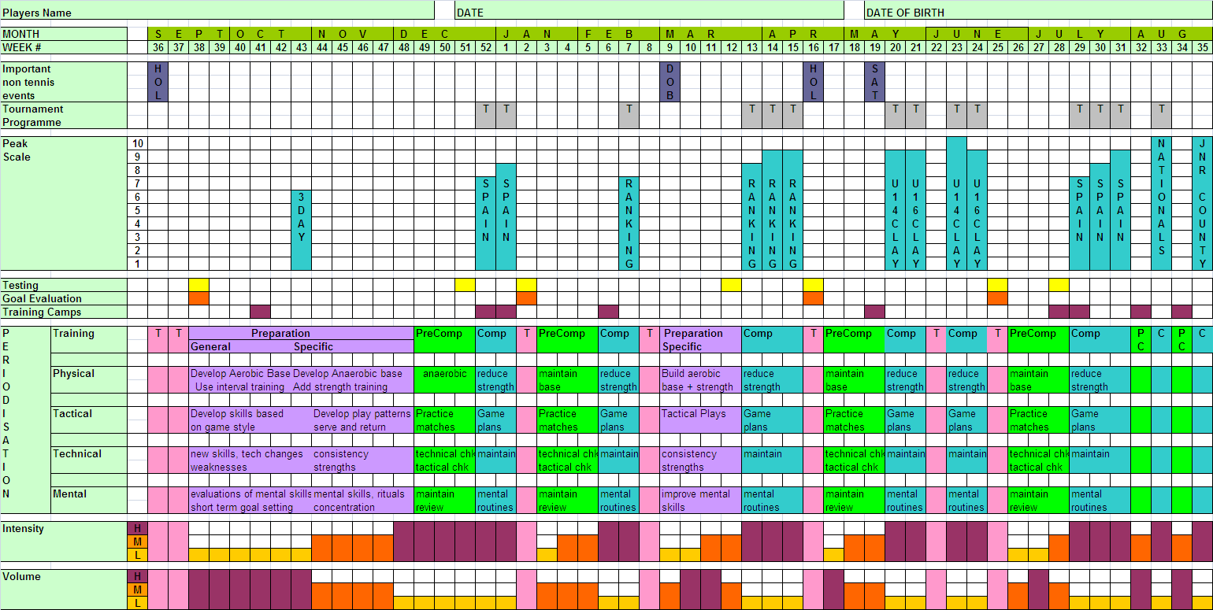
Notes:
NEXT SLIDE FEDERER GOALS

Slide 34
Notes:
237 consecutive weeks as world number 1
302 weeks in total as world number 1
17 Grand Slam titles
Played in at least 5 finals at each Grand Slam event
35 consecutive quarter final appearances as a minimum
At this years Australian Open 33rd Grand Slam appearance
76 Career titles winning almost 900 matches winning over 80% of all matches played
Number 1 in prize money with total prize money to date $76.5million
HOW DO YOU WANT TO BE REMEMBERED – NEXT SLIDE GRAVESTONES

Slide 35
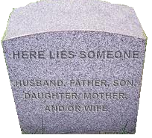
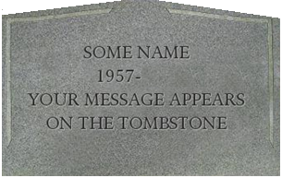
PERSONAL PERFORMANCE
What makes people successful?
Give your life a purpose
Leave a legacy
Notes:
The biggest difference between successful people and others is that they have a vision
They know what they want
They set goals which helps them get what they want
How do you want to be remembered ?
Talk about the dash between your dates

Slide 36
YOUR LEGACY

Slide 38
ANY QUESTIONS?

Slide 39
PO Box 111
Barnsley
South Yorkshire
S75 3YW
08445-877767
Info@CorporateAthleteUK.com

