Slide 1

Welspun Group | Textiles
Strategy for Increasing India’s Share in Global Exports of Made-ups
April 7, 2015, FICCI

Slide 2

Significance of 2015 for Global Textile Industry
Emergence of Quota Free World – 1st January, 2005
It’s a decade of Quota Free World.

Slide 3
Consuming World and Producing World
Consuming Countries
Producing Countries

Slide 4
Global Share of Textile & Made Ups Exports (Excluding Apparel)
Value of Exports - US$ 218 bn
Value of Exports - US$ 338 bn
China has emerged as most competent Textile Economy in Quota Free World.
Source: UN Comtrade, Wisedge Analysis

Slide 5
Global Textile Market
US$ bn
5.9% CAGR
6.6% CAGR
Global textile and apparel trade recovered in 2013 and is expected to grow @ 6.6% for next 7 years and reach a size of US$ 1.18 trillion by 2020
Source: UN Comtrade, CII Knowledge report and Wisedge Analysis

Slide 6
Steady Growth in Made Ups Global Trade
CAGR 2005-12
5%
7%
6%
6%
10%
6%
Home textiles / made-ups trade has grown at a steady pace with bed linen having the highest trade share and higher growth in Blankets
*Data for 2013 and 2014 is being extrapolated on the basis of CAGR 2005-12
Source: UN Comtrade

Slide 7
Made Ups Exports Leadership - FY2012-13

Slide 8
China’s GDP Per Capita
GDP per capita is gross domestic product divided by midyear population. GDP is the sum of gross value added by all resident producers in the economy plus any product taxes and minus any subsidies not included in the value of the products. It is calculated without making deductions for depreciation of fabricated assets or for depletion and degradation of natural resources. Data are in current U.S. dollars.
Source: worldbank.org

Slide 9
Agenda
Learning from China’s Strategy
Shifting International Trade Pattern
India’s Strategy

Slide 10
Agenda
Learning from China’s Strategy
Shifting International Trade Pattern
India’s Strategy

Slide 11
Comparison of GDP Per Capita
GDP per capita is gross domestic product divided by midyear population. GDP is the sum of gross value added by all resident producers in the economy plus any product taxes and minus any subsidies not included in the value of the products. It is calculated without making deductions for depreciation of fabricated assets or for depletion and degradation of natural resources. Data are in current U.S. dollars.
Source: worldbank.org

Slide 12
China – 2005 to 2015
Global Hub for manufacturing
World’s largest manufacturing economy
World’s largest exporters of the goods [$2.34 trillion (2014)]
World’s largest economy by purchasing power parity (PPP) [$19.230 trillion (PPP; 2014)]
Second largest importer in of goods [$1.96 trillion (2014)]
GDP - $9.24027 trillion (current US$, 2013)
GDP per Capita - $6,807 (current US$, 2013)
Average Growth Rate - 10% (over past 30 years)
Population below poverty line - 6.1% (2013)
Labour Force - 787.6 million (2012)
Unemployment - 4.1% (Q2, 2014)
Source: worldbank.org, www.wikipedia.org

Slide 13
China’s Game Plan
To build-on the strength of the large population, a low skill industry to alleviate poverty and to build infrastructure for future value added high-tech manufacturing.

Slide 14
China’s Strategy
Aggressively Adjusting Industry Structure
  China government made some aggressive decisions and executed them in disciplined way.
Artificially Undervalued Currency
  In 2005, China held Renminbi (Yuan) at undervalued rate by pegging it to USD.
  This led to improve competitiveness of Chinese textile exporters.
FDI
  Increased flow of Foreign Direct Investment by foreign companies established through Joint Ventures employed investments on machines, plant, technology and skills.
Location of parks near Coast Line
  Textile parks are located near coast line to strengthen supply chain
Economies of Scale
  Large scale manufacturing unit to gain economies of scale

Slide 15
China’s Strategy
Improve Competence by Shifting Focus from Pricing to Costing
  Low price points to gain market share
Focus on Total Costs Superiority
  Efforts was made to reduce all the cost elements such as labour cost, cost of materials etc.
Compliance of Social and Labour Standards
  Adherence to compliances like social responsibility, child labour, health and safety,
  e.g. SA 8000 widely adopted by Industry.
Strengthen Supply Chain
  Focus on making an efficient system and optimum resource allocation
  Enlarge market, build up more marketing channels and gain controlling right in global supply chain.
  Development of Industrial Parks near coastal area.

Slide 16
China’s Strategy
Aggressive Skill Development Programme
  Vocational and Education training integration with Schooling.
  Stipend programme for Secondary School Education in rural areas
  Regulations in Law such as “Citizens shall have the right to receive vocational education.”

Slide 17
Skill Development: The Chinese Model
VET System in China – School and Outside school system
Vocational Education and Training (VET)
School based
Outside School System
Primary Education
Pre-employment training, On the job training
Adult training, Re-employment training
Junior Secondary
Vocational Junior Secondary
Senior Secondary
Vocational Senior Secondary
General Higher Education
Vocational Higher Education
Employment Training Centre
Private Training Centre
Enterprise sponsored Training Centre
Vocational Senior Secondary
Regular Specialised Secondary
Adult Specialised Secondary
Skilled worker / Technical Schools
Senior Skilled
Workers School
Junior vocational/specialised colleges
Technician colleges
Polytechnic colleges
Employment

Slide 18
Number of Vocational Training Institutions and Trainees in 2006
Type | Number of Training Institutions | Number of Trainees
Technical Schools | 2,855 | 27,03,000
Employment Training Centres | 3,289 | 79,72,000
Private/Civilian-run training centres/NGOs | 21,425 | 1,90,50,000
Enterprise-sponsored training centres | 22,000 | 3,00,00,000
Source: www.ccsenet.org, International Business Research, Vol.1- No.3, 2008

Slide 19
Sources of Educational Funds
Year 2010
Source | Amount (billion Yuan)
A. Government Appropriation for Education | 1467.01
B. Funds from Private Schools | 10.54
C. Donations and Fund raising for running schools | 10.79
D. Income from Teaching, Research and other Auxiliary Activities and Tuition & Miscellaneous Fees | 410.61
E. Other Educational Funds | 57.24
Total Fund (A+B+C+D+E) | 1956.18
1956.18 bn Yuan = INR 19,75,742 Crores [@ Exchange rate – 1 CNY = 10.1 INR]
Source: www.ccsenet.org, International Business Research, Vol.1- No.3, 2008

Slide 20
Agenda
Learning from China’s Strategy
Shifting International Trade Pattern
India’s Strategy

Slide 21
Shifting International Trade Pattern
After setting the trade free from quantitative (quota) restrictions, USA and EU have tried to influence the trade by creating trade blocks and preferential access by means import duties.
USA, EU and Japan traditionally had threat perception about each other ……. For the first time these three are joining hands for trade.
TPP (Trans Pacific Partnership) (12 Countries)
Australia, Brunei, Canada, Chile, Japan, Malaysia, Mexico, New Zealand, Peru, Singapore, USA and Vietnam
TPP covers product standards and …..
Intellectual Property rights, FDI, Competition policy, Environment, Labour, State owned Enterprise policies, E-commerce, Govt. Procurement, Technical Barriers to trade, transparency in Health care technologies and pharmaceuticals regulatory coherence.

Slide 22
Shifting International Trade Pattern
TPP controls over 35% of World Trade (Over 50% along with TIPP).
The Countries outside TPP will suffer loss of market access due to non tariff measures.
TPP is likely to be “Yarn Forward” ROO (Rules of Origin Agreement).
The Chinese Textile Industry is shifting base to Vietnam.
TIPP (Trans Atlantic Trade and Investment Partnership)
USA and EU
RCEP (Regional Comprehensive Economic Partnership) (16 Countries)
China, Japan, South Korea, Australia, New Zealand , India, Brunei, Myanmar, Cambodia, Indonesia, Laos, Malaysia, Philippines , Singapore, Thailand and Vietnam
GSP+ by EU to Pakistan
Huge disadvantage for India as need to face loss of 9.6 to 10%

Slide 23


EU-India FTA
EU- India FTA being discussed for a long time.
Major beneficiary is going to Textiles & Apparels sector.
It will help Indian Textile Products become cost competitive w.r.t. other competing countries like Pakistan, Bangladesh & Vietnam
Job Creation
Rise in Trade
Purchasing Power
Free Trade Agreement
New Investment
It is projected that once the FTA is signed, Indian Textiles & Apparels exports are set to increase by US $ 5 Bn.

Slide 24
Various FTAs
TPP
  Canada
  Chile
  Mexico
  Peru
AIFTA
Vietnam is the only Garment Producing country.
If TPP comes into force then Vietnam will have a preferred access to US market.
China is likely to use this opportunity by migrating
textile industry to Vietnam
TIPP EU
Vietnam
USA
India
Australia
Japan
New Zealand
Malaysia
Brunei
Malaysia
Singapore
Vietnam
RCEP
  China
TPP – Trans Pacific Agreement
TIPP – Trans Atlantic Trade and Investment Partnership
RCEP - Regional Comprehensive Economic Partnership
AIFTA – ASEAN – India Free Trade Area
Indonesia,
Philippines, India
Thailand, Laos
Myanmar
Cambodia

Slide 25


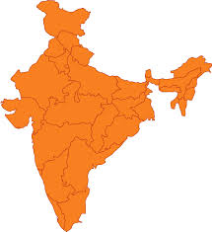

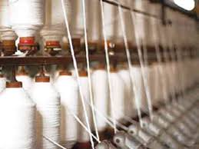
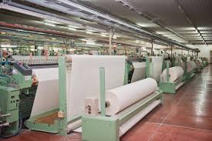
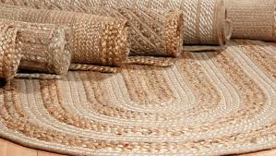

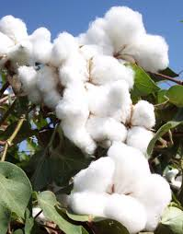
India’s Position in Global Market
2nd
Largest Employer in India. Employs around 35 Mn workforce
14.1%
Contribution to Industrial Production of country.
4%
Contribution to India’s GDP
17%
Contribution to Exports Earnings FY12-13
22% of World Spindles Capacity
Highest # looms in World
World’s # 1 Producer of Jute
World’s # 2 Producer of Silk
World’s # 1 Producer of Cotton
25

Slide 26
India's Textile & Apparel Exports 2013-14 (%)
Apparel constitutes about 40% of India’s textile exports, whereas Made Ups at 12%
Source: Office of Textile Commissioner

Slide 27
Individual Product Cost
Key elements such as Raw material, Labour, Power , waster and Steam cost contributes more than 74% of cost of the product.

Slide 28
Utility cost comparison
Comparison with Competitors in 2012
Parameters | India | Bangladesh | Indonesia | Egypt | China | Pakistan | Turkey
Labour wages (US $ / month) | 135 | 87 | 226 | 226 | 328 | 127 | 839
Power Rate (US cents / Kwh) | 11.29 | 8.13 | 8.51 | 3.49 | 12.29 | 10.62 | 10.24
Raw Water Cost (US cents / m3) | 39.57 | 29.26 | 49.19 | 10.48 | 53.26 | 25.67 | 30.73
Steam (US cents / kg) | 1.44 | 1.3 | 1.16 | 1.75 | 1.64 | 1.24 | 2.1
Capital Interest Rates (%) | 8 | 13 | 9 | 11.5 | 5 to 6 | 7 | 10
Source: Texprocil Benchmarking Report

Slide 29
Utility cost comparison
Comparison with Competitors in 2012
Parameters | India | Bangladesh | Indonesia | Egypt | China | Pakistan | Turkey
Labour wages (US $ / month) | 135 | 87 | 226 | 226 | 328 | 127 | 839
Power Rate (US cents / Kwh) | 11.29 | 8.13 | 8.51 | 3.49 | 12.29 | 10.62 | 10.24
Raw Water Cost (US cents / m3) | 39.57 | 29.26 | 49.19 | 10.48 | 53.26 | 25.67 | 30.73
Steam (US cents / kg) | 1.44 | 1.3 | 1.16 | 1.75 | 1.64 | 1.24 | 2.1
Capital Interest Rates (%) | 8 | 13 | 9 | 11.5 | 5 to 6 | 7 | 10
``
``
``
``
``
As India is not competitive in utilities, need to concentrate on improvement of these areas through Skill Development, Labour Reforms, Government support.
Source: Texprocil Benchmarking Report

Slide 30
Agenda
Learning from China’s Strategy
Shifting International Trade Pattern
India’s Strategy

Slide 31
India’s Strategy
India need to build a strategy to capture maximum share in consuming world i. e. US and Europe.
India needs to take cognizance of shifting global trade patterns
due to various FTAs

Slide 32
Adverse Factors
Vanishing Export Incentives due to GST implementation and WTO compliance.
Higher cost of Finance because discontinuation of interest subvention scheme.
Continues to have low labour efficiency and productivity compared to China.
Continues to be poor deficient so have no scope for low power rates.

Slide 33
SWOT Analysis – Indian Textiles Industry
STRENGTHS
WEAKNESSES
Abundant RM Supply
Low wages
Large skilled/unskilled population
Low efficiency
Lower Productivity
Lack of scale of economies
Exchange rate
OPPORTUNITIES
THREATS
Free Trade Agreement with EU
Rising incomes, spending power in domestic market
Trans-Pacific Partnership
Competition from Free Market Access Countries

Slide 34
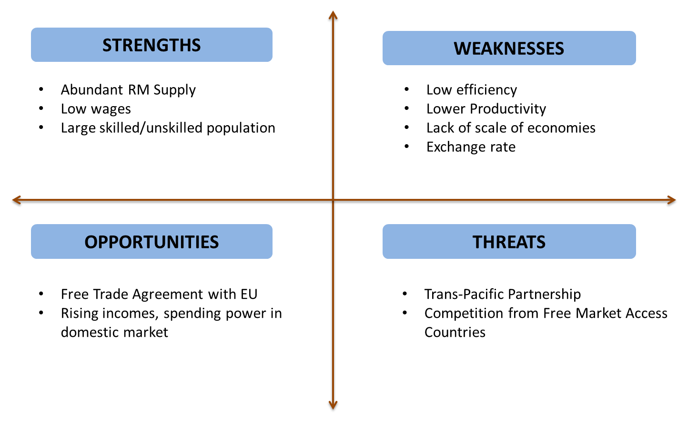
SWOT Analysis – Indian Textiles Industry
Opportunity for Cotton Made Ups Business

Slide 35
SWOT Analysis – Indian Textiles Industry
Competitive Advantage

Slide 36
SWOT Analysis – Indian Textiles Industry
Ensured availability of manpower

Slide 37
SWOT Analysis – Indian Textiles Industry
Labour Reforms
Skill Development

Slide 38
SWOT Analysis – Indian Textiles Industry
Large Mega Parks
Encourage large private Integrated Manufacturing unit by incentives

Slide 39
SWOT Analysis – Indian Textiles Industry
Exporters should hedge the risk of rate fluctuation

Slide 40
SWOT Analysis – Indian Textiles Industry
STRENGTHS
WEAKNESSES
Abundant RM Supply
Low wages
Large skilled/unskilled population
Low efficiency
Lower Productivity
Lack of scale of economies
Exchange rate
OPPORTUNITIES
THREATS
Free Trade Agreement with EU
Rising incomes, spending power in domestic market
Trans-Pacific Partnership
Competition from Free Market Access Countries

Slide 41

EU-India FTA
EU- India FTA has many resolved and unresolved demands, those are listed as below:
Sr # | Demand | State
1 | Textiles | Resolved
2 | Automobile Sector | Unresolved
3 | Financial Services Sector | Unresolved
4 | Legal Sector | Unresolved
5 | Whisky and Wines | Almost Resolved
6 | Accountancy | Unresolved
7 | Government Procurement | Unresolved
8 | ITES (EU wide Work Permit) | Unresolved
9 | Status of Data Secured Nation | Unresolved

Slide 42
SWOT Analysis – Indian Textiles Industry
STRENGTHS
WEAKNESSES
Abundant RM Supply
Low wages
Large skilled/unskilled population
Low efficiency
Lower Productivity
Lack of scale of economies
Exchange rate
OPPORTUNITIES
THREATS
Free Trade Agreement with EU
Rising incomes, spending power in domestic market
Trans-Pacific Partnership
Competition from Free Market Access Countries

Slide 43
Strategy
Availability of Raw Material and Manpower
Abundant raw material and large population definitely support the strategy to build large volume of made ups from India.
Labour reforms should be aggressively pursued and aggressive Skill Development programmes should be launched
Continued low efficiency and low productivity of labour needs to be addressed through Labour Reforms and Skill Development.
Support Large Scale Operations
The Government should support large mega parks and private large integrated manufacturing units for made ups manufacturing to maximise the scale of operation.

Slide 44
Strategy
Setup Mega Textile Parks near Port Cities
Government should encourage to setup Mega Textile Parks and Large Integrated Textile Manufacturing units near port cities to minimise the time for Inland transportation.
FTA with EU – An Opportunity for Indian Textiles
The Government should freeze FTA with EU at earliest. This will give India advantage over Pakistan.
TPP (Trans Pacific Partnership)
India should join TPP to avoid isolation.

Slide 45
Strategy
Encourage social and labour compliance to facilitate joining TPP
Indian exporters need to be social and labour compliant to get into TPP. Thus Government should encourage exporters adhere to social and labour compliances by giving them incentives
Launch of WTO compatible scheme
India should launch WTO compatible incentive schemes to restore the incentives
Announcement of Interest Subvention Scheme
Interest subvention scheme for made ups and whole textile industry should be announced to lower down the cost of finance.

Slide 46
Thank you !!

