Slide 1
Strategy for Approaching Zero Defects for RMGs: Initiatives & Bench Marking
Promoting Indian Garments to Perfection
Textiles Committee,
Mumbai

Slide 2
Structure of Presentation
Promoting Indian Garments to Perfection
Part- A : Proposed Initiatives for Approaching Zero Defects
Part-B: Man, Machine & Management (3Ms) for approaching Zero Defects : Decoding through a Survey
Part-C: Suggestive Measures

Slide 3
Part- A
Promoting Indian Garments to Perfection
Strategy for Approaching Zero Defects in Manufacturing of Readymade Garments (RMGs)

Slide 4
Importance of RMG in Textile Industry
Promoting Indian Garments to Perfection
Sector being labor intensive provides highest employment in the entire value chain and employs significant women work force.
Highest value added segment on T & C
Total Market Size of RMG during 2012-13 is $ 68.57 Bn
More than 50 % of contribution to the sectoral export
Market Size of Indian RMG Sector (in US $ Bn.)
Sector | Domestic Market | Export | Total
RMG Woven | 39.30 | 8.74 | 48.04
RMG Knitted | 4.92 | 7.00 | 11.92
Made-ups | 3.90 | 4.71 | 8.61
Total | 48.12 | 20.45 | 68.57
Source: Market for Textiles & Clothing and WITS database

Slide 5
Purpose
Promoting Indian Garments to Perfection
A five pronged approach to achieve Zero defect.
Identifying the defects and its influence on quality and competitiveness
Classifying the source of the defect
Possible solutions to achieve zero defects i.e. Man (Skill development), Machine (Technology Intervention), Management (Quality Management System), etc.
Defining and addressing ancillary elements for quality enhancement.
Action plan for policy intervention

Slide 6
Vision & Mission
Promoting Indian Garments to Perfection
Vision
“Achieve global excellence in manufacture & export of quality garments.”
Mission
Facilitate manufacturing of defect free garments
Bring technology of RMG manufacturing at par with leading RMG manufacturing and competing countries.
Enhancing the existing manpower skills to match up the latest technology and create new generation skill manpower to produce quality garments.
Establish and implement effective Quality Management Systems (QMS) in the supply chain to achieve zero defects.

Slide 7
Objectives
Promoting Indian Garments to Perfection
To upgrade the backward supply chain technology like weaving, knitting, processing and finishing for quality raw materials.
Technology upgradation in RMG manufacturing
Addressing the issue of packing & packaging leading to defects.
To promote indigenous manufacturing of high quality trims and accessories.
To develop and upgrade the skill sets to match up the new technology.
Establish Quality Management Systems (QMS) in RMG process with a view to inculcate quality culture and thereby promoting higher quality produce.
Regular assessment for updating the changes in technology, quality and productivity for policy interventions.

Slide 8
Source of Defects
Promoting Indian Garments to Perfection
Defective raw material: 80% of the fabrics produced in unorganised sector leading to defects.
Defects in the process of apparel making: fabrication stage contributes largest share of defects due to outdated technology, skill gap and lack of QMS.
Defects in packing of the garments: no specific benchmark available in the country for packing the apparels.
Trims and accessories: deficiency in indigenous quality accessories is also affecting the production of quality garments.
Skilled Manpower: Highly and continuously trained manpower required for the production process.

Slide 9
Defects in fabrication stage
Promoting Indian Garments to Perfection
A study on a branded knitted garment manufacturing unit of India indicates that the unit is experiencing about 11.18% defects in the process of manufacturing during 2013.

Slide 10
Proposed Strategic Initiatives
Promoting Indian Garments to Perfection
Facilitating modern technology in weaving, processing, fabricating
Developing the Indigenous industry for Trims & Accessories
Addressing the Skill requirement for defect free manufacturing
Promote Quality Management Systems (QMS)
Regular assessment of change in technology & product quality

Slide 11
Part-B
Promoting Indian Garments to Perfection
TC Benchmarking Survey on Man, Machine & Management (3Ms) for approaching
Zero Defects

Slide 12
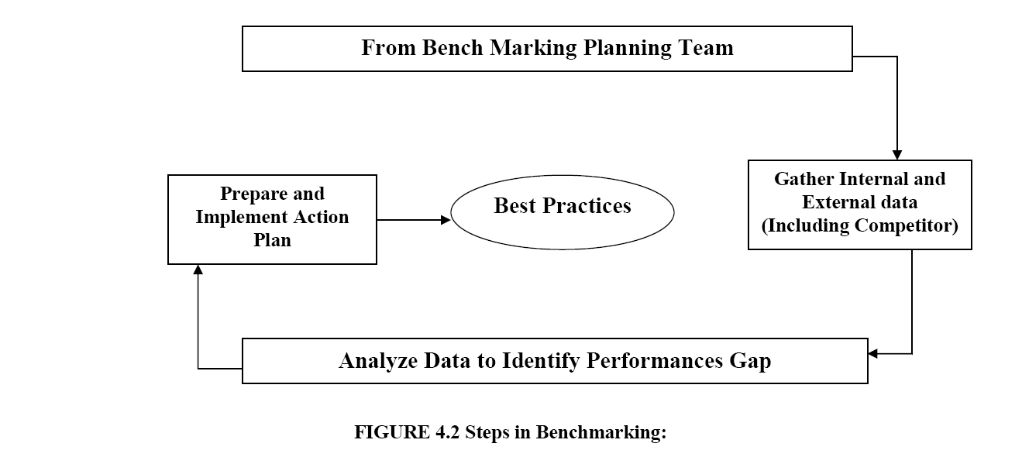
Methodology
Promoting Indian Garments to Perfection
A core team of experts constituted
RMG units selected on the basis of…
The exposure to export markets.
The RMG manufacturers having tie up with international brands.
Units were also selected from woven & knitted segments
Efforts were also made to select best units from each segment.
A structured questionnaire administered for collecting data on Man, Machine & Management

Slide 13
Bench-marking & Key Findings
Promoting Indian Garments to Perfection
Selected Centers:
Ludhiana and Tirupur for Knitted RMGs
Bengaluru and Tirupur for the Woven Apparels.
Product Basket & Turnover:
Turnover of the selected units – Rs 1000 crores
Product profile of knitted RMGs - T-shirt, Jacket, Sweatshirts, Leggings, Kids & Baby Garments
of both medium and large size.
Product basket of the woven RMGs - Kids & Baby Garments, Men’s & Boy’s Shirts, Trousers
(both for Men & Women), Women Wears, etc.

Slide 14
Market Shares
Promoting Indian Garments to Perfection
Market Shares of the selected RMGs:

Slide 15
Overview of the Defects in the Selected Units
Promoting Indian Garments to Perfection
Selected knitted & woven units are producing less defective as compared to industry average
Defective garments sold in the domestic market as export surplus

Slide 16
Stage-wise defect occurrence in RMG production
Promoting Indian Garments to Perfection
Pre-sewing Stage - Inspection of Raw material
Inspection used as an important tool to
address the defect.
The manpower used by units is properly
trained & technology use is minimal
A back-lit Inspection machine with roll
length recorder used by some units as
ideal method.
Raw material | Source | Selected Units (%)
Fabrics | Domestic | 3-10
 | Imported | 2-5
Trim & Accessory | Domestic | 1.5-3
 | Imported | 1-2

Slide 17
Defects in Fabrication stage & preventive actions – Selected Units
Promoting Indian Garments to Perfection
Stages of Production | Sub stages | Defects | Rework (%) | Rejection (%) | Preventive & Corrective Action
Spreading, laying & Cutting |  | 0 | 0 | 0 | Quality & Compliance Technology & Regular Training
Sewing | Inline Inspection | 7 | 6.5 | 0.5 | Regular Training
 | End line Inspection | 3 | 2.5 | 0.5 | Technology & Regular Training
 | Finished Garment Inspection | 1 | 1 | 0 | Technology & Regular Training
Washing/Wet processing |  | 1 | 0.5 | 0.5 | Technology, Training Quality & Compliance
Final Stage |  | 0 | 0 | 0 | Technology, Training

Slide 18
Technology Level of the Units during last five Years – Selected Units
Promoting Indian Garments to Perfection
Stages of Production | Sub-Stages | Technology Level | Cost in Rs. | Frequency of the up gradation
Pre sewing | Inspection | Photo spectrometer/ grey room/ light boxes | 2 crore | 5 yearly
 | Cutting | CAM Cutter (Fully Automatic) | 1crore | 3 yearly
Sewing | Sewing | SNLS UBT prog. | 10 crore | 5 yearly
Washing/ Wet Processing | Washing / Finishing | Form finishers | 4 crore | 5 yearly
 | Wet Processing | Fully Automatic Machines | NA | 5 yearly
Packing | Packing | Fully Automated as per the buyer requirement | NA | 5 yearly

Slide 19
Post Sewing Operations
Promoting Indian Garments to Perfection
Higher rejection was observed in case of heavy washing programs, damages are caused during washing. However type of damages and their reasons were not available.
Subsequent processes are ironing, passing through metal detector and packing. .
Third party AQL 2.5 GIL II /AQL 1.5 GIL II inspections are carried out by these units to ascertain the acceptability of the lot after packing.

Slide 20
Best Manufacturing Practices & QMS
Promoting Indian Garments to Perfection
Operations | Selected Units
Fabric Inspection | 100%
Accessories inspection | AQL 2.5
Cutting plan | yes
Sewing plan | yes
Finishing plan | yes
Bundle tracking | yes
Inline/ End line Checking reports | 100%
Final inspection reports ( rejection data) | AQL 2.5 GIL II /AQL 1.5 GIL II
Operator efficiency | Cutting : 65-74%; Sewing 45-64%
Operator skill test | yes ( Induction, on the job)
Reporting through ERP/SAP | Yes , SAP which leads to quick and accurate reporting

Slide 21
Quality Inspection system followed by the units
Promoting Indian Garments to Perfection
Piece goods quality control | Cutting quality control | In process quality control (sewing) | Quality control of finishing sections | Process inspection | Two hourly audit | Day's final audit | Lot final audit
NA | Done | Inline Inspection End line inspection Finished garment inspection | AQL 2.5 | Visual, pass only the defect free garment | Done to attain AQL 2.5 | NA | Done in presence of buyer

Slide 22
HR Practices by the units
Promoting Indian Garments to Perfection
HR Practices | Description | Selected unit
Present State of Work force (grade) | A+ (Highly skilled) | 25%
 | A (Skilled) | 42%
 | B (Semi skilled) | 6.6%
 | C (unskilled) | 26.4%
Men to Machine Ratio | Pre-sewing (Cutter) | 3:1
 | Sewing | 1:1
 | Post-sewing | 2:1
 | inspection at all stages | Yes
Remarks | -- | --
Training method in place |  | In-house training/ISDS
Notes: Ratio applicable to Top garments only and will differ for bottom garments Training method in place are In-house training & Induction, basic skill test and soft skills

Slide 23
Major findings
Promoting Indian Garments to Perfection
Indian RMG industry is experiencing the constraint of defects and requires special attention for eliminating it and enhancing the competitiveness.
Selected units are producing less defective RMGs as compared to the industry average but not zero defect garments.
Hence may be adopted as models for approaching zero defects.

Slide 24
Part-C
Promoting Indian Garments to Perfection
Suggestive Measures

Slide 25
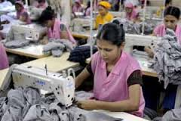
Suggestive measures: Skilling
Promoting Indian Garments to Perfection
The training systems to be realigned to latest technology.
Mechanism on comprehensive training system within the unit as well as outside of the units.
ISDS should be reoriented to provide both shop-floor and managerial skilled manpower to the industry.
Focus should be on problem solving model in order to reduce the rework and rejection
Introduce IE technique for improving efficiency and productivity.
National level workshops for Capacity Building in the issue.

Slide 26
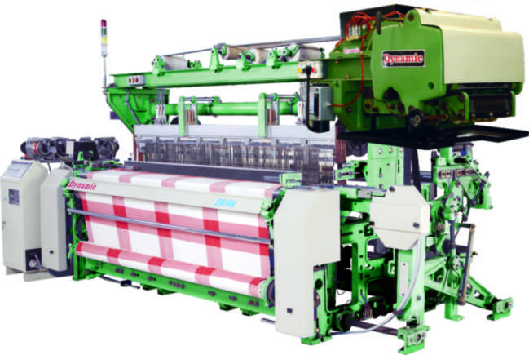
Suggestive measures: Machine
Promoting Indian Garments to Perfection
Encouraging adoption of latest technology as in case of bench marked units.
Focus on defect free raw material from latest technological machinery in power loom, knitting and Processing industry.
Reconditioning of existing machines to suite with latest technology and compatible to further processing. Ex. Tubular to open-width of Knitted fabrics.
Introduction of jeans manufacturing in knitting industries.
The Sewing machine with Servo motors and UBT gives the apparel industry a tremendous strength on production, quality and savings on sewing threads and energy.

Slide 27
Suggestive measures: Machine (Contd..)
Promoting Indian Garments to Perfection
Modernisation of the Processing & Dyeing industry and relocate the existing manual yarn and fabric dyeing units to a common facility centres with modernised machinery and infrastructure.
The industry should adopt the digital colour matching system through computer. Also in CFC of the clusters.
To promote in establishing attachment manufacturing facilities for improving productivity and quality.
To establish textile machinery Manufacturing Park. The PPP mode may be explored.

Slide 28
Suggestive measures: Management
Promoting Indian Garments to Perfection
It is proposed to launch “Mission on Quality Compliance (MQC)” for the RMG industry.
Establishment of model garment production unit to demonstrate the latest technology for excellence in quality and productivity.
To assign the job of developing norms for quality and productivity in garment industry
To benchmark the garment industry for best quality on the basis of available Quality Management Systems (QMS).
Infrastructure and management practices by developing a scheme for assessment and rating of RMG industries.
To develop strategic training & quality plan for zero defect manufacturing in garment industry.

Slide 29
Suggestive measures: Others
Promoting Indian Garments to Perfection
Regular Assessment of change in Technology & Product Quality through a Resource Centre/ Data bank.
To carry out the International Benchmarking study on global competitiveness of apparel industry.

Slide 30
Promoting Indian Garments to Perfection
THANK YOU

