Slide 1
The Technology Back-up :
GST Network

Slide 2
Goods and Services Tax Network
Incorporated on 28th March 2013
  Under section 25 of the Companies Act, 1956
  As a private limited company
Promoted jointly by the Central & State Govts with the following equity Structure
  Central Govt 24.5%
  EC and State Govts 24.5%
  Pvt Financial Institutions 51.0%

Slide 3
Mandate of GSTN
Provide shared IT infrastructure and services to Central and State Governments & tax-payers for implementation of GST
  Common Registration, Return Filing and e-Payment services
  Integration of Common GST Portal with existing tax administration systems
  Build efficient and convenient interfaces for tax-payers
  Assist tax authorities in plugging tax evasion
  Promote best practices and provide training to stakeholders
  Assist States who do not have requisite IT capabilities by providing them with back end modules

Slide 4
IT Backbone for GST
Being destination based tax, inter-state trade of goods and services would need a robust settlement mechanism among the states and the Centre.
This is possible only when, there is a strong IT infra and services backbone, which enables
  Capture,
  Processing and
  Exchange of information amongst stakeholders (taxpayers, state, central govt, Banks and RBI)

Slide 5
IT Backbone for GST
GST System will cater to
  65 lakh taxpayers
  32 tax administrations (Central Govt, 29 states, 2 UTs)
It will be one-stop-shop for the key needs of taxpayers of the entire nation

Slide 6
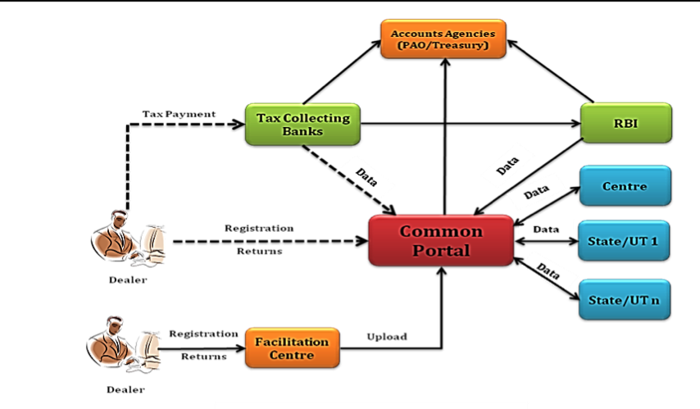
IT Eco-system for GST

Slide 7
GST Common Portal
To be developed, operated and maintained by GSTN
It will be a pass through portal
It will do ITC claim processing/settlement based on sales and purchase data filed by paired dealers
It will be tightly integrated with State/Central Tax systems.
It will also have data on past years for the taxpayers (one point contact for dealers)

Slide 8


IT Strategy
Harmonization of Business Processes and Formats
Autonomy of back-end systems of States and Centre
Common & Shared
IT Infrastructure
IT
Interfaces
Centre/States
Tax IT Systems
Non-Statutory Functions
Statutory Functions
Core Services
  Registration
  Returns
  Payments
Helpdesk support
Information on Inter-State supply and cross-credit utilization (IGST Settlement)
Tax Payer Profiling
Approval of Registration
Assessment
Refunds
Audit and Enforcement
Adjudication
Internal workflows to support above functions

Slide 9
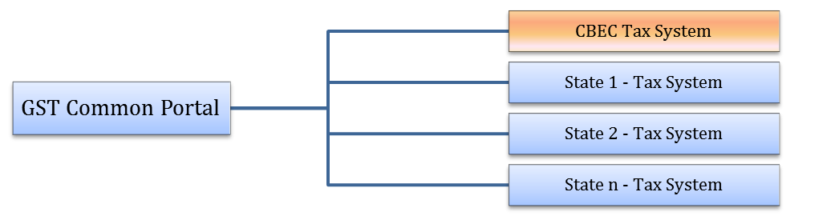
GST Rollout Strategy: Model-1
States/CBEC to develop their own backend modules and exchange data with GST common portal using APIs over a secured network
Data Center
APIs

Slide 10
GST Rollout Strategy: Model-2
GSTN to develop backend modules for States & host the same at central data center location
Backend Modules 1
Backend Modules 2
Backend Modules n
State 1
State 2
State n
Data Center
WAN Network
GST Common Portal
Access to States over a secured network.

Slide 11
Migration of Existing Dealers
Existing VAT/ Service Tax/ Central Excise dealer data will be migrated to GST system
  No need of fresh registration for existing dealers
  Work on migration of data is in progress
Challenges
  Different formats in use for VAT, Service Tax & Central Excise
  Each dealer will be given unique ID (GSTIN)
    Modalities for conveying GSTIN, User ID and Password being discussed with Central & State Govts

Slide 12
Registration
GST Common Portal will be the single window for registration of new dealers
New dealers will apply at the GST Common Portal online
Applications received will be transmitted online to tax authorities
Approval will be granted within a defined time frame
On approval, GSTIN, User ID and password will be assigned online

Slide 13
Returns
All returns will be submitted at the GST Common Portal
Common Return format for taxpayers all over India
Monthly verification and settlement of ITC claims by matching transactions reported in the returns filed by seller and purchaser

Slide 14
Payments
GST Portal will enable payment of GST through a variety of modes such as
  Internet banking
  Debit and Credit cards
  OTC payment in Agency Banks
  Payment through RTGS/ NEFT from other banks
Integration of GST System with
  30 Agency banks for internet payments
  Multiple gateway operators for card payments

Slide 15
Taxpayer Ledger
GST Common Portal will maintain and display the Taxpayer Ledger
Each taxpayer will be able to access his own Ledger 24x7
Ledger will give information such as
  Tax liability, tax dues & tax deposited
  Input tax credit earned & utilised
  Refund granted
  Interest and Penalty

Slide 16
Inter-state Trade
GST Portal will provide a common system for intra-state and inter-state transactions
  Taxpayers to report all transactions of a tax cycle, including inter-state transactions, in a common return format
GST Portal will act as the clearing house for inter-government settlement between the Centre and States

Slide 17
Thank You

Slide 18
States Opting for Model-2
Bihar | Nagaland
Orissa | Meghalaya
Uttar Pradesh | Arunachal Pradesh
Delhi
Tripura
Manipur
Mizoram

