Slide 1
TECHNICAL TEXTILE
APPLICATIONS ON INDIAN RAILWAYS
Presentation on
Geosynthetics
Its function
&
Applications

Slide 2
A BRIEF OVERVIEW
Indian Railways has a vast network of track with 68,442 km of Route Length with a total of 1,23,236 Track kms.
It runs more than 13,000 Passenger Trains daily.
It carrying about 23 million passengers.
It runs more than another 9,000 Freight Trains daily and carry about 3.35 MT of Freight Traffic per day on an average.
Indian Railways keeps taking up expansion and modernization plans.

Slide 3
NEED OF TECHNICAL TEXTILES
Indian Railways had done about 3358 kms of works of New line, Doubling and Gauge Conversion and about 5000 kms of Railway Electrifications in 2018-19.
Geo-synthetics has applications in Construction projects & Maintenance of existing embankment in Indian Railways.
Further applications can be there in various areas of its operation like PPEs, fire retardant properties, meditech and security.

Slide 4
ADOPTION OF NEW TECHNOLOGIES
Indian Railways makes special emphasis for new products/ technologies and innovations for:
Running of High Speed trains.
Running of Heavy Axle Load 25 T.
Reduction in unit cost of transportation.
Improving safety and mobility .
Improving Freight loading.
Hence, adoption of new products/technologies, including Technical Textiles to achieve better properties is inevitable.

Slide 5
FUNCTIONAL REQUIREMENTS IN CIVIL ENGG. WORKS IN INDIAN RAILWAY
Separation:
For laying of new tracks where soil conditions requires separation of layers to prevent inter-mixing of two soil types to maintain integrity of each material under the applied loads- Geo- Textile.
(ii) Filtration:
Again to maintain tracks in healthy condition, products having such properties that allow passage of water from the soil in either direction while simultaneously prevent the uncontrolled passage of soil particles would be very useful- Geo-Composites.

Slide 6
FUNCTIONAL REQUIREMENTS IN CIVIL ENGG. WORKS IN INDIAN RAILWAY
(iii) Drainage:
Geo-composite Drains can be used for drainage as a basal layer in case of embankments where the water table is high and also for drainage behind retaining walls and / or bridge abutments as a replacement of graded filter (in the form of boulders and gravels)- Prefabricated Vertical Drains (PVD).
(v) Reinforcement & stabilization:
For strengthening of weak formation and for reinforced earth structures- Geo-grid and Geo-composite.

Slide 7
FUNCTIONAL REQUIREMENTS IN CIVIL ENGG. WORKS IN INDIAN RAILWAY
(vi) Erosion Control:
In swampy conditions where the ground water is close to the surface, to improves the load support capacity, In cases of steep soil slope, for long-term stability and erosion control in conjunction with vegetation- Geocell, Geo-mat.
(vii) Barrier:
Geo-synthetics act as a barrier to migration of water from one side of barrier to another side. This function is used in tunnel lining-Geo-membrane.

Slide 8
GEO-SYNTHETICS SPECIFICATIONS ISSUED BY INDIAN RAILWAY (RDSO/LUCKNOW)
Non-woven Geo-textile to be used as separator / filtration in Railway formation
Geo-composite Drain behind Bridge Abutment / Retaining Wall
Geo-composite Drain to be used at the base of the Embankment for Railway Formation

Slide 9
EXPECTATIONS FROM INDUSTRY
Standard Testing facilities for various parameters of geo-synthetics are not available in India due to which data received from many sources can not be verified.
RDSO, in its own efforts making Specification of Geo-grid to be used as base reinforcement / stabilization. However latest specification available in this regard will help Indian Railways.

Slide 10
FUNCTIONAL REQUIREMENTS OF GEO-SYNTHETICS IN OTHER APPLICATIONS
Coach Furnishing items:
  Floor Board
  Side wall & Partition Wall
  Seat Cover & Upholstery
  Curtain
Desirable Properties:
Fire retardant property is required to safeguard against fire for safety of passengers so that the materials don’t aid in spreading the flame. But simultaneously aesthetic requirements are to be kept in mind. The materials must also have least toxicity so that the smoke/fumes of burning itself is not toxic.

Slide 11
COACH FURNISHING APPLICATIONS
Items | Material Used at present | Specifications
Floor board | Wood Based Impregnated Compressed Laminate | Specification No. C-9407 (Rev-3) Amendment-3
Side wall & Partition wall paneling | Decorative Thermosetting Synthetic Resin Bonded Laminated Sheets | Specification No. C-K514 with Amendment-7
Seat cover and upholstery | Vinyl Coated Upholstery Fabric (Artificial Leather) Fire Retardant Upholstery Stain Proof Fire Retardant Upholstery Cloth | Specification No. RDSO/2008/Cg-07 Amendment-5. Specification No. C-9901 (Rev-2) Amendment-5 Specification No. C-K610 (Rev-1) Amendment-4
Curtain | Fire Retardant Curtain Fabric | Specification No. C-9911 (Rev.3) Amendment-6

Slide 12
PROTECTIVE TEXTILES USED IN SECURITY
Item | Procured during 2015-16, 2016-17 & 2017-18(in nos.)
Luminous jacket | 1350
Bomb Suppression Blanket | 12
Bomb Suit | 2
Polyester Tent | 38
Body Protector | 142
Individual Search Vest | 1450
Specifications of these items are formulated by MHA and adopted by Railways.

Slide 13
MEDICAL TEXTILES
Uses and Desirable Properties
Staff gowns, caps, shoe covers, incontinence care (Diapers), Wound care products (Cotton, gauze, swabs, bandages etc.)
  easy disposability & low cost as these tend to be
  Disposable.
Bed sheets, pillow covers, operation theatre surgical drapes etc.
Should be cotton for comfort, softness but should be strong enough to withstand multiple usage after daily change.
Curtains
Bacteria static coatings as these can’t be changed daily.

Slide 14
SPECIALITY PRODUCTS
Sutures (Absorbable and Non absorbable)
Implants, Meshes, Burn Dressings
Fibres used for filtering/cleaning as in Dialysis, Liver or lung functions
Elastic Bandages, orthopaedic splints
Knitted vascular prosthesis
Specifications of Meditech items formulated by Ministry of Health &
Family Affair and Department of Pharmaceuticals under Ministry of
Chemicals & Fertilizers.

Slide 15
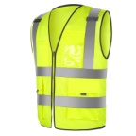
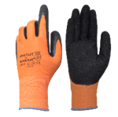
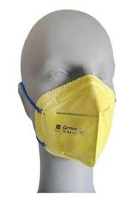

PERSONAL PROTECTIVE EQUIPMENT (PPE) APPLICATIONS
Body Protection
Hand Gloves
Respirators
Fall Protection

Slide 16
OTHER APPLICATIONS ON IR
Bedrolls including bed-sheet and pillow
Desirable Properties:
Comfort, maintainability and aesthetics, environment friendly
disposal methods and recyclability
As per policy of GOI, bedroll items like bed sheets (poly-vastra), pillow
covers (cotton/poly-vastra), towels (Turkish Cotton) and blankets are being
Procured from KVIC (Khadi Village Industries Commission) and ACASH
(Association of Corporations & Apex Societies of Handlooms).
One item ‘Disposable Napkin Cotton Rich Spun lace Nonwoven’ has been
introduced in place of hand / face towel in bedroll for AC coach passengers
on cost neutrality basis.

Slide 17
Linen Items used in trains on
Indian Railways
Blankets.
Bed sheets.
Pillow covers.
Hand Towels.
Bath Towels.
Curtains for AC Coaches.
Seat Covers.

Slide 18
Uniforms on Indian Railways
Loco Pilots & Guard.
Station Master, Manager.
Ticket Checking staff.
Gangman.
Pointsman.
Shunting Master.
Technicians.
Welders.
TXR (JE/SSE) Supervisor.
Nurses/ Ward boy.
Safaiwala (Housekeeping Assistant)

Slide 19
Fabric Requirements for Railways
Stain resistant fabrics.
Pest resistant curtains.
Hygiene of passengers.
Washable Blankets to avoid dry cleaning.
Easy washable/ Quick drying linen.
Less water consumption during wash.
Fire resistant fabrics for curtains/ seats.
Alternate material to berth rexine.
Reusable Linen packets (alternate to paper packets).

Slide 20
Requirements for Railways
Fabric for fire fighting staff.
Dress cum rain resistant clothing material (staff should able to work in heavy rains).
Alternate to paper packets in which linens sets are supplied to passengers.
Any methods for recycling of upholstery/ rexine cloth, because it is very difficult to dispose after use.
Gangman, technician, welders, Patrolman are working in very adverse weather condition, suitable clothing for such staff.

Slide 21
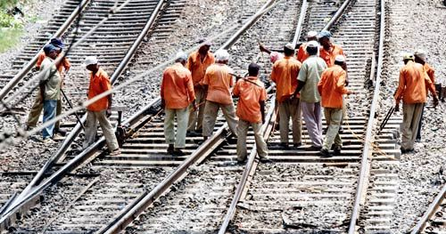
Gangmen Working in site

Slide 22
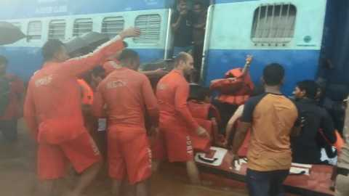
Restoration of Passenger during heavy rain.

Slide 23
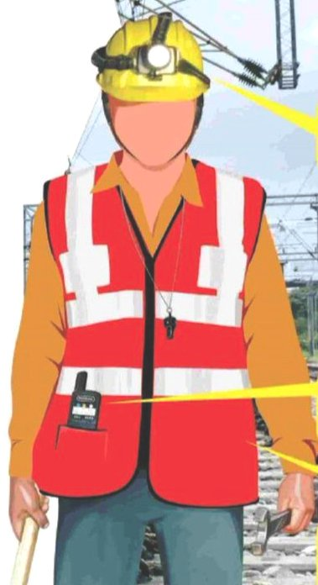
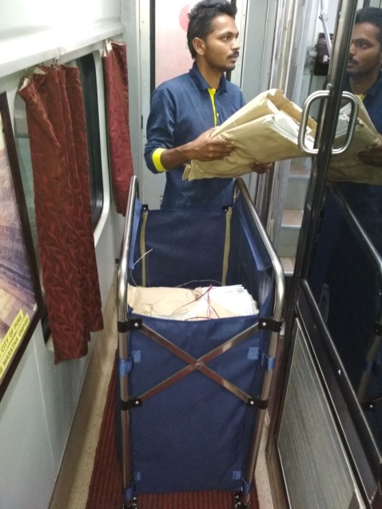
Gangmen Uniform
Linen Trolley Bag
Clothing materials for gangman/ technician working in extreme weather.

Slide 24
Conclusion
IR is extensively using Geo-Textile items at the locations of weak formations and strengthening of poor soils.
New constructions & projects also have extensive use of Geo-Textiles.
Many other items (particularly PPEs, Coach furnishing items) falling under Technical Textiles category are being used in significant volumes by Zonal Railways/Production Units.
Latest specifications issued in this regarding has been requested by Indian Railways from Ministry of Textiles/BIS.
Standard Testing facilities for various parameters of geo-synthetics are not available in India due to which data received from many sources can not be verified.

Slide 25

Thank You

