Slide 1
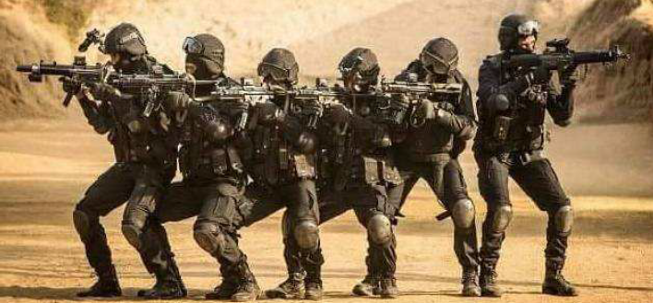
National Security Guards
Vision
A world class zero-error force
Motto
Sarvatra Sarvottam Suraksha
Prem Vishwas, Sqn Commander (HQ NSG, New Delhi)

Slide 2
National Security Guards
Inception of NSG-Black cats took place in 1986 to tackle the menace of CT / CH and Proximate security for VVIPs.
Besides NSG, we have numerous special forces in India which have been formed with specific objectives.
In addition to NSG, I would be encompassing the requirements of all such other special forces also.

Slide 3
National Security Guards
Optimum readiness of the special forces is a necessity in present security scenario around the world to carryout their mandated task and achieve desired goals.

Slide 4
Identity of Tech Textiles
If we talk about textile industry as a whole and Technical Textile as a part to it, it akin the word commando which is strategically concepted, designed, manufactured and finished for its specific functional goal similar.

Slide 5
Why Technical Textiles?
Advantages in the form of operational results, health and safety, durability, high strength, easy maintenance etc has favored technical textiles to excel and touch upon every potential user.

Slide 6
Segments of utility
Based upon the specific needs and functional utility, primary segments of Technical and Smart textiles for special forces are:-
Clothtech
Protech
Mobiltech &
Meditech

Slide 7
Attributes
Major expectations from Technical textiles are:-
Selective Concealment
Gear Compatibility
Easy Operatability
Great Manouverity
Light weight & Good Strength
Easy in handling
Competitive pricing
Ecologically sustainable
Justifiable life w.r.t operational environments

Slide 8
Ready Scopes in Forces
Few Utility items which are already in use:-
Bullet Resistant Jackets & Vets
B R Shields
Tactical operational clothing
Tactical Shoes of different types
Socks for different operational conditions
ECC & Special clothing items
Tents/Tarpaulin/PBS Roll/Ground Sheet
Conti...

Slide 9
Ready Scopes in Forces
Supplement to Bullet resistant Vehicles
Hazmat Vans and complementing items
Medical utility items for forces in fields
Anti Riot gears and equipment
Fire Retardant Dangri/Chemical Protection suit
Rain Ponchos / Hand gloves/ Water resistant cloth
and many such more.

Slide 10
Special forces has specific mandates and very less timeline. We require timely acquisitions to upgrade and be in readiness in order to counter unprecedented situations.

Slide 11
Constraints of quality resources and bounded frameworks prolongs the timeline of acquisitions which directly affects the mandated operational objectives.

Slide 12
Major concerns
Limited availability of competitive products in national arena confirming to the functional requirements of the forces primarily in quality parameters.
Availability of numerous fake products at unreasonable price and non-serious market players.

Slide 13
Major concerns
Poor awareness regarding technological advancements w.r.t our objective requirements.
Limited provisions and powers to enable acquisition of established products and challenges in emerging modes of procurement.

Slide 14
Major concerns
Lack of appropriate QR/TDs and proper quality assurance mechanism/certifying bodies.
Lack of dedicated QR formulation and revision body at ministry level for adopting fast moving technological advancements and dynamically changing requirements of the users .

Slide 15
Major concerns
Categorization of items for procurement through specific arenas without upgrading the basic resources.
Repeated failures by business partners to adhere to the laid down terms and conditions.

Slide 16
Major concerns
Multiple non-confirmations of products in quality and performance benchmarks.
Silence of firms at appropriate stages of procurement such as pre-bid meet and representations at strategic junctures.

Slide 17
New Horizons
Regular revision of Benchmarks.
GFR Provisions for startup acquisitions.
Revision of MSME status and regulations.
Continuous improvements in GeM portal.
Methodological and objective directives from NITI aayog in acquisition of certain crucial items.
https://nsg.gov.in/initiation-proposals/request-presentation

Slide 18
