Slide 1

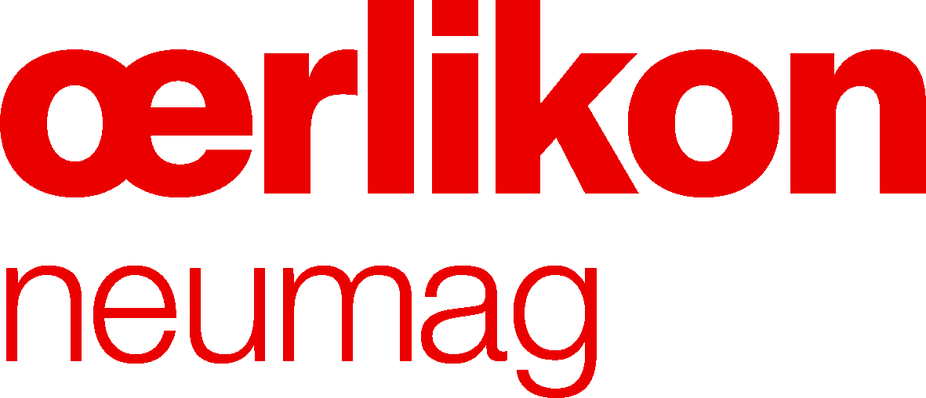

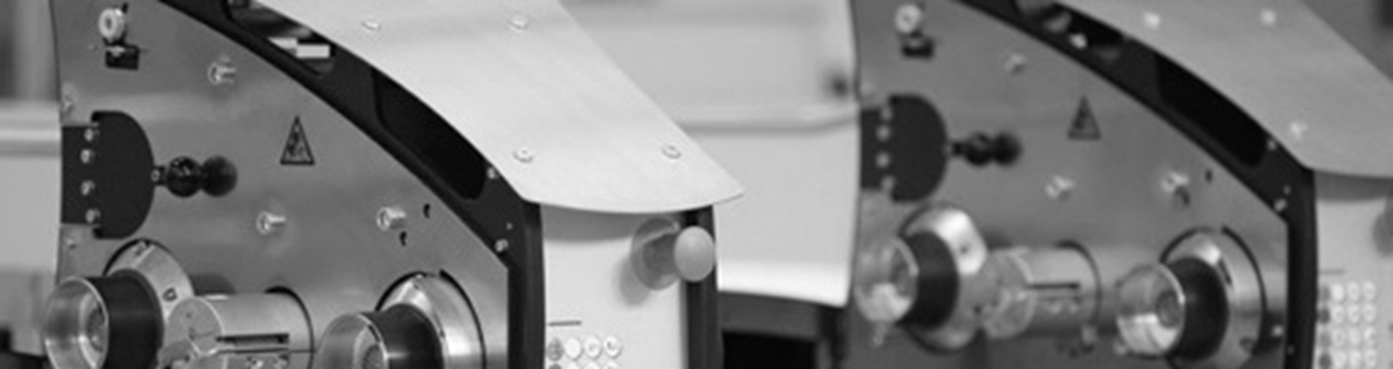
OMF IDY Presentation
Technotex 2019 Conference
Bombay Exhibition Centre, August 29, 2019
By Mr. Debrabata Ghosh

Slide 2

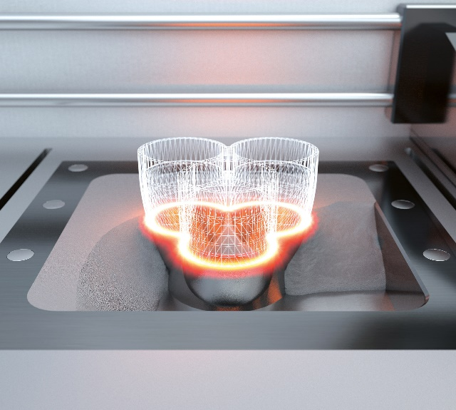
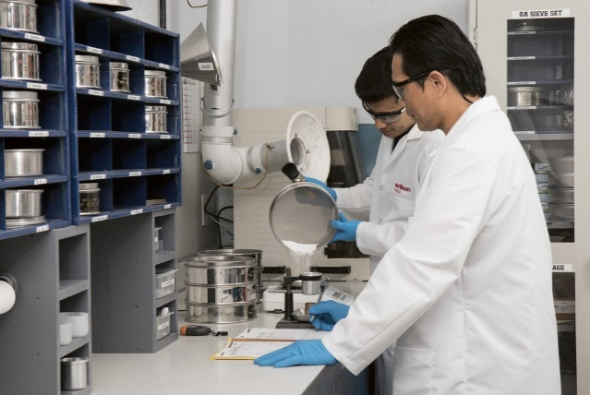
Oerlikon – A global, high-tech engineering group with unique competences
Advanced Materials
Surface Solutions
Materials Processing
Understanding the properties of materials at the smallest scale. World-class materials manufacture of powders and wires for industrial applications, including additive manufacturing
No 1 in surface solutions offering the most comprehensive portfolio of surface technologies from standard to tailor-made solutions
Unique component engineering expertise. Comprehensive expertise in the engineering and processing of materials and surfaces to design high-performance industrial components
Oerlikon is a market leader in advanced materials, surface engineering and polymer processing.
Our solutions encompass materials, coating equipment, coating services and the engineering of entire plants.
We build our business on unique technology competences, the widest global reach and trusted customer relations in highly demanding industries such as aerospace, automotive, energy, tooling and textiles.
Every day we develop new materials, new surface technologies, new applications, components and textile manufacturing solutions to empower our customers to create and innovate better products.
OMF IDY Presentation_Technotex 2019 Conference_Mumbai

Slide 3
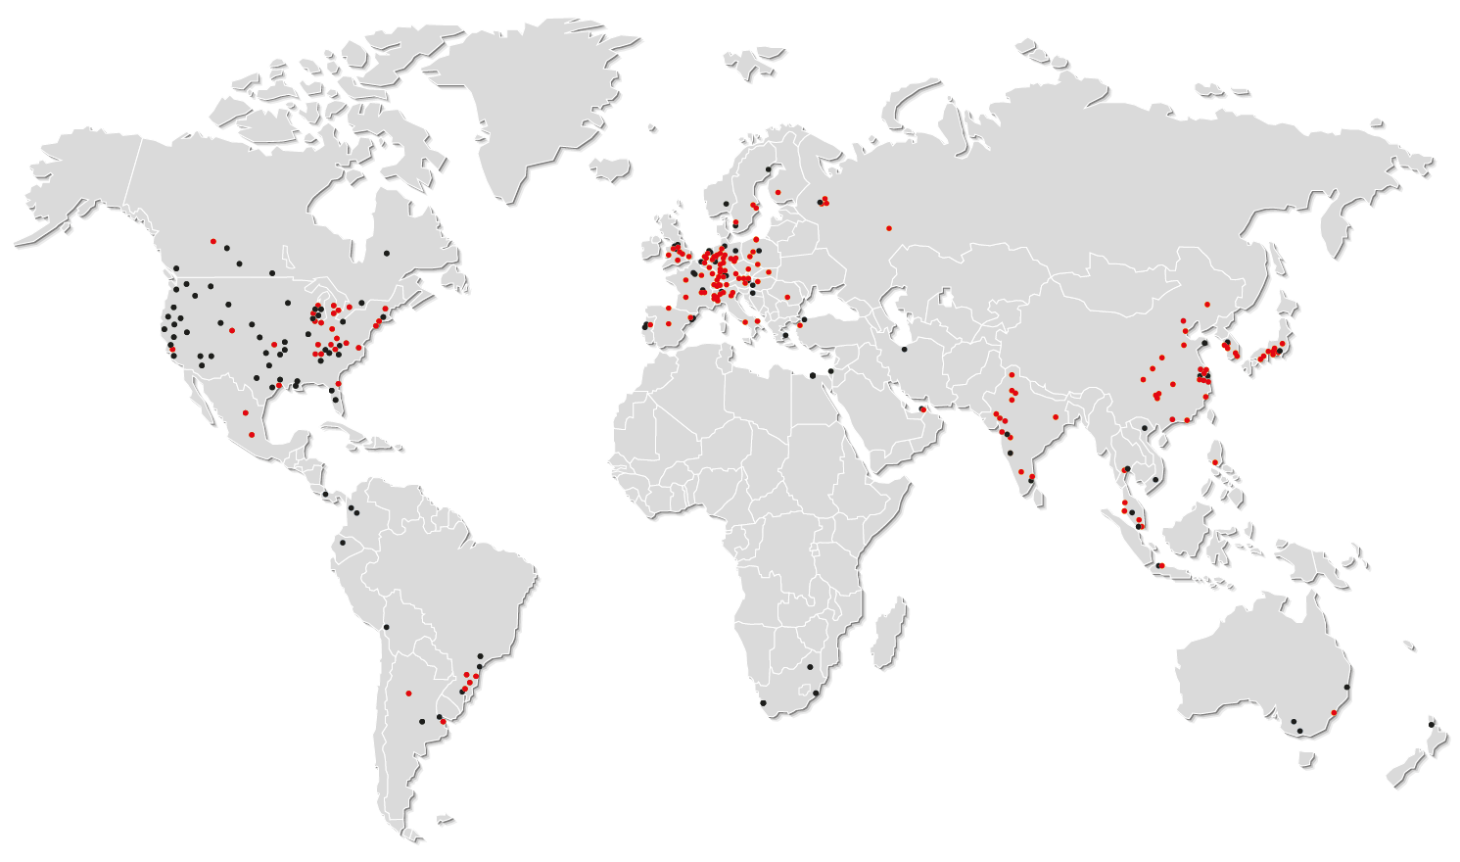

A leading global presence to serve our customers locally
CHF 2 609 Million
sales (2018)
Surface Solutions Segment
CHF 1 511 Million
Manmade Fibers Segment
CHF 1 098 Million
World market leader with widest ranging
portfolio of surface technologies,
advanced materials, coating equipment
and services
From melt to yarn, fibers and nonwovens –
world market leader for systems used in
the manufacture of manmade fibers
175 locations in 37 countries
160 Surface Solutions sites
50 production and R&D sites
162 sales and service sites
Employees in N. America
1 435
Employees in Europe
5 973
Employees in Asia Pacific
2 945
Employees in other regions
374
OMF IDY Presentation_Technotex 2019 Conference_Mumbai

Slide 4
2 Segments with distinctive characteristics
1
2
Surface Solutions
Manmade Fibers
End markets
Aerospace
Automotive
Energy
Tooling
General industries
Apparel
Functional wear
Home textile
Industrial applications, i.e.
Automotive & Construction
Technologies
Thin Film Coating
  PVD
  PECVD (PACVD)
Thermal Spray
Friction Systems
Plasma Nitriding
Additive Manufacturing
Yarn spinning and texturing
Nonwoven
Polycondensation
Polymer processing
Staple fiber
Capabilities
Surface technologies
Application know-how / Engineering
Service DNA
Materials
Process know-how
Equipment and plant engineering
Assembly
Service solutions
OMF IDY Presentation_Technotex 2019 Conference_Mumbai

Slide 5

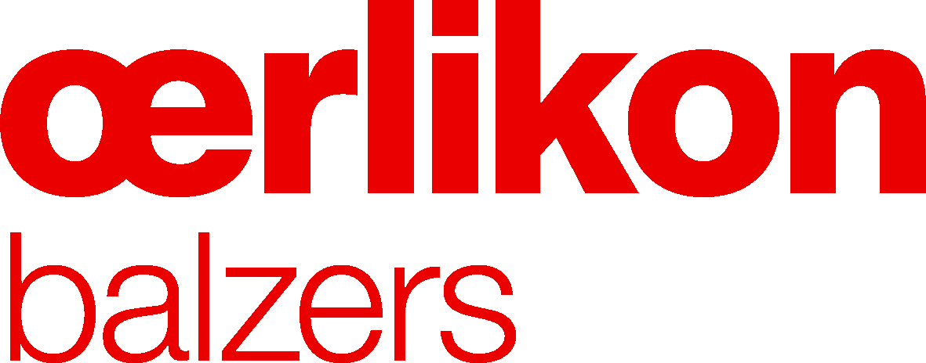

Serving attractive growth markets
Aerospace
Automotive
Energy
Tooling
General Industries
Manmade Fibers
OMF IDY Presentation_Technotex 2019 Conference_Mumbai

Slide 6

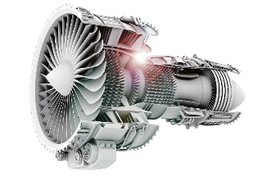
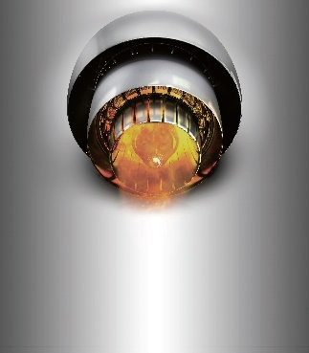
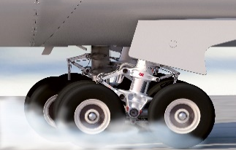

Making aerospace safer, more powerful and
more efficient
Compressor and turbine
Abradable coatings in engines to seal the gas path and improve performance and efficiency and thereby increase safety and allow to operate using less fuel (1%-3%)
Engine hot section
Thermal barrier and environmental coatings for combustor and turbine sections allowing component to operate at higher temperature resulting in improved efficiency
Landing gear
Thermal spray coating technology for reliable and long lasting landing gears
Every major aero engine manufacturer trusts Oerlikon technologies to boost performance, improve safety and fuel efficiency, and control emissions
We create advanced materials, functional coatings and process technologies to improve performance across the aerospace industry allowing the global aerospace industry to save millions of liters of fuel.
Aircraft interior
Non-reflective coatings and color coatings for cabin fixtures
OMF IDY Presentation_Technotex 2019 Conference_Mumbai

Slide 7

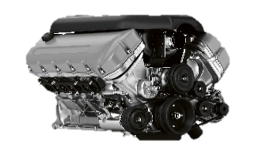
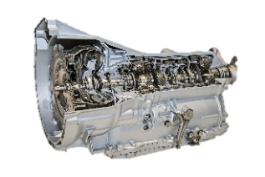
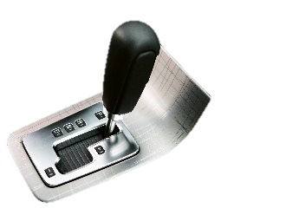
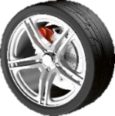
Advancing productivity, sustainability and profitability in the automotive industry
Improved engine performance
Materials and coatings for injectors, valves, oil pumps, cooling systems and turbochargers reduce friction and wear and improve performance, lifetime of lower emissions
Smoother-shifting transmission
Coatings & friction technologies to improve performance, oil compatibility, enhanced comfort, extended life cycle, lower weight, wear resistance and reduced costs for synchronizer and transmission systems
Innovative design parts
Coating technologies provide door handles, mirrors, push buttons, switch covers, gear shifters, frames and more with an environmental friendly chrome look
More than half of the world’s top ten car manufacturers use Oerlikon technologies to increase components lifetime and reduce fuel consumption
We create advanced materials, functional coatings and process technologies to driving automotive improvements by reducing weight, fuel, emissions and make new design solutions possible.
Improved passenger safety
Brake disc coatings and manmade fibers solutions to equip manufacturers with technologies for safety belts, airbags and tires
OMF IDY Presentation_Technotex 2019 Conference_Mumbai

Slide 8
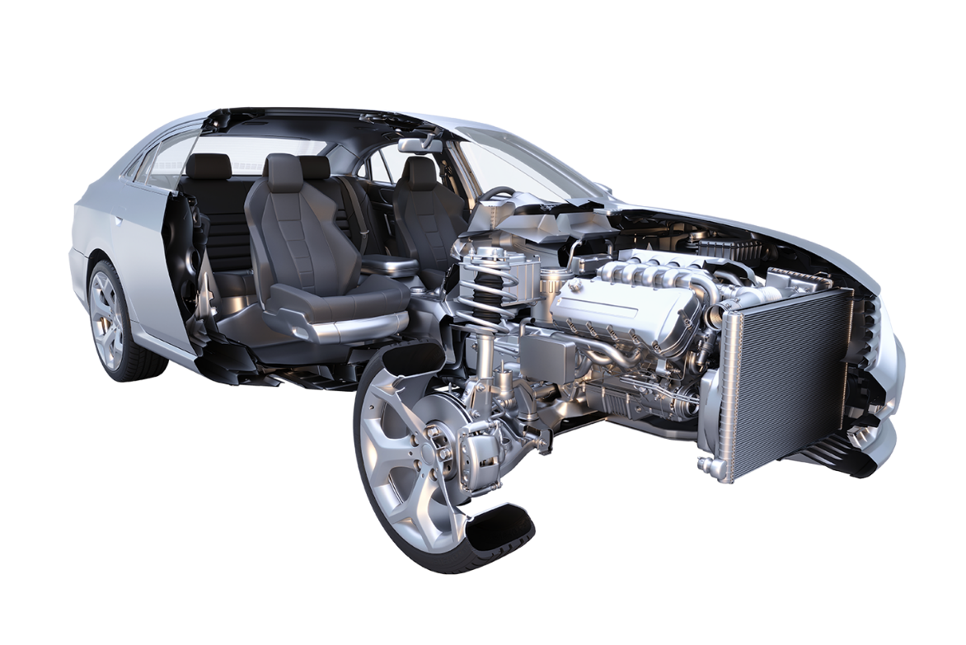
Reducing friction, wear and emissions –
Over 100 components coated per car
Typical Oerlikon applications in a car
Production tools
Engines
Valves
Fuel injection
Exhaust system
Transmission
Gears
Suspension
ESP/brake system
Turbocharges
Decorative elements
Safety belts
Car interior
Moldings
Exterior decoration
Tires
12
1
15
11
2
14
13
4
3
3
10
1
4
2
5
7
5
9
6
6
8
7
8
16
9
10
Lighter, slicker, more effective
Oerlikon offers coatings and technologies for over 100 car parts to reduce corrosion, friction and wear. The resulting fuel efficiency and improved durability of light metals means manufacturers can build smaller engines. Coated components help to cut fuel consumption by 2% to 4%, reduce oil consumption by 30%, and reduce engine block weight by 12%.
11
12
13
14
15
16
OMF IDY Presentation_Technotex 2019 Conference_Mumbai

Slide 9
Industrial Filament Worldwide Production and Capacities
Polyester IF Capacity
Polyamide IF Capacity
‘000 tons
‘000 tons
3.253
3.420
2.674
Americas
1.823
1.980
2.032
Americas
Europe
Europe
China
China
India
India
Asia
Asia
RoW
RoW
2012
2017
2020
2012
2017
2020
Polyester IF Production
Polyamide IF Production
‘000 tons
‘000 tons
2.392
2.528
1.560
Americas
1.383
Americas
1.922
Europe
1.161
Europe
China
China
India
India
Asia
Asia
RoW
RoW
2012
2017
2020
2012
2017
2020
Source:PCI Redbook 2017
OMF IDY Presentation_Technotex 2019 Conference_Mumbai

Slide 10
World Market Industrial Yarn 2017
Production of Man-made fibers 2017: 71.6 Milllion Tons
World production IDY: 4.7 Milllion Tons
Source: The Fiber Year 2018
OMF IDY Presentation_Technotex 2019 Conference_Mumbai

Slide 11





Polyester IDY Capacities - Regional Outlook
China: +5.8% p.a.
2017: 2.2 mill tons
2025: 3.2 mill tons
Europe: +1.3 % p.a.
2017: 222 tsd tons
2025: 235 tsd tons
Americas: -3.5% p.a.
2017: 133 tsd tons
2025: 96 tsd tons
India: +8.4% p.a.
2017: 60 tsd tons
2025: 100 tsd tons
RoW: +0.0% p.a.
2017: 16 tsd tons
2025: 16 tsd tons
Asia: +2.8% p.a.
2017: 596 tsd tons
2025: 732 tsd tons
Estimated PET-IDY capacity 2025: > 4.5 mln tons
CAGR '17-'25: 3.1%
Source: PCI Red Book 2017, OMF estimate
OMF IDY Presentation_Technotex 2019 Conference_Mumbai

Slide 12
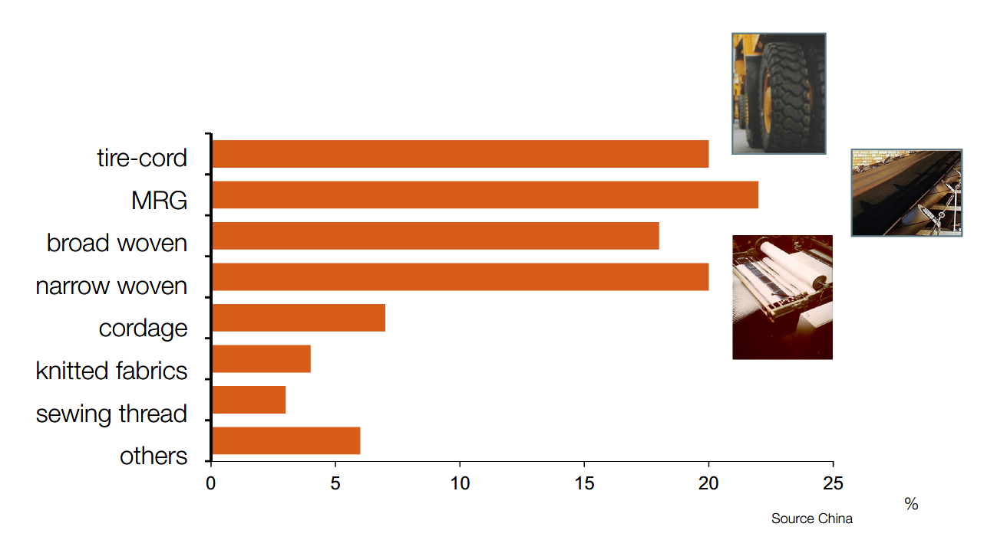
Main Applications for PET IDY
OMF IDY Presentation_Technotex 2019 Conference_Mumbai

Slide 13
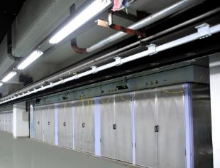
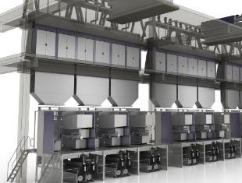
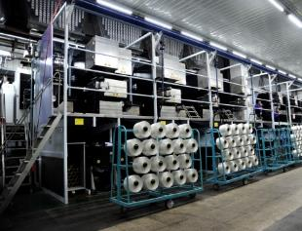
Introduction What is the Oerlikon Barmag IDY concept?
 | The Oerlikon Barmag IDY machines offer high productivity and broad product ranges for our customers to compete in a changing market.
 | The IDY machine principle Designed for the specific process needs Offering HMLS, HT, LS/XSLS and automotive yarn concepts Layout for high productivity and superior yarn quality, including specialty yarns
 | High profits through High yarn quality Reduced OPEX Energy-saving and efficient process High productivity Flexible product range
The idea
The concept
The benefits
OMF IDY Presentation_Technotex 2019 Conference_Mumbai
Notes:
Machen Sie anhand dieser Folie Ihren Zuhörern deutlich, dass IDY eine Prozessinnovation ist,
die in jeder Phase des Prozesses zusätzliche Nutzen erzeugt.
Using this slide, make it clear to your listeners that IDY is a process innovation
that generates additional benefits in every phase of the process.

Slide 14
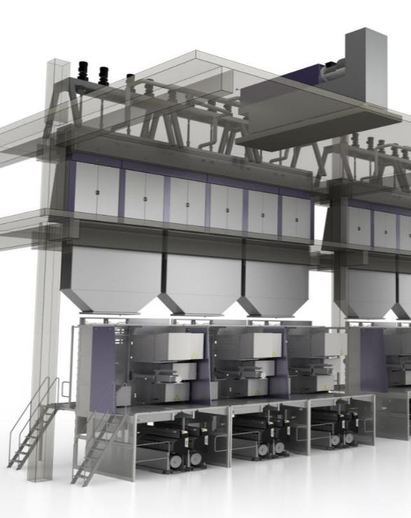
Industrial Yarn Process
Extruder
Spinning pump drive
Spinning beam
X-flow quench
Inter-floor duct
Draw panel / take-up
Winder
OMF IDY Presentation_Technotex 2019 Conference_Mumbai

Slide 15

Industrial Yarn - Key benefits
Overview Key Benefits
Savings in OPEX
Lower energy consumption
Less waste
High yarn quality
Product optimized processes
Notes:
Machen Sie Ihren Zuhörern deutlich, dass die Nutzenverbesserung in allen Bereichen stattfindet:
Verbesserung der Ergebnisqualität, Verbesserung der Prozessqualität und Kostenreduktion.
OMF hat in allen Bereichen optimiert!
Make it clear to your listeners that benefit improvement is taking place in all areas:
improvement of the quality of the results, improvement in the process quality and cost reduction.
OMF has carried out optimizations in all areas!

Slide 16
Key benefits Overview (1/2)
  Savings in OPEX
  Example: 12,000 tpa IDY plant
  (8 positions):
  2 extruders
Savings
6,000 US$ / year
  8 spin beams
Savings
26,000 US$ / year
  8 draw panels
Savings
57,000 US$ / year
(8.400 hours per year; 0.1 US$/kWh)
All figures are based on own investigation and / or market information without guarantee
OMF IDY Presentation_Technotex 2019 Conference_Mumbai

Slide 17
Key benefits Overview (2/2)
  Energy savings through
    Reduced heat loss (SP 8)
    E10 extruder Series
  HF godet heating principle
  Efficient winder drives
  High efficiency – less waste through
    Fast and easy string-up
  Stable yarn quality at a high level through
  Barrier screw design
  3LA Spin Pack Filtration
  EvoQuench HMLS
  High yarn quality through
  Straight yarn path with driven guide rolls (HMLS)
  Through product optimized processes
  Through ISPW winding
OMF IDY Presentation_Technotex 2019 Conference_Mumbai

Slide 18
Key benefits Product optimized processes
  Product optimized processes
  End product Process Overview
  HMLS
  HT/LS
  X-SLS
  Automotive
  LDI (Low Denier IDY)
OMF IDY Presentation_Technotex 2019 Conference_Mumbai

Slide 19
Key benefits End Product Overview
End Use | Requirements | Machine Concept
Tires | High Tenacity + High Dimensional Stability | PET HMLS / PA6; 66 HT/LS
MRG | High Tenacity + Low Elongation | PET HT/LS, HMLS / PA6; 66 HT/LS
Broad Woven | Low Shrinkage + No Broken Filaments | PET X-SLS / PA6; 66 HT/LS
Geotextiles | High Tenacity + High Modulus | PET HT/LS
Narrow Woven, Ropes, Nets | High Tenacity | PET HT/LS / PA6; 66 HT/LS
Mooring Rope | High Modulus, Activated,+ Marine Finish | PET HT/LS
Automotive (Seat Belt, Airbag) | High Tenacity + Uniform Dye + No Broken Filaments | PET Safety Yarn / PA6; 66 HT/LS
Sewing Thread, Embroidery | High Tenacity | PET LDI
OMF IDY Presentation_Technotex 2019 Conference_Mumbai

Slide 20
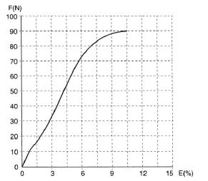
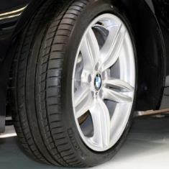
Key benefits Product optimized processes
HMLS
End use:
Tires / MRG / geotextiles
Requirements:
High modulus
Low shrinkage
High thermal & dimensional stability
Machine concept: HMLS
Denier range:
4 x 1000 up to 4 x 1500 or
2 x 2000 up to 2 x 3000
OMF IDY Presentation_Technotex 2019 Conference_Mumbai
Notes:
Warum machen wir nicht 6 oder 8 fädig? = Weil das Ergebnis nicht unseren Garn- & Spulenqualitätsansprüchen genügt…

Slide 21
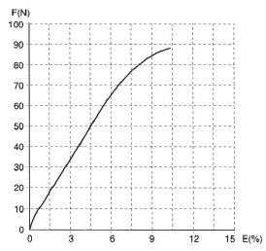
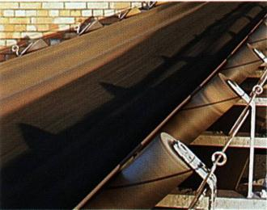
Key benefits Product optimized processes
  HT/LS
End use:
MRG, Geotextiles, Ropes, Nets
Mooring ropes
Requirements:
High breaking force / Low elongation
Stiffness
Pre-activation / Marine finish
Machine concept: HT/LS
Ends: 4/8, 6/12, 8/16
Denier range: 8 x 1500, 12 x 1000, 16 x 1000
(Up to): 4 x 3000, 6 x 2000, 8 x 2000
OMF IDY Presentation_Technotex 2019 Conference_Mumbai

Slide 22
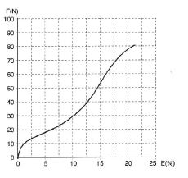
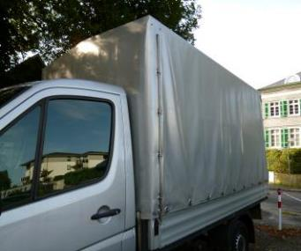
Key benefits Product optimized processes
  X-SLS
End use:
Broad wovens (tarpaulins, advertising banners)
Requirements:
X-Tra super low shrinkage
No broken filaments
Machine concept: X-SLS
Ends: 4/8, 6/12, 8/16
Denier range: 8 x 1500, 12 x 1000, 16 x 1000
(Up to): 4 x 3000, 6 x 2000, 8 x 2000
OMF IDY Presentation_Technotex 2019 Conference_Mumbai

Slide 23
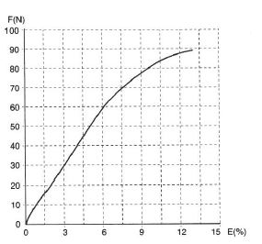
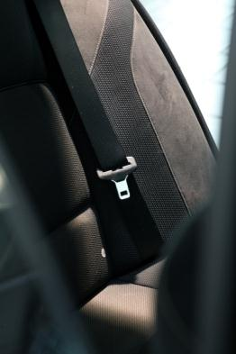
Key benefits Product optimized processes
  Automotive
End use:
Seat Belt
Airbag
Requirements:
High tenacity
No broken filaments
Uniform dye
Machine concept: safety yarn:
Ends: 6 / (8)
Denier range: 8 x 500
(Up to): 8 x 1500, 4 x 2000
OMF IDY Presentation_Technotex 2019 Conference_Mumbai

Slide 24
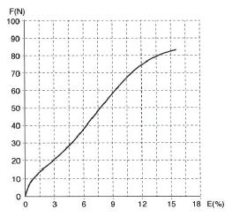
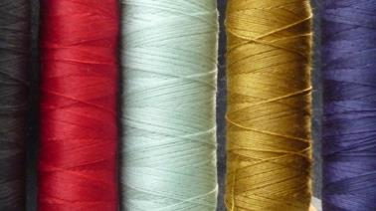
Key benefits Product optimized processes
  LDI (Low Denier IDY)
End use:
Sewing thread
Embroidery
Requirements:
High tenacity
Machine concept: LDI:
Ends: 12, (16)
Denier range: 12 x 50, (16 x 50)
(Up to): 12 x 500, (16 x 500)
OMF IDY Presentation_Technotex 2019 Conference_Mumbai

